Slide 1


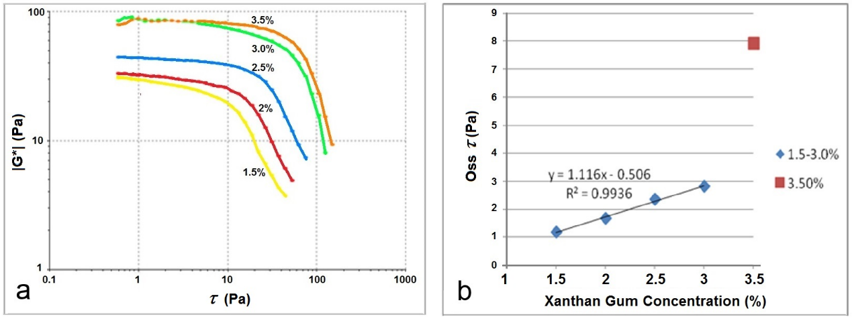
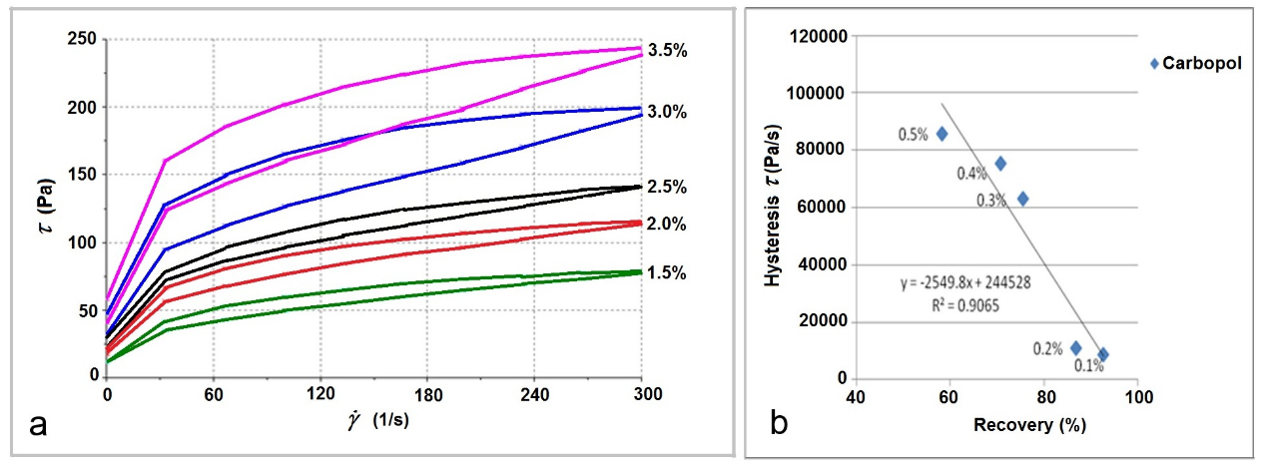
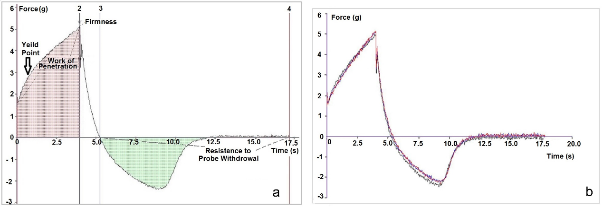
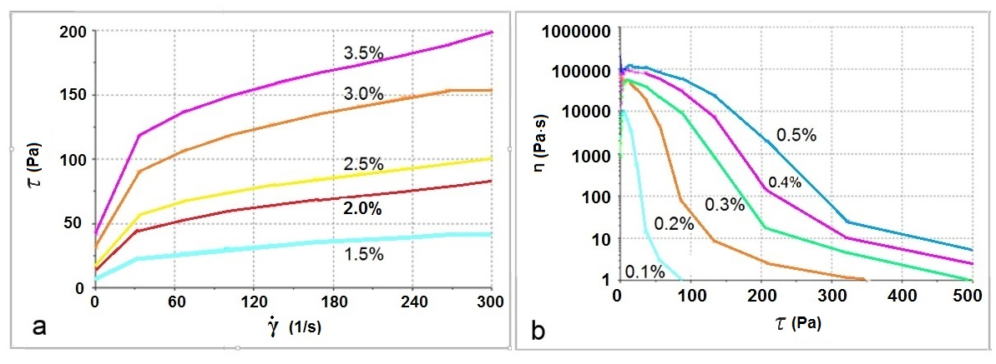
A comparative study of the rheological and textural methods used to characterise cosmetic O/W emulsions
Helen Sisson¹, Neil Cunningham², Milica Stevic PhD¹, Slobodanka Tamburic PhD¹
¹ Cosmetic Science Research Group, London College of Fashion, University of the Arts London, London, UK
² Centre for Industrial Rheology, UK
Introduction
There is a large number of rheological methods in the literature, but little practical information for cosmetics formulators on the value of each method, i.e. its applicability to different situations. In this study, a comparative assessment of the methods used to establish commonly used rheological parameters was carried out. We have focused on two parameters which are, alongside viscosity, of great importance in practical formulation work - yield stress and the level of thixotropy. Both are useful in understanding how materials behave in the laboratory, in production, during storage and in use. They are also related to the sensory properties of cosmetic emulsions [1].
Materials and Methods
Fig. 2. Oscillatory stress sweep curves for the xanthan gum emulsions (a) and the linear correlation between the concentration of xanthan gum and the yield value (b), excluding 3.5% w/w.
Two series of samples, based on a simple O/W emulsion, were used: with neutralised carbopol (0.1%, 0.2%, 0.3%, 0.4% and 0.5%) and with xanthan gum (1.5%, 2.0%, 2.5%, 3.0% and 3.5%w/w).
The instruments used in this study were: an air-bearing controlled-stress rheometer (RheoStress RS75, Haake, Germany), a T-bar viscometer (Brookfield DV-E, Brookfield, UK) and a texture analyser (TA.XT Plus, Stable Micro Systems, UK).
Comparative assessment of yield stress by five methods:
Low-rotation T-bar test on a viscometer (at 5 rpm with helipath, using a spindle T 92). Readings were taken after the first 20 seconds then at 10-second intervals until 60 seconds, calculating the average of the 5 values [2]. The air-bearing rheometer was used for the shear stress sweep (0.5-500 Pa), the shear rate sweep (300-0.01 s⁻¹), and the oscillatory shear stress sweep (0.5-500 Pa at 1Hz). For all rheometer measurements, the 35mm serrated parallel plate was used. Immersion/de-immersion test on a texture analyser (with a one inch-diameter cylindrical probe) was also performed [3]. The point at which the material yields is shown via the inflection point on the immersion curve (Fig. 4).
Comparative assessment of the level of thixotropy by three methods:
Hysteresis loop test (0.01 - 300 - 0.01 s⁻¹) and three-step thixotropy test (low/high/low shear, in this case 10/250/10 s⁻¹, each step taking 30 seconds) were both performed on the rheometer. A novel repeated immersion/de-immersion test (3 repetitions) on the texture analyser was also performed, using the same settings as for the yield stress test.
Fig. 3. Hysteresis loop area curves for xanthan gum emulsions (a); linear correlation between the level of thixotropy obtained using the three step thixotropy method and the hysteresis loop area method for carbopol emulsions (b).
The three-step thixotropy test measures the % recovery of the sample subjected to a low shear (10 s⁻¹), very high shear (250 s⁻¹) and again low shear (10 s⁻¹) for 30 seconds each time. The results of this test were compared with the more standard hysteresis loop test (up-and-down curve test), shown in Fig. 3a for the xanthan gum emulsions. In this case, the area between the up and down curves (hysteresis area) was taken as the measure of thixotropy, both methods taking into consideration instantaneous effects of the structure breakdown under the influence of external force. The comparison of the results obtained by the three-step and the hysteresis loop methods has revealed a good negative correlation (Fig. 3b) .
Fig. 4b represents a typical response of the repeated immersion/de-immersion test, where three measurements have been performed in short succession on the same area in order to measure the level of thixotropy. The parameter used was the work of adhesion, i.e. the area under the negative curve (reflecting de-immersion process). All tested samples have shown the same pattern - the largest difference between the first and the second measurement, while subsequent measurements have shown almost no difference (hence only three repetitions). The repeated immersion/de-immersion test has displayed a positive correlation with the three-step method, although not statistically significant.
Results and Discussion
The results obtained using a low-rotation T bar test could be considered a measure of yield stress/gel strength, rather than viscosity. This is based on the argument that true viscosity measurement requires the sample to be sheared between two close-fitting, geometrically-defined surfaces, which is not the case with the T bar [2]. A linear correlation between increasing polymer concentration and the yield value measured by T bar was found (r²=0.994 and r²=0.968 for the carbopol and xanthan gum emulsions, respectively).
Fig 1 shows the results of two flow rheology methods – the shear rate (a) and shear stress sweep (b). Neither has produced the results consistently in line with the increasing polymer concentration. The values of the complex modulus G* obtained from the oscillatory stress sweep of the xanthan gum emulsions are shown in Fig. 2a. Yield stress is detected as an inflection point on each curve. The yield values of the first 4 samples form an almost ideal linear relationship with the concentration of xanthan gum (Fig. 2b), while the most concentrated sample performed differently. This phenomenon, which was not detected using less sensitive methods, is probably due to the level of polymer entanglement and the resulting secondary chemical bonds at that concentration [4]. In the case of carbopol emulsions, the correlation was very good for the whole range (r² = 0.996).
Using a novel texture analyser yield stress method [4,5], we have tested both series of emulsions, with very consistent results. Fig. 4a shows a typical immersion/de-immersion curve, with the inflection on the ascending part indicating the yield value.
Therefore, the T bar method, oscillatory stress sweep and immersion test all show the same trends (although not the same values) of yield stress for the two series of samples, providing logical, consistent and reproducible results.
Fig. 4. Typical curves obtained using the immersion/de-immersion test on the texture analyser for the detection of yield value (a) and the repeated deformation test for the detection of the level of thixotropy (b)
Conclusion
The most consistent yield stress results were obtained using the low-rotation T-bar test and the oscillatory stress sweep test, as well as the novel immersion/de-immersion texture analyser test. Providing all three instruments are available, a formulator is advised to choose the oscillatory stress sweep as the most reliable, theoretically and practically.
In terms of the finite-time thixotropy measurements, both three-step thixotropy test and hysteresis loop test have proven consistent in assessing immediate effects of the application of shear force to o/w emulsion samples. By changing the conditions of each test, it is possible to produce an indefinite number of methods, the merits of which should be established with regard to the purpose of the test (e.g. physico-chemical characterisation, stability prediction, production specification, sensory characterisation).
Fig. 1. Shear rate sweep (a) and shear stress sweep curves (b) for carbopol emulsions.
References
[1] Suzuki, K and Watanabe, T. Sensory assessment and rheological properties of o/w creams, Journal of Texture Studies 2(4), pp. 431 – 440 (2007); [2] Centre for Industrial Rheology, Rheology of creams, ointments and lotions (2016) Available at: http://www.rheologyschool.com/advice/rheology-tips/36-rheology-of-creams-ointments-and-lotions; [3] Stable Microsystems, Application studies (2016) Available at: http://www.stablemicrosystems.com/frameset.htm?http://www.stablemicrosystems.com /TextureAnalysis.htm; [4] Craig, D.Q., Tamburic, S., Buckton, G. and Newton, J.M. An investigation into the structure and properties of Carbopol 934 gels using dielectric spectroscopy and oscillatory rheometry. Journal of Controlled Release, 30(3), pp.213-223 (1994); [5] Tai, A., Blanchini, R. and Jachowicz, J. Texture analysis of cosmetic/pharmaceutical raw materials and formulations, International Journal of Cosmetic Science, 36 (4), pp. 291-304 (2014);

