Slide 1
Martina Cole’s ‘The Take’
TV Adaptations – How class is written on the body via the clothing used as costume.

Slide 2

Martina Cole’s ‘The Take’
Best selling author 16 novels
Total book sales 10 million worldwide
Translated into 28 languages
British Book Awards ‘Best Crime Thriller’ 2005 for ‘The Take’
300,000 hardback copies sold
Best selling hardback 2005
No 1 on Sunday Times hardback bestseller list 2005
The Take

Slide 3
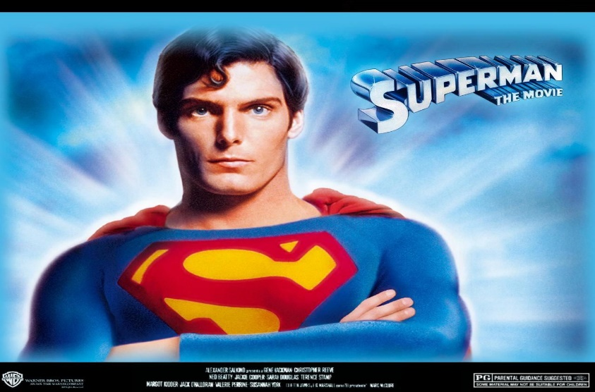
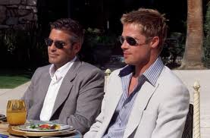

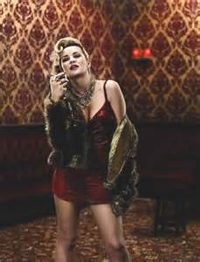

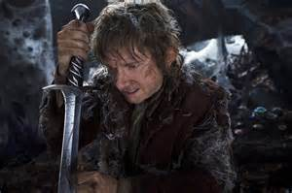
Industry Practices

Slide 4
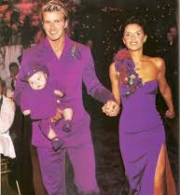
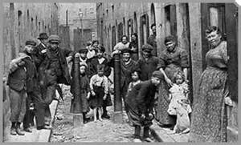
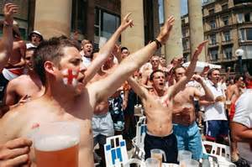

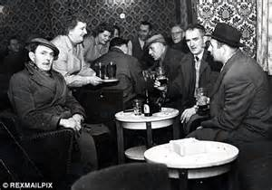
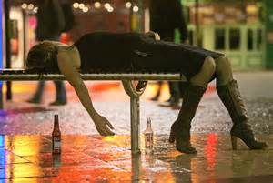

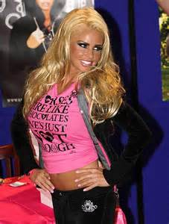
Something Lacking………..

Slide 5
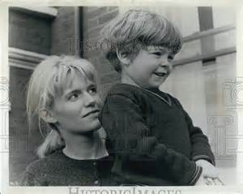
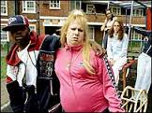
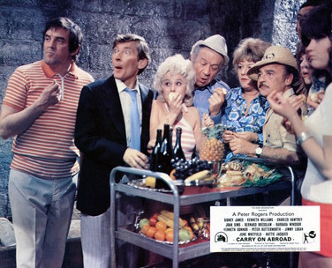
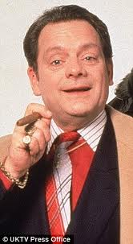
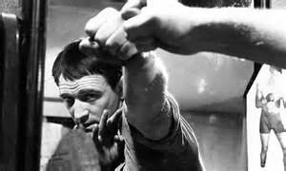
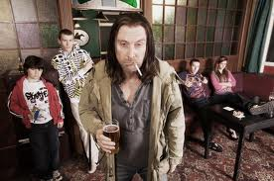
Representing the working class
Responses are individual but not individualistic, signs operate via agreed meaning (Fiske & Hartley [1978] 2003)
Vicki Pollard
Carol White in ‘Poor Cow’
Del Boy
Carry on Abroad
Richard Harris in ‘This Sporting Life’
Frank Gallagher

Slide 6
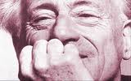
Henri Lefebvre ([1981] 2005) ‘Critique of Everyday Life: From Modernity to Modernism. Volume 3’. London. Verso
‘…Something more, something less, something else; lived experience….. (Lefebvre, [1981]2005 P5)
Can Henri Lefebvre’s theories around the practice of everyday life apply to television costume?

Slide 7
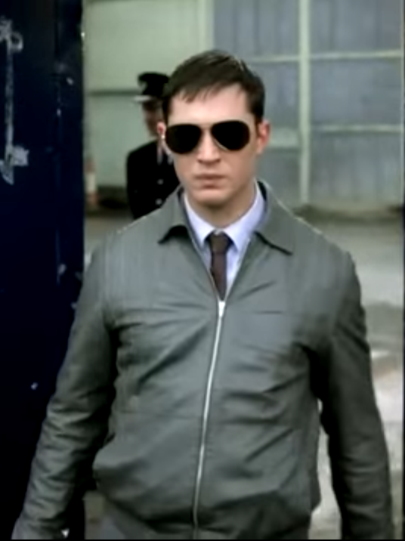
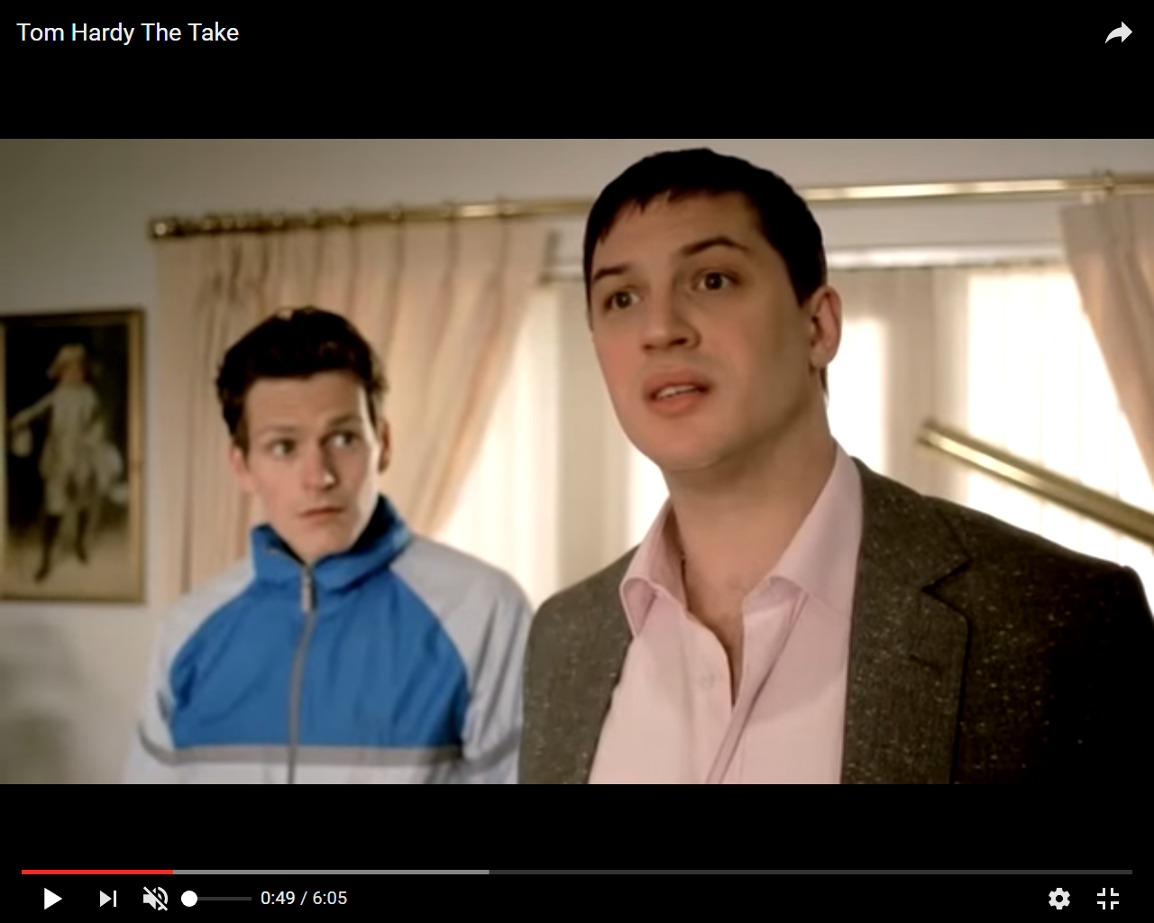
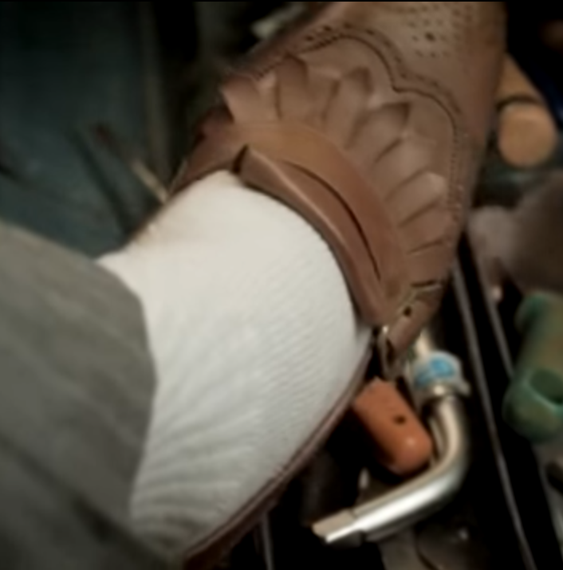
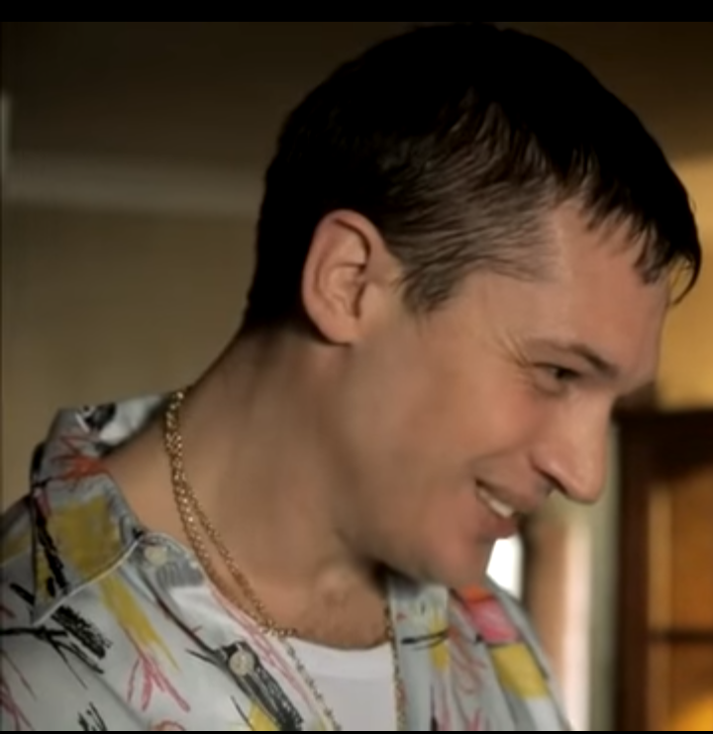
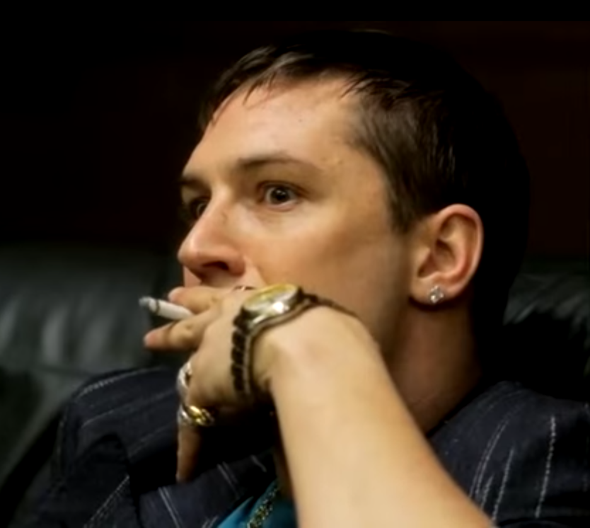
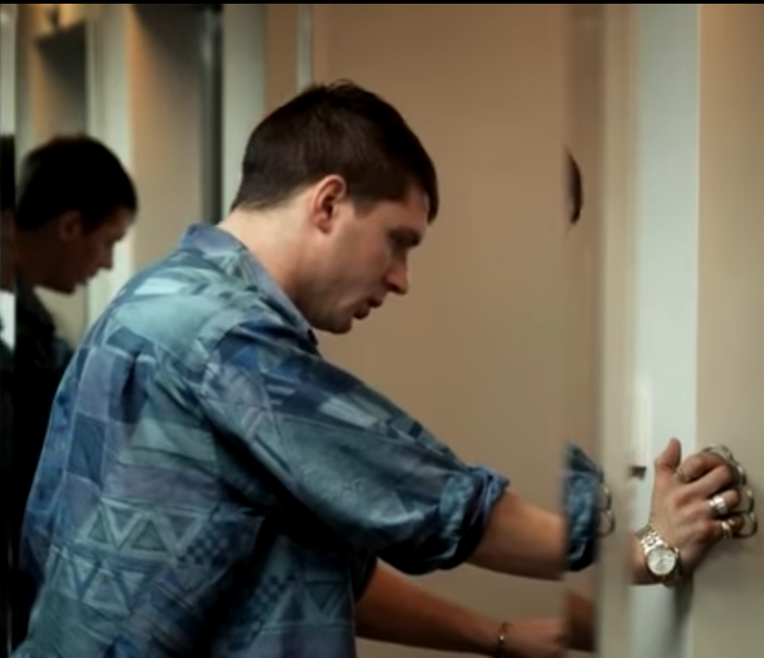
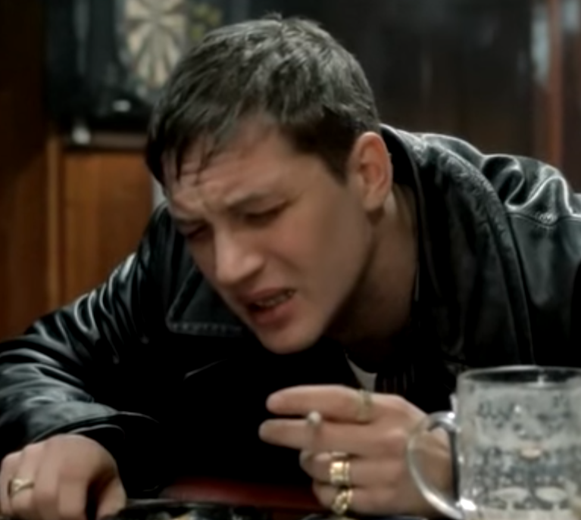
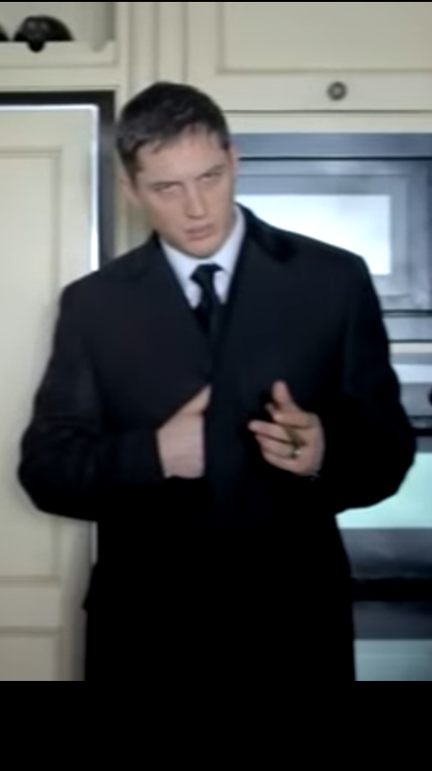
Something lacking……..

Slide 8
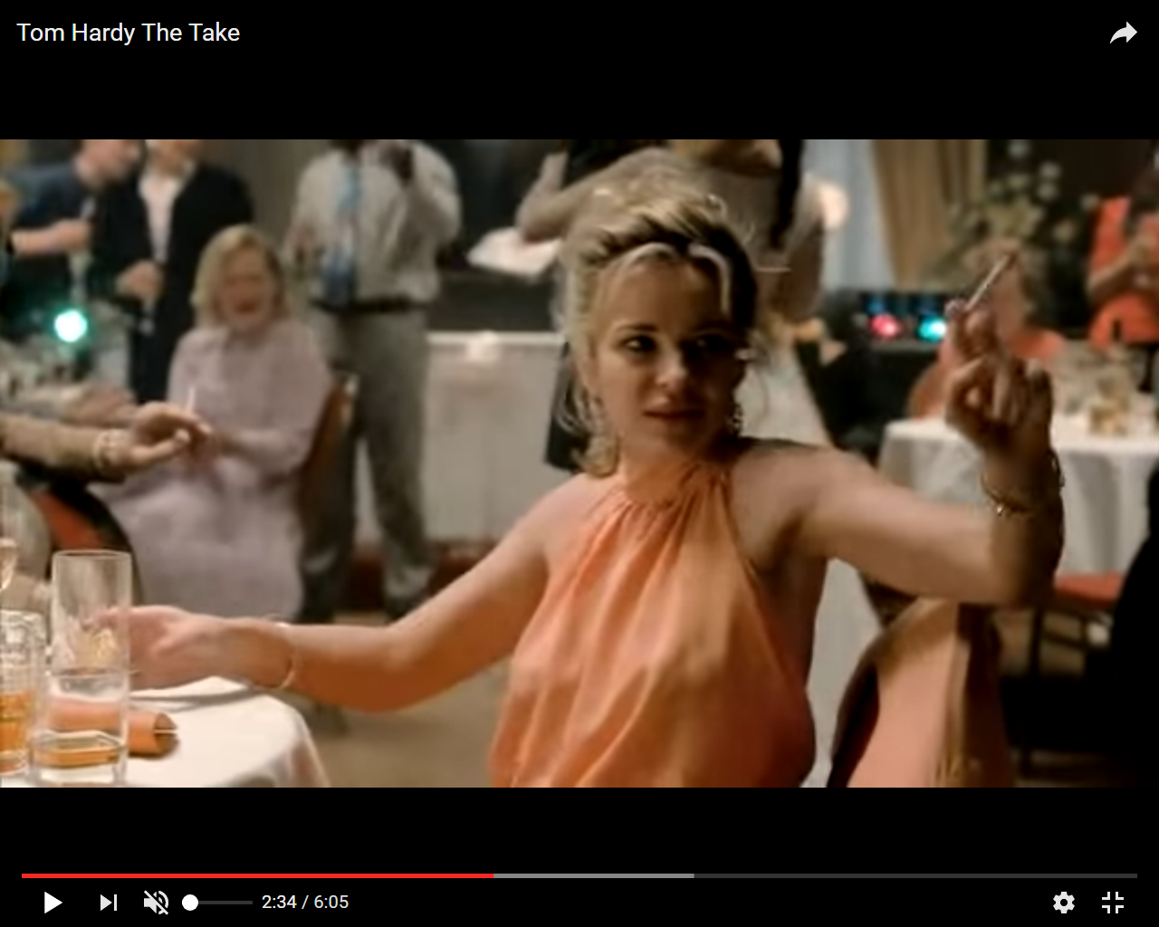
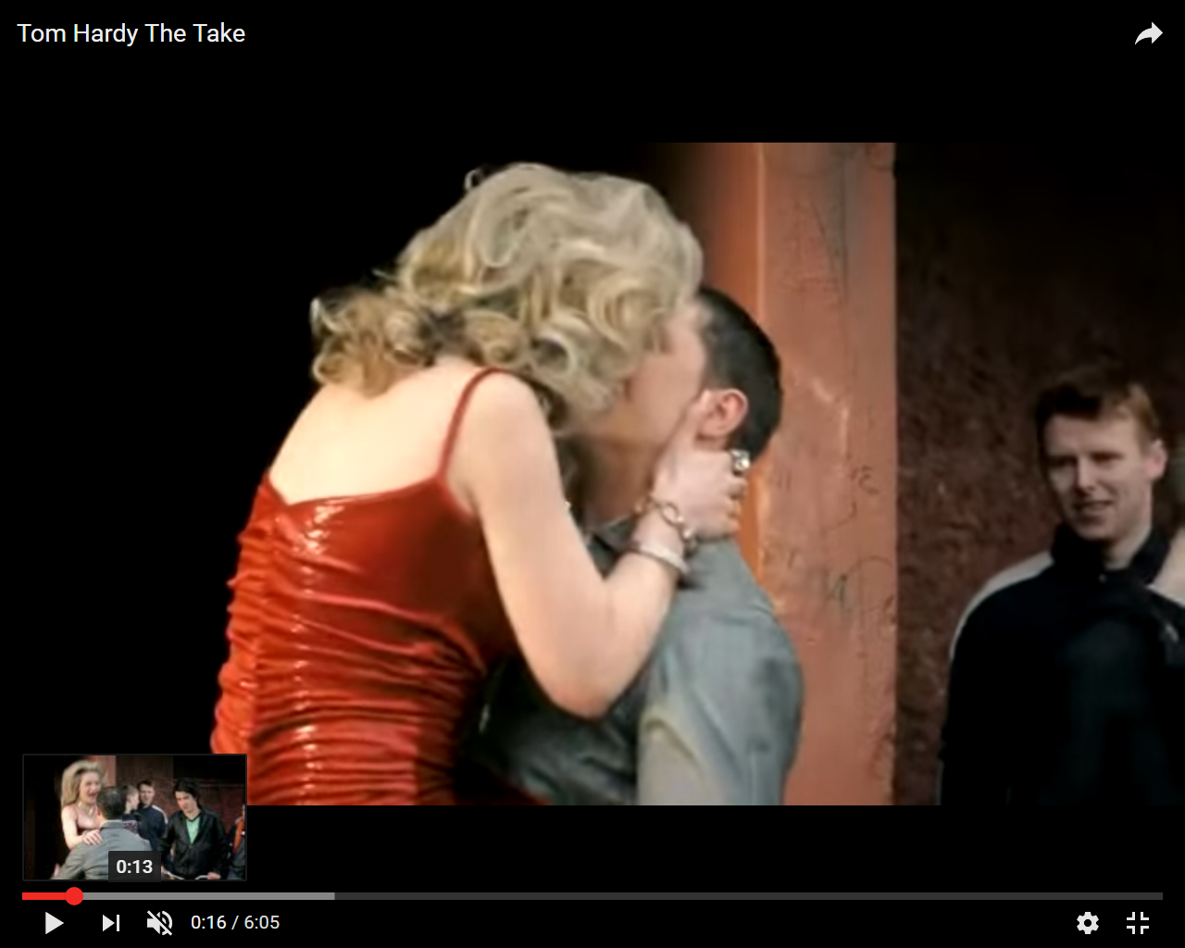
Something missing………

Slide 9
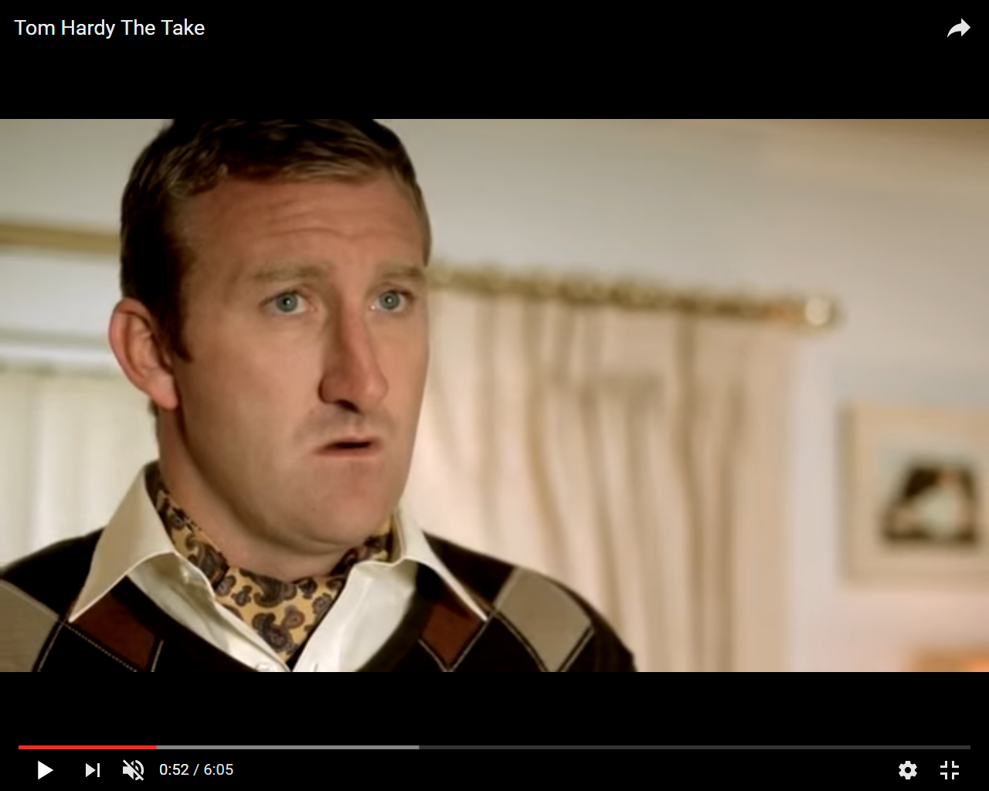
Lived experience?

Slide 10
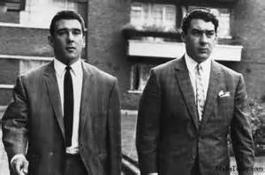
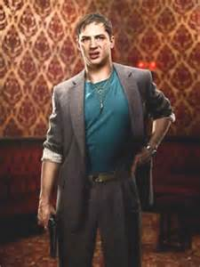
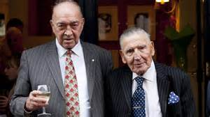
Paradox and Tension
‘It is not easy to grasp the paradox which eludes all reductionist thinking whereby the homogenous covers and contains the fragmented’ (Lefebvre [1981], 2005 p85)
Ronnie & Reggie Kray
Freddie Jackson
Eddie Richardson, Frankie Frasier

Slide 11
Information Redundancy
Jackie Jackson
‘Redundancy eliminates the noise missed up in the message……..excessive difference kills meaning by preventing understanding – that is to say decoding. Yet complete application of a code involves repetition in perfect intelligibility and, consequently utter monotony’ (Lefebvre [1981] 2005, p139).

Slide 12
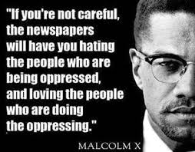
Clichéd Conclusions
Responses are individual but not individualistic, signs operate via agreed meaning (Fiske & Hartley [1978] 2003)

