Slide 1
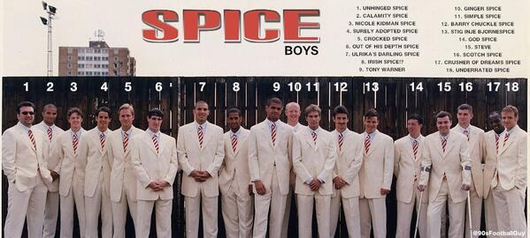
Fashion and Football; ‘The Spice Boys’, masculinity, male bodies and moments of contestation’

Slide 2
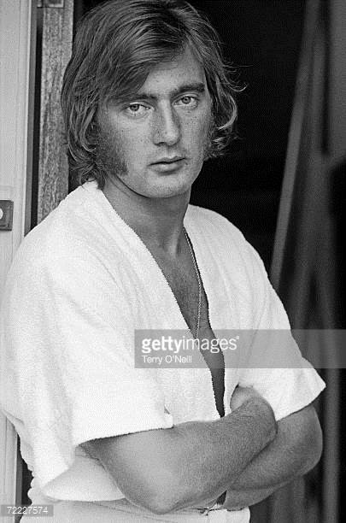
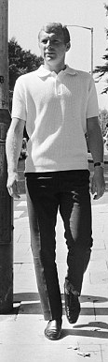
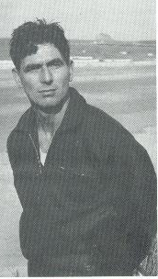
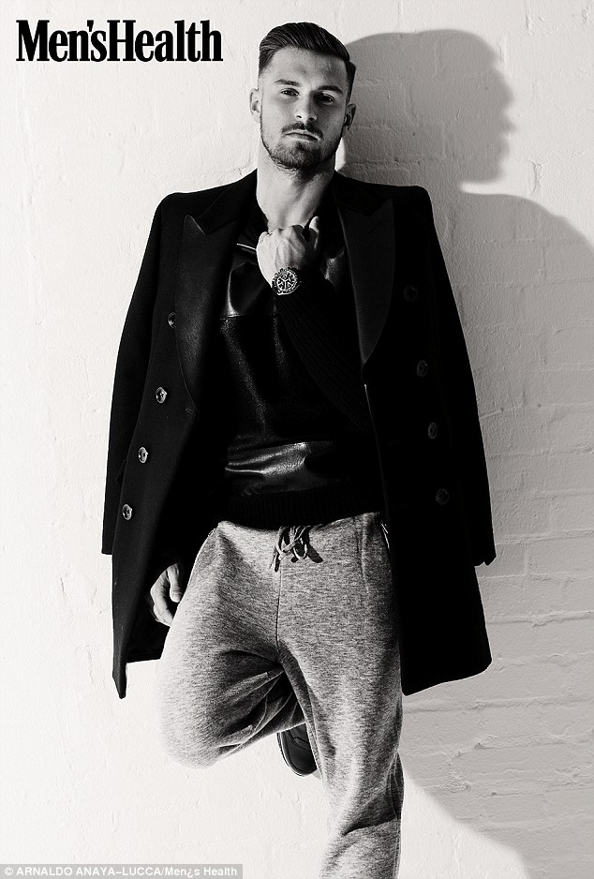
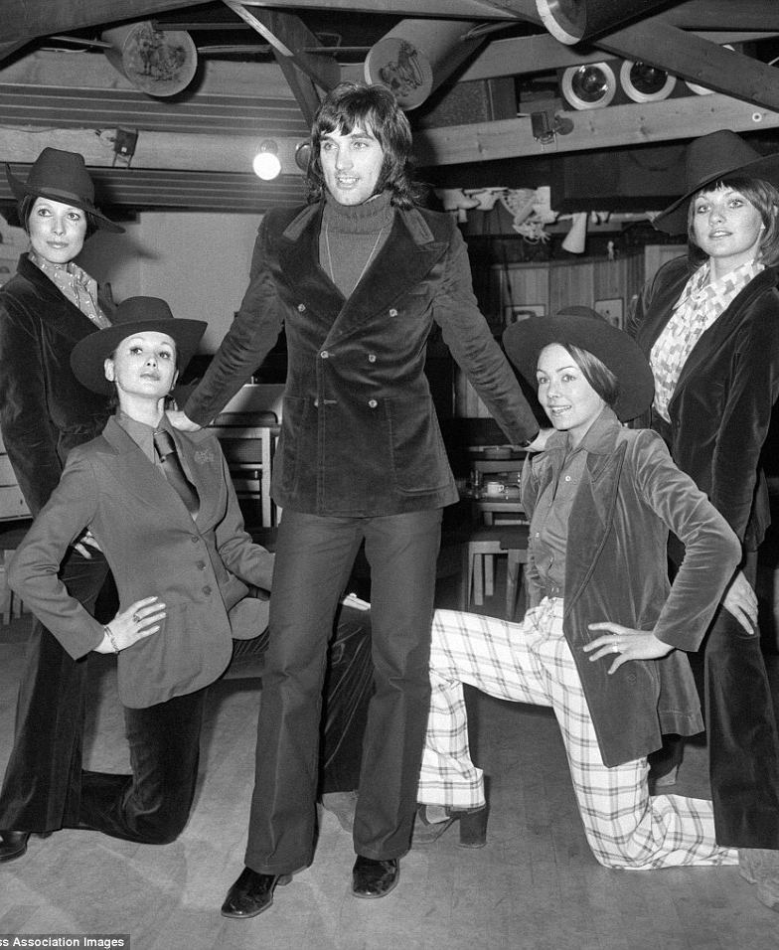
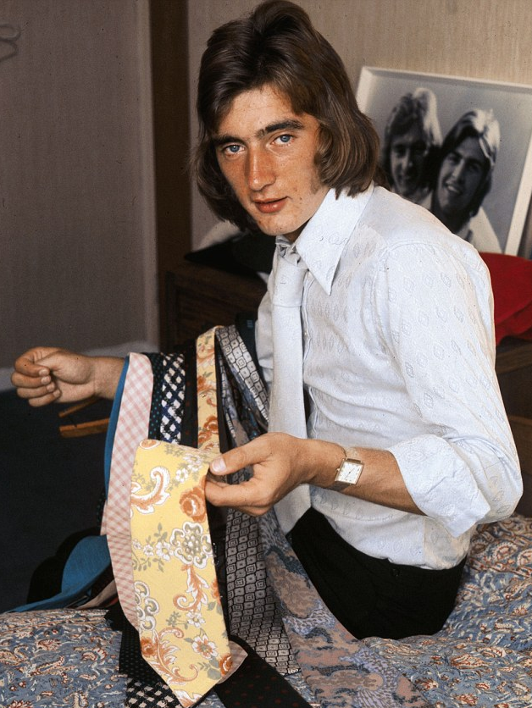
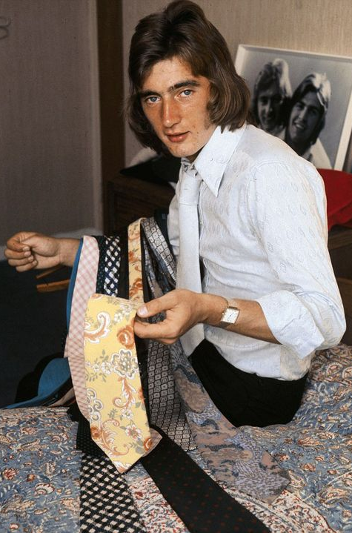
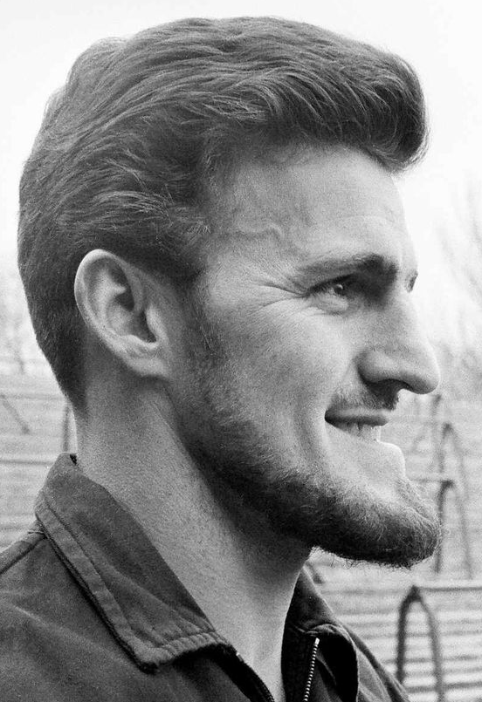
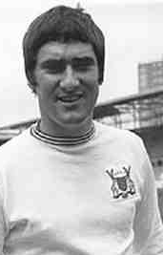
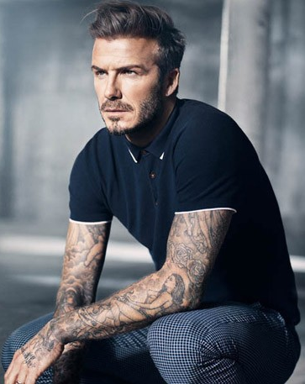
Football & Fashion: A complex and Multi Faceted Relationship
George Best, Alan Hudson, David Beckham, Aaron Ramsey, Gordon Smith, Jim Baxter, Bobby Moore

Slide 3
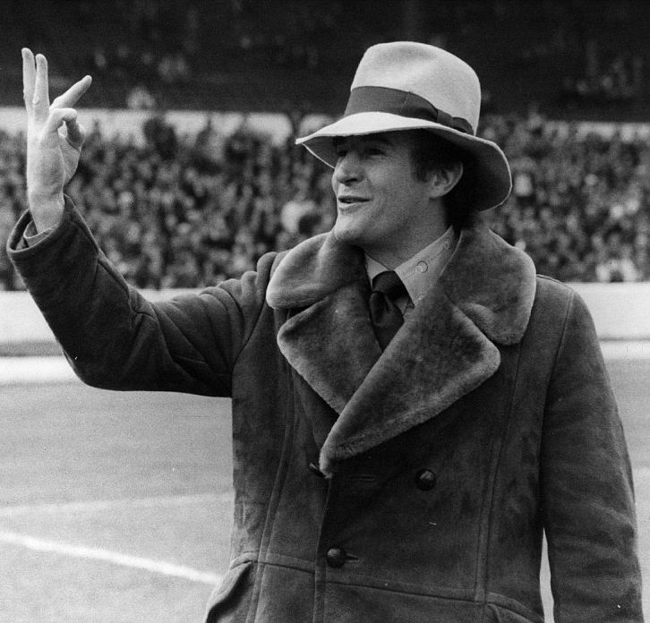
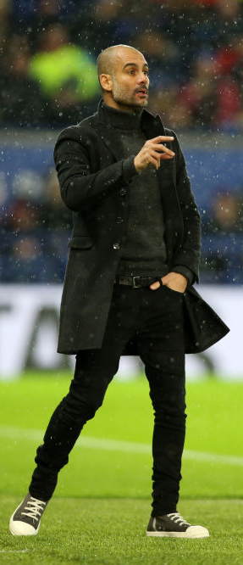
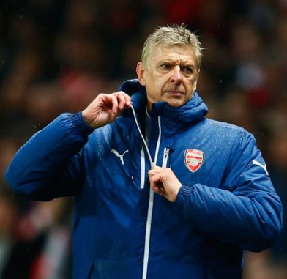
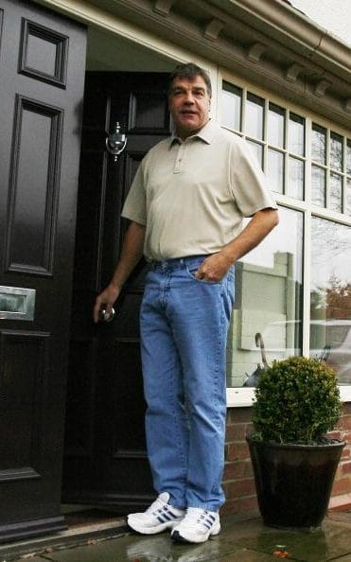
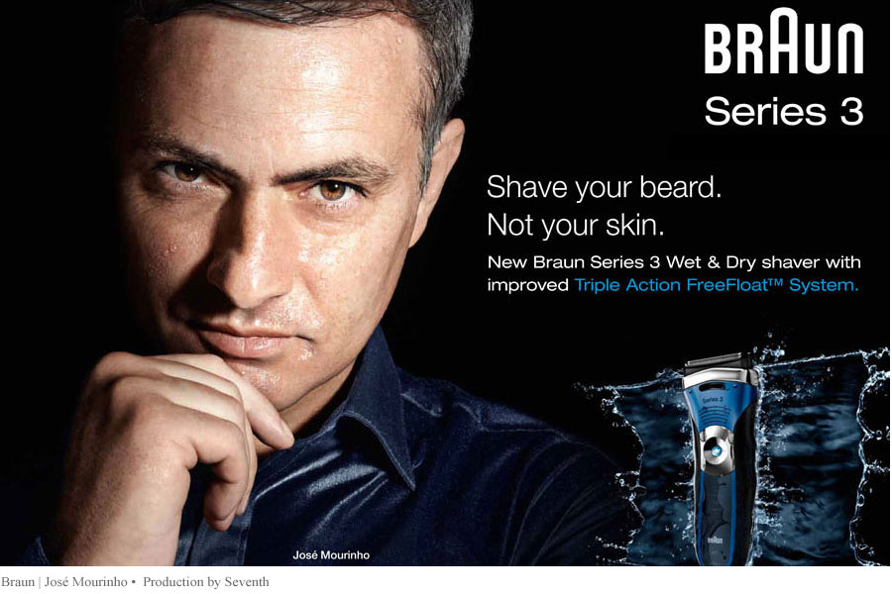
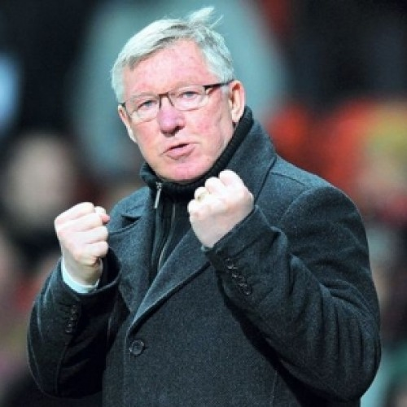
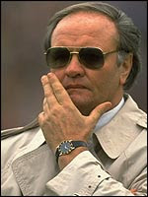
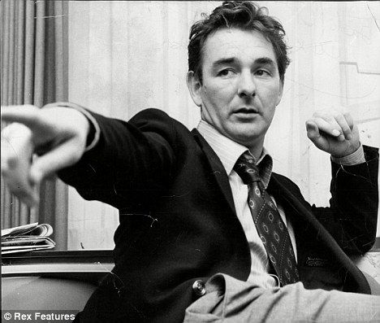
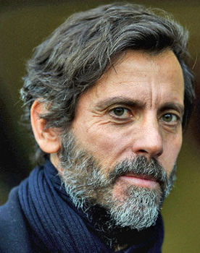
Football & Fashion: A complex and Multi Faceted Relationship
Malcolm Allison, Brian Clough, Pep Guardiola, Quique Flores, Arsene Wenger, Alex Ferguson, Sam Allardyce, Jose Mourinho, Ron Atkinson

Slide 4
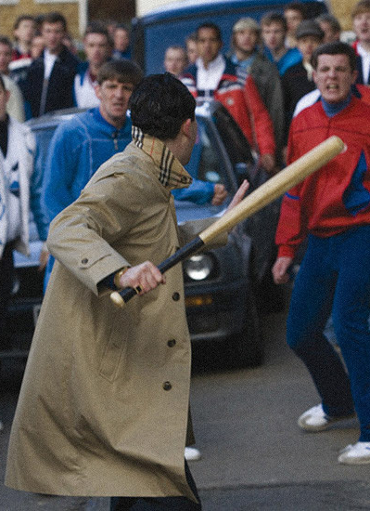
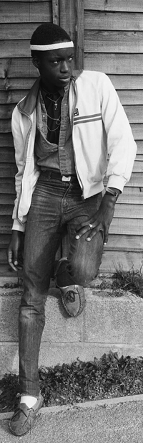
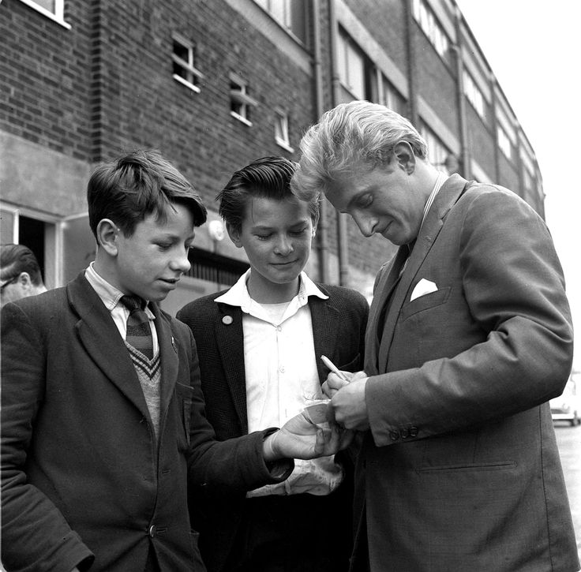
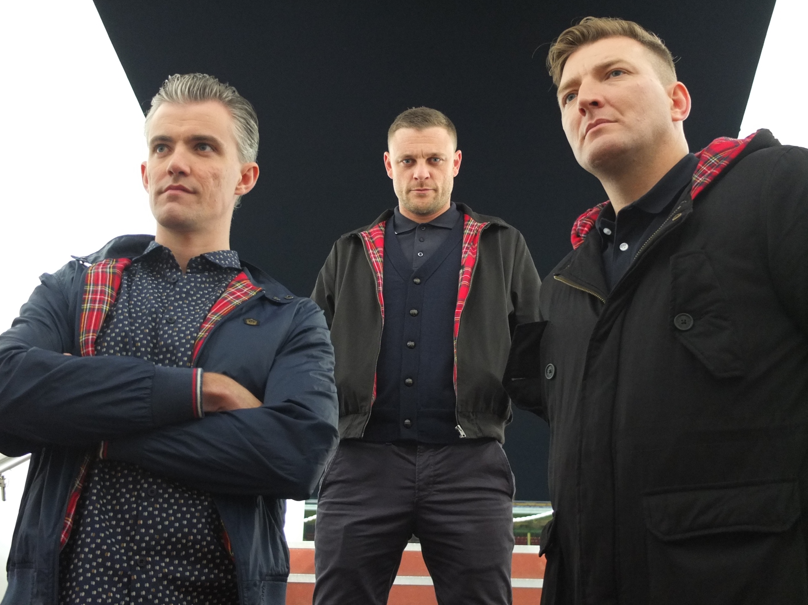
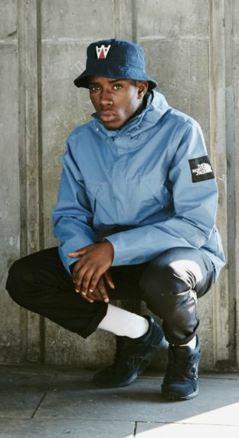
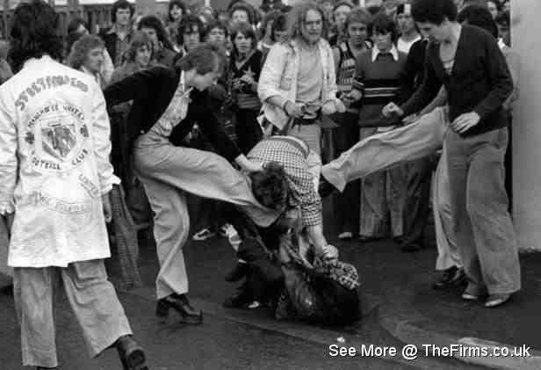
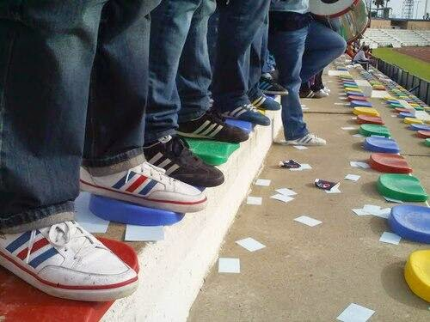
Football & Fashion: A complex and Multi Faceted Relationship
(Sub) Cultures of consumption

Slide 5
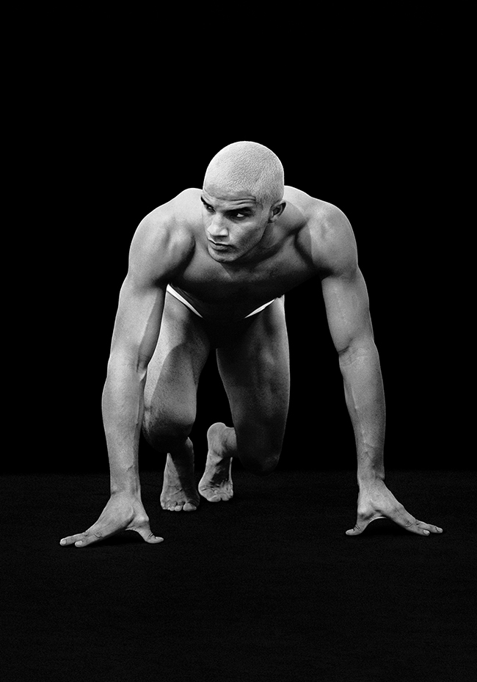
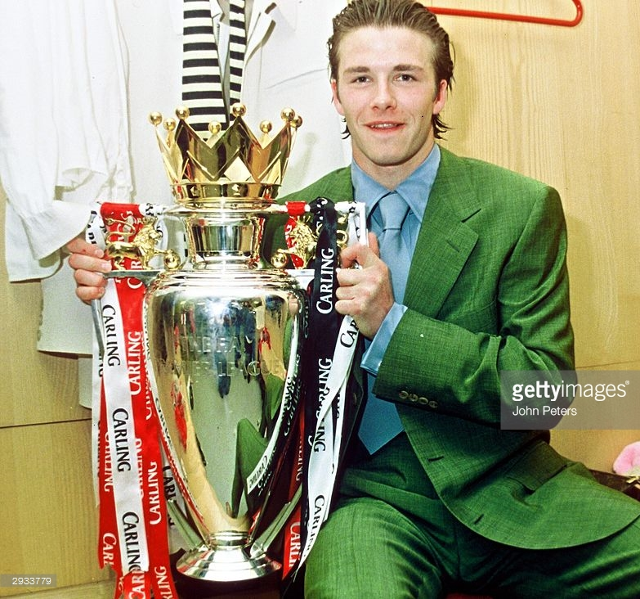
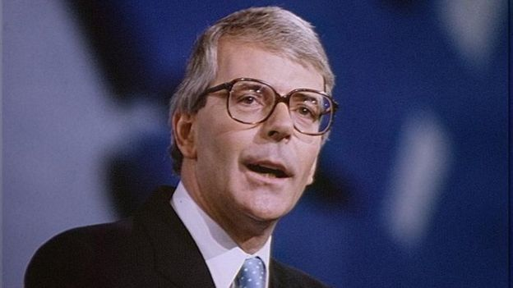
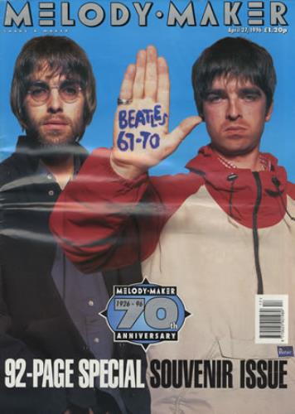
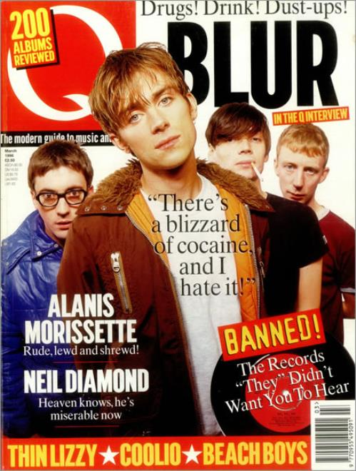
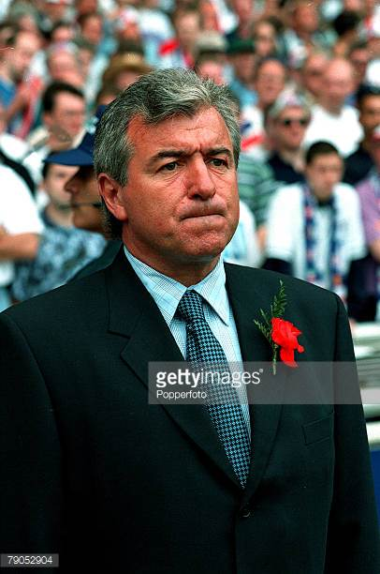
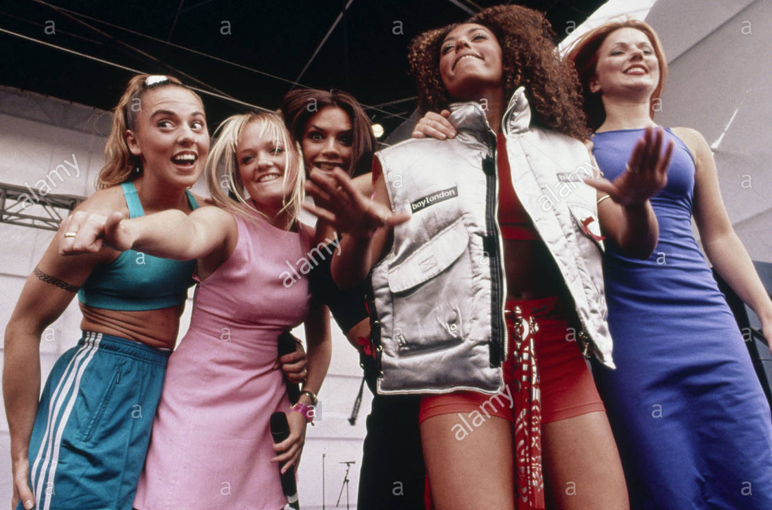
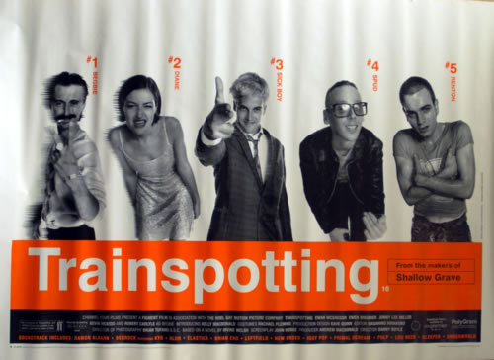
1996 context & Representation
David James for Armani, David Beckham, Terry Venables, John Major, Oasis, Blur, Trainspotting, The Spice Girls

Slide 6
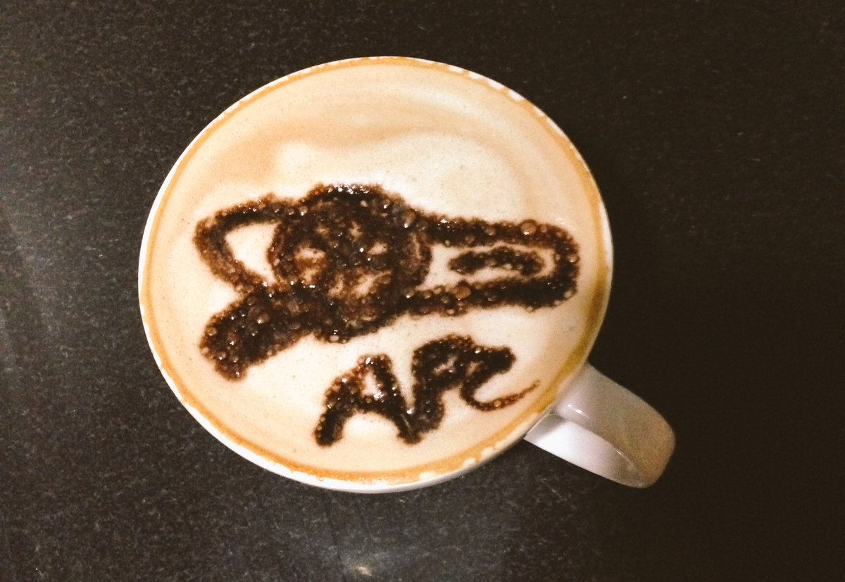
Class: Fuzzy, Frothy boundaries
Gunners Latte
How does social distinction become politicised? (Cannadine 1998)

Slide 7
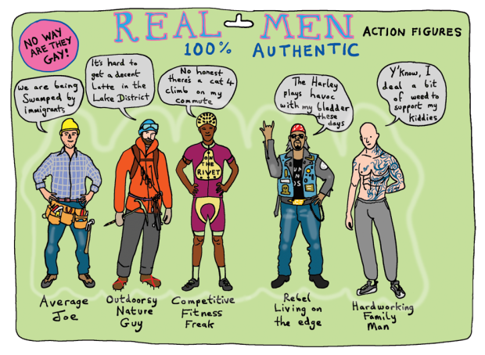
Masculinities
Grayson Perry, 2017
‘differences in identity are produced out of discriminatory processes that establish some identities as more or less valuable than others’ (Lawler, 2014: 13)

Slide 8
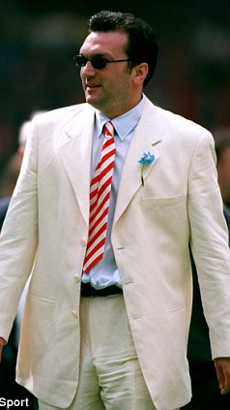
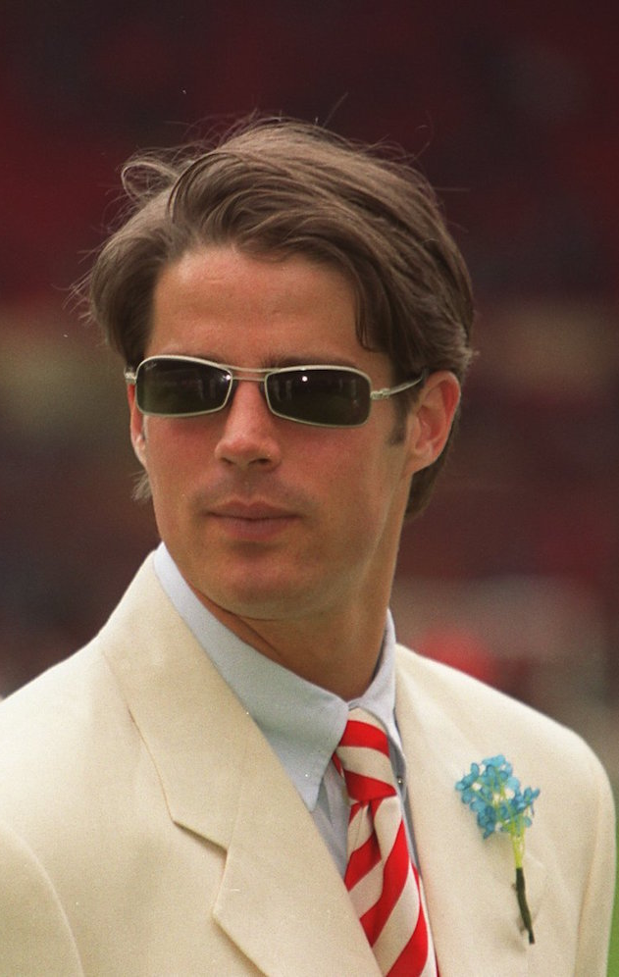
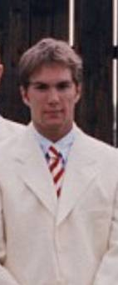
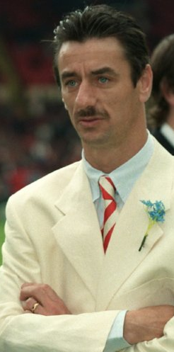
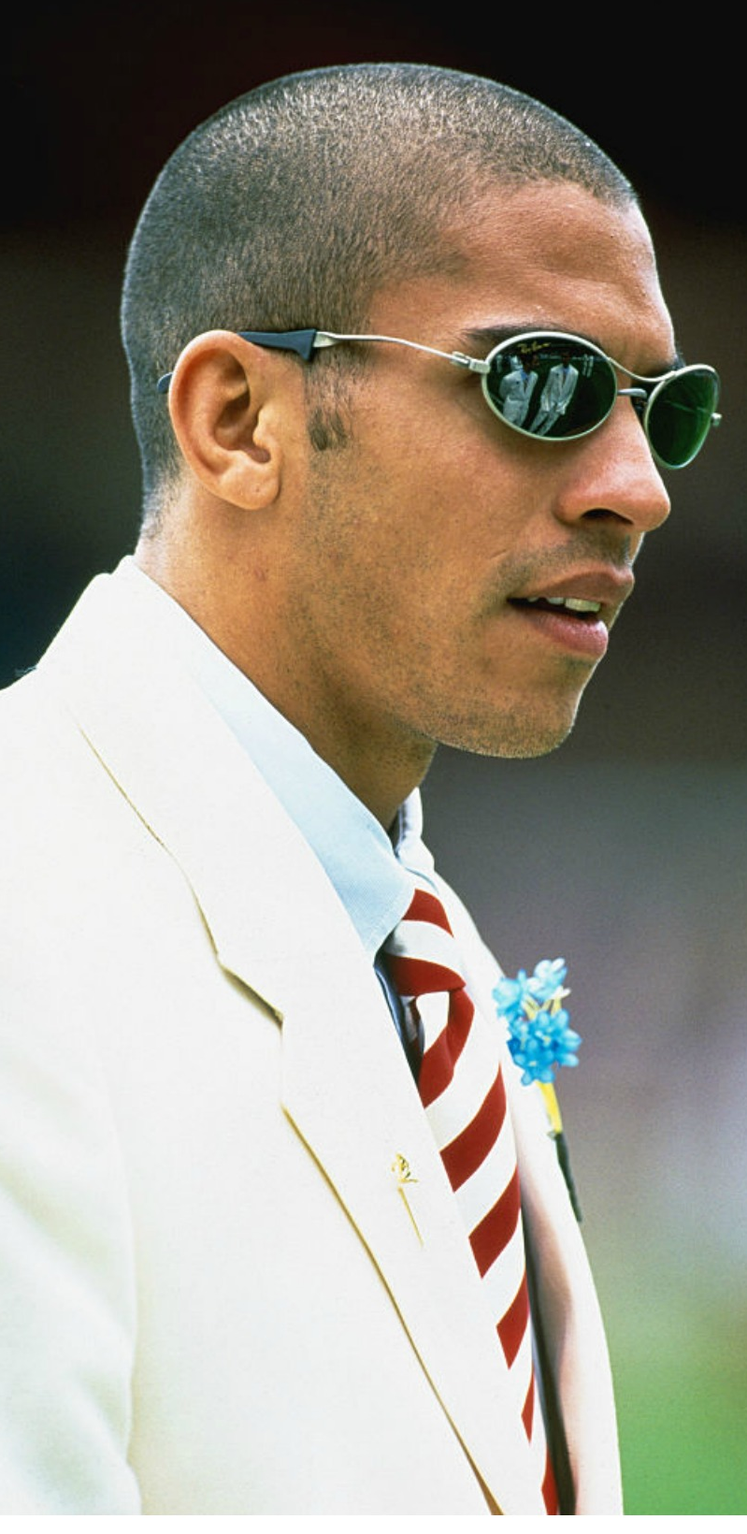
Male Bodies: unhinged Spice, adopted spice, simple spice, ugly spice and Abusive spice
Neil Ruddock,
Jamie Redknapp,
Jason McAteer,
Ian Rush,
Stan Collymore
‘by deriding those that step out of place, boundaries are maintained’ (Skeggs, 2004: 108)

Slide 9
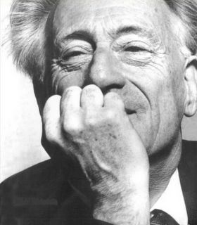
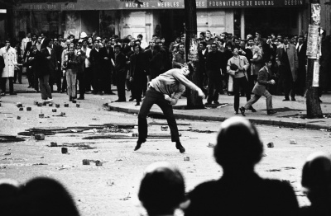
Contestation
Henri Lefebvre
Paris, May 1968
‘…Something more, something less, something else; lived experience….. (Lefebvre, [1981]2005 P5)

