Slide 1
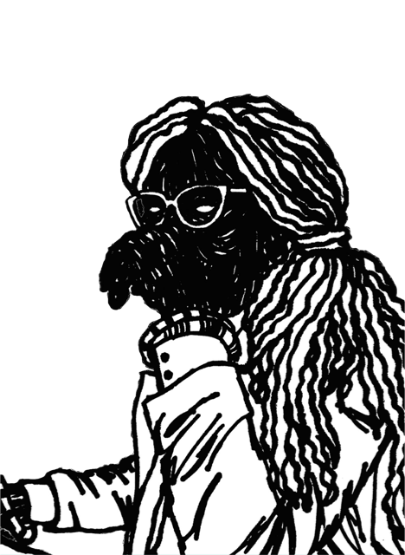
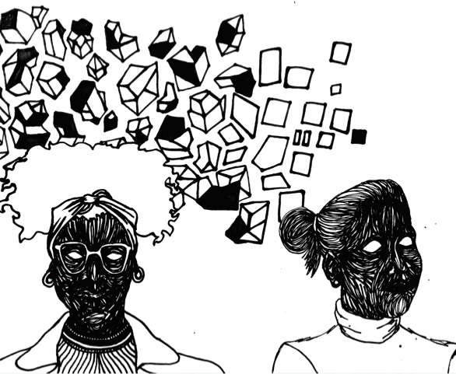
Diversity, Pedagogy and the Creative Arts: perceptions and experiences of diverse students at UAL
Siobhan Clay. Educational Developer, The Exchange UAL
Notes:
Hi, my name is Siobhan Clay and I am an Educational Developer at University of the Arts London.
I am going to talk about my Social Justice and Education Masters Dissertation research (IOE, UCL), on diverse student’s experiences of art school and their aspirations to teach.

Slide 2
Why this research and why now?
Sector wide attainment gap for Black, Asian, Minority Ethnic (BAME) students in UK Higher Education
Dearth of diverse teaching staff
Does one have implications for the other?
Wanted to understand teacher diversity from the student perspective
Notes:
16% in sector, 22% at UAL (2017)
…despite increasingly diverse student body. Student numbers in sector 22% (ECU, 2017) and UAL X
6.5% BAME teaching staff in HE
does one have implications for the other? What factors might support or act as barriers to teaching; student-staff relationships, curriculum, role models?
Wanted to understand what difference greater staff diversity could make to students learning and uni experiences and how this might affect aspirations to enter teaching as a career.
Interviewed 9 students from Art, Design and Comms courses with over 40% BAME students in the 2nd year of course
Phenomenological approach, semi-structured interviews to gain a deep understanding of how the world appears to the individual through deep description

Slide 3
Theoretical frameworks
Critical Race Theory (CRT)
Whiteness
Cultural Capital
Notes:
CRT illuminates systems and questions societal and institutional structures and practices biased towards ‘white’ normative values ,so ‘everyday’ as to be invisible to the majority polity
Gloria Ladson-Billings Culturally relevant pedagogy diverse and relevant curricula that draws on students cultural and familial/community experiences
David Gillborn discussion on class is altogether more comfortable than Race.
Whiteness
Zeus Leonardo ‘…a pedagogical situation that fails to address white racism is arguably already the conduit of hostility’ (ibid:39).
Cultural Capital
Bourdieu cultural knowledge and upbringing, ways of speaking and knowing, accepted and acknowledged usually closely align with those of the art school
Sue Clegg function of ‘limiting the cultural capital ‘growth’’ of some students and affecting future employment opportunities in a neo-liberal marketplace
Tara Yosso Community cultural wealth argues that diverse students’ multi-language, multi-generational and social-group flexibility are in fact highly valued cultural resources which should be of benefit, rather than deficit, at university.

Slide 4
Key findings
Importance of good student-staff relationships
Lack of discourse on race and identity work
Developing inclusive curriculums
Aspirations to teach

Slide 5
Importance of good student-staff relationships
‘Well my first project was absolutely really important I think, because it was about immigration, the Irish diaspora, so the people that came over from Ireland to England…You know [lecturer] kind of understands what I wanted to do, and like I said, I think he really thinks the project is interesting too, it’s not airy-fairy.’ (p.63)
Notes:
Staff-student relationships
Students regularly used words like ‘clicked’, ‘identify’, ‘connect’, ‘energy’, ’passion’ and ‘understanding’ when discussing positive staff relationships.
it was clear that strong student-tutor relationships don’t necessarily need to mirror the individual’s ethnicity to work – students can and do have successful relationships with staff from different genders, ethnic and class backgrounds.
Clear that when students felt they had someone they could go to, they perceived an implicit ‘understanding’ between them that supported their development, confidence and work.

Slide 6
‘Because I’m going, no, no, because I said this work isn’t finished. Yes, it's finished, and it’s, like, no, it isn’t, because it’s not saying what I want it to say. So, yes, that was just quite difficult, there wasn’t anywhere I can go with it, there wasn’t anyone I could really talk to, and I think even the black tutor was a bit appalled by it but didn’t really sort of try and help me fix that, what it was doing which I didn’t want it to do, so, yes, that was the very first thing I made and I just felt really awful, I just thought, […] who are these people that I’m with, I’ve got no one to talk about these issues with.’ (p.69)
Notes:
This student is describing presenting a piece of work about a traumatic racist incident experienced as a young child and how it was repeatedly mis-read by tutors who perceived it from the white child’s perspective
Emma described a sense of diminished trust in and lack of support from the teaching staff and a feeling that she had to choose between ‘rocking the boat’ or keeping silent, aware that tutors were judging and marking her work
Finding a connection & establishing good staff relationships can help to stabilize students in an otherwise unstable, volatile discipline that requires constant risk-taking, performance and self exploration (Stevenson, 2015). Not all students found this kind of support/relationship

Slide 7
Lack of discourse/misunderstandings on race and identity work
‘Because of your position as a black person, quite often, I think, things can be projected into your work that aren’t necessarily what you intended. Like it's sort of an anger about racism or something that might just not be what you were kind of going for, so […] it definitely would be helpful to be able to have more dialogues around these things.’ (p.64)
Notes:
Discourse on race and identity work
findings evidenced a general lack of discourse about work pertaining to Race, complex life experiences and cultural identity.
Articulated a sort of ‘avoidance of understanding’ from some staff, a lack of teacher discussion, understanding and intervention when difficult topics and situations arose in the crit environment. Echoes Sherrid’s Room of Silence (2016) Rhode Island school of Design. This denies students the opportunity for valuable feedback - the very purpose of the crit - and publically reinforce ‘difference’
expectation that staff will facilitate the difficult territory that making art presents, whilst their reflections recount a failure to meet these expectations. When work pertaining to identity and race are misunderstood or silenced by staff it places responsibility with the student to defend themselves which in turn can affect staff and peer relationships. Conversely their peers ‘whiteness’ never came up when discussing work.

Slide 8
Developing inclusive curriculums
‘I would say the teaching curriculum could be more diverse [...] I don’t know much about my own culture and it would be nice to kind of throw in an Arab theorist or a black African theorist, or Caribbean […] Because what we’re learning in the design and the skillset is something that’s internationally going to be used, and it’s going to be shipped all over the world.’ (p.71)
Notes:
Perceived gap in the curriculum regarding non-western influences which concurs with current sector campaigns (NUS, UCL)
Most of the interviewed students could see the benefit of a more diverse staff profile and curriculum but it was a necessary for the students from diverse backgrounds
Across the interviews the imperative for a more representative curriculum was seen to be the responsibility of course teams but there was a perception that whilst staff were largely white European ‘they would all have the same way of thinking’

Slide 9
‘I did a part time foundation […] and black art was never mentioned, black artists were never mentioned, so not having been in the art field for years I just thought, oh, well, maybe black people just don’t make art, don’t do fine art. By the time I got to university I was, like, oh, right, okay, there are more people than Yinka Shonibare…’(p.72)
Notes:
Curriculums that are narrow in scope present a kind of static knowledge where alternative voices are scarce, reproducing rather than ‘growing’ the canon.
And as Hatton (2003) says, it remains faithful to narratives and concepts that have long been privileged and ill prepares students for being in a multi-cultural world.
Infinite possibilities that wider knowledge, perspectives and understandings could have in changing and expanding the academic field (Clegg, 2011).
It also brings to mind Donszelmann’s research (2015) introducing post-colonial theory to a BA fine art course in order to liberate it from the margins of the curriculum and bring it firmly into the mainstream

Slide 10
Aspirations to teach
‘I have no idea how it happens, I think you just get asked’ (p.90)
Notes:
Lots enthusiasm for teaching as a career but little was known about this process apart from a higher qualification and industry experience would support
Personal characteristics; ‘organized’ and ‘focused’ were mentioned
CRT scholars would posit that such informal and vaguely framed progression processes are structural actions which preserve and legitimize the institutions white hegemony
2 factors can act as barrier: Attainment and Industry;
1st or 2:1 usual route to PG study
BAME creative practitioners are underrepresented in the sector and account for just 11% of the workforce (Creative Industries Federation, 2015)

Slide 11
…it’s only going to happen once there are enough diverse people in the industry to come back […] so because there is more diversity now and there are lot more people that are interested in these type of fields, then I think it will be reflected in the staff members when those students come back. (p.76)
Notes:
Student thought the limited diversity in the industry had direct impact on the current staff demographic but recognised that more students in the subject field could eventually change this
Who has access to informal opportunities that lead to teaching roles, who is left out, and why?

Slide 12
Discussion activity
In small groups read the 2/3 quotes on your table and discuss:
What is at play here?
What can we learn from this (positive or negative)?
What practical approaches would the group employ to address these points?

Slide 13
The future of learning lies with the cultivation of conversations, of dialogue.
hooks, 2010:44
Notes:
End on bell hooks quote- fitting and essential in art and design education, where we consider ourselves dialogic but whose dialogue is heard?
Critical pedagogy
Teaching critical thinking: Practical wisdom (2010)

Slide 14
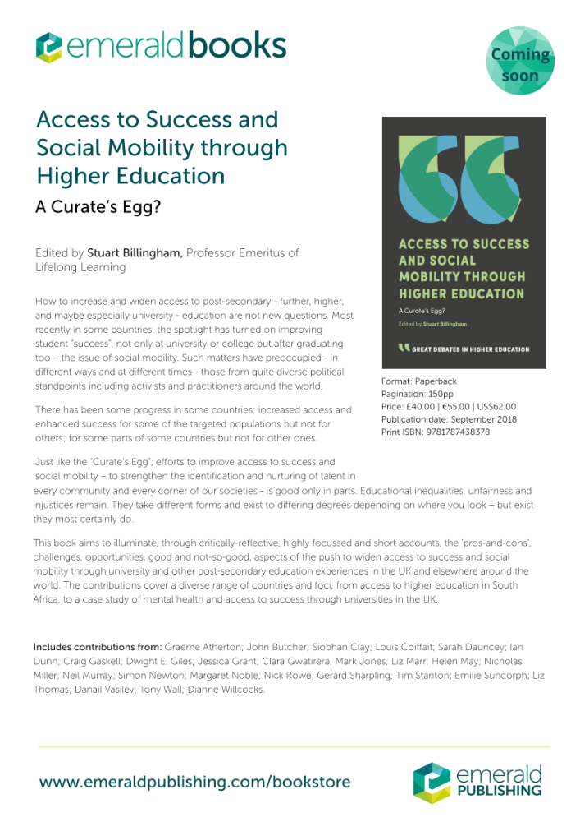

Slide 15
Many thanks for coming
s.clay@arts.ac.uk
All illustrations by Olivia Twist https://www.yesoliviatwist.com

