Slide 1
Arts Research in Open Access Repositories: WELCOME
Dr Stephanie Meece, University of the Arts London
Notes:
-“ to efficiently manage all types of research outputs, from monographs to exhibitions, artists’ books to animations, performances to symposia.”
-History of arts research in repositories: Kultur, etc. We had a network and shared solutions, which we miss.
-Practical workshop to share and support
-No rulebook, no one solution
-different institutions, different funding and resourcing
-advice that you can take or leave or adapt
-meeting others who are dealing with the same issues
-SHARING SOLUTIONS AND BEING EMPOWERED
-both administrative (workflow solutions, how to manage particular types of output) and larger problems (reassurance and support to be proactive and make decisions)

Slide 2
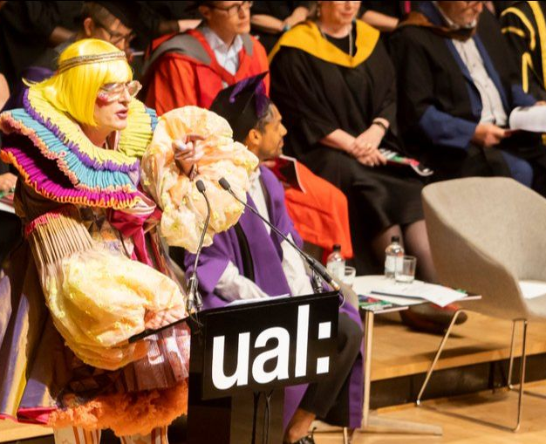
Arts Research in Open Access Repositories
UAL Research Online
Built in 2008-9 (with Jisc funding), launched 01/2010.
Nearly 10,000 items, around 65,000 files
Research outputs and PhD theses from University of the Arts London
UAL is Europe’s largest specialist university for arts, design, and media

Slide 3
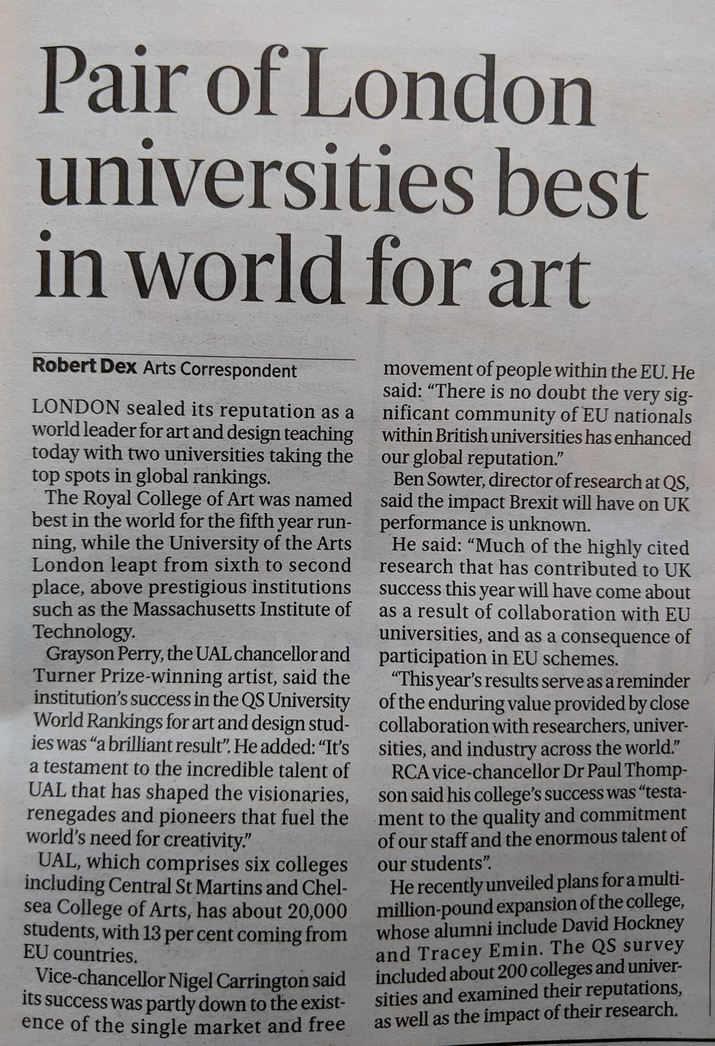
Arts Research in Open Access Repositories
UAL Research Online
Built in 2008-9 (with Jisc funding), launched 01/2010.
Nearly 10,000 items, around 65,000 files
Research outputs and PhD theses from University of the Arts London
UAL is Europe’s largest specialist university for arts, design, and media
“We’re number two!” [QS World University rankings by subject]

Slide 4
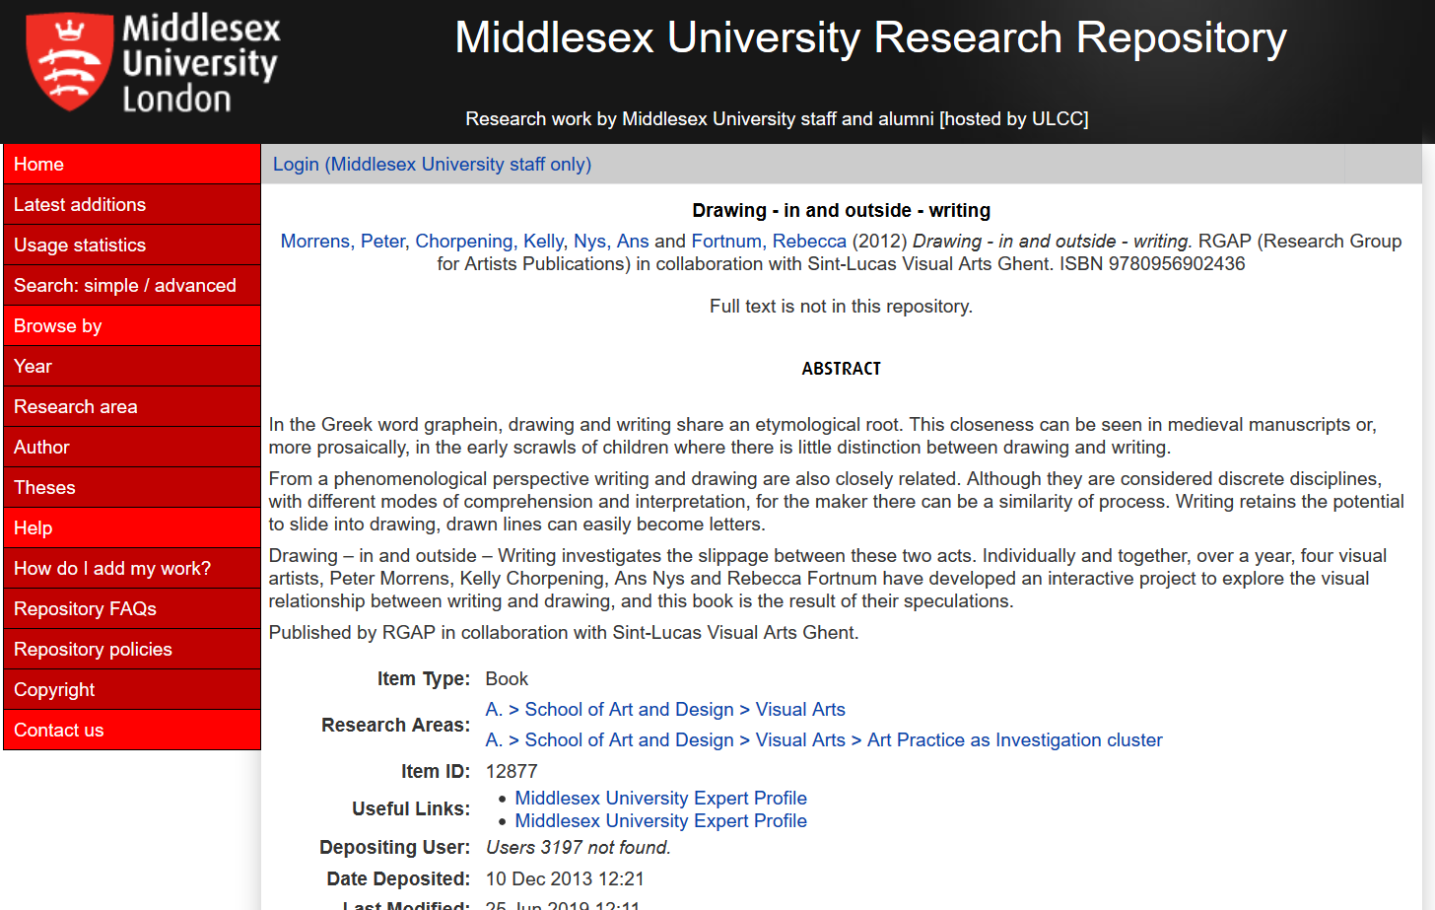
Notes:
Eprints: Designed by researchers in computer science, specifically to make Open Access to research outputs easy: primary goal was providing discoverability and easy access – not for all the other things we have ended up using it for. And not for research outside the sciences, at first.
Demo: UAL research online. https://ualresearchonline.arts.ac.uk/
Drawing in and outside writing (design object as well as a report – crosses boundary between text output and art object)
http://eprints.mdx.ac.uk/12877/
http://ualresearchonline.arts.ac.uk/3780/
(both eprints)

Slide 5
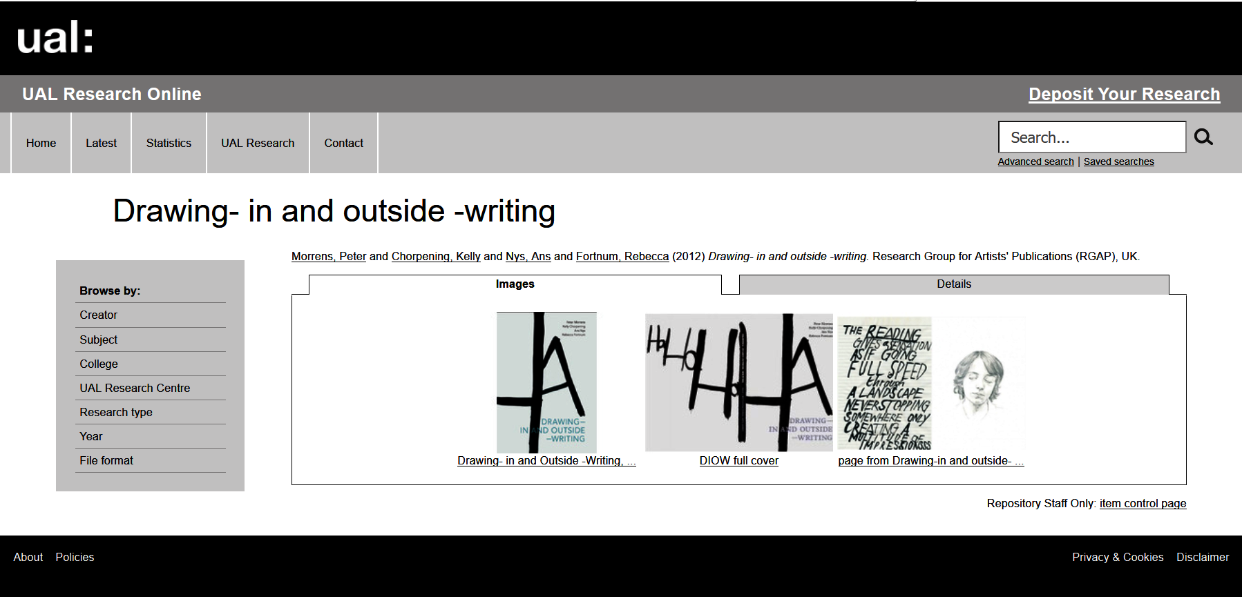

Slide 6
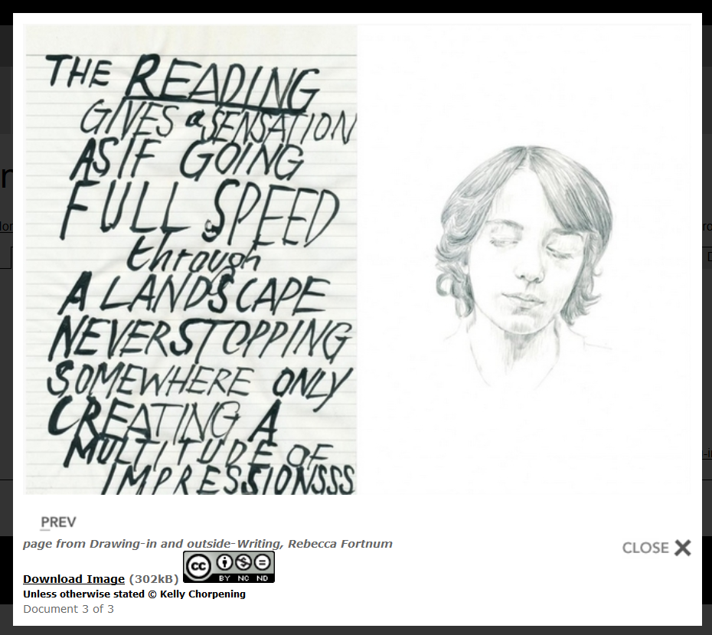

Slide 7
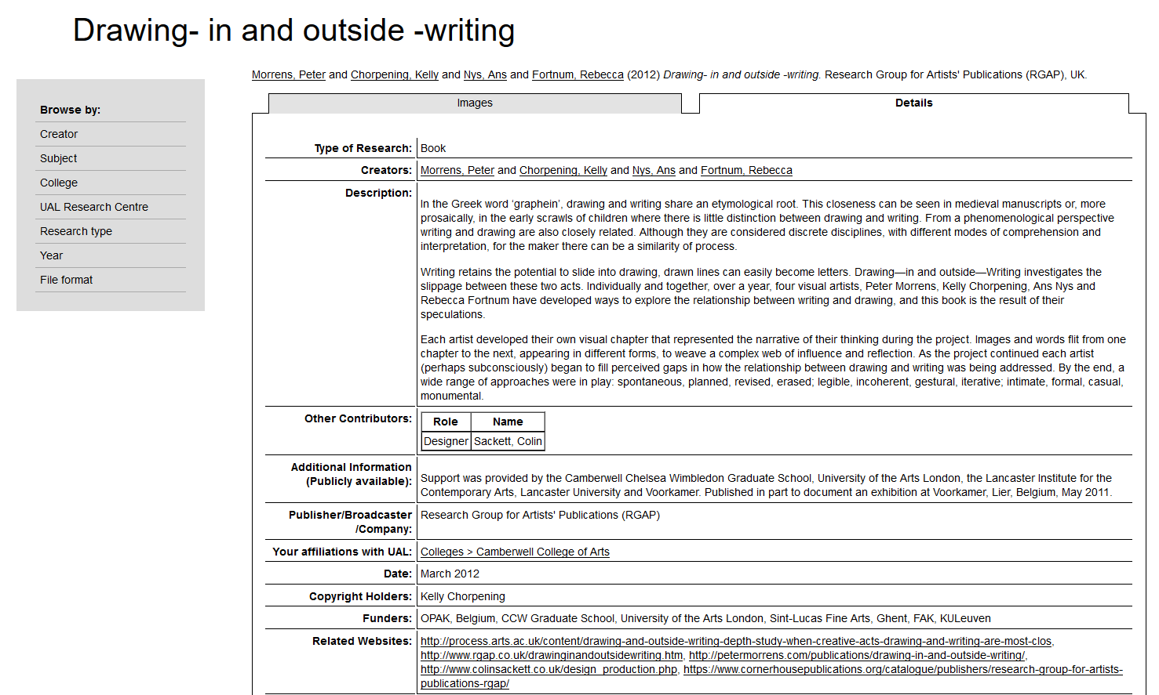

Slide 8
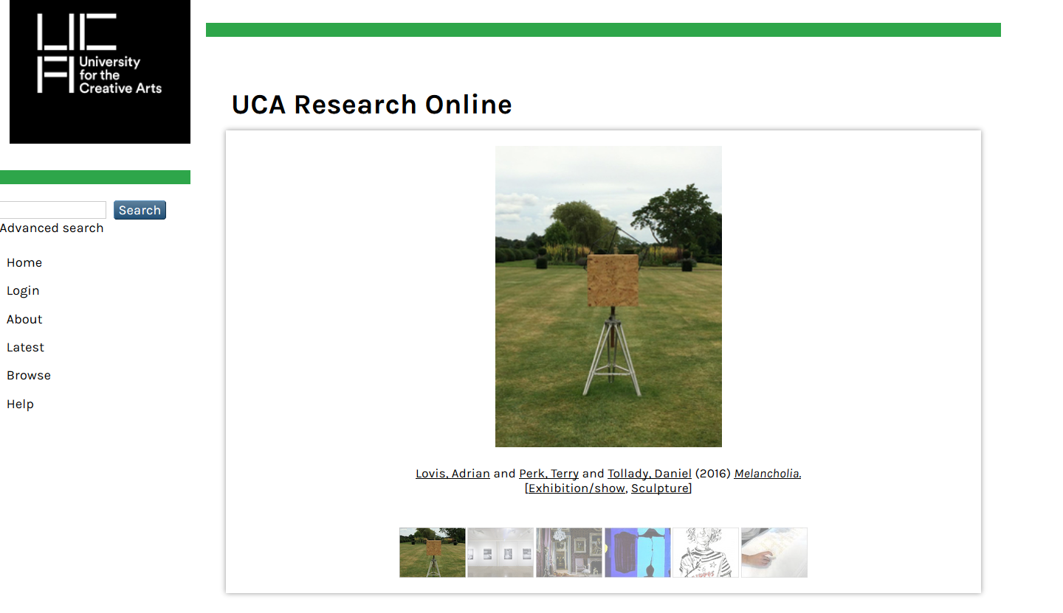
Notes:
Selected other IRs using Eprints with the Kultur plugin, at specialist arts and design institutions:
https://research.uca.ac.uk/
http://researchonline.rca.ac.uk/
http://crco.cssd.ac.uk/
http://radar.gsa.ac.uk/
but it is not how they look – it’s what is going on underneath this that makes these work as open access repositories

Slide 9
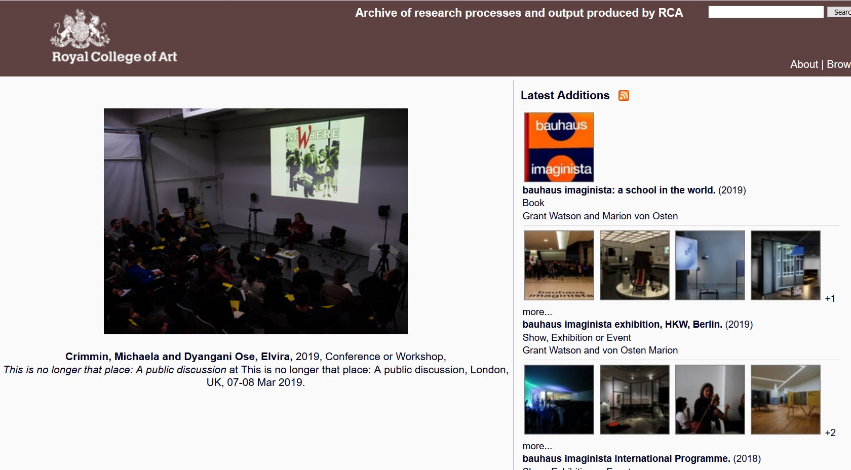

Slide 10
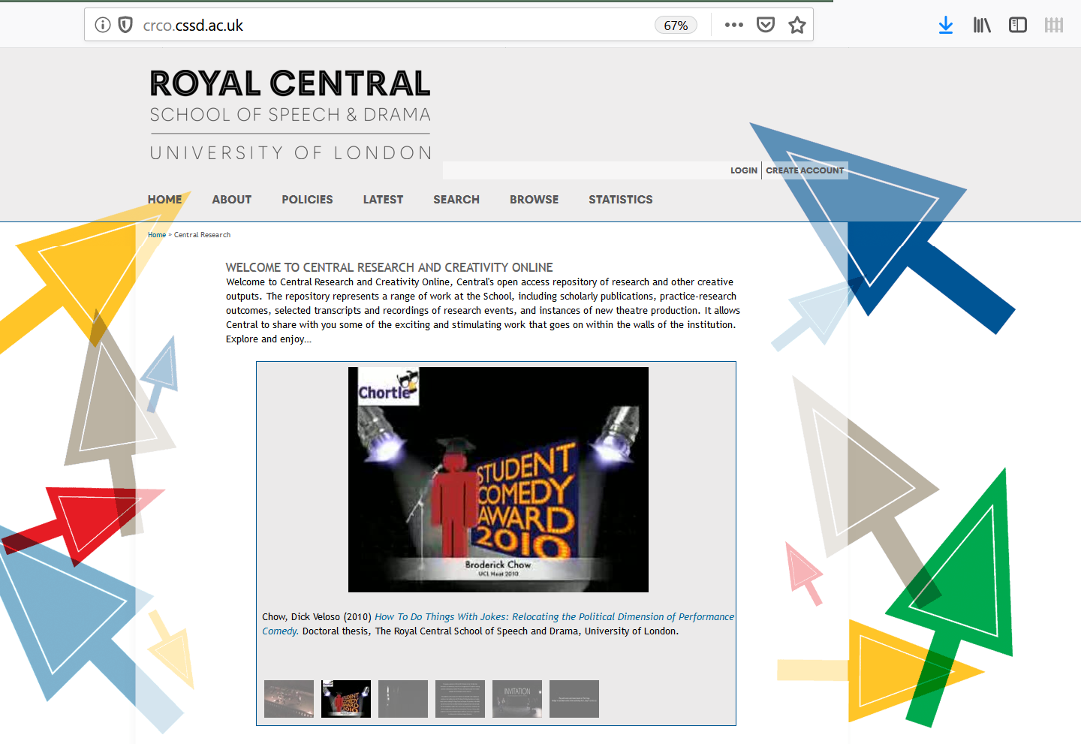

Slide 11
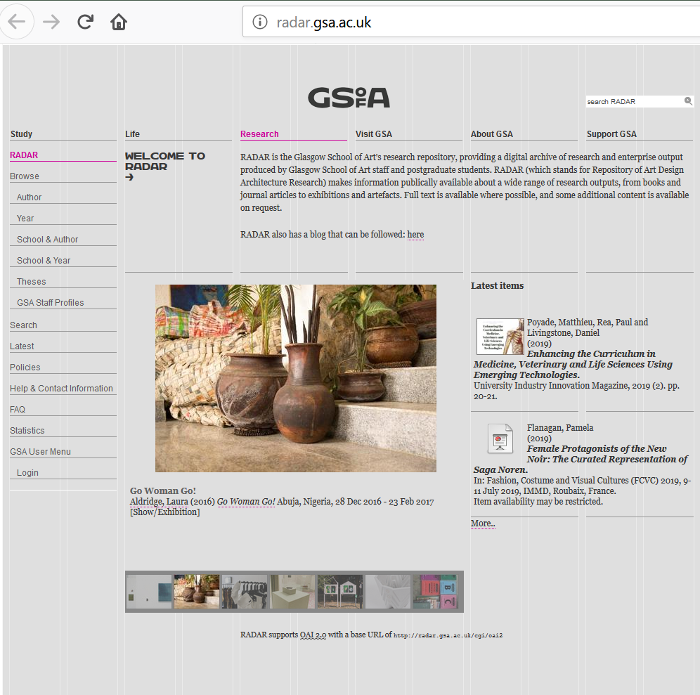

Slide 12
UAL Research Online
http://ualresearchonline.arts.ac.uk/946/ Cunning Chapters, is an artist’s book. The images are composed and professionally shot to display the book’s structure, papers, and textures.
http://ualresearchonline.arts.ac.uk/12870/ Neurogenesis is an art object. A two minute video presents the object, photographs of its installation in a gallery show how it was communicated and experienced, and there is metadata and a description of the research content of this work.
http://ualresearchonline.arts.ac.uk/1688/ Fragment/a, is a traditional exhibition, based on research carried out by the London College of Fashion/Victoria and Albert Museum Designer in Residence from September 2002 to August 2004. There are installation shots, drawings, a text description, and a formal 1500 word document that is the ‘Research Overview’.
http://ualresearchonline.arts.ac.uk/7470/ Grammar of Ornament, is a body of work consisting of ceramic plates and hand cut papercuts. The record includes high quality images, a press release, several reviews of exhibitions in which the work was shown which are restricted but accessible to university staff and upon request, metadata and a full description.
http://ualresearchonline.arts.ac.uk/13281/ Echoes and Callings, is a collaborative performance between a photographer and a sound artist, with images of the performance, a video [16 minutes] of the performance, and the usual metadata, research statement, biographies of the artists, and links to reviews.
http://ualresearchonline.arts.ac.uk/1014/ ‘Day of Record’ was an exhibition that invited black people to the V&A to have their hairstyles and nail art photographed. (n.b. “Images of many of the attendees were added to the V&A's photographic collection and a dedicated website was created as a permanent and rare record of contemporary black British hairstyle and nail-art.”) [http://www.vam.ac.uk/collections/contemporary/day_record/nails/index.php]
Notes:
As far as I can tell, UALRO is the largest Open Access repository of scholarly research in arts and design, in the world.
It makes available around 87,000 files, as content for around 9500 research outputs.
In sum: the practice based research in our collection uses “a diverse range of media and forms of experience and expression”. UALRO’s goal is to create a digital representation of work that may not be born digital, and to make that representation as rich as possible.
We, along with the other arts and design repositories, are poorly resourced; until recently a team of only 1.5 FTE (2.0 since last August) which means that researchers must upload their work themselves, while we act as editors and collection managers. Thus we are dependent on what we are given by the creators themselves.

Slide 13
Researcher-led digital collections
Research Catalogue https://www.researchcatalogue.net/ -‘expositions’
personal websites: http://chriswainwright.com/projects/ http://www.annetallentire.info/
journals: https://www.oarplatform.com/about/ http://screenworks.org.uk/
Notes:
What creative arts practitioners prefer: visually stunning websites, innovative presentation of research outputs/expositions…
Generally less concerned with the boring bits: metadata standards, standardised ontology, accessibility regardless of level of technology or connectivity, interoperability with other academic systems, conformity with accepted academic citation style, etc.

Slide 15
Research through practice
"creative work in itself is a form of research and generates detectable research outputs“*
Creative practice generates knowledge and innovations that are different from other research methods
The best way to explore an idea is not necessarily through words
Practice as research may never clearly articulate a research ‘question’, and may never lead to academic publication in the conventional sense.**
Notes:
“The turn to creative practice is one of the most exciting and revolutionary developments to occur in the university within the last two decades and is currently accelerating in influence. It is bringing with it dynamic new ways of thinking about research and new methodologies for conducting it, a raised awareness of the different kinds of knowledge that creative practice can convey…”
-Smith and Dean 2009
*‘Practice-led research, research-led practice in the creative arts.’ by Hazel Smith (Editor), R T Dean (Editor), 2009. Series: Research Methods for the Arts and Humanities
**” The outcomes of practice as research are multiple – insights into arts processes, understandings of a range of social and cultural phenomena, new kinds of artistic products, outcomes or relationships. Importantly, practice as research may never include the action of writing anything down – it may never clearly articulate a research ‘question’, it is open to and uses sense, sensation and intuition as part of knowledge making, and may not lead to academic publication in the conventional sense.”
-Johannes Sjoberg and Jenny Hughes, ‘Practice as Research’ at https://www.methods.manchester.ac.uk/themes/qualitative-methods/practice-as-research/

Slide 16
Practice as research
it extends beyond the immediate context of practice,
  it requires reflection on the action
  it must be informed by other practice and theory
  must bring about an enhancement in knowledge and understanding in the discipline (AHRC)
  It incorporates a scholarly apparatus that enables other researchers in the discipline to assess the value and significance (AHRC)
Notes:
Not all practice is research. What makes practice into research?
-it extends beyond the immediate context of practice, it requires reflection on the action, it must be informed by other practice and theory. It must be theoretically able to be contextualised within a research tradition, but that exegesis doesn’t have to be included.
-AHRC required that practice as research must bring about an enhancement in knowledge and understanding in the discipline, and incorporate a scholarly apparatus that enables other researchers in the discipline to assess the value and significance of the results of the research and the methods through which they were achieved: (AHRC website – gone now).

Slide 17
A Clear Mission
Who are we for?
Notes:
-technology is not neutral, it is embedded in politics
-tension between OA goals and the surveillance aversion of some academics who don’t want to be managed
-OA has deep links with libertarian/radical geek culture (stridently sharing); but administrators need to monitor, audit and prove; conform to regulations.
-OA showcase vs. internal management tool
For example, a recent paper by PRAG members cited a need for “portfolio framework for the documentation, evaluation, assessment and archiving of creative and interdisciplinary research and the evidence of its impact” [Portfolios ‘Beyond Text’ Anne Boddington, Maria Delgado and Simon McVeigh A discussion paper presented at the seminar Evidencing Research and Impact in Arts & Humanities Practice (Wellcome Collection, 3 February 2017)] – emphasis mine
But repositories were designed to simply hold and keep research outputs and ensure they are legally and safely openly accessible.
The need for outputs to be evaluated and assessed, and their impact evidenced, reflects the growing managerialisation of UK scholarship. Repositories have been pressed into action to fulfil these additional internal management tasks, for which they were not designed and which in some ways they actively resist; the open access movement was grounded in a more anarchic impulse, meant to subvert existing structures and conventions, not to assist them.

Slide 18
A Clear Mission
Who are we for?
  1. External users who need access to scholarly research. We are providing open access to research outputs.
Notes:
Understanding and articulating goals/mission is essential – empowers you to make decisions, support your researchers, achieve Open Access, and stand your ground.

Slide 19
A Clear Mission
Who are we for?
  1. External users who want access to scholarly research. We are providing open access to research outputs.
  2. Our researchers, who want accessibility, preservation, fulfilment of their responsibilities to their employers and funders, and an adequate, appropriate representation and record of their research.

Slide 20
A Clear Mission
Who are we for?
  1. External users who want access to scholarly research. We are providing open access to research outputs.
  2. Our researchers who want accessibility, preservation, fulfilment of their responsibilities to their employers and funders, and an adequate, appropriate representation and record of their research.
  3. This is a library collection.
Notes:
…of use to the research support office, but separate from it.
-a digital collection belonging to the library, taken care of in the same way as any other library collection.

Slide 21
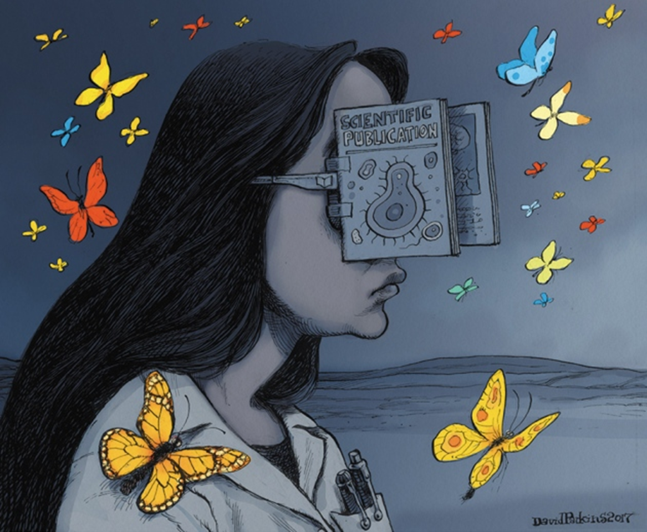
Notes:
[n.b. cannot locate attribution/licensing for this image so should should not be shared publically]

Slide 22
This presentation is copyrighted by Stephanie Meece. The ideas in both the slides and the notes may be cited, with full attribution, following normal academic standards.
Images from UALRO are shared under CC-BY-NC-ND, and if re-used should be attributed to their creators, and include links back to the original work in UALRO.

