Slide 1
Wearables and Choreosonic Gestures
Michèle Danjoux

Slide 2
Design & Performance
DAP-Lab
a cross-media lab exploring convergences between performance, telematics, textile/fashion/costume design and movement/choreography, visual expression, film/photography, and interactive design

Slide 3
Wearables in Interactive Performance/Performance Installation
The subject area comprises “wearable” (performance) design and analogue and digital corporeal engagement in dance-theatre and live art contexts, linking choreography and movement study with somatics, the sonic arts and design research. Interactive technologies are applied to garments and wearable design for sensory augmentation and transformation of the body in real-time interactive audio-visual performance / performance installation (immersive environments)

Slide 4
Design-in-Motion
My research/artistic practice currently involves the design of wearables (costumes and accessories) for dance/performance, integrating technology into the process
A key concern has become how my design interventions integrating technologies for sounding can influence the emergence of movement, acting as provocation to choreographer and dancer/performer alike
Simultaneous to this, I place the dynamic body at the core of the design process
Wearing becomes a performance technique that draws the digital back across into the visceral, into a collective behavioural environment where we listen and follow the smallest movement, the exhalations, the rattling of metal chains dropping against the floor, the whisper of rustling fabric, the pleated sigh, the whirring of a tiny speaker worn on a wrist

Slide 5
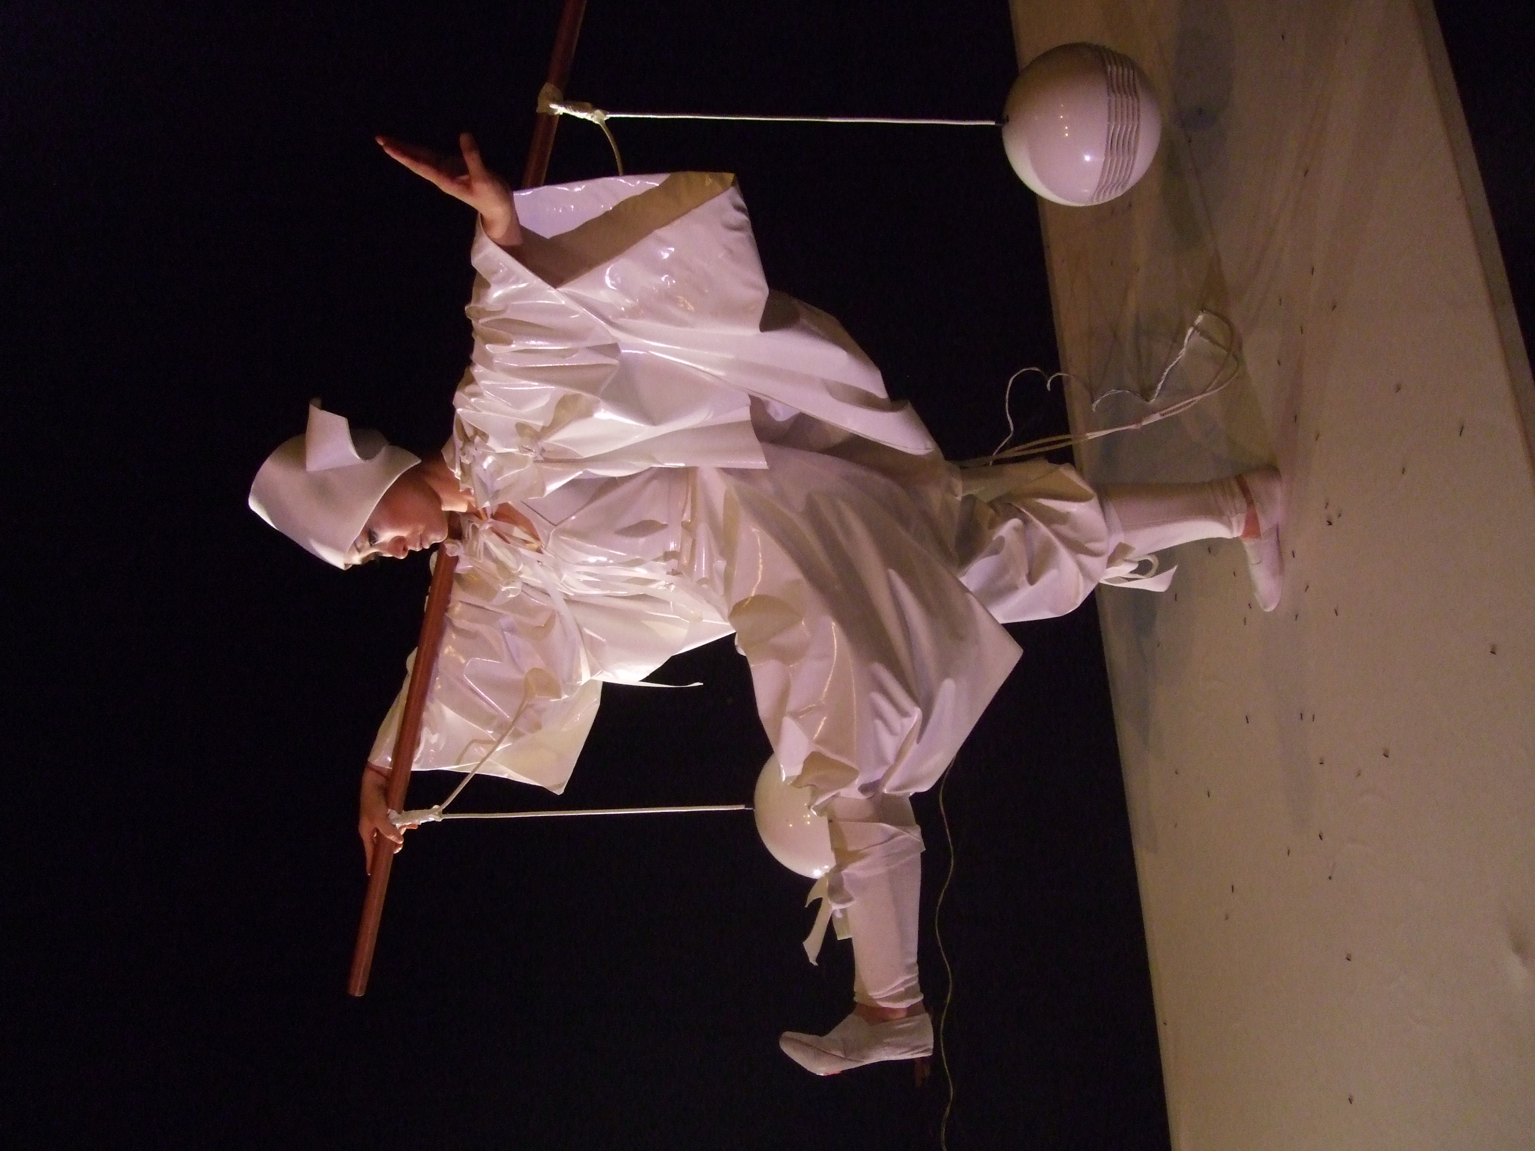
Extensions of the (performing) Body
"We use instruments as an extension of our hands and they may serve also as an extension of our senses. We assimilate them to our body by pouring ourselves into them…” (Polanyi: 1958, p. 31)
Polanyi, M. (1958), The Study of Man, Chicago: University of Chicago Press.

Slide 6
Questions
Relate to:
How wearable design can influence and shape choreographic composition or movement of a dancer/performer
What extent garment design and the aesthetics of costume can influence movement expression of the dancer/performer to enable them to become an expanded techno-organic instrument generating sound on stage
Whether new forms of dance can emerge via this expanded system of expressivity

Slide 7
Live Electronics
Sounding Bodies and the Entwined Body Instrument
Gesture-control gloves / wearables for musicians

Slide 8
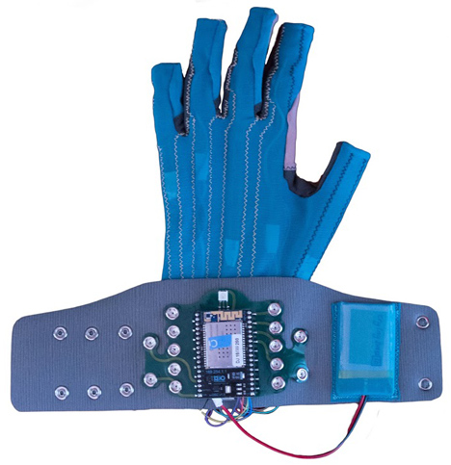
Imogen Heap: MiMu with sensor technology and battery integrated into glove

Slide 9
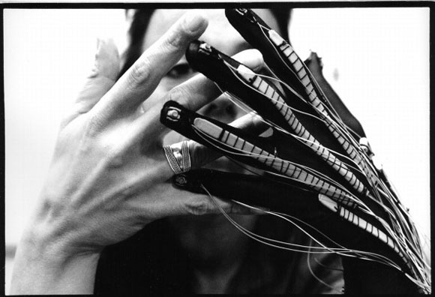
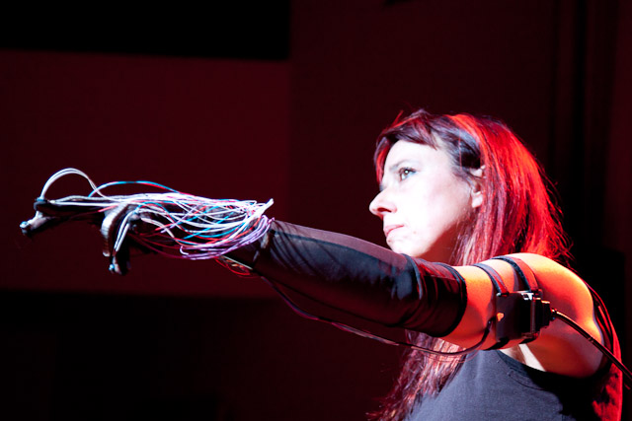
Laetitia Sonami: Lady’s Glove

Slide 10

for the time being
[Victory over the Sun]
2011 - 2014
Red Square Kasimir Malevich (1915)
A choreosonic performance
DAP Lab
Premiered @ Waterman’s, London 26th – 27th May, as part of their International Festival of Digital Arts 2012

Slide 11
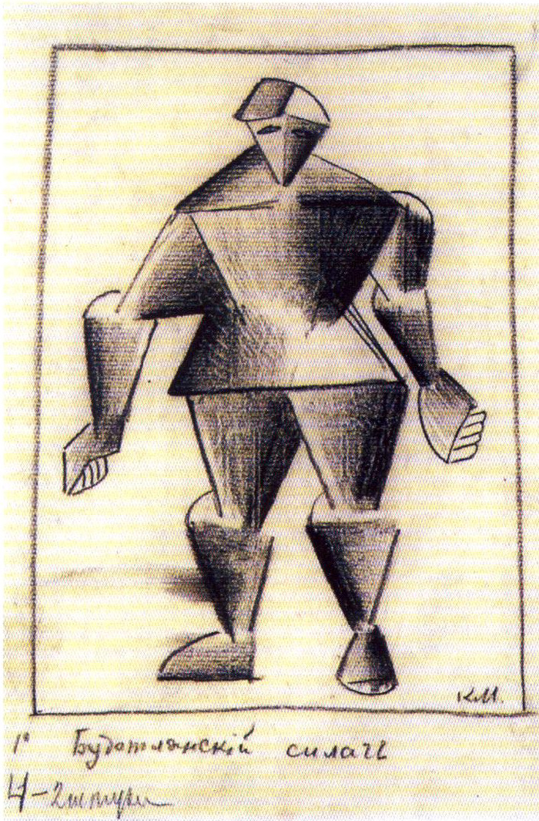
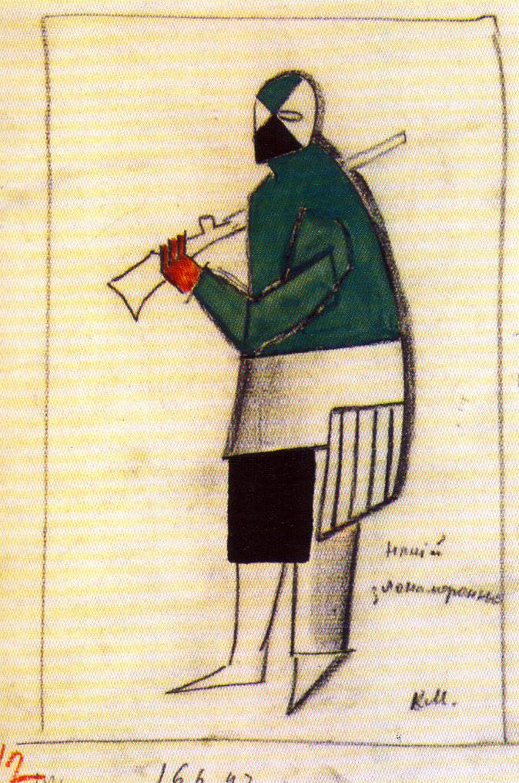
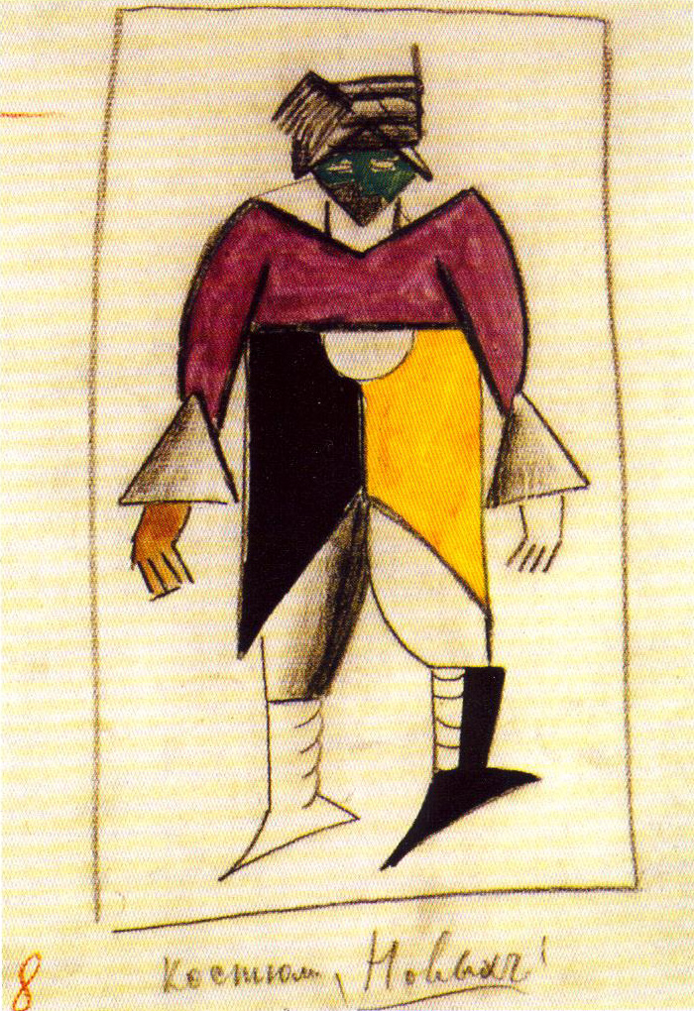
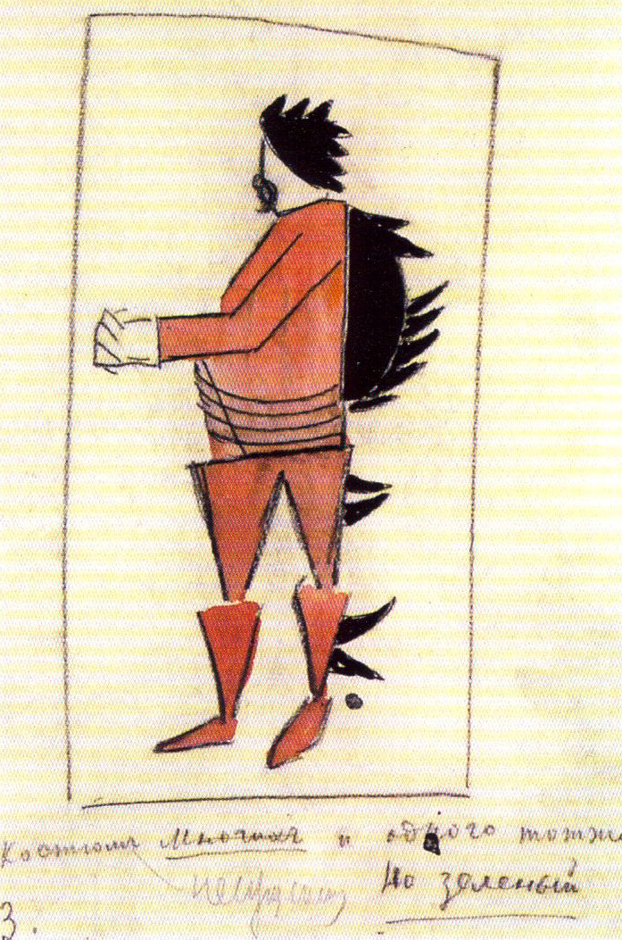
Futurist Strongman
Man with Bad Intentions
New Man
Kazimir Malevich Costume Design
For Victory over the Sun
(1913)
Many and the One

Slide 12
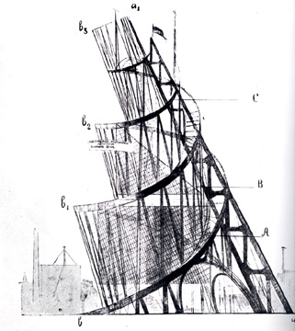
Tatlin’s Tower “Model for Monument to the Third International”
Vladimir Tatlin (1920)

Slide 13
The Prototypes electro-acoustic instruments for kinaesonic choreographies
TatlinTower
GraveDigger
RedMicro Dress
Futurian

Slide 14
TatlinTower
Act 1/Scene 1
Headgear taking inspiration from Tatlin’s Tower and transmittance utilizing metal coil/spring to produce sound piece to be worn on the head

Slide 15
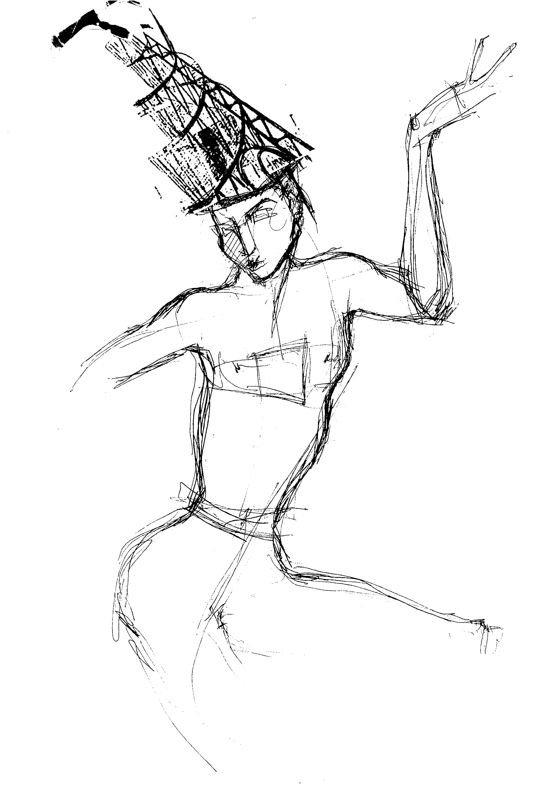
Vladimir Tatlin (Tatlin’s Tower)
Headdress with microphone for reverberation dance with speaker

Slide 16
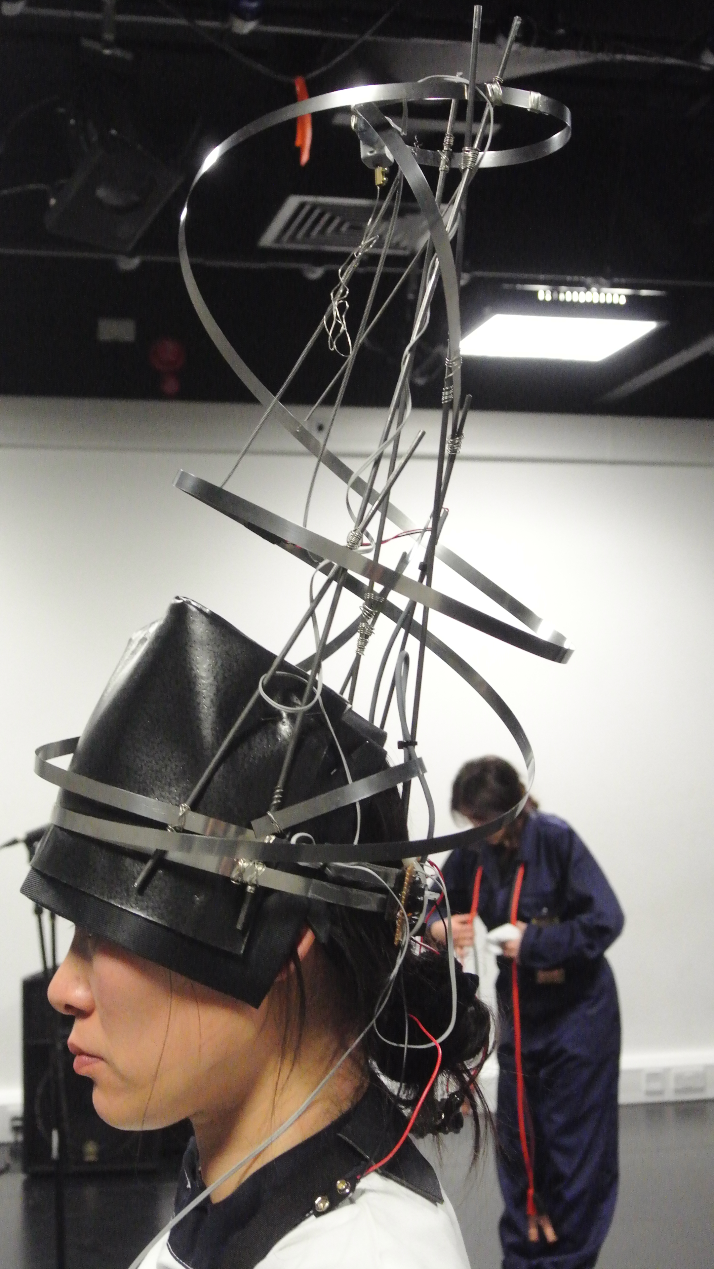
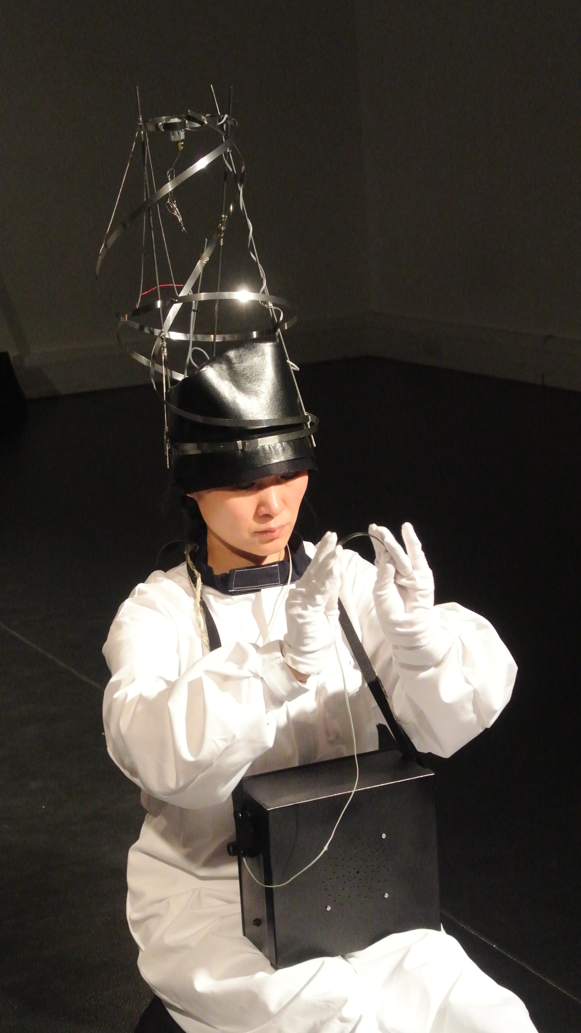
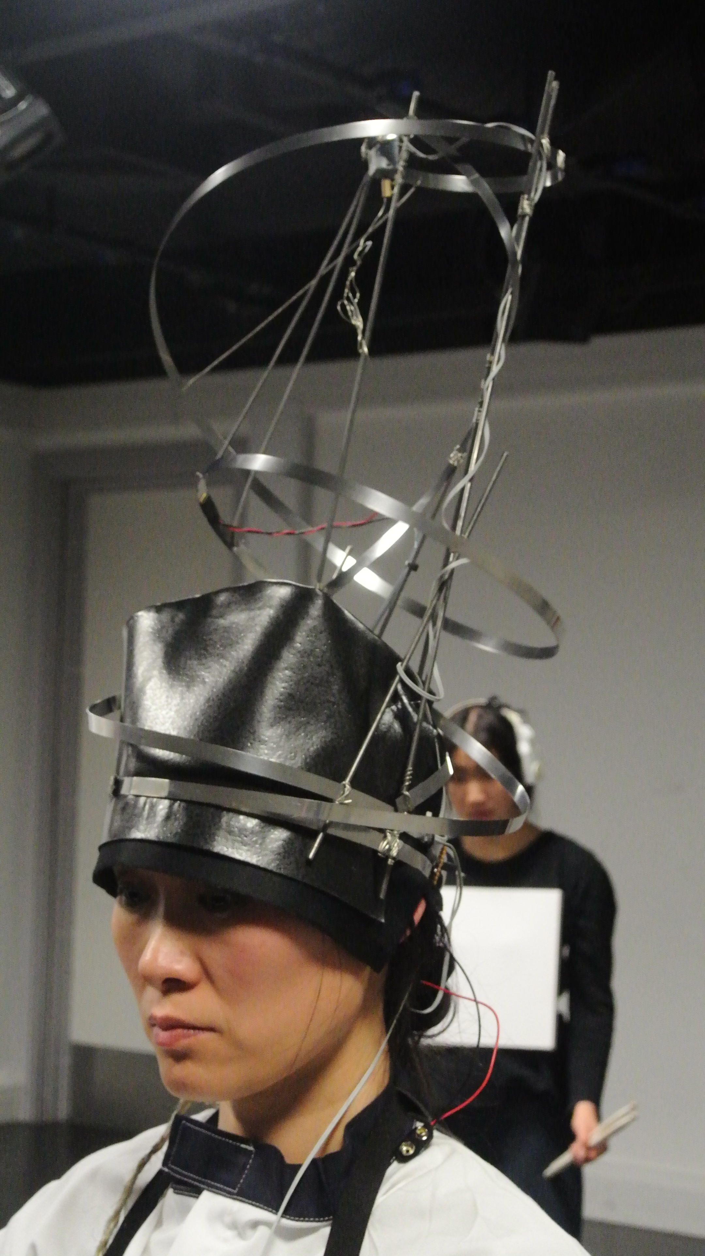
TatlinTower Headdress

Slide 17
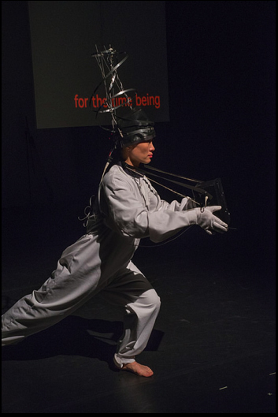

Slide 18
Grave Digger
Kinect Interface
Act 1
A motion sensing input device for Xbox 360 with camera tracking for sonic and visual output

Slide 19
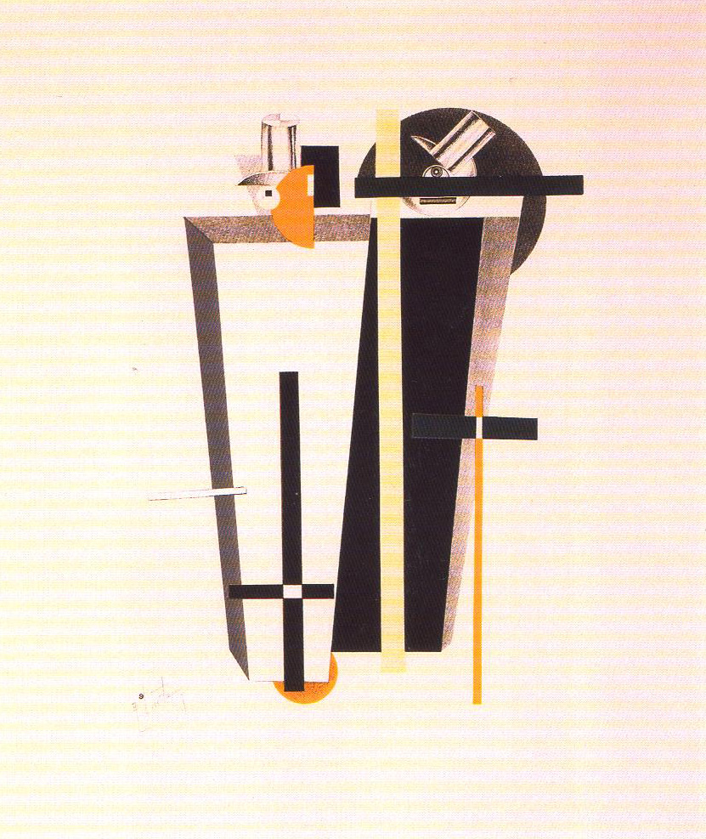
Grave Diggers
Victory over the Sun portfolio
El Lissitzky 1923

Slide 20
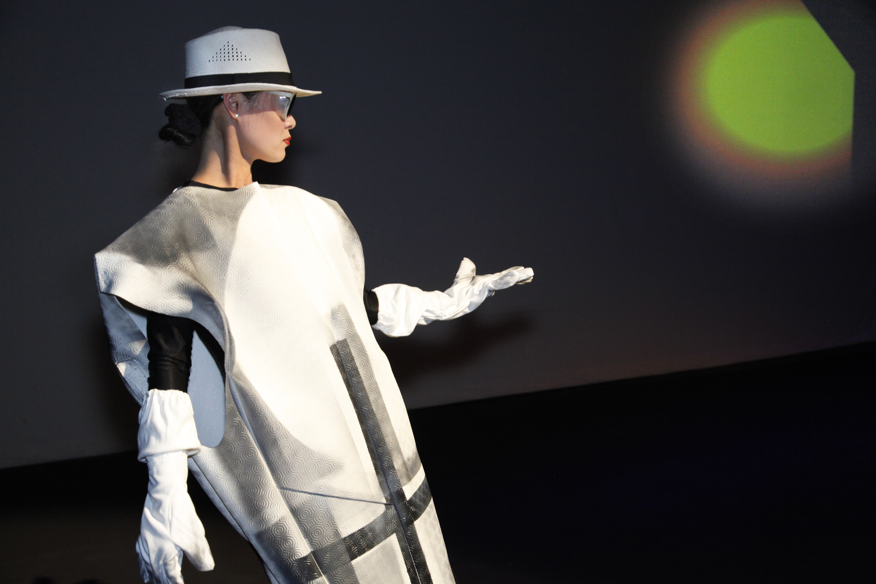

Slide 21
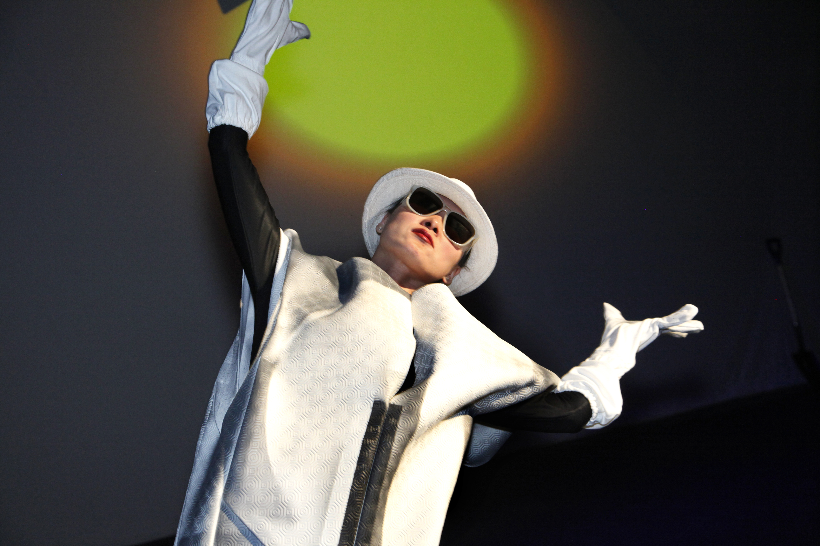
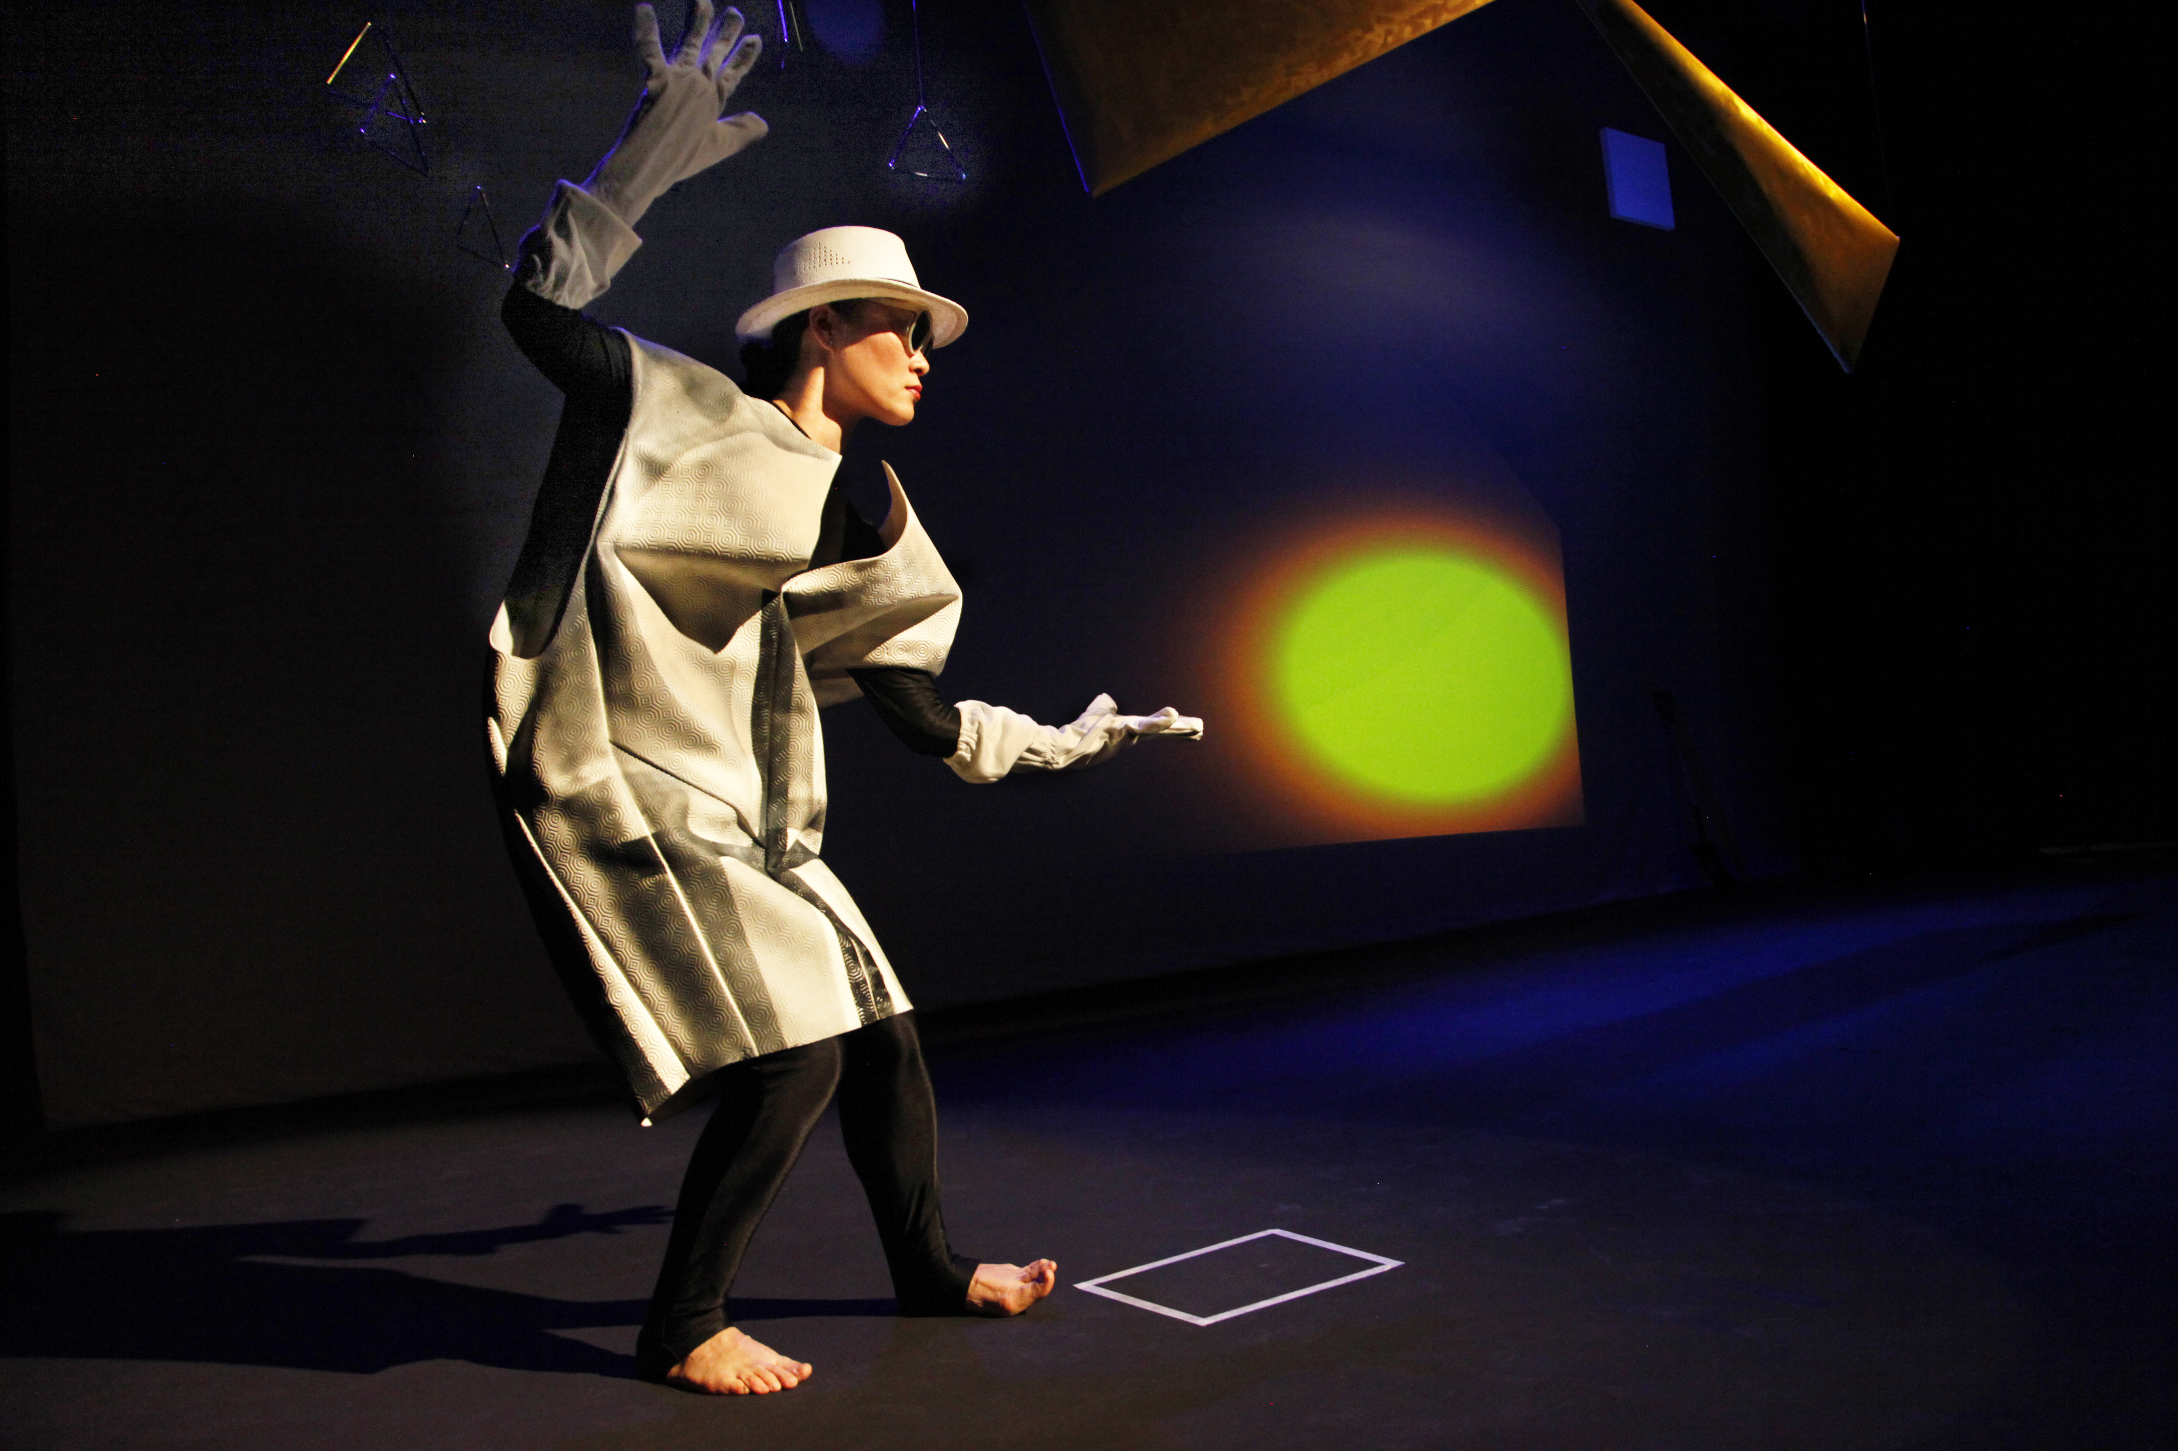
Performed bodily experience with the virtual instrument become real-time manifestations of kinesthetic and motor activity in Ren’s gestural manipulation of image (sun) and soundscape within the responsive environment.

Slide 22
RedMicro Dress
Act 2

Slide 23
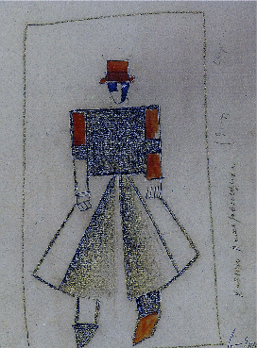
Pall Bearer
Victory over the Sun
Kazimir Malevich (1913)

Slide 24
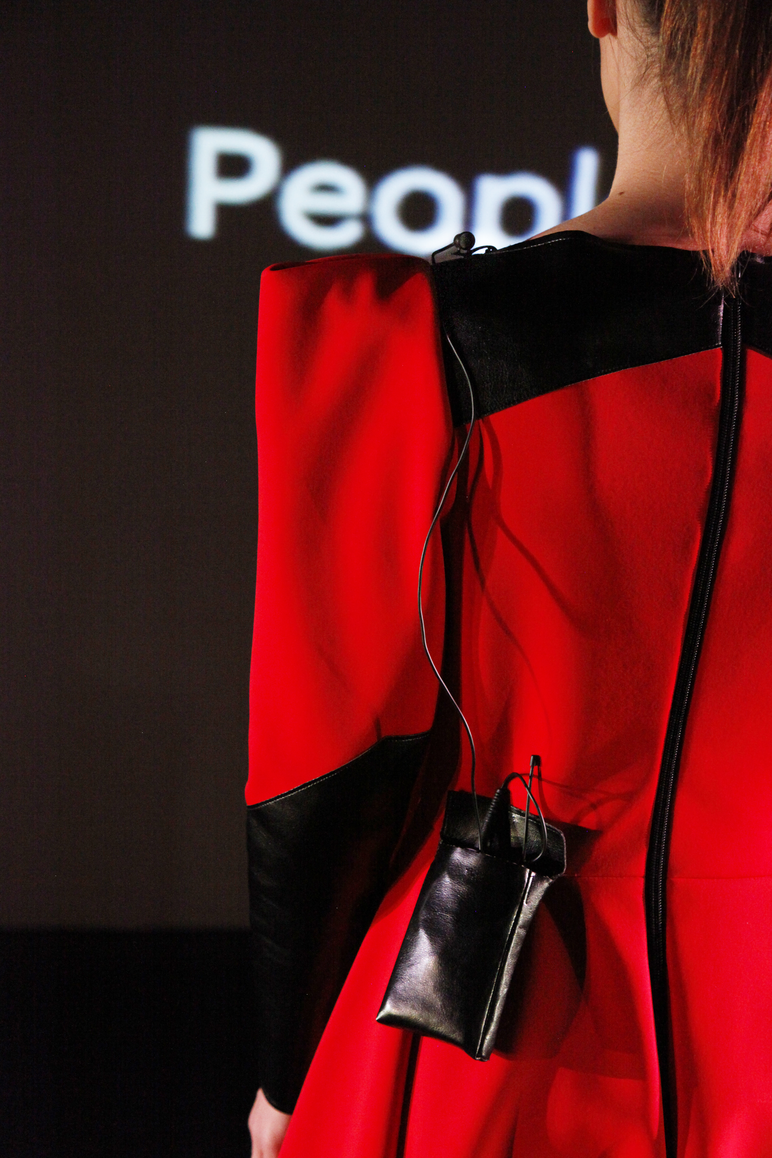

Slide 25
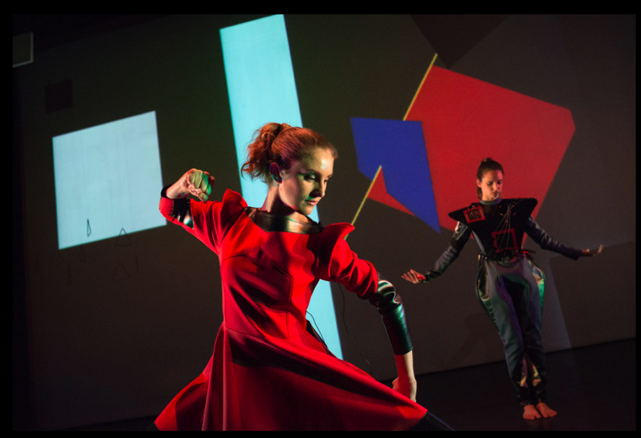

Slide 26
Futurian
Sounding Chest Plate
RedMicro Dress Duet in the 10th Country

Slide 27
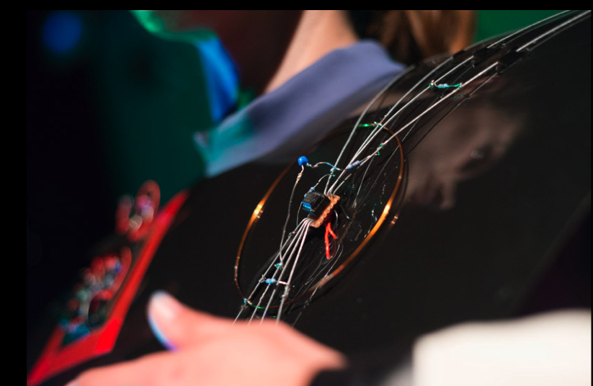

Slide 28
M. Danjoux
Wearables and Choreosonic Gesture
24 March 2015
DAP-Lab: http://brunel.ac.uk/dap / www.danssansjoux.org michele.l.danjoux@googlemail.com

