Slide 1
Alone up Here
December 2018

Slide 2
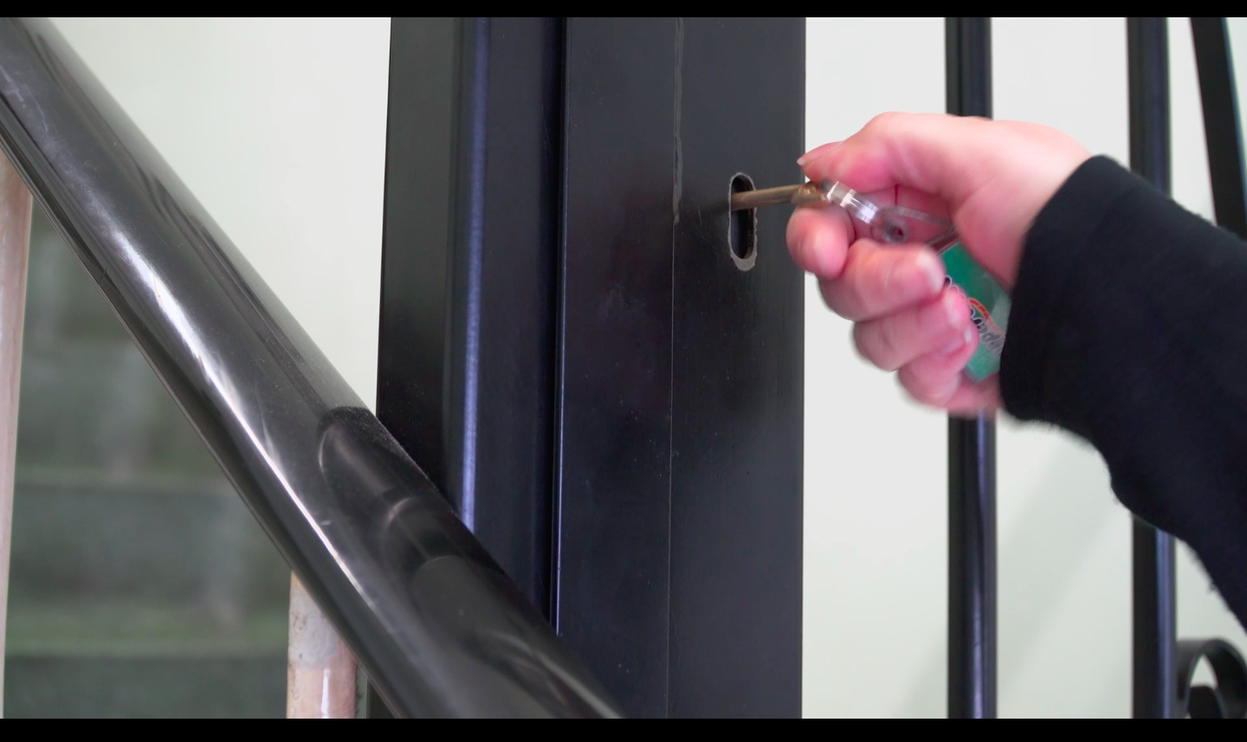
From Alone up There to Alone up Here: Unlocking the Potentials of Lauren’s Movement
Alone up Here (2018)

Slide 3
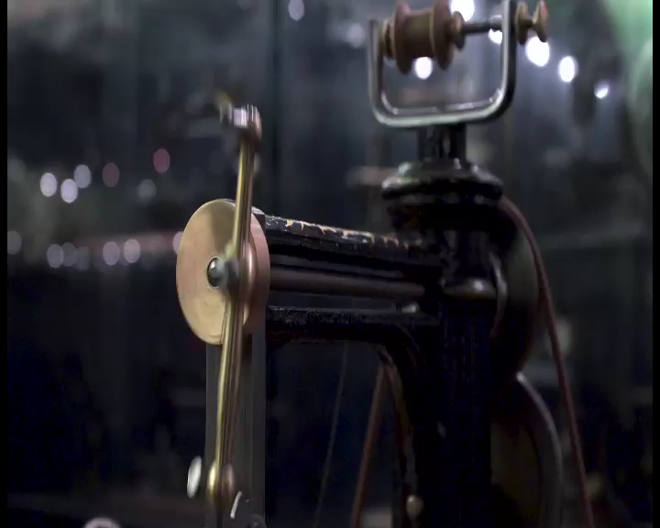
I Am ‘Wired Differently’, I Am ‘High Functioning’, and Will Not ‘Switch Off’: Interpreting the Politics of the Film’s Framing Device
Alone up Here (2018)

Slide 4
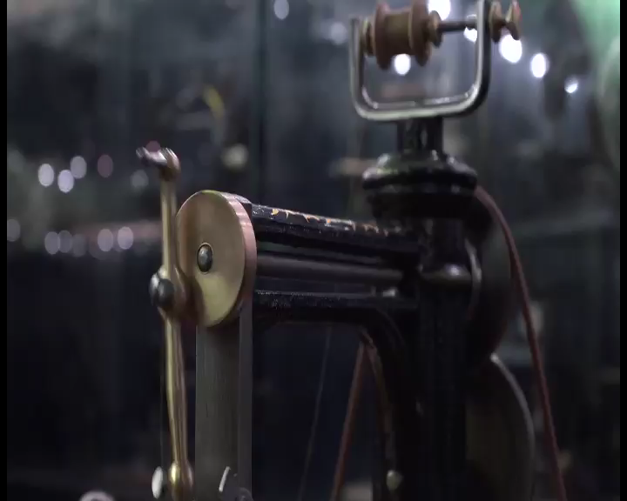
I Am ‘Wired Differently’, I Am ‘High Functioning’, and Will Not ‘Switch Off’: Interpreting the Politics of the Film’s Framing Device #2
Alone up Here (2018)

