Slide 1
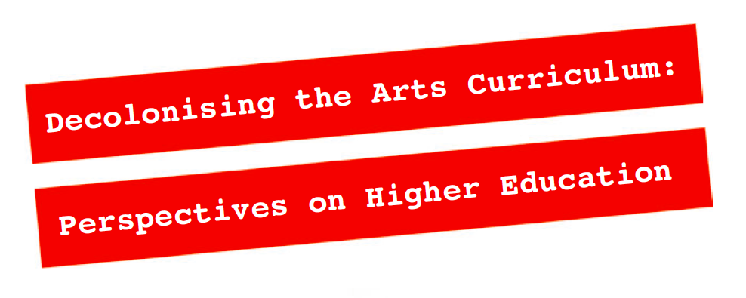

@
Exhibition in the LCC Library from 4 – 31 October 2018
A zine has been co-produced by UAL Teaching and Learning Exchange and the Arts Student Union to bring together diverse perspectives on decolonising the arts curriculum in the UK. An exhibition and series of events will take place at LCC in October.
Weekly events on Thursdays 5-7pm:
4 October ‘Decolonising the Arts Curriculum’ Launch Event, Canteen Ampitheatre and Library
11 October ‘Decolonising the Locale’ Panel Discussion, Room T304
18 October ‘Decolonising the LCC Disciplines’ Panel Discussion, Lecture Theatre A
25 October ‘The Zine as Decoloniser’ Critical Production Event, Library Learning Zone
‘The project of decolonisation is less about seeking out authentic culture as such but more about the opening up of creative spaces to facilitate the production of culture informed by indigenous thinking and doing’
– Gurnam Singh, 2018
For more information and updates: http://decolonisingtheartscurriculum.myblog.arts.ac.uk/

