Slide 1

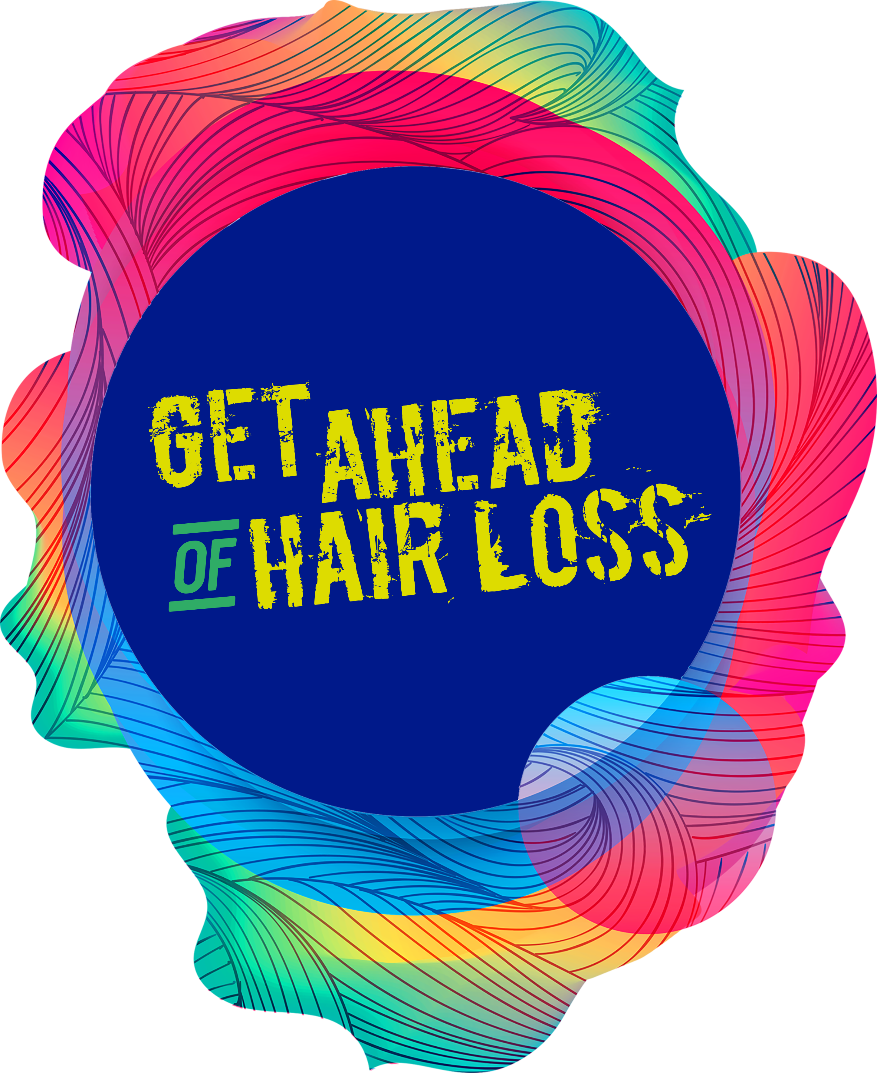
Natural treatments for hair growth – do any work?
Dr. Gill Westgate
G. Daniels* , S. Akram*, G. E. Westgate† and S. Tamburic*
Can plant-derived phytochemicals provide symptom relief for hair loss? A critical review
*Cosmetic Science Research Group, University of the Arts, London

Slide 2
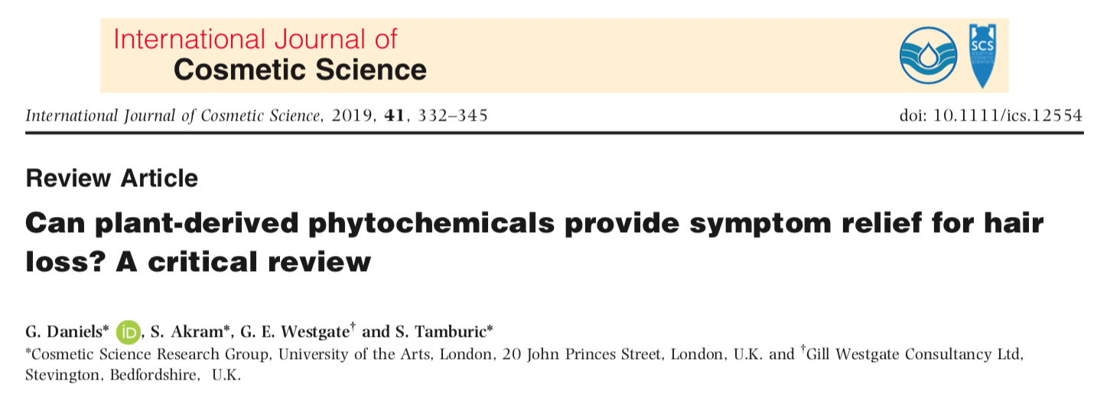
Natural treatments for hair growth – do any work?
G. Daniels* , S. Akram*, G. E. Westgate† and S. Tamburic*
Can plant-derived phytochemicals provide symptom relief for hair loss? A critical review
*Cosmetic Science Research Group, University of the Arts, London

Slide 3

Hair biology basics

Slide 4
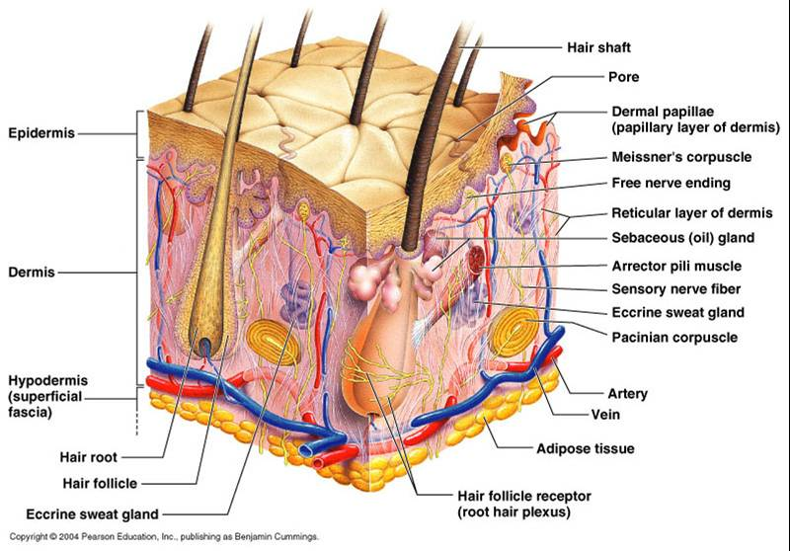

Slide 5
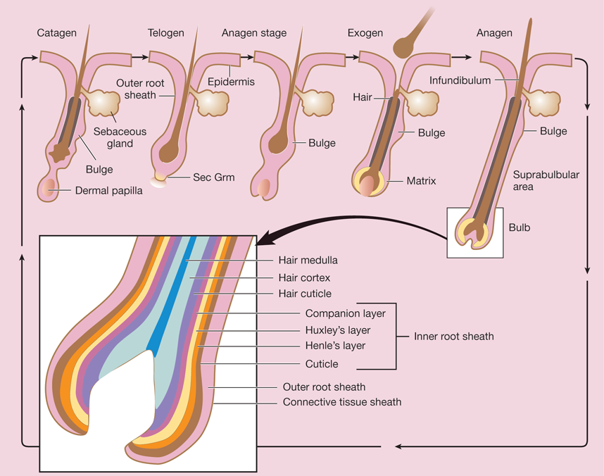
Hair Grows in a Cycle of activity and rest
At any given time, between 80% and 90% of the HFs on a healthy scalp are in the stage of active hair fibre growth
Anagen
Excess shedding happens when more follicles exit the hair cycle than usual and enter a resting stage
Telogen
Notes:
Hair loss involves alteration to the hair cycle or change to the size of the follicle that affects visible hair,

Slide 6




Botanicals to treat hair loss?
We need to consider………
Which type of hair loss are we addressing
How to get proof that products really work
Topical vs. dietary options
Be aware of the sources of information!
Scientific Literature/www/Folklore/stories/testimonials/history/culture

Slide 7
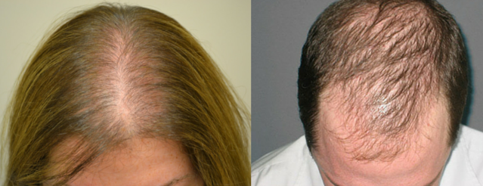
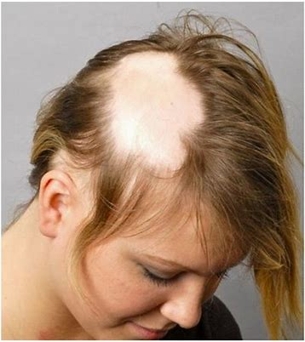
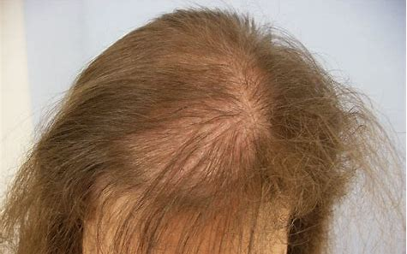
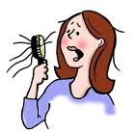
Which Type of Hair Loss
Androgenic alopecia
Alopecia Areata
Telogen Effluvium
Symptoms
Pattern Hair Loss
Patchy to total hair loss
Diffuse hair loss
Hair Shedding and scalp show through
Notes:
It is proposed that ‘hair loss’ or ‘thinning’ is a multi-factorial perception of hair density, fibre diameter, hair colour and degree of curl, which together contribute to the overall perception of scalp coverage. Diagnosing hair loss cause can be tricky. Knowing when it’s a medical issue is even more tricky….and we know GPs and Dermatologists do not have enough time or knowledge…
The advice is to leave alone, to wait for it to recover or to try something with clinical proof

Slide 8
How botanicals work for hair
Anti-androgen
Anti-oxidant
Anti-inflammatory
Cell proliferator
Inhibitors of 5 alpha reductase
Maintain hair follicles in anagen
Free radical scavengers
Maintain Healthy cells in the follicle and scalp
Blocks inflammatory mediators
Promotes healthy cell growth

Slide 9
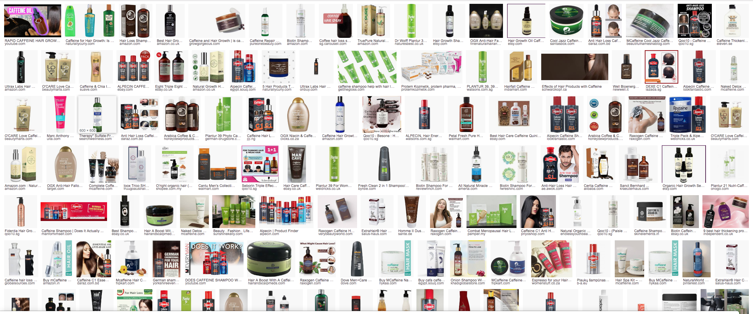
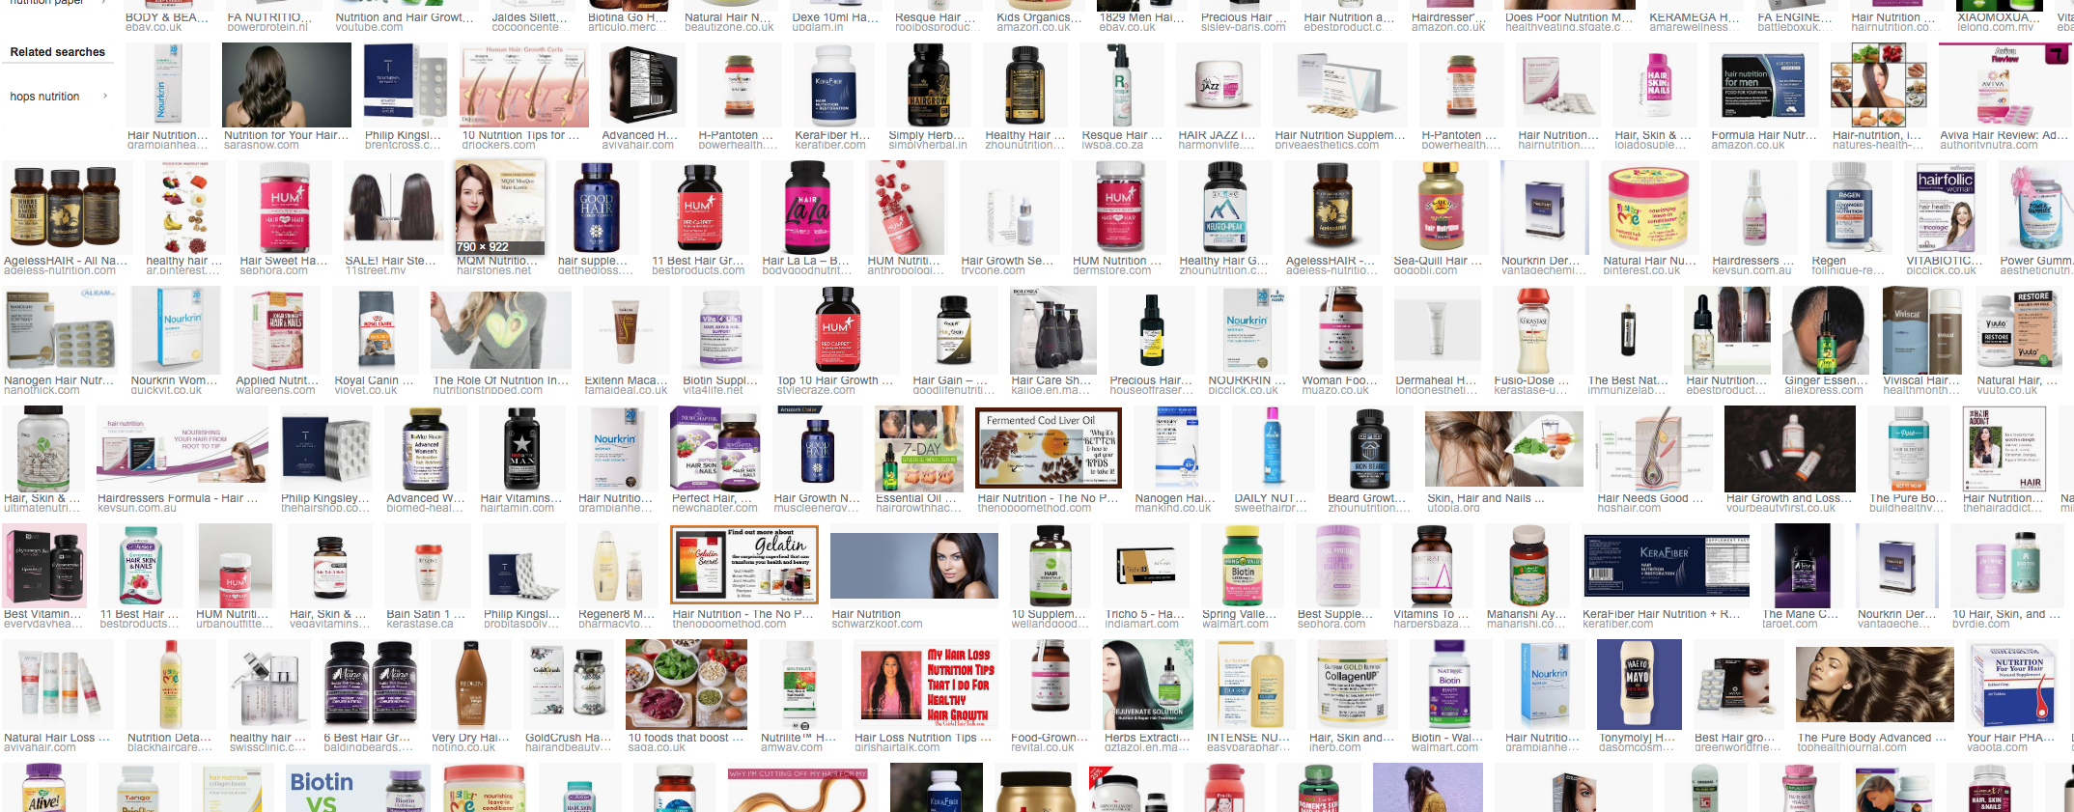
Natural plant derived ingredients are used in:-
Topical Cosmetic Treatments
NutriCosmetics
Highly Crowded
Very Fragmented
Relatively Few Ingredients
Notes:
Phytochemicals are often the sought-after choice of hair loss treatment; because of the appeal such actives hold with the consumer/ clinical patient and their non-drug status. Furthermore, many phytochemicals are recogniszed for their role in traditional plant-based treatments of skin and hair conditions, and a body of scientific lit- erature related to their medicinal applications may already exist.

Slide 10
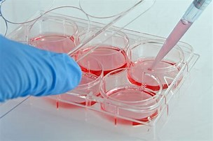
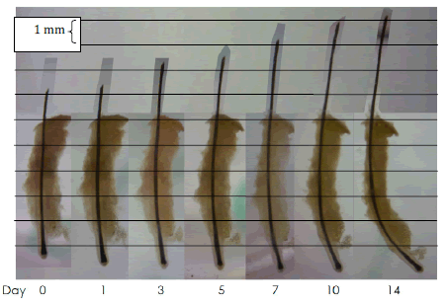
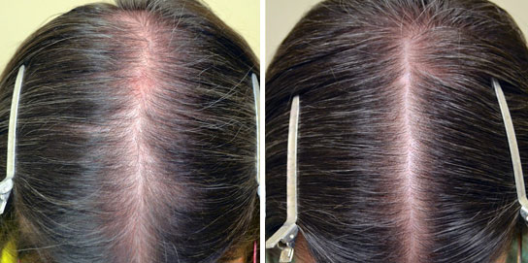
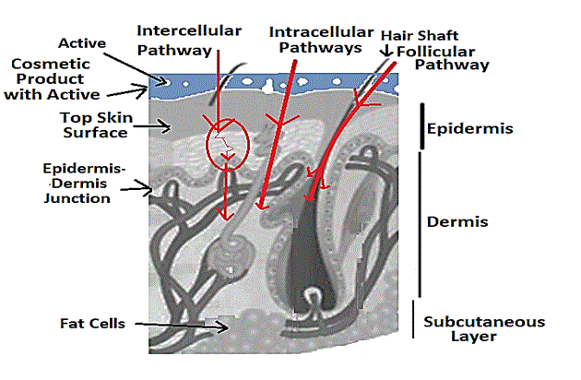
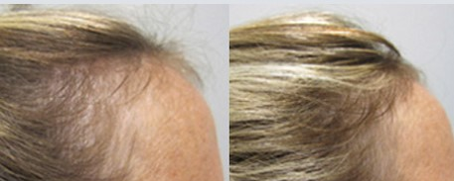
Important to test if they work
Dermal Papilla cells
Hair follicles ex vivo
Clinical Testing
Skin/hair penetration
Notes:
https://bioaccent.org/nanotechnology/img/nanotechnology18-g001.gif
http://www.msfullhair.com/rogaine-for-women/
https://media.springernature.com/lw785/springer-static/image/chp:10.1007%2F978-3-319-26594-0_114-1/MediaObjects/76725_0_En_114-1_Fig9_HTML.gif
https://www.omicsonline.org/articles-images/clinical-experimental-dermatology-hair-follicle-4-182-g002.png
http://www.dermatology.org/hairnailsmucousmembranes/graphics/jpegs/19.jpg

Slide 11
Phytochemicals for hair and how they work

Slide 12
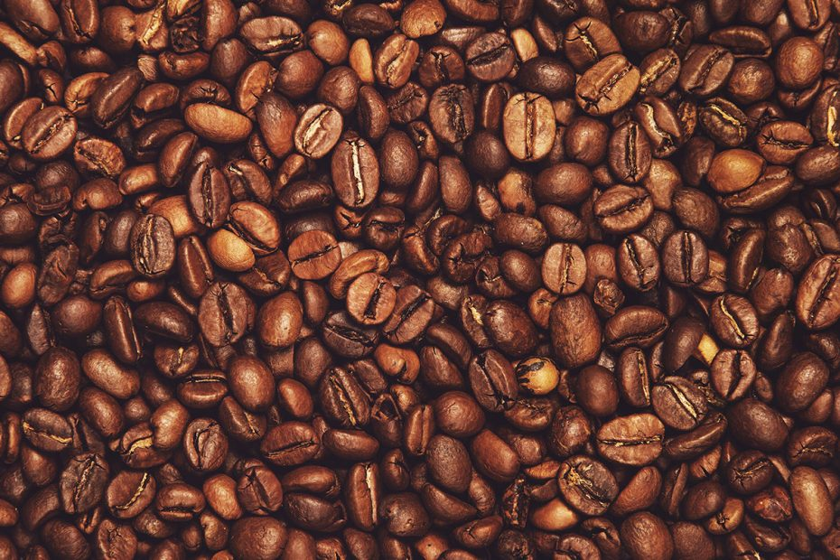
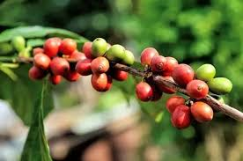
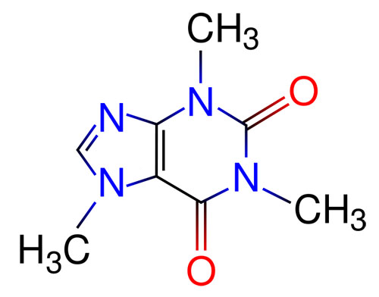
Caffeine
Dermal Papilla cells
Anti-androgen
Anti-oxidant
Anti-inflammatory
Coffea arabica
Hair follicles ex vivo
Skin/hair penetration
Clinical Testing
Broad range of evidence available in the peer reviewed literature…possibly the most researched of all the phytochemicals
Notes:
Caffeine is a purine alkaloid, derived from several sources including coffee beans, tea leaves and cocoa and kola nuts
Possibly the most well researched of the phytochemicals

Slide 13
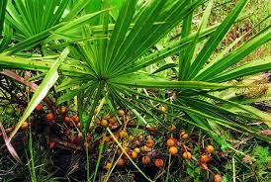
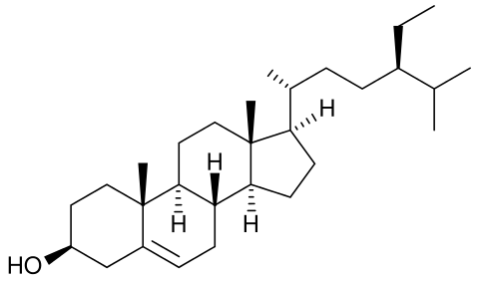
Saw Palmetto
Dermal Papilla cells
Serenoa repens
Hair follicles ex vivo
Anti-androgen
Clinical Testing
Lots of evidence available in the peer reviewed literature…probably the most used of the phytochemicals. Topical and dietary.
Notes:
There are two types of herb palmetto supplements available in the market. One type is dried saw palmetto berries and the other type saw palmetto extract in the form of tablets. Recommended dose is 160mg twice a day. Although saw palmetto is listed in the US pharmacopoeia, it falls under the guidelines for food supplements. It is not regulated by the Federal drug authority FDA.

Slide 14
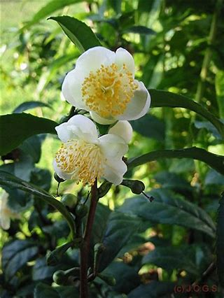
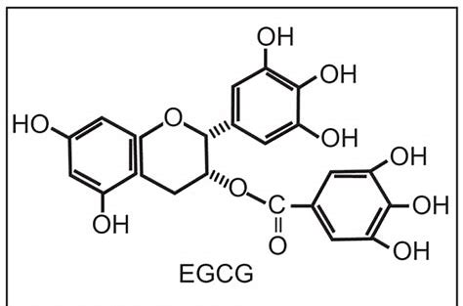
Polyphenol ECGC
Dermal Papilla cells
Camellia sinensis
Hair follicles ex vivo
Anti-oxidant
Anti-inflammatory
Cell proliferator
Less evidence available in the peer reviewed literature. Mostly in vitro data.
Notes:
Caffeine is a purine alkaloid, derived from several sources including coffee beans, tea leaves and cocoa and kola nuts

Slide 15
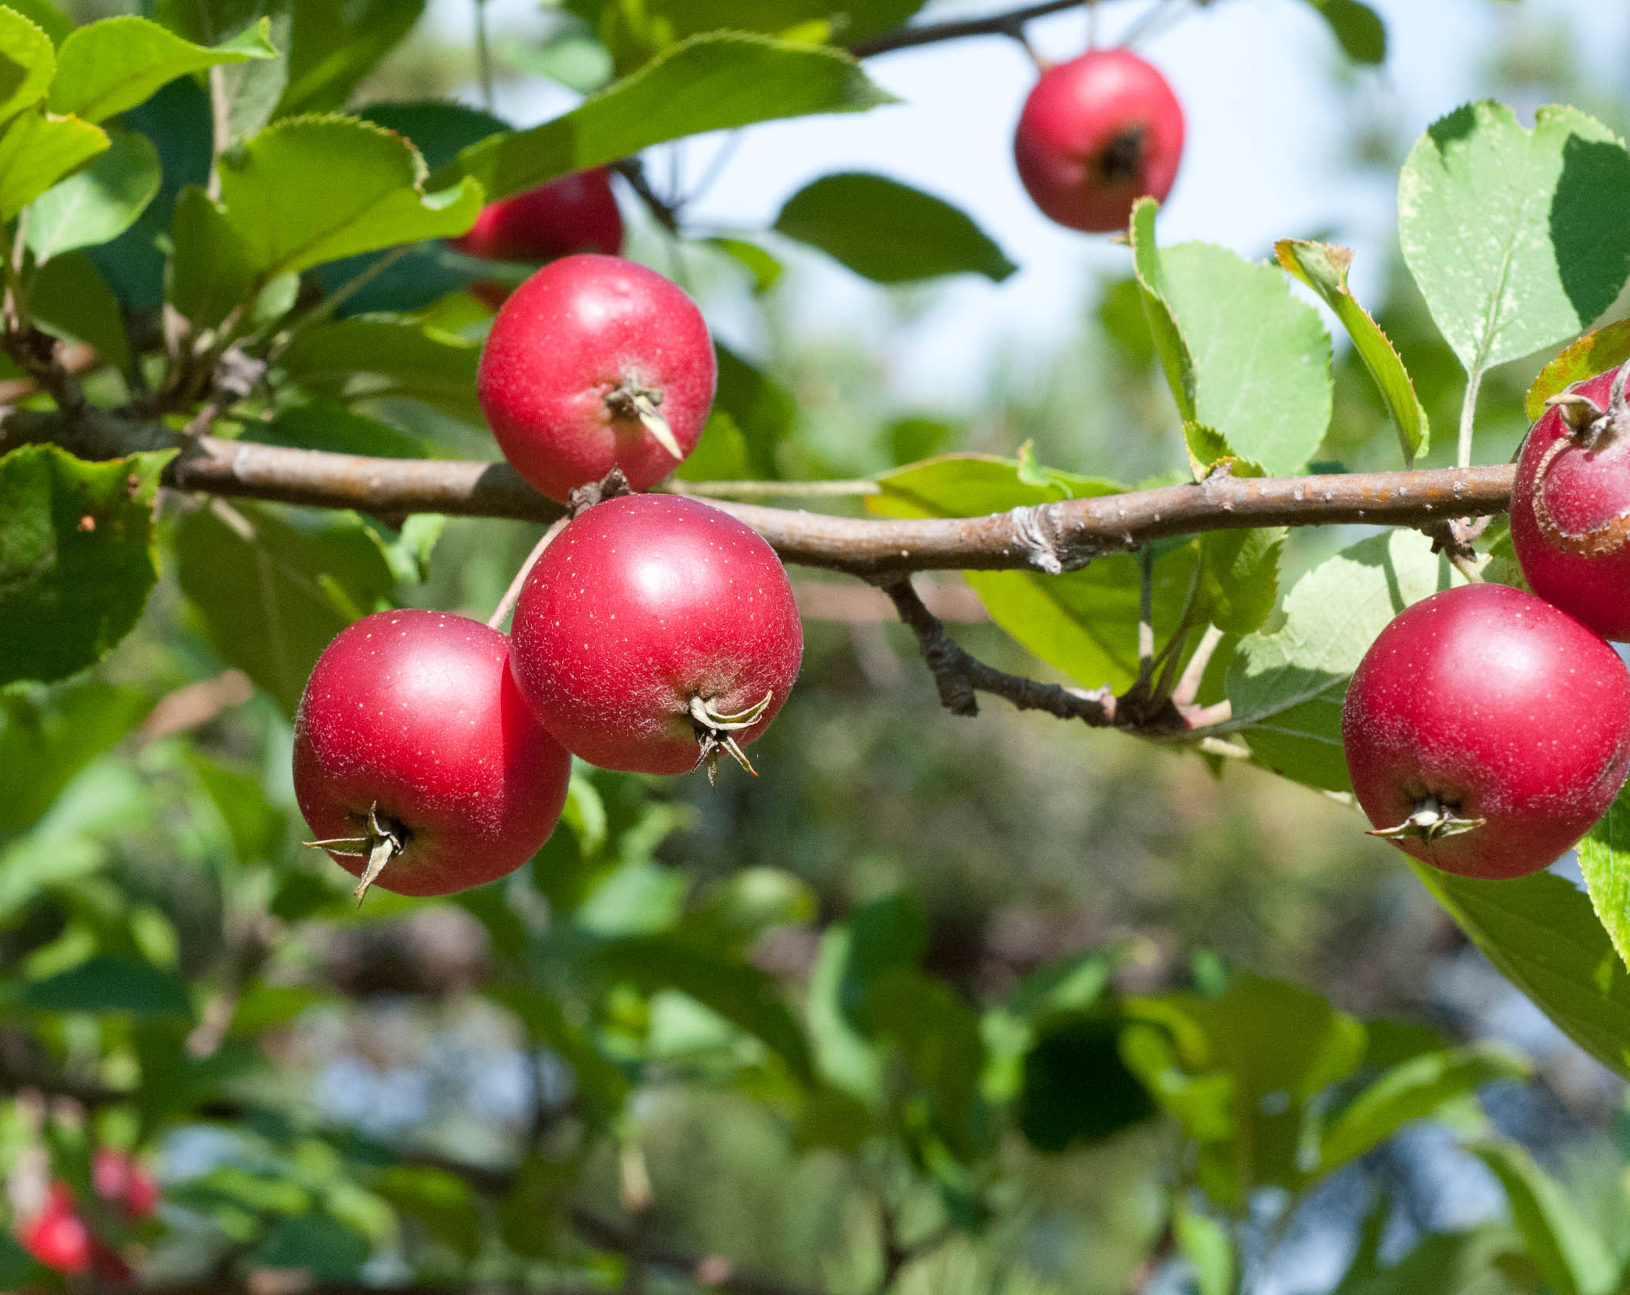
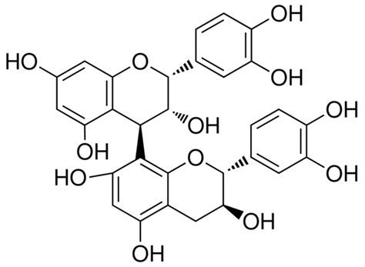
Polyphenol Procyanidin B2
Dermal Papilla cells
Malus pumila
Anti-oxidant
Anti-inflammatory
Clinical Testing
Less evidence available in the peer reviewed literature. Mix of in vitro and clinical data.
Notes:
Caffeine is a purine alkaloid, derived from several sources including coffee beans, tea leaves and cocoa and kola nuts

Slide 16
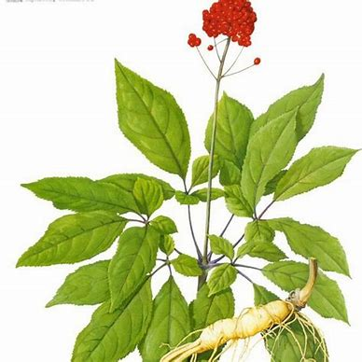
Ginsenosides
Dermal Papilla cells
Panax ginseng
Anti-androgen
Cell proliferator
Least evidence available in the peer reviewed literature. Mostly in vitro data. Strong cultural influence from Asia
Notes:
Caffeine is a purine alkaloid, derived from several sources including coffee beans, tea leaves and cocoa and kola nuts

Slide 17
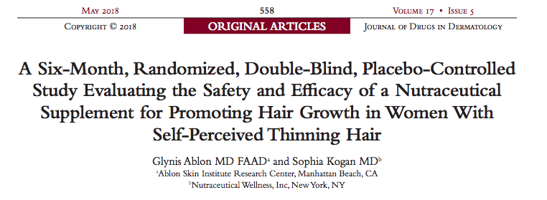
Conclusions
Study designs are very diverse
The best companies publish their clinical and research data; many don’t.
Lack of placebo controls in most clinical studies
Too few subjects included
Un blinded studies – open lable
Poor control of active species in product in studies
Unpublished studies used for claims support
Some good evidence provides support for botanicals as an option for hair loss

Slide 18

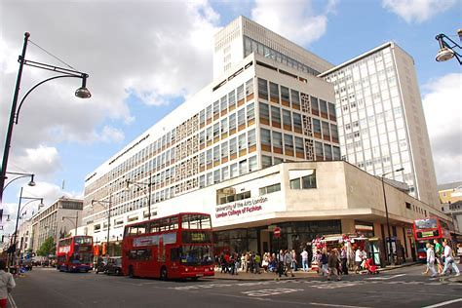
Acknowledgements
Sabih Akram
Gabriela Daniels
Danka Tamburic
THANK YOU

