Slide 1
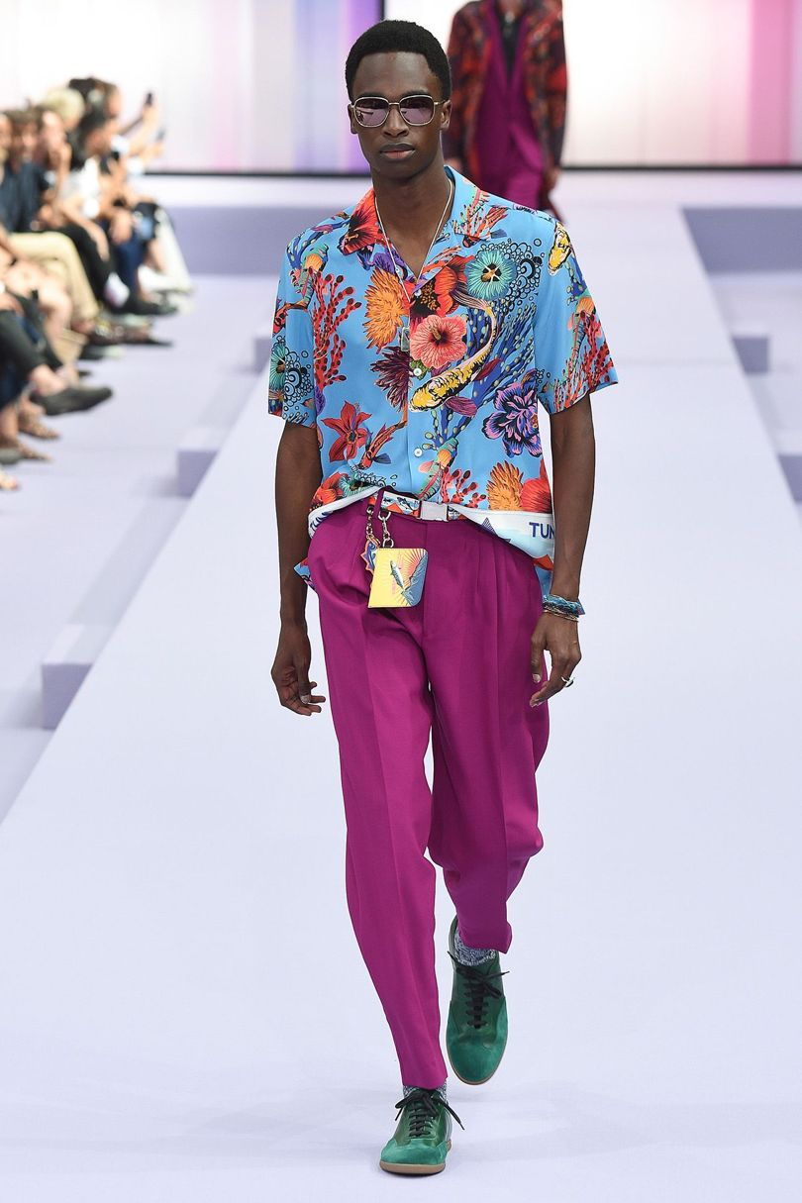
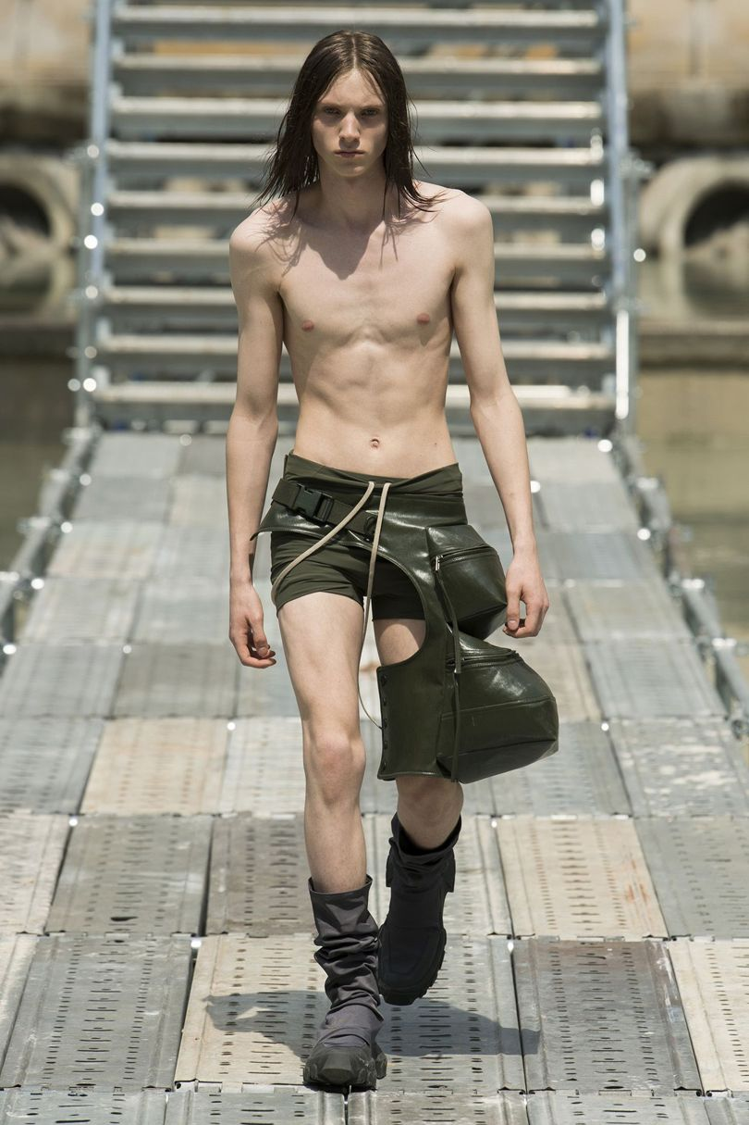
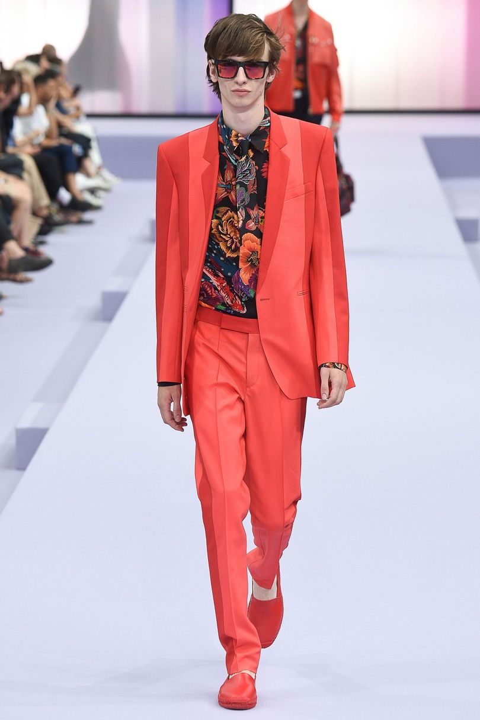
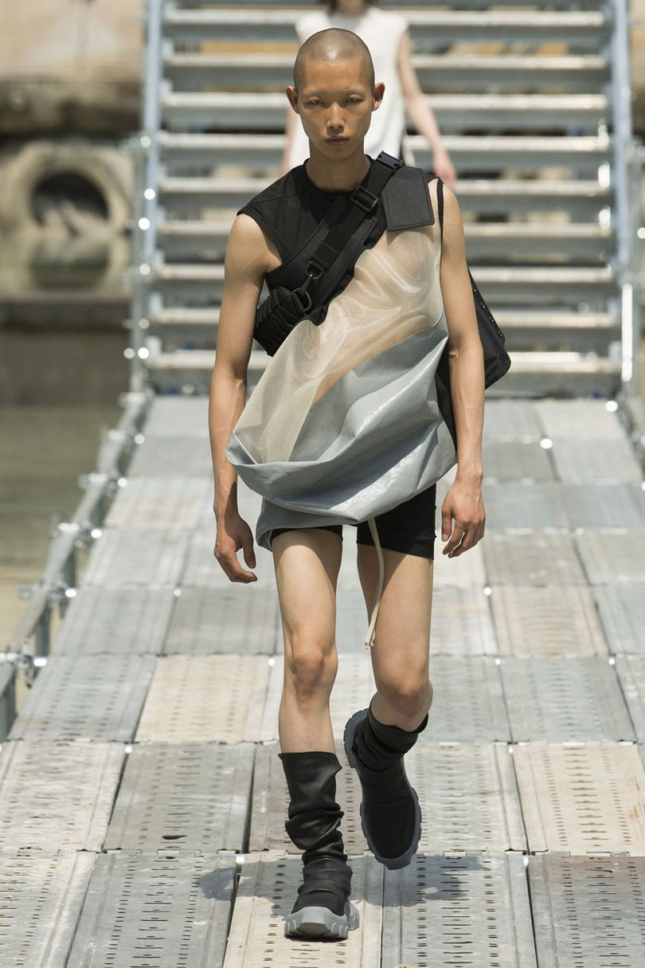

Decoding the contested aesthetics of contemporary men’s fashion
Jay McCauley Bowstead
Paul Smith S/S 18, Rick Owens S/S 18.

Slide 2
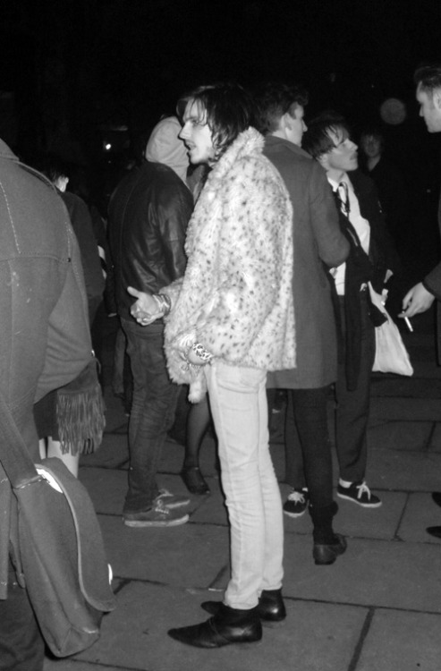
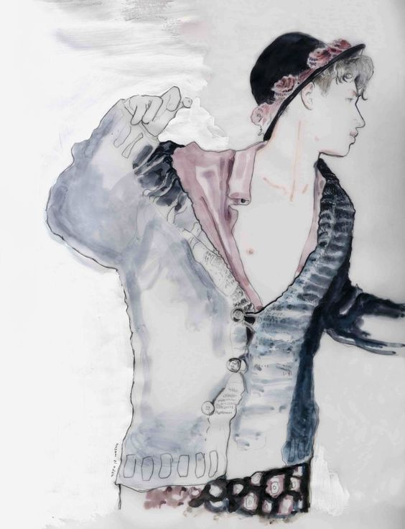
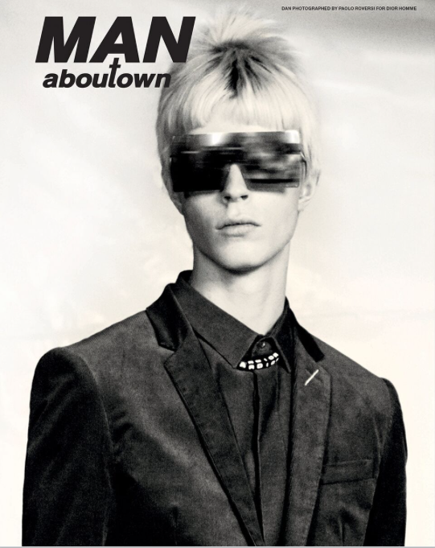
Lookatthisfuckinghipster.com, Husam el Odeh illustration, Man About Town

Slide 3
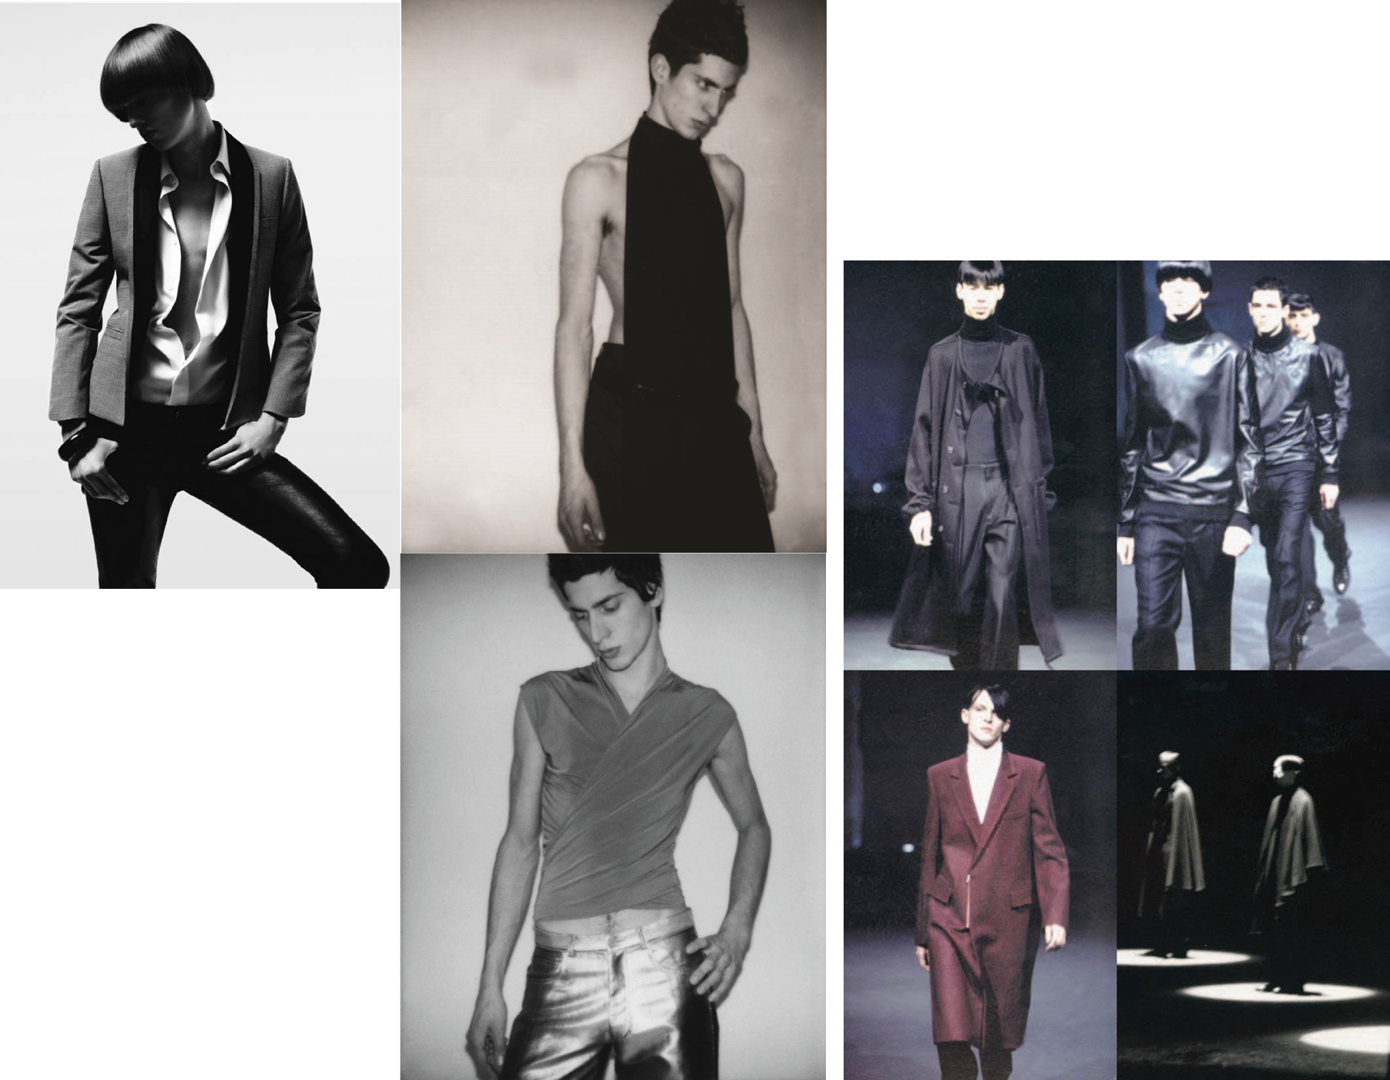
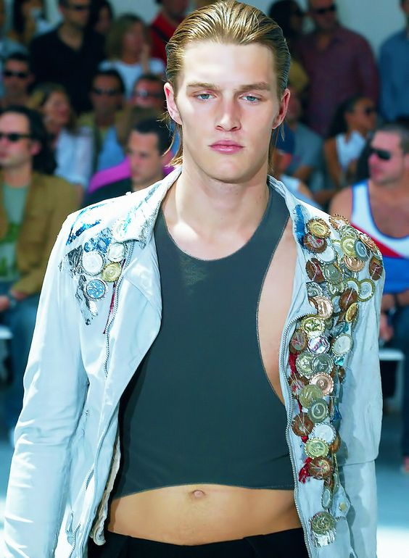
hedi slimane – dior homme s/s 07, hedi slimane – ysl a/w 01/02, raf simons a/w 99/00, helmut lang s/s 04.

Slide 4
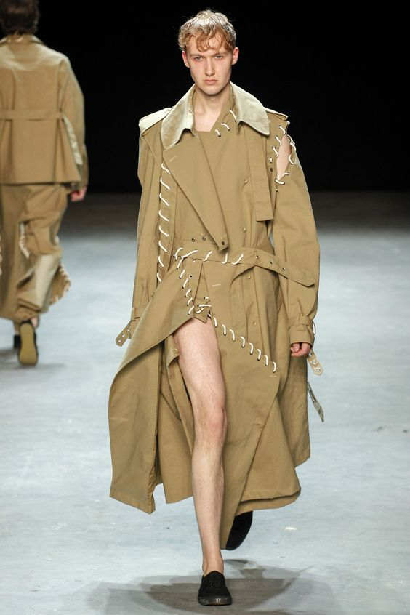
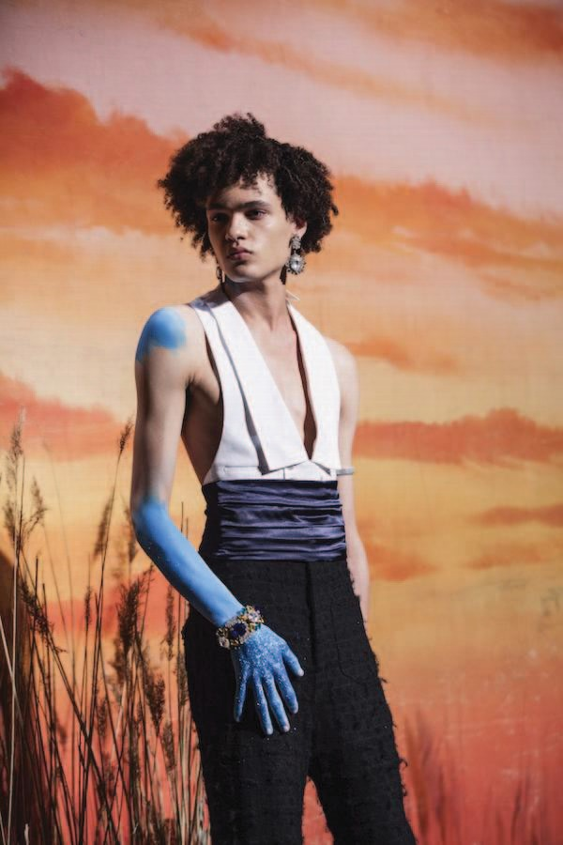
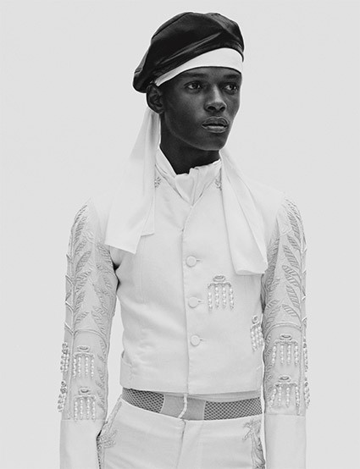

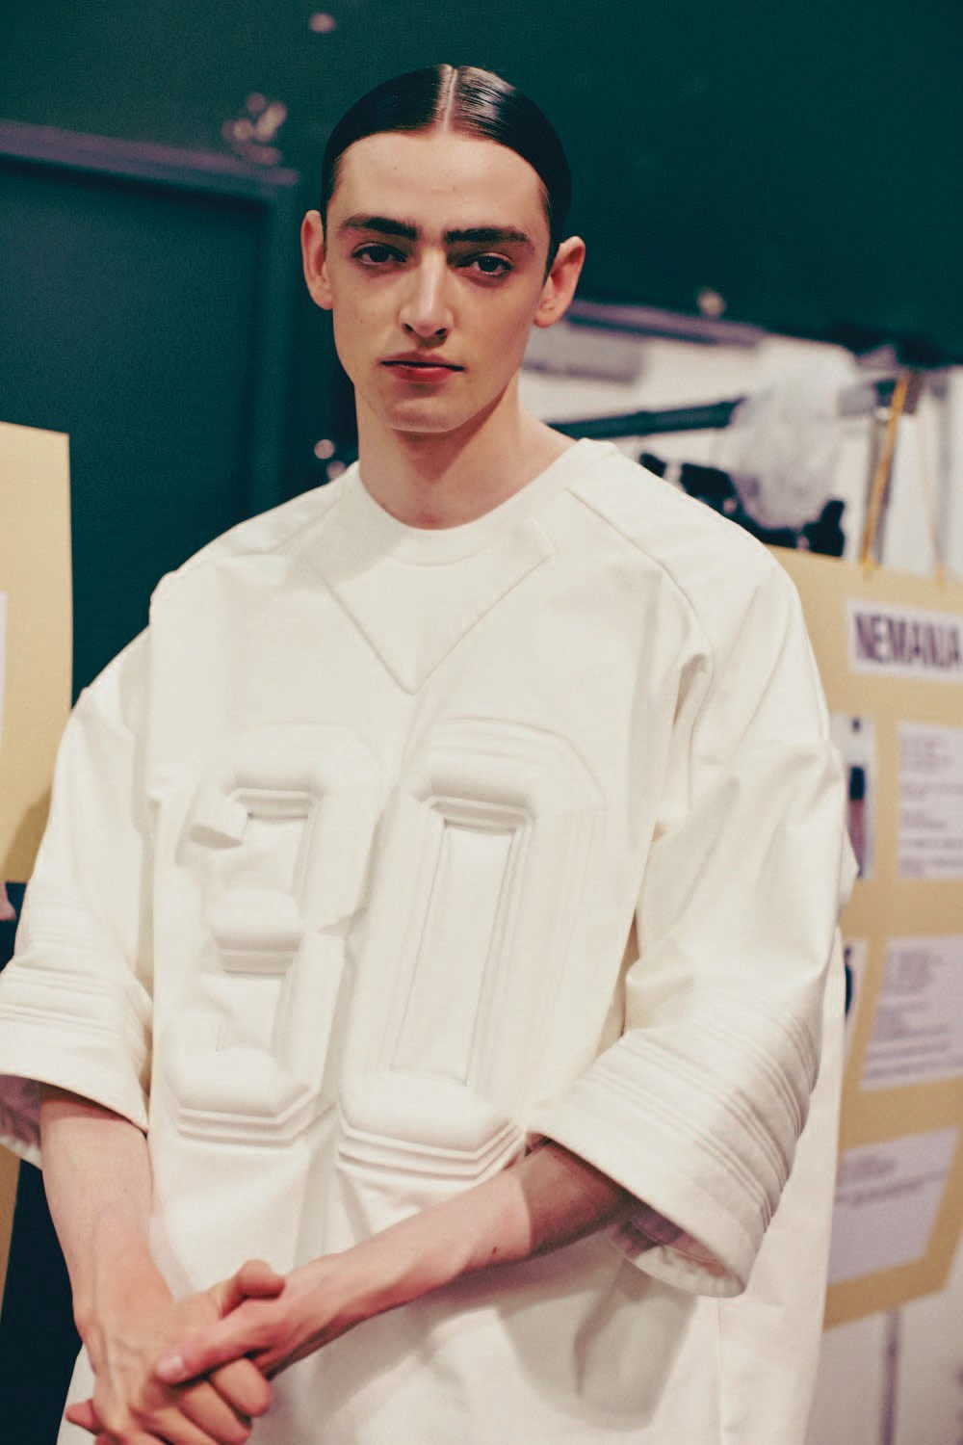
craig green s/s 17, grace wales bonner a/w 15,
grace wales bonner s/s 17, juun j. s/s 14.

Slide 5

