Slide 1
Replacing Dimethicone as a binder in pressed powders with vegetable-derived alternatives
Diogo Baltazar, Elise Velkeneers and Slobodanka Tamburic
Cosmetic Science Research Group, London College of Fashion, London, UK

Slide 2
Introduction and Aim
Growing consumer scepticism regarding silicones has prompted the of demand silicone-free products formulated with materials from natural and sustainable sources;
The industry has extracted and refined natural vegetable-based emollients as alternatives, but there is a lack of comparative data in the literature.
Aim of this project:
To evaluate the use of sustainable, vegetable-derived binders in pressed powders against a silicone standard, via an inter-and intra-formulary study using different binders and press strengths.

Slide 3
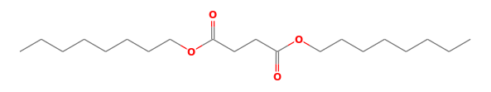
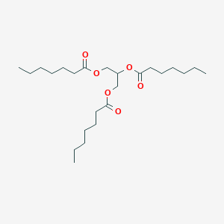
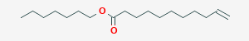
Materials
Base formulation ingredients:
  Talc, Methylparaben, Propylparaben
  Pigment: CI 77510 (Ferric Ferrocyanide; Prussian Blue; Iron Blue)
Binders
  Dimethicone (DM)
  Vegetable-based binders:
    Diisooctyl Succinate (DOS)
    Triheptanoin (TH)
    Heptyl Undecylenate (HU)
DOS
TH
HU
Fig. 1 Molecular structure of vegetable-based binders

Slide 4
Methods: formulation
Phase A – milling;
Phase B – add to Phase A + milling;
Bulk powder left to stand for 24 h;
Pressing @ 1000 or 2000 psi
Table 1. Pressed powder formulations
Phase | INCI | % (w/w)
A | Talc | Ad 100%
 | CI 77510 | 10.00
 | Methylparaben | 0.20
 | Propylparaben | 0.10
Binder variables:
B | Dimethicone | 3.0 - 6.0 - 9.0
 | Diisooctyl Succinate | 3.0 - 6.0 - 9.0
 | Triheptanoin | 3.0 - 6.0 - 9.0
 | Heptyl Undecylenate | 3.0 - 6.0 - 9.0

Slide 5
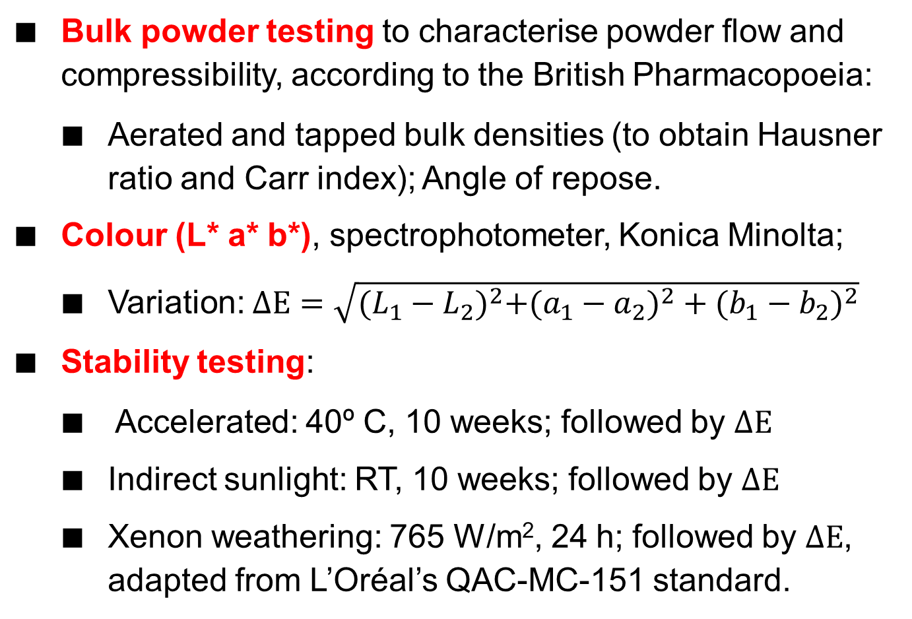
Methods: testing bulk powder and colour
Bulk powder testing to characterise powder flow and compressibility, according to the British Pharmacopoeia:
  Aerated and tapped bulk densities (to obtain Hausner ratio and Carr index); Angle of repose.
Colour (L* a* b*), spectrophotometer, Konica Minolta;
  Variation: $ΔE=\sqrt{{(L_{1}−L_{2})}^{2}+{{(a_{1}−a}_{2})}^{2}+{(b_{1}−b_{2})}^{2}}$
Stability testing:
  Accelerated: 40º C, 10 weeks; followed by $ΔE$
  Indirect sunlight: RT, 10 weeks; followed by $ΔE$
  Xenon weathering: 765 W/m², 24 h; followed by $ΔE$, adapted from L’Oréal’s QAC-MC-151 standard.

Slide 6
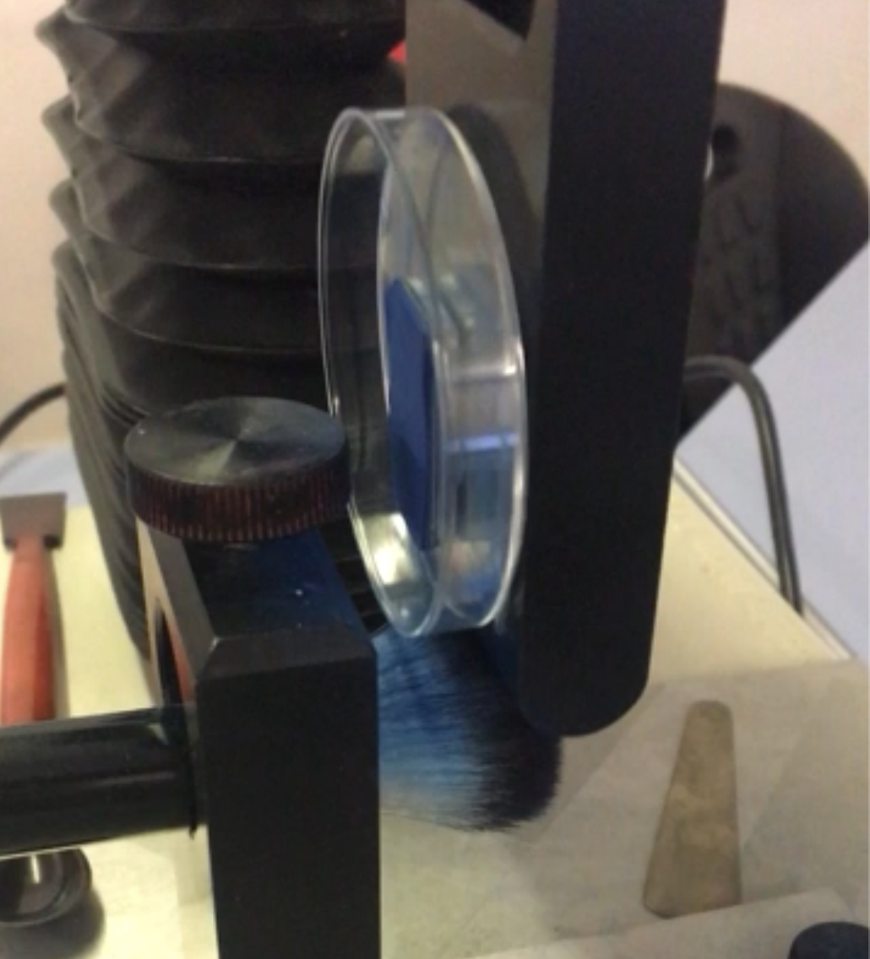
Methods: testing compact powder
Drop test: 30 cm drop onto a flat surface, 3 times; adapted from ASTM D5276;
Hardness: 2 mm probe with a TA.XTplus Texture Analyser (Stable Micro Systems, UK); Eyeshadow Test Protocol and using the Exponent software.
Payoff – new method:
  Weighing, followed by testing:
    TA.XTplus Texture Analyser;
    Lipstick cantilever rig;
    Makeup brush;
  10 passes, followed by weighing.
Fig. 2 Payoff method with a cantilever rig on the TA.XTplus

Slide 7
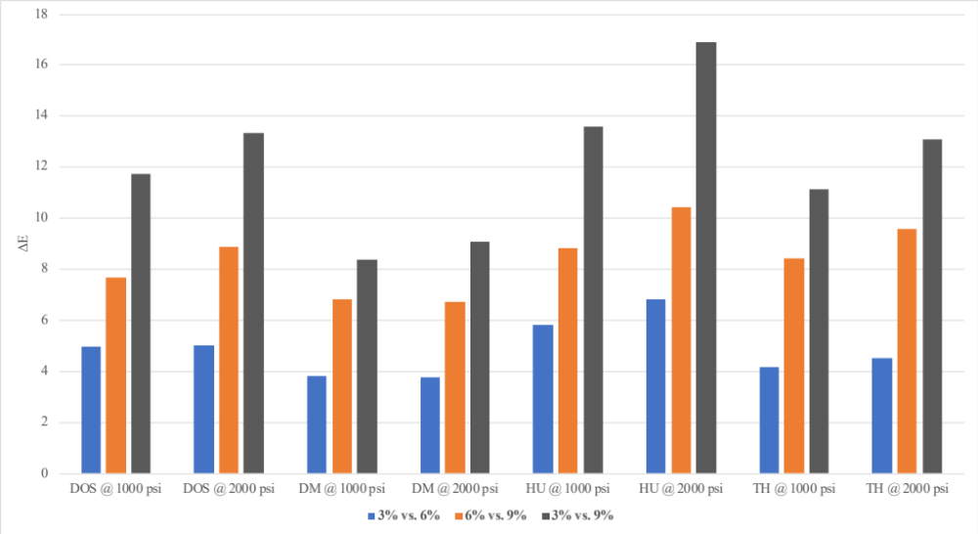

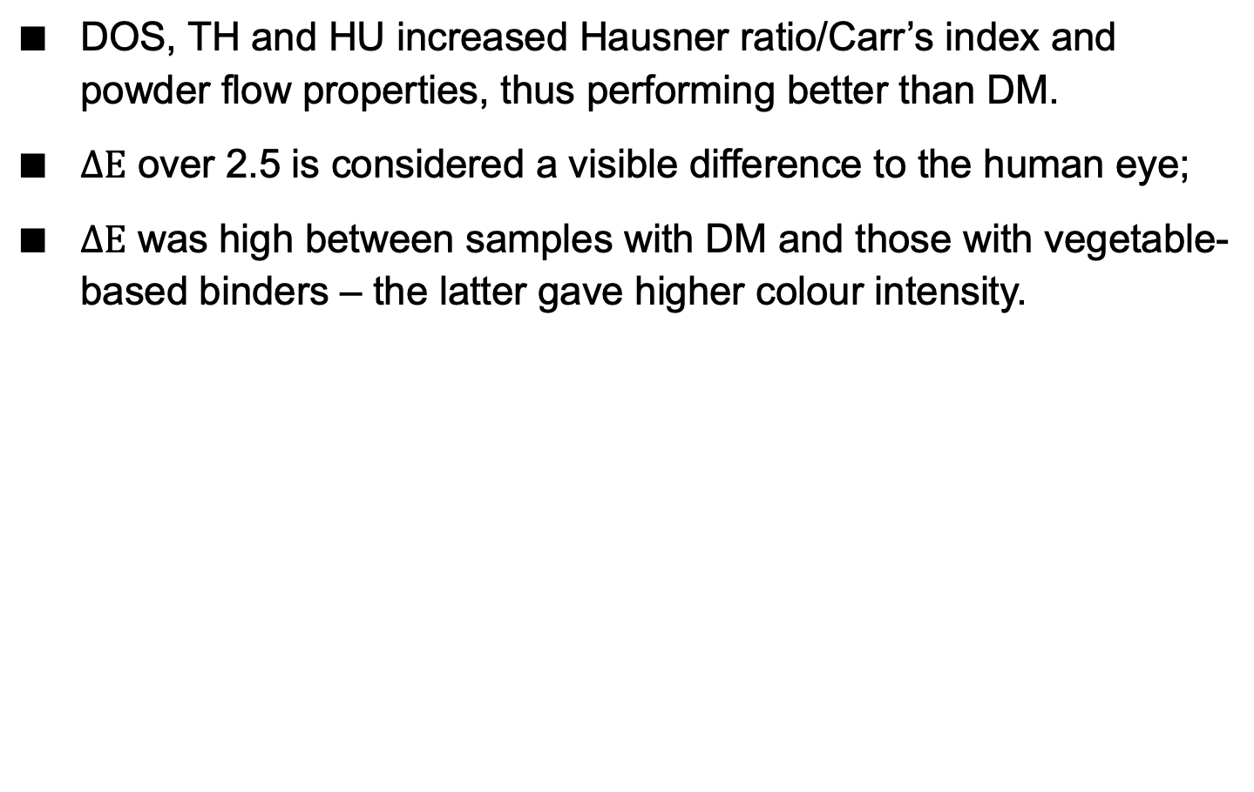
Results – $ΔE$ vs formulation variables
DOS, TH and HU increased Hausner ratio/Carr’s index and powder flow properties, thus performing better than DM.
$ΔE$ over 2.5 is considered a visible difference to the human eye;
$ΔE$ was high between samples with DM and those with vegetable-based binders – the latter gave higher colour intensity.
Table 2. $ΔE$ between press strengths
Pressed Powder | ΔE 1000 vs 2000 psi
Benchmark | 0.25
DOS 3% | 2.86
DOS 6% | 2.00
DOS 9% | 2.35
DM 3% | 0.50
DM 6% | 0.35
DM 9% | 2.19
HU 3% | 1.98
HU 6% | 2.00
HU 9% | 4.21
TH 3% | 0.67
TH 6% | 0.69
TH 9% | 1.99
Fig. 3 $ΔE$ between powders with same binder at different concentrations

Slide 8
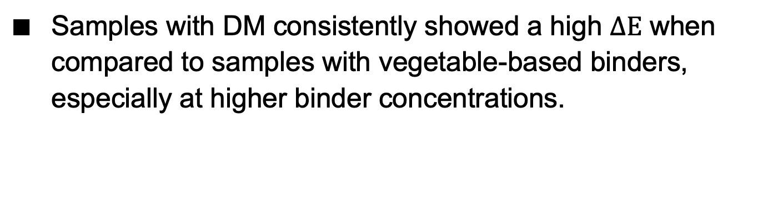

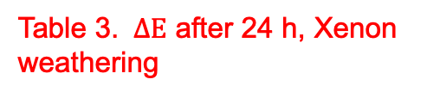

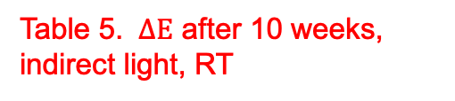
Results – $ΔE$ vs stability testing
Samples with DM consistently showed a high $ΔE$ when compared to samples with vegetable-based binders, especially at higher binder concentrations.
Table 3. $ΔE$ after 24 h, Xenon weathering
Table 4. $ΔE$ after 10 weeks, accelerated stability (40º C)
Table 5. $ΔE$ after 10 weeks, indirect light, RT
Pressed Powder | 1000 psi | 2000 psi
Benchmark | 1.16 | 0.47
DOS 3% | 1.62 | 0.69
DOS 6% | 0.83 | 0.50
DOS 9% | 1.22 | 1.14
DM 3% | 1.00 | 1.64
DM 6% | 3.62 | 2.05
DM 9% | 10.18 | 9.86
HU 3% | 2.49 | 1.34
HU 6% | 2.41 | 1.79
HU 9% | 1.62 | 1.30
TH 3% | 2.14 | 1.21
TH 6% | 0.51 | 1.13
TH 9% | 1.20 | 0.86
Pressed Powder | 1000 psi | 2000 psi
Benchmark | 0.18 | 0.26
DOS 3% | 0.19 | 0.17
DOS 6% | 0.43 | 0.28
DOS 9% | 0.39 | 0.60
DM 3% | 0.67 | 0.70
DM 6% | 3.31 | 3.31
DM 9% | 10.00 | 10.85
HU 3% | 0.45 | 0.33
HU 6% | 0.66 | 0.71
HU 9% | 1.45 | 1.46
TH 3% | 0.89 | 0.25
TH 6% | 0.22 | 0.27
TH 9% | 0.72 | 0.56
Pressed Powder | 1000 psi | 2000 psi
Benchmark | 0.66 | 0.93
DOS 3% | 1.77 | 0.77
DOS 6% | 1.65 | 0.58
DOS 9% | 0.26 | 0.92
DM 3% | 0.97 | 1.82
DM 6% | 2.50 | 2.81
DM 9% | 10.15 | 10.27
HU 3% | 1.37 | 1.48
HU 6% | 1.57 | 0.98
HU 9% | 0.38 | 0.83
TH 3% | 0.57 | 0.50
TH 6% | 0.93 | 0.58
TH 9% | 1.46 | 0.43

Slide 9
Results – Drop Test
All binders increased compact resilience, except DM at 3% and 1000 psi.
Table 6. Integrity of pressed powders after 1, 2 and 3 drops, where ‘X’ indicates unacceptable damage (i.e. the pressed powder broke or cracked), ‘—' indicates minor damage (i.e. the pressed powder showed chipping), and ‘O’ indicates no damage
Pressed Powder | 1000 psi |  |  | 2000 psi
 | 1st Drop | 2nd Drop | 3rd Drop | 1st Drop | 2nd Drop | 3rd Drop
Benchmark | X | X | X | — | — | —
DOS 3% | — | — | — | O | — | —
DOS 6% | O | — | — | O | — | —
DOS 9% | O | O | — | O | O | O
DM 3% | X | X | X | O | — | —
DM 6% | O | — | — | O | O | —
DM 9% | O | O | O | O | O | O
HU 3% | O | O | — | O | O | O
HU 6% | O | O | — | O | O | O
HU 9% | O | O | O | O | O | O
TH 3% | O | — | — | O | O | O
TH 6% | O | O | O | O | O | O
TH 9% | O | O | O | O | O | O

Slide 10
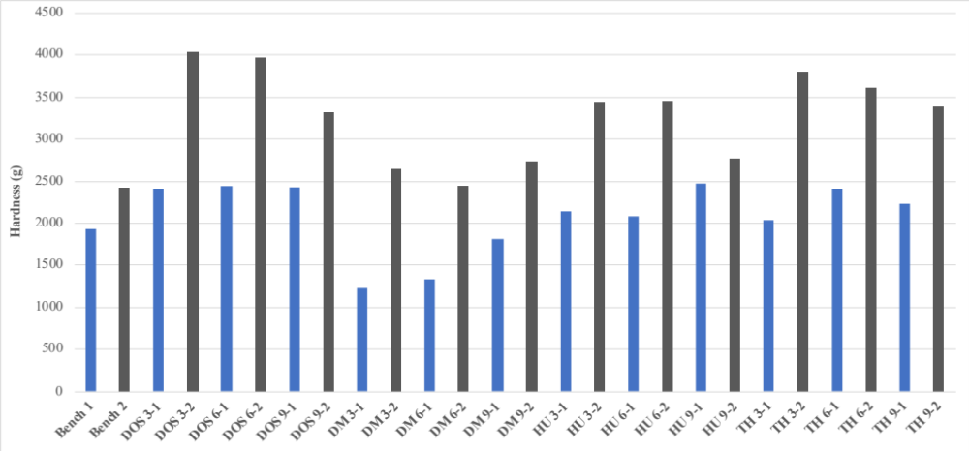
Results – Hardness
Samples with DM showed lower hardness compared to the vegetable-based alternatives at all binder concentrations and press strengths. This is in line with the drop test.
Fig. 4 Hardness (g) of pressed powders at different binder concentrations and press strengths

Slide 11
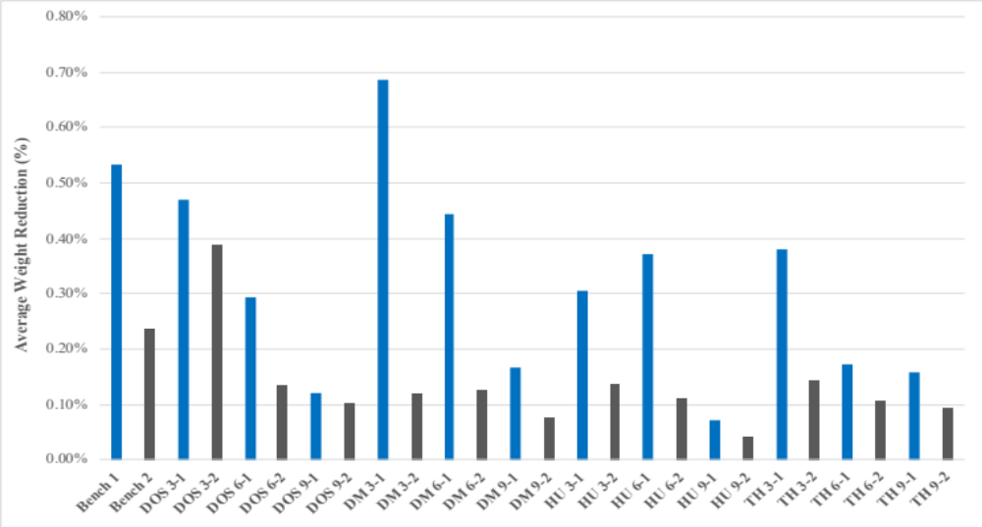
Results – Payoff
DM gave higher payoff (lower weight reduction), which is in line with both the hardness and drop test results;
Vegetable alternatives had similar payoff – consumer acceptability should be tested to confirm appropriateness.
Fig. 5 Payoff (% weight reduction) of pressed powders at different binder concentrations and press strengths

Slide 12
Conclusions
Vegetable binder alternatives provided, compared to DM:
  Better powder properties for compaction;
  Higher colour intensity and acceptable colour stability;
  Good properties in terms of compact powder hardness, integrity and payoff;
DM probably degrades under the test conditions;
Alternatives to DM potentially could be used at lower concentrations, making products more cost-effective;
Consumer acceptability should be considered in the future;
Vegetable-derived binder alternatives can perform better than DM and are in line with consumers’ preference for naturally-sourced sustainable alternatives to silicones.

Slide 13
References
Mintel, Human ethics can boost palm oil’s profile (2018)
Mintel, Natural, Organic and Ethical Toiletries – UK (2017)
British Pharmacopoeia, Stationery Office (2014)
L’Óreal QAC-MC-151
ASTM D5276
E. F. C. Griessbach, R. G. Lehmann, Chemosphere, 38(6), 1461-1468 (1999)

