Slide 1
Formulating shampoo bars: the search for optimal surfactant combinations
Diogo Baltazar¹, Anna de Tord Puigmal², Gabriela Daniels¹,
Slobodanka Tamburic¹
¹Cosmetic Science Research Group, London College of Fashion, London, UK
²Omorovicza Cosmetics, London

Slide 2
Introduction and Aim
Shampoo bars present a sustainable alternative to liquid shampoos due to minimal use of water and the reduction of the product’s volume and weight;
Shampoo bars must be consistent in performance and stability;
Increasing demand for shampoo bars is not matched by research into their optimisation.
Aim of this project:
To test a series of solid surfactant combinations and their ability to provide stable shampoo bars that meet consumer demands.

Slide 3
Materials
Base formulation ingredients:
  Stearyl Alcohol
  Methylparaben (and) Ethylparaben (and) Propylparaben
Surfactants
  Disodium Lauryl Sulfosuccinate (DLS)
  Sodium Coco-Sulfate (SCS)
  Cocamidopropyl Betaine (CAPB)
  Cocamide MEA (CMEA)

Slide 4
Methods: formulation
Phase B – heated to 70º C;
Phase A – coated with the Phase B solution;
Cooling down to RT;
Pressing at ~50 psi.
Table 1. Shampoo Bars formulation overview
Phase | INCI | % (w/w)
A | Disodium Lauryl Sulfosuccinate (DLS) | 0 – 77.30
 | Sodium Coco-Sulfate (SCS) | 0 – 77.30
 | Cocamidopropyl Betaine (CAPB) | 0 – 77.30
B | Cocamide MEA (CMEA) | 0 – 25.00
 | Stearyl Alcohol | 22.50
 | Methylparaben (and) Ethylparaben (and) Propylparaben | 0.02

Slide 5
Methods
Stability testing – 12 weeks:
  at 4º C;
  at RT, both exposed to sunlight & protected from sunlight
  Accelerated: at 40º C.
pH – bars dissolved to obtain 0.03% solution at RT; 3505 pH meter (Jenway, UK).
Hardness – P/2N 2 mm probe, average hardness (g) with a TA.XTplus Texture Analyser (Stable Micro Systems, UK) using the Exponent software.
Foam – bars dissolved to obtain 0.03% solution at RT; 50 mL of solution shaken 10x (Foam Volume calculated) and left to drain for 1, 2, 3, 4 and 5 min (Foam Drainage calculated).

Slide 6
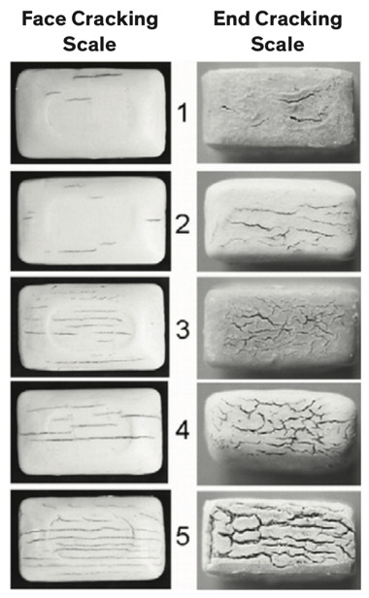
Methods
Bar dissolution: time required to dissolve fully a bar sample to obtain a 0.03% solution under stirring, up to 8 h;
Bar cracking: bars in contact with deionised water on one side for 2 h and allowed to dry at RT for 24 h; bars assessed against a Standard Cracking Test Rating Scale.
Zein Protein Irritancy Test:
  According to EC’s Protocol 26 for Skin Irritation and Corrosivity and following the Götte Modified Method, using a 0.25% shampoo bar solution;
  BCA Protein Assay, following Pierce TM BCA Protein Assay Kit instructions; absorbance measured at 562 nm.
Fig. 1 The Standard Cracking Test Rating Scale (adapted)

Slide 7
Results – Stability testing
Shampoo bars without CMEA retained their organoleptic properties at RT and 40º C, but some bars presented slight changes at 4º C, potentially due to increased humidity;
Shampoo bars with CMEA presented slight or significant changes after 12 weeks at 40º C, but no alterations at 4º C;
  CMEA could be important in maintaining product properties under humid conditions.
pH of all shampoo bars did not vary throughout the 12 weeks of testing, at all conditions used;
  pH between 5.0 and 7.0 was observed.
A Period After Opening test should be done to confirm these results.

Slide 8
Results – Hardness
No major patterns were noticed, but CAPB seems to decrease hardness;
CMEA both increased and decreased hardness, but seemed to contribute to bar homogeneity, as the hardness graphs (not shown) showed less fluctuations.
Table 2. Average hardness (g) of shampoo bars with and without CMEA
Surfactant Mixtures | Hardness (g) of Bars without CMEA | Hardness (g) of Bars with CMEA
DLS | 5.32 | 5.54
SCS | 5.40 | 4.84
DLS+CAPB | 5.02 | 3.65
SCS+CAPB | 4.95 | 5.79
DLS+SCS | 5.45 | 5.53
DLS+SCS+CAPB | 5.32 | 4.51
CAPB | - | 4.62

Slide 9
Results – Foaming
Combining CAPB with anionic surfactants (DLS and SCS) has yielded more foam, i.e. higher foam volume;
  Binary surfactant mixtures (anionic + amphoteric) appear to work best, compared to other mixtures.
Differences in foam drainage were not observed.
Table 3. Foaming power of shampoo bars with and without CMEA
Surfactant Mixtures | V_{F} (mL) for Bars without CMEA | V_{F} (mL) for Bars with CMEA
DLS | 17.33 | 13.33
SCS | 15.33 | 11.67
DLS+CAPB | 25.33 | 25.00
SCS+CAPB | 22.00 | 9.67
DLS+SCS | 8.00 | 14.67
DLS+SCS+CAPB | 18.67 | 15.67
CAPB | - | 23.67

Slide 10
Results – Bar Dissolution and Cracking
DLS consistently showed very long dissolution times, only lowered by combining with CABP;
SCS was the quickest to dissolve, but combining it with any other surfactant increased dissolution time;
CMEA decreased dissolution time of bars with DLS, but increased those with SCS.
All shampoo bars presented cracking between 1 and 2.
Table 4. Average dissolution time for shampoo bars in deionised water, to obtain a 0.03% solution
Surfactant Mixtures | Average dissolution time (h) for Bars without CMEA | Average dissolution time (h) for Bars with CMEA
DLS | > 8 | 2.25
SCS | 1 | 2.5
DLS+CAPB | 2.5 | 1.25
SCS+CAPB | 1.25 | 2.75
DLS+SCS | > 8 | 3
DLS+SCS+CAPB | > 8 | 1.25
CAPB | - | > 8

Slide 11
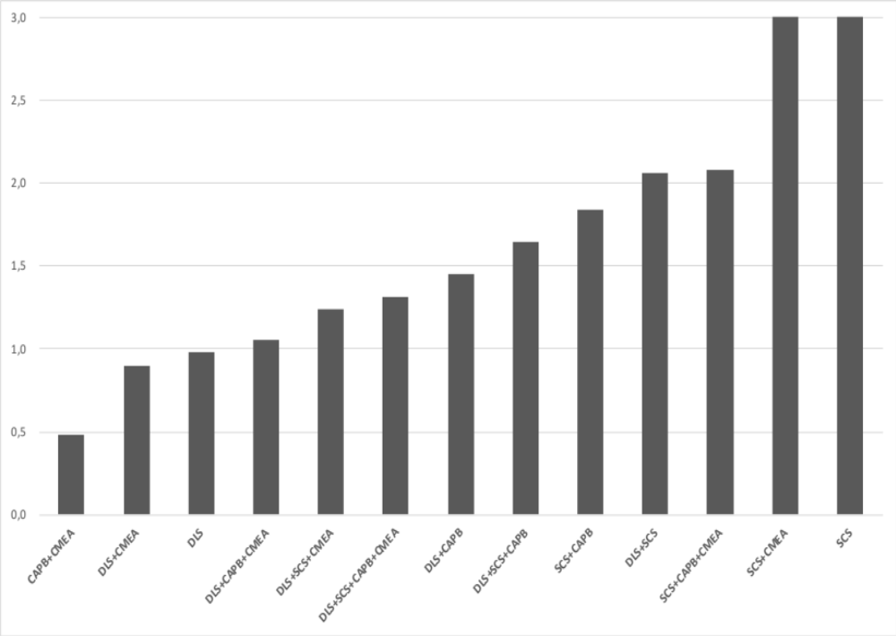
Results – Zein Protein Irritancy Test
DLS consistently showed low irritation potential, especially when used alone or with CMEA, and also reduced the irritation of SCS, even more than CAPB;
CAPB + CMEA showed the least irritation potential;
CMEA appears to reduce irritation potential, overall.
Fig. 2 The irritation potential of shampoo bars as measured by the amount of zein protein denatured by the surfactants used

Slide 12
Conclusions
Optimising shampoo bars for stability and functionality is not a straightforward process – surfactants behave differently;
  Optimising one attribute compromised another.
CAPB appeared to be useful in increasing foaming and mildness;
CMEA appeared to influence stability and efficacy; however, this depends on the primary surfactant used;
This study should be furthered by using other surfactants and performing instrumental and sensory evaluations in vivo.
DLS provided the best properties overall, especially if combined with CAPB, thus being an important surfactant in the creation of stable shampoo bars with good properties for the consumer.
Combinations of 2 and 3 surfactants showed better properties than using only 1 or combining 4.

Slide 13
References
A. Ogle, Nat Geo (2018).
https://www.nationalgeographic.co.uk/environment/2018/08/5-reasons-ditch-your-shampoo-bottle-shampoo-bar (accessed 2020.07.20)
The Dow Chemical Company (2015)
https://msdssearch.dow.com/PublishedLiteratureDOWCOM/dh_092d/0901b8038092d6b0.pdf?filepath=personalcare/pdfs/noreg/324-00519.pdf (accessed 2020.07.20)
European Commission (2015)
http://ec.europa.eu/health/scientific_committees/consumer_safety/docs/sccs_o_190.pdf (accessed 2020.07.20)
P. A. Cornwell, Int J Cosmet Sci, 40(1), 16-30 (2018)
M. B. Morrison, M. Paye, J Soc Cosmet Chem, 46, 291-299 (1995)

