Slide 1
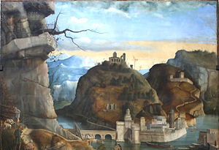
Notes:
Call of the Sons of Zebedee by Marco Basaiti, 1510

Slide 2
‘When we attempt to express a novel experience or thought ­ when we aspire to render the unspoken speakable and the un­ heard audible - we do so as functions of artificial memory, as functions of lifeless objects. ‘ (Flusser & Bec 2012:62)

Slide 3
Mark Ingham
Acting Programme Director Spatial Communications
& CTS Senior Lecturer
London College of Communication
UAL
@malarkeypalaver
#fishingforzededee
#Flusser

Slide 4
[START]
'Fishing for Zebedee'
"I've got to call you something." (Dylan 1965-1977)

Slide 5
Taking Vilem Flusser and Louis Bec’s Vampyroteuthis Infernalis as a ‘line of flight’
this presentation uses the characters from the Magic Roundabout as luminaires in,
‘The eternal night of the vampyroteuthis-zebedee
[which] is filled with colours and sounds that are emitted by living beings, an eternal festival of colours and sounds,
a son et lumiere of extraordinary opulence.

Slide 6
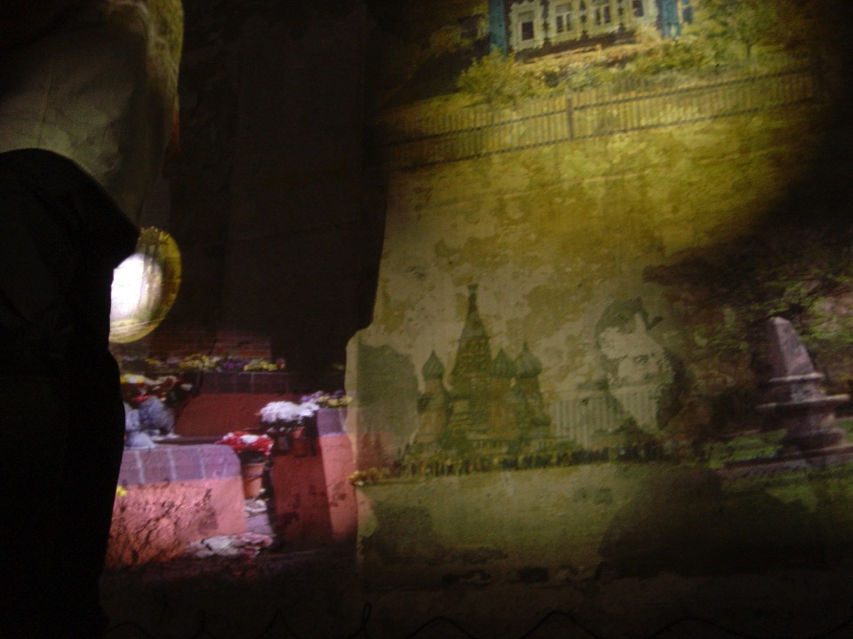

Slide 7
The enchanted village is carpeted with red, white, and violet stone;
there are dunes of blue and yellow sand,
sparkling with pearls and fragments of molten meteorites.

Slide 8
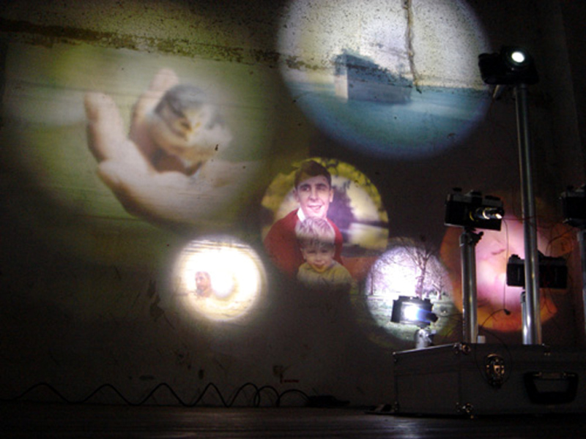

Slide 9
Forests, meadows, and plains of plant-like animals,
beaming with colours,
sway with fanned tentacles.

Slide 10
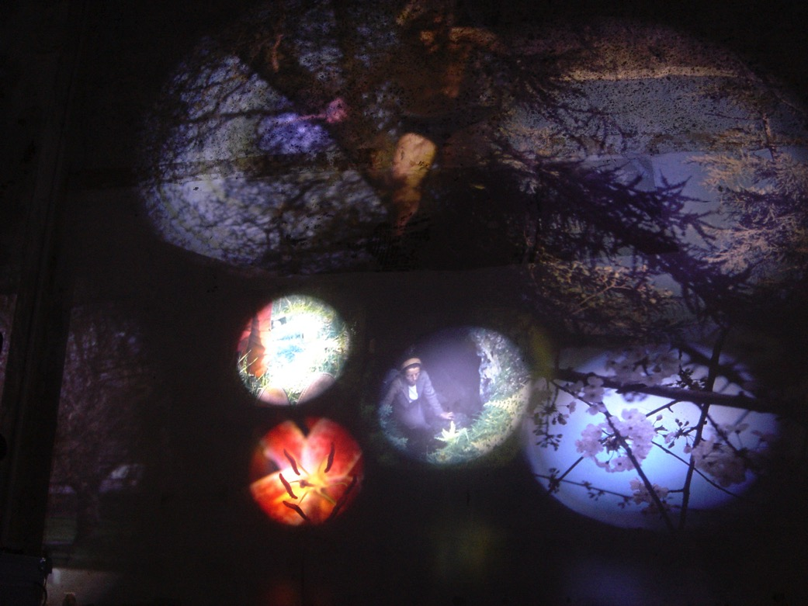

Slide 11
Wandering in their midst are giant iridescent
snails, cows, dogs and
whirring above them are
swarms of crabs,
flashing in silver, red, and yellow.

Slide 12
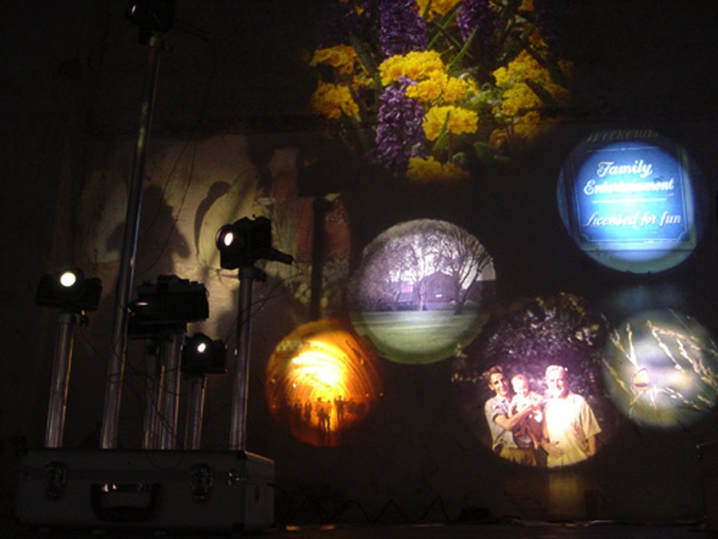

Slide 13
It is a luxuriant garden that the
vampyroteuthis-zebedee
can illuminate,

Slide 14
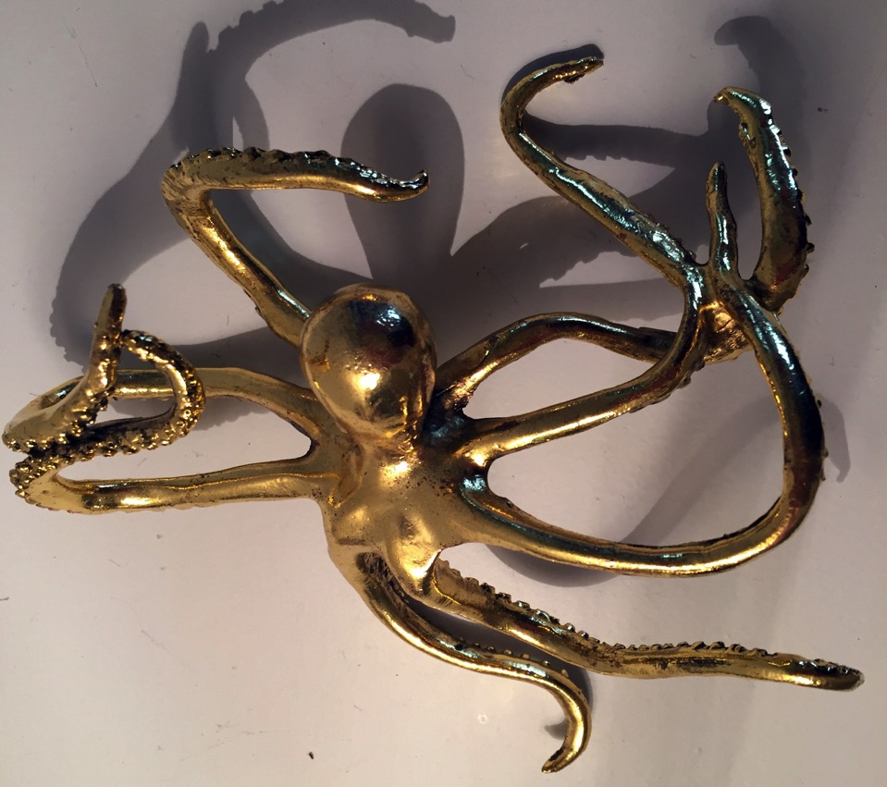

Slide 15
on a whim and a whirl,
and enjoys its desserts in splendour

Slide 16
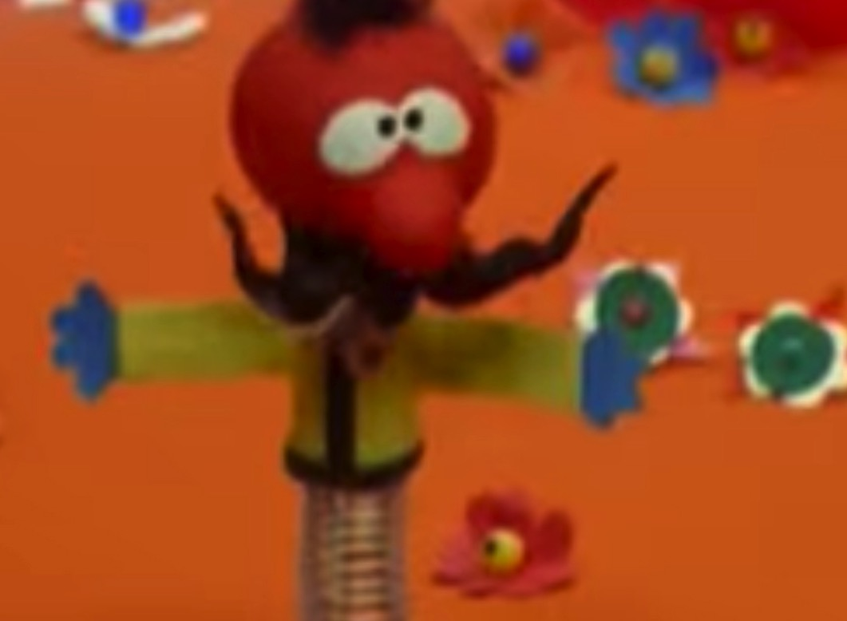

Slide 17
"I'm terribly confused,”
as Brian, the Snail, often said.

Slide 18
I am becoming
animal,

Slide 19
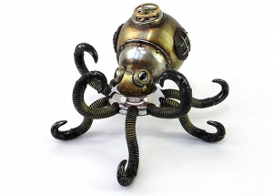

Slide 20
a rocking horse,

Slide 21
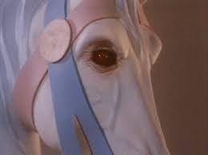

Slide 22
a ventriloquist’s emu

Slide 23


Slide 24
a felt frog who will
never be a prince.

Slide 25


Slide 26
The labyrinth I inhabit has multiple exits but only one entrance.
How you come out of my maze does not depend on how you enter,
you will be morphed.

Slide 27
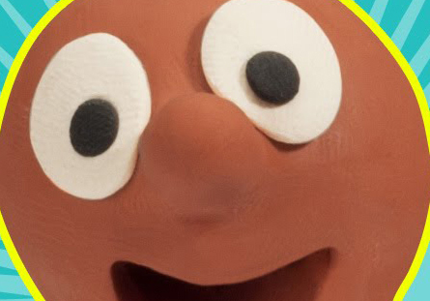

Slide 28
Charged by the planes of immanence
your lines of flight will electrify
and animate you.
Suckling and entangling you become;

Slide 29
bag puss,
& zippy,
& muffin the mule,
& bill and ben,
& lady penelope,
& lady lovelace
&zebedee,
& boing!

Slide 30
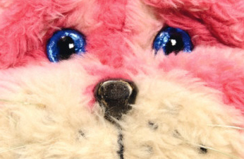

Slide 31
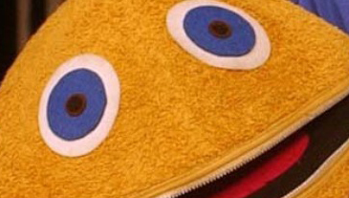

Slide 32
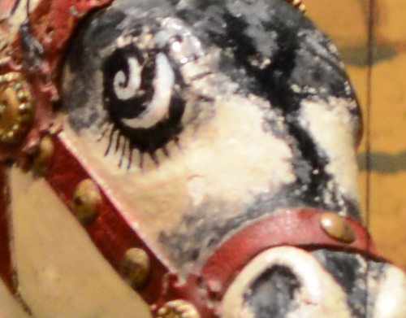

Slide 33


Slide 34
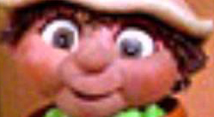

Slide 35


Slide 36


Slide 37
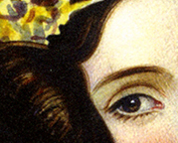

Slide 39
You fight the forces of abstraction to distraction
and it is a draw.
You perform,
you happen,
you dematerialise,
you objectify,
you are the subject,
you are not

Slide 40
You will evolve,
revolve, and dissolve some of those
images of thought you have explored
by constructing fleeting imaginary worlds

Slide 41
What will pull you back to the memory of crossing the singular threshold?

Slide 42
Will it be through rosebudishness,
madeleineness, or by the encounter
with the idea that forces
you to think differently?

Slide 43
Will it be through a spring,
a wooden ball,
a moustache,
red,
blue,
yellow
and black?

Slide 44
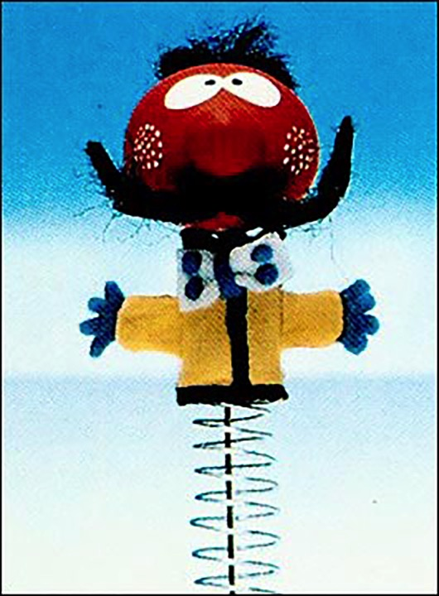

Slide 45
[SHOW]
The Magic Roundabout - The Experiment (4’ 40”)
https://youtu.be/2zCGjSoZzkY?t=10s

Slide 46
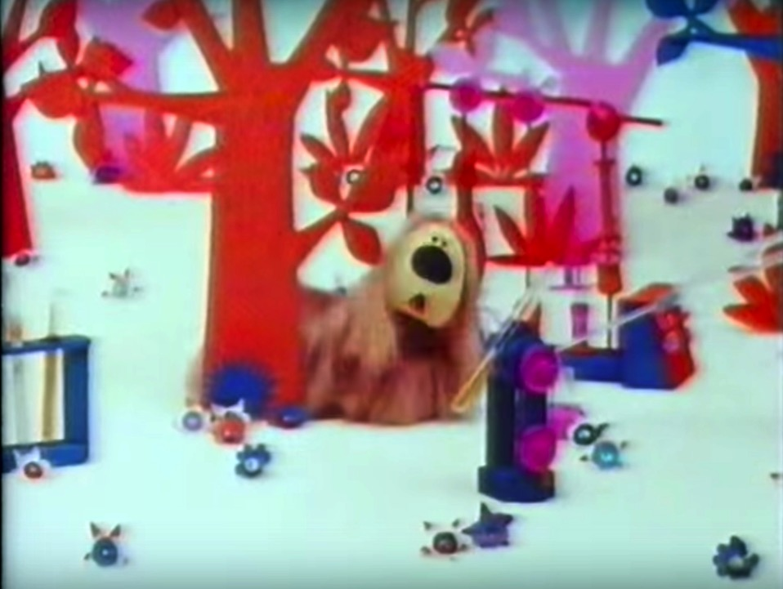

Slide 47
THE VAMPYROTEUTHIS-ZEBEDEE is
A MUSTACHIOED MOLLUSK MAGICIAN
(MMM)

Slide 48
MUSTACHIOED MOLLUSK MAGICIANs
are bilaterally symmetrical,
but many of them can redesign one half of their body
in favour of the other to become
"half animals."

Slide 49
Their bodies consist of a visceral mass and a mantle.
Like the skeleton of vertebrates, the mantle is characteristic of molluscs;
it is also a high achievement in the development of life.
In terms of its structural simplicity and functional complexity,
it has no equal.

Slide 50
In its frontal part the mantle forms a muscular
organ/spring, the "foot,”
that supports the mass of the body
(like that of snails, for instance).

Slide 51
“Snails are underestimated”
as Brian would say.

Slide 52
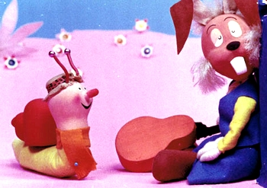

Slide 53
From this part of the mantle developed an extraordinarily mobile and sensitive head,
equipped with numerous antennae, tentacles,
moustaches and other sensory organs.
Among all the heads that have ever developed,
it can be regarded as the most intelligently designed.
Another part of the mantle secretes a spiral shell spring.

Slide 54
This spiral symmetry is the fundamental theme of the MMM body.
They are ekcentric animals whose bodies incline toward coiling
both as a whole and in all their details.
Their elan vital, this self-winding,
achieves dizzying heights

Slide 55
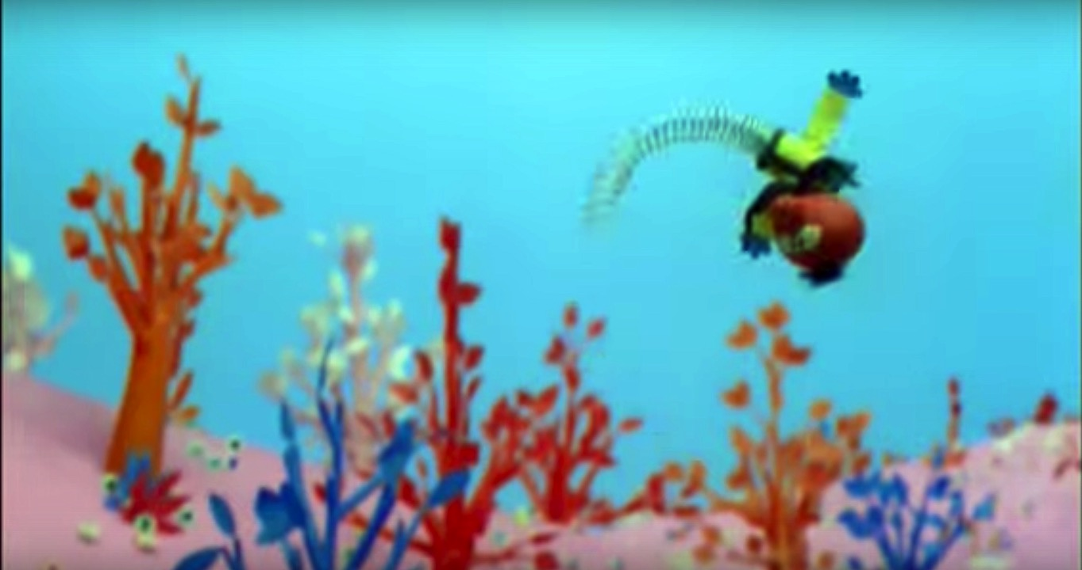

Slide 56
In cephalopods, like MUSTACHIOED MOLLUSK MAGICIANs,
having done away with their shells,
this balled up energy bursts forth.
They are the swiftest, most agile, and most predatory of all animals.
It is as if the entire phylum Mollusca, violent as it is, had balled itself up only to
eject the vampyroteuthis-zebedee into the world.

Slide 57
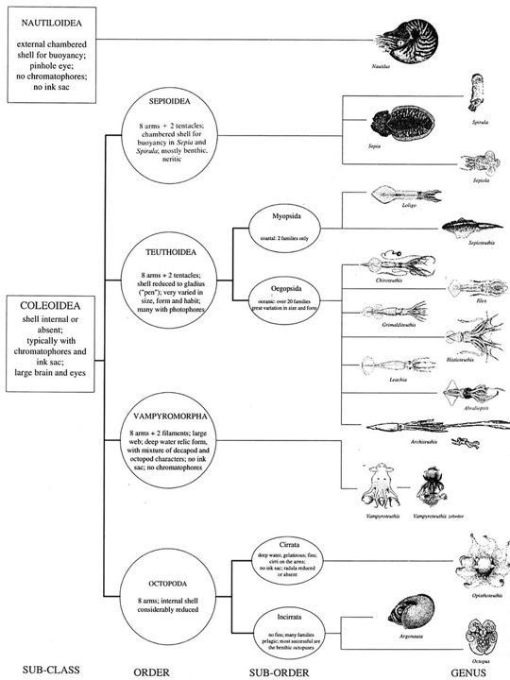

Slide 58
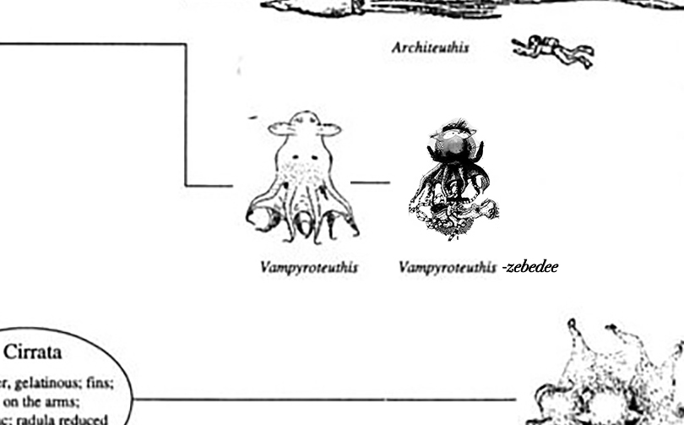

Slide 59
"Zebedee will put it right”
said Florence

Slide 60
The Magic Roundabout
The Experiment [Youtube SCRIPT] (sic)

Slide 61

yeah
is it
Oh diabolically clever now is everything ready
yes then letter the experiment begin
I need a 50 ml
you've got my head off said Brian you are bald said Dougal
yes like or snails said Brian
well I have some great news for you said Dougal evilly great news
really said Brian all you're going to be so pleased said Dougal Brian wasn't too
sure it won't hurt said Dougal
so Brian submitted to do Google's experiment
no I'm i got it right muttered Dougal
hi don't say that said Ryan
my head feels very funny

Slide 62
oh dear so do i think the mixture was a bit strong
I who's put the light out
squeak Brian now I don't want you to panic said Google you don't want me to
what I said Brian panicking
Florence arrived help said Brian who are you said Florence
Brian shriek Brian are being got at his you have said Florence trying not to
laugh
I didn't recognize you without your hat and she got it and put it on for Brian
thank you said Brian

Slide 63
ermintrude arrived at dugans experimental establishment
you don't happen to have a pair of scissors about you by any chance ask
Brian
good heavens a wooly caterpillar
I'm not a wooly caterpillar are too dear
now i'm brian i'm andrew thought you know I've always fancied myself with her
this is going to be tricking re do re
you can't hurry science

Slide 64
if you want here you'll have to be patient as you say do you know
let me see yeah she should be about done
let's have a look ermintrude was revealed in all her glory and Dougal
decided that discretion was the better part of valor want some sugar Dougal
said Florence

Slide 65
I'm not Dougal I'm intrude said I'm intrude rather proudly Florence called
7000 arrived
look said Florence do something
deputy examine the evidence I see
he muttered are Brian ermintrude met can see your face your thing
allow me I think I might be in a spot of bother
not a dugall what do you mean by
it

Slide 66
sensitivity sternly and he poured some of his special mixture on google said
okay don't have a black whatever i'm hearing up study don't get up get up
that'll teach him sensitivity
google tried hard to rub the mixture off on some leaves but it was no good
oti 70 sprayed Brian ermintrude with his mixture and they were back to normal
google wasn't how humiliating
he said well I feel like a rabbit and he went back to his laboratory for some of
his own medicine

Slide 67
would you like a piece of sugar Dougal said Florence
I could do with something sudoku it's been a harrowing day
Oh your hair
shouldn't it be a little longer
yeah
Yeah
yeah
yeah
yeah
yeah
yeah
yeah

Slide 68
And so this fable has reached its end.

Slide 69
The vampyroteuthis-zebedee has emerged and is now peering at us with its
hateful/soulful and humanesque eyes,
with its pneumatic skin fluctuating
from grey/yellow to violet/red to blue/black,
its spring and suction cups pulsing,
its mouth vomiting streams of water mixed with
time for beds.

Slide 70
Otherwise it is still and immured
(to speak, at least), of its innumerous relatives:
dougals, eukelampres,
brians, enedraroplons,
florences, artagepargogones,
ermintrudes, hadals,
dylans, phusagrions,
rustys and kamptes)
within the walls of an aquarium/enchanted village.

Slide 71
A vigilant ball of energy.

Slide 72
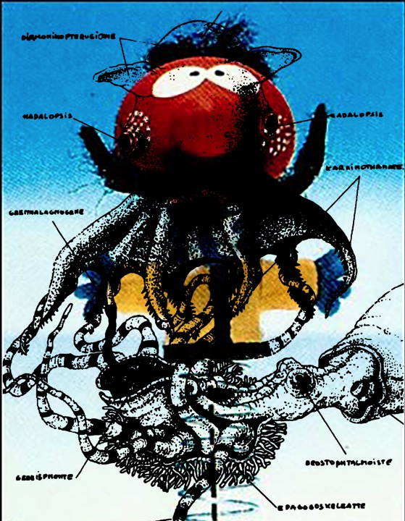

Slide 73
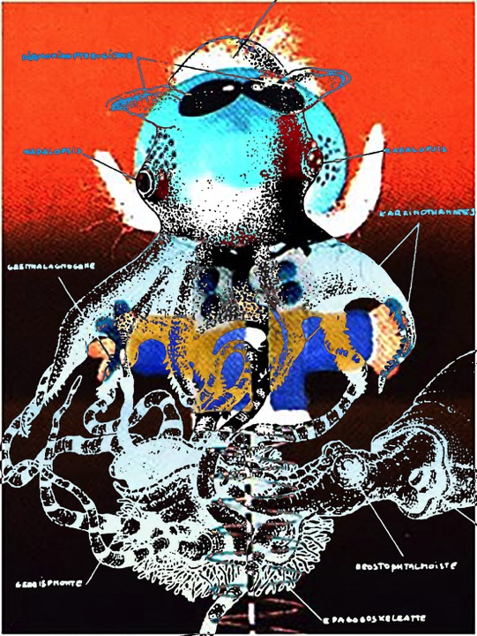

Slide 74
Well you can’t win them all,
said Zebedee, time for bed.”

Slide 75
https://www.youtube.com/v/kZTBDnj0Cgc?playlist=kZTBDnj0Cc&autoplay=1&loop=1
Time for bed
[END]

