Slide 1

Artificial Intelligence for Assessing Hair Assembly Features
9th International Conference on Applied Hair Science
Gabriela Daniels¹, Slobodanka Tamburic¹, Sergio Benini², Mattia Savardi², Jane Randall³, Tracey Sanderson³
¹ Cosmetic Science Research Group, London College of Fashion, London, UK
² Department of Information Engineering, University of Brescia, Brescia, Italy
³ Sensory Dimensions Ltd, UK
Notes:
I am G Daniels from the Cosmetic Sc Res Group at LCF and I will introduce you my poster
Artificial Intelligence for Assessing Hair Assembly Properties

Slide 2
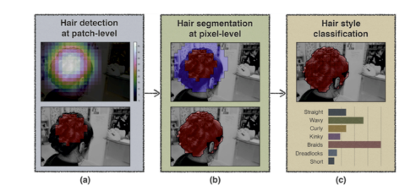
Machine learning and hair
What has been published so far?
Work on hair recognition and classification of hair styles from images in the wild [1] and hair shape predictions [2]
AI has not been used for hair assembly property analysis
No publicly available data set
Fig. 1. Processing chain from hair detection to style classification
Where are the main gaps in the public domain?

Slide 3
Study objectives
Objective 1: to apply computer vision and machine learning techniques to quantify the effects of haircare treatments on hair assembly and to identify correctly whether unknown tresses were treated or not.
Objective 2: to explore and compare the outcomes of the human assessment with those of the artificial intelligence (AI) algorithms.

Slide 4
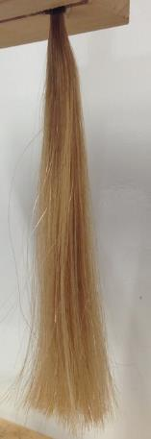
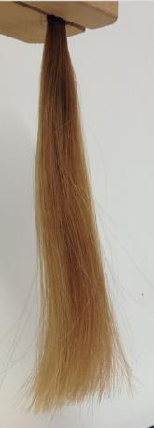
Methods: image dataset creation
Figaro tresses database: n=1080 images,
available via Mendeley dataset and Data in Brief [3][4]
-45º
0º
+45º
Fig. 4,5,6,. Images of the same hair tress (bleached) taken from the three different angles.

Slide 5
Project stages
Machine learning
Decide on the principles and structure behind the training data set, including the Expected Theoretical Behavior (ETB) of hair
Produce the training data set of images
Image analysis
Hair detection and analysis of the training data set
Validation tests for the classifying algorithms
Sensory assessment
Visual paired difference test, comparison with ETB and image analysis
Online paired image test, comparison with ETB and image analysis
Analysis of data set features and comparison with the ETB
Fig.2. Project workflow

Slide 6
Materials
Methods: hair treatments and image generation
Caucasian virgin hair tresses (n=120), fine medium brown hair, length=10cm, weight=3g
Half of the sample (n=60) was kept as virgin hair; half of the sample (n=60) was bleached lightly with a commercial bleaching product
Commercial shampoo and conditioner (volumising and conditioning) were used for treating all hair tresses
Expected theoretical behavior: The treatment will cause volume increase, decrease in alignment and reduction of flyway. The virgin and bleached hair will display the same effects, but the magnitude in bleached hair will be higher.
Photographs of tresses @ T0
No treatment
Photographs of tresses @ @T1
After the application of two consecutive treatments
Photographs of tresses @T2
After the application of one more treatment
Fig.3. Workflow representation of the image dataset generation

Slide 7
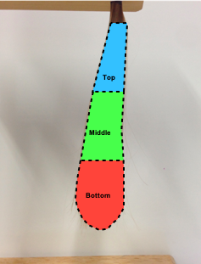
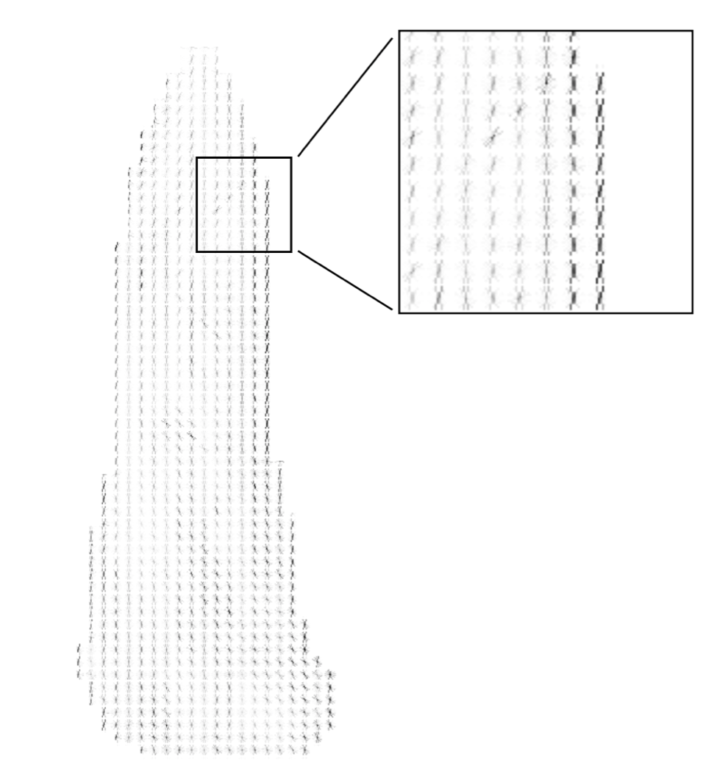
Methods: machine learning
A training dataset was created using 70% of each image subset (virgin and bleached hair).
Features for analysis: Volume (Global & Local Hair volume) and Alignment (Histogram of Gradients- HOG) [5] as, in combination, these provide information on the hair assembly responses to a volumizing but also conditioning treatment
Two validation tests were conducted using 30% of images (unseen):
“Time order tests” - could images of the same tress from two unknown treatment points be correctly ordered?
” Timepoint recognition test” - could a tress image from unknown treatment point be assigned to the correct treatment points
Fig. 7. Example of tress sub division in thirds for the computation of the Local Hair Volume
Fig. 8. Example of HOG extraction

Slide 8
Methods: sensory and online tests
Sensory and online tests included three questions, asking the participants to assess: tress volume, straightness and flyaway.
Visual paired difference visual test: t0 vs t2
Hair presented suspended from a bar, under controlled conditions
Naïve assessors, n=50
Online paired image comparison test: t0 vs t1, t0 vs t2,t1 vs t2
Hair images taken at 0º presented via Qualtrics (SAP,USA)
Naïve assessors, n=100
Fig.9. Summaries of the sensory human assessment

Slide 9
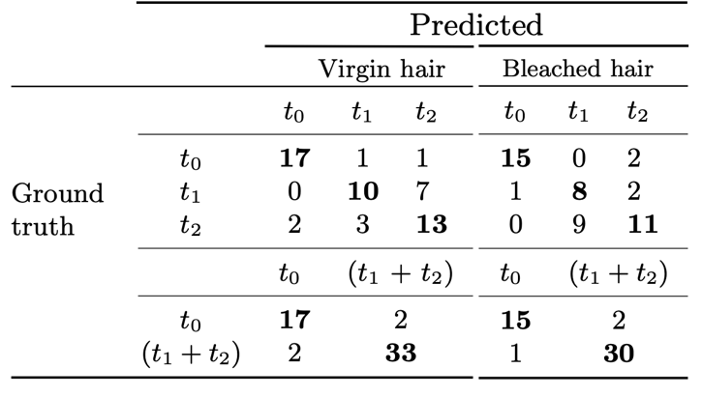
Machine learning test results
Treatment order test: Two images of a tress representing two time points should be correctly ordered
Example: tress A comes from a time point before tress B; over 80% accuracy
Timepoint recognition test
Example: unknown tress is correctly allocated to its timepoint
More challenging; higher accuracy when T1 and T2 were grouped together
Fig. 10. Confusion matrices. Correct results in bold

Slide 10
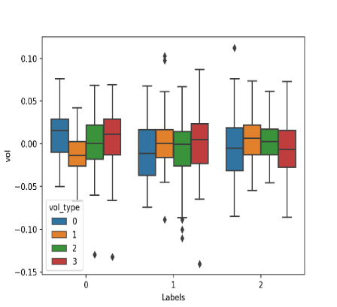
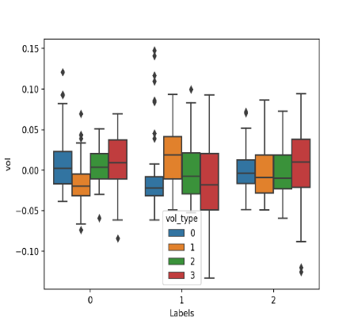
Results: AI analysis of volume and alignment
Virgin hair:
Volume: GHV reduction at t1* and t2* vs t0
Alignment index: alignment increased by 5% and 4% for t1 and t2 vs t0
Bleached hair:
Volume: GHV reduction at t1* and t2 vs t0
Alignment index: alignment increased by 7% and 4% for t1 and t2 vs t0
Volume change between treatment time points and t0
Key: Global HV=0 Upper HV=1 Middle HV=2 Lower HV=3
Time points
Time points
Fig. 11. Hair volume analysis of the virgin hair subset
Fig. 12. Hair volume analysis of the bleached hair subset

Slide 11
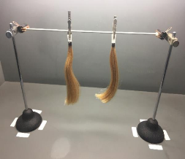
Results: paired difference test
Table 1. Results from the visual paired comparison test, n=50
 | Virgin hair |  |  | Bleached hair
Question | t0 | t2 | p-value | t0 | t2 | p-value
Which tress is more voluminous? | 33 | 17 | 0.016 | 32 | 18 | 0.032
Which tress is straighter? | 11 | 39 | 0.000 | 18 | 32 | 0.032
Which tress has more flyaway? | 22 | 28 | 0.240 | 31 | 19 | 0.059
Treated hair at t2 has less volume and is straighter* than untreated hair at t0 (both virgin and bleached hair)
Flyway** result is borderline for bleached hair
The results are not in line with the ETB but are in line with the AI analysis
Fig.13. Presentation of the hair tresses for paired difference test
* =hair straightness has been used as the closest possible away to describe good alignment in human terms
** = flyaway, defined as individual fibers separation from the bulk of the assembly, was not included in the AI analysis; however, it corresponds to conditioning

Slide 12
Conclusions
This study highlights the usefulness of AI for hair tress assessment, as it could include hair features which are difficult to define and assess individually by humans. It also provides more sophisticated overall assessment of the hair assembly appearance.
Human assessments based on a 3D-view of the hair corroborate the AI assessment.
Human assessment of hair conducted from one viewpoint only is not sensitive to the more subtle shape and volume effects resulting from shampoo and conditioning treatments.

Slide 13
References:
[1] U. Muhammad, M. Svanera, R. Leonardi, S. Benini, Hair detection, segmentation and hairstyle classification in the wild, Image and Vision Computing, 2018, 71, pp.25-37
[2] M. Zhang, Y. Zheng, Hair-GAN: Recovering 3D hair structure from a single image generative adversarial networks, Visual Informatics, 2019 3(2) pp.102-112
[3] M. Savardi, G. Daniels, S. Tamburic, U. Muhammad, S. Benini, Figaro-tresses: a dataset for evaluating hair assembly features before and after cosmetic treatment (v2020), Mendeley Datasets
[4] M. Savardi, G. Daniels, S. Tamburic, U. Muhammad, S. Benini, Figaro-tresses: a dataset for evaluating hair assembly features before and after cosmetic treatment, Data in Brief, 2020, 31
[5] Learn OpenCV, https://www.learnopencv.com/histogram-of-oriented-gradients/ (Accessed on 2020.07.20)
Acknowledgements
The authors wish to acknowledge the contribution of the students from the MSc Cosmetic Science at London College of Fashion for conducting the hair tress treatments and image acquisition and Dr Umar Muhammad for his initial contribution to the AI investigation

