Slide 1
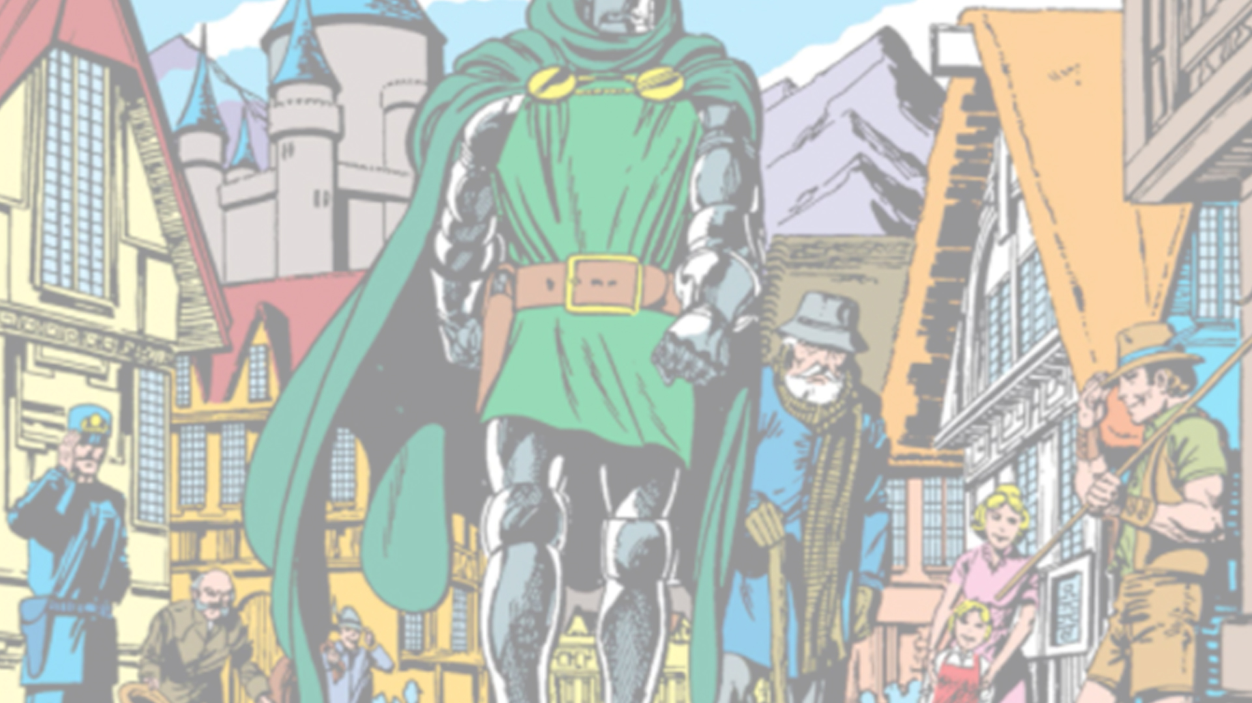

Image quotation of past events to enforce storyworld cohesion in John Byrne's Fantastic Four
Image quotation of past events to enforce storyworld cohesion in John Byrne's Fantastic Four
Mark Hibbett
University of the Arts London
Mark Hibbett
University of the Arts London

Slide 2
Character components
Character-Specific
  Appearance
  Names And Titles
  Physical Actions
  Dialogue
Storyworld-Specific
  Locations
  Other Characters
  Objects
  Previous Events
Authorship
  Market Authors
  Textual Authors
Behaviour
  Perceived Behaviour
  Personality Traits
  Motivations
Notes:
Based on my PhD which uses Dr Doom as a case study for a 13 dimensional model of Character Cohesion

Slide 3
Character components
Character-Specific
  Appearance
  Names And Titles
  Physical Actions
  Dialogue
Storyworld-Specific
  Locations
  Other Characters
  Objects
  Previous Events
Authorship
  Market Authors
  Textual Authors
Behaviour
  Perceived Behaviour
  Personality Traits
  Motivations
Notes:
This talk will specifically concentrate on 3 of the 13 components: Previous Events and Market and Textual Authorship, and I want to show how John Byrne uses Previous Events in the storyworld as a way to comment on the cohesion of the Marvel diegesis, and to assert his own claims to authorship.

Slide 4
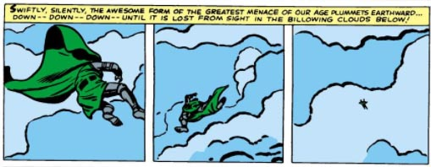
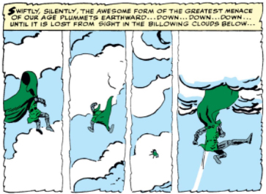
Image quotation
Lee, Stan (w), Jack Kirby (p), Dick Ayers (i). "In the Clutches of Doctor Doom!". Fantastic Four v1 #17 (Aug. 1963), Marvel Comics.
Lee, Stan (w), Steve Ditko (a). "Marked for Destruction by Doctor Doom!". The Amazing Spider-Man v1 #5 (Oct. 1963), Marvel Comics.
Notes:
He does this via Image quotation, which is a technique regularly used in comics of this period for two main purposes. Most obviously it's used in recaps, here to tell readers what had happened before, and also to add some information

Slide 5
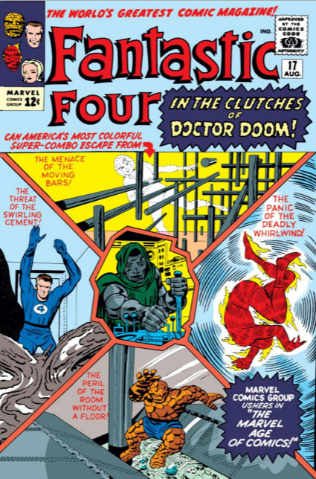
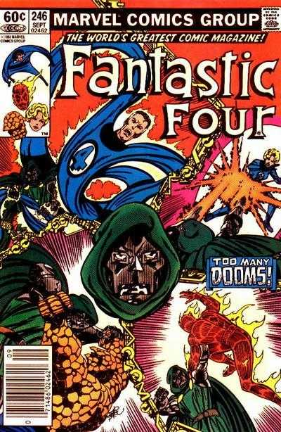
Image quotation
Lee, Stan (w), Jack Kirby (p), Dick Ayers (i). "In the Clutches of Doctor Doom!". Fantastic Four v1 #17 (Aug. 1963), Marvel Comics.
Byrne, John (w, a). "Too Many Dooms". Fantastic Four v1 #246 (Sep. 1982), Marvel Comics.
Notes:
It's also used as a tribute or homage to an older one. This shows John Byrne doing it, and he does it a lot during his run on FF from 1981 to 1986, as a way to talk about, and use, the coherence of Marvel continuity. He also uses it to assert himself as a primary author and a successor to Kirby.

Slide 6
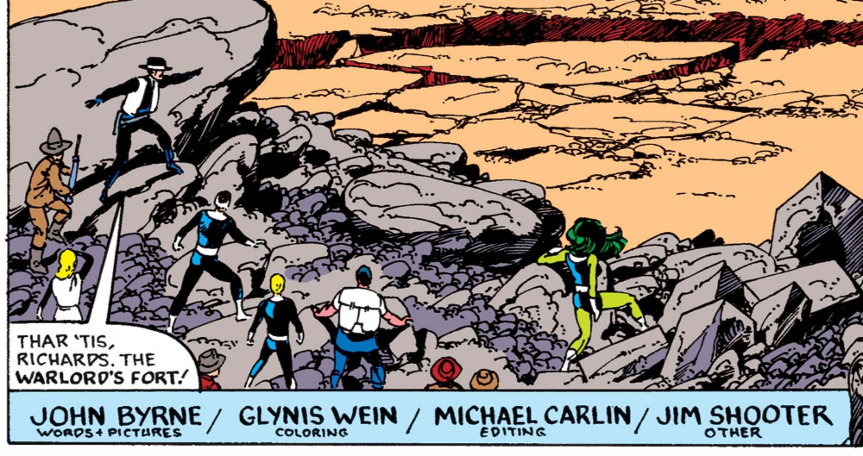
Textual authorship
Byrne, John (w), John Byrne (a). "Fathers and Others". Fantastic Four v1 #273 (Dec. 1984), Marvel Comics..
Notes:
This is achieved partly through Textual authorship. This is where we see the name of the authors inside the comic itself .
Unusually for superhero comics, John Byrne doesn't really collaborate during his run on FF. he writes and pencils, sometimes inks and even letters himself too.

Slide 7
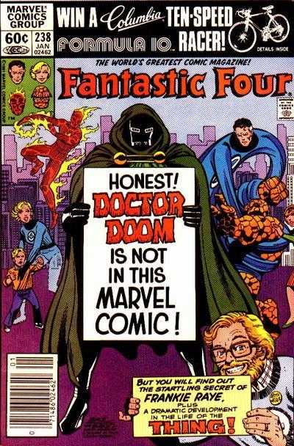
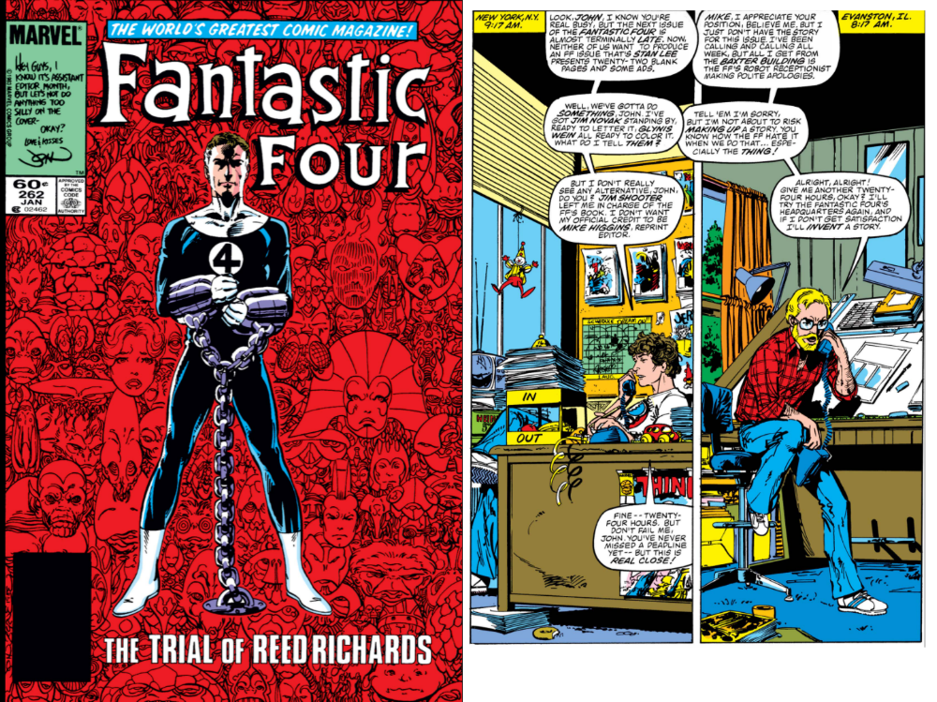
Market authorship
Byrne, John (w, a). "The Lady Is for Burning!". Fantastic Four v1 #238 (Jan. 1982), Marvel Comics.
Byrne, John (w), John Byrne (a). "The Trial of Reed Richards".
Fantastic Four v1 #262 (Jan. 1984), Marvel Comics.
Notes:
But Byrne also attempts to assert his Market Authorship - that is having his own name, or even face, on the cover of the comic as a selling point. This is "John Byrne's Fantastic Four"

Slide 8
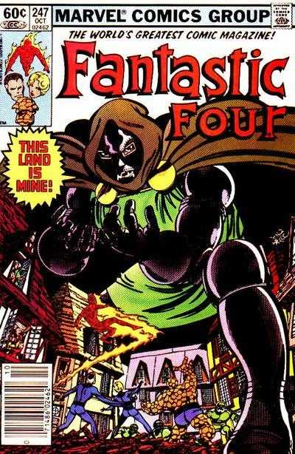
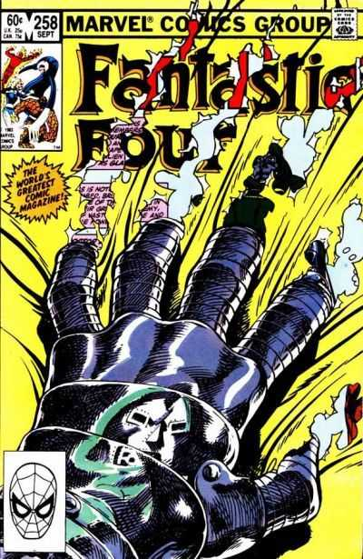
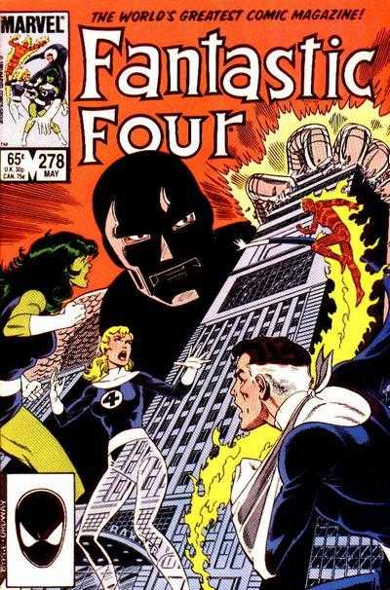
Byrne, John (w, a). "This Land Is Mine!". Fantastic Four v1 #247 (Oct. 1982), Marvel Comics.
Byrne, John (w, a). "Interlude". Fantastic Four v1 #258 (Sep. 1983), Marvel Comics.
Byrne, John (w, p), Jerry Ordway (i). "True Lies". Fantastic Four v1 #278 (May. 1985), Marvel Comics.
Notes:
I'm going to look at how he does all this, over three texts.
This Land Is Mine from Fantastic four 247, Interlude in FF 258, and True Lies in FF 278

Slide 9
Byrne, John (w, a). "This Land Is Mine!". Fantastic Four v1 #247 (Oct. 1982), Marvel Comics.
Notes:
This Land Is Mine published in 1982. Doctor Doom has summoned the Fantastic Four to Latveria.

Slide 10
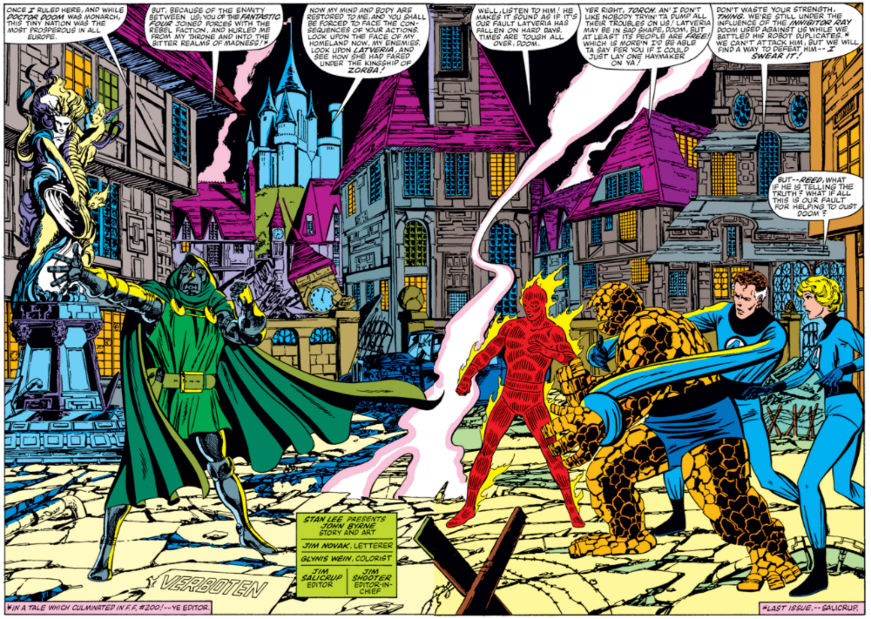
Byrne, John (w, a). "This Land Is Mine!". Fantastic Four v1 #247 (Oct. 1982), Marvel Comics.
Notes:
He's taken them there to show them the results of their actions some years ago when they helped a revolution against him.

Slide 11
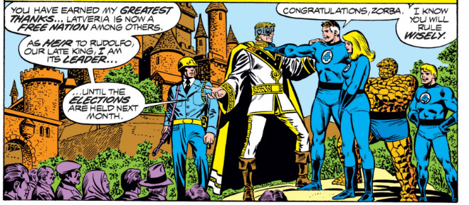
Wolfman, Marv (w), Keith Pollard (p), Joe Sinnott (i). "When Titans Clash!". Fantastic Four v1 #200 (Nov. 1978), Marvel Comics.
Notes:
This happened in FF 200 . Here we see the results of the revolution, with Prince Zorba taking over. This panel is fascinating for its symbolism for American Foreign policy, but I don't have time to go into it now!

Slide 12
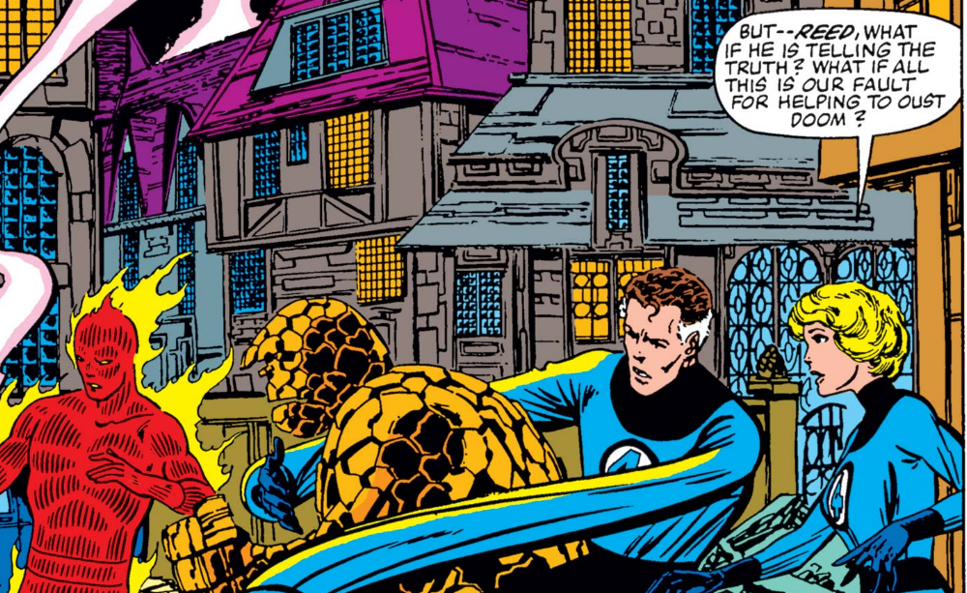
Notes:
Sue: "what if this is our fault?" This is a question very much being asked of American foreign policy at the time of the story - is it better to help revolutions, like America's own revolution, or to have strong dictators in power to bring stability?
Normally in a superhero story it's a Good Thing to take power away from a supervillain. Here it seems it isn't, and Byrne has to find ways to justify this viewpoint

Slide 13
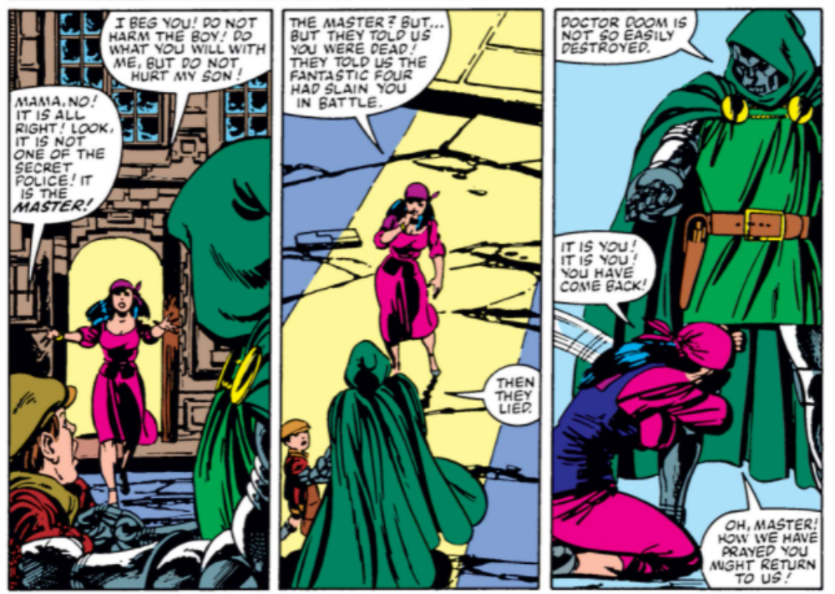
Byrne, John (w, a). "This Land Is Mine!". Fantastic Four v1 #247 (Oct. 1982), Marvel Comics.
Notes:
He does this via the story of a small boy called Kristoff. He bumps into Doom, his mother begs for mercy - just as we'd expect - but then it turns out that she thought it was Prince Zorba's secret police, and is RELIEVED to see it's Doom.

Slide 14
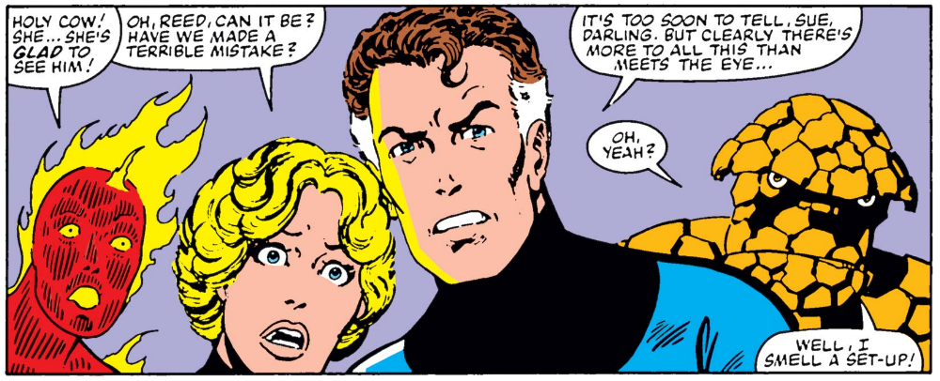
Byrne, John (w, a). "This Land Is Mine!". Fantastic Four v1 #247 (Oct. 1982), Marvel Comics.
Notes:
"I smell a set-up" says The Thing, and he'd be right to think so. Doom has done this many times before, faking the love of his people for outsiders, not just in the Fantastic Four but other comics and other media. The reader expects a set-up too, so Byrne has to show it's for real.

Slide 15
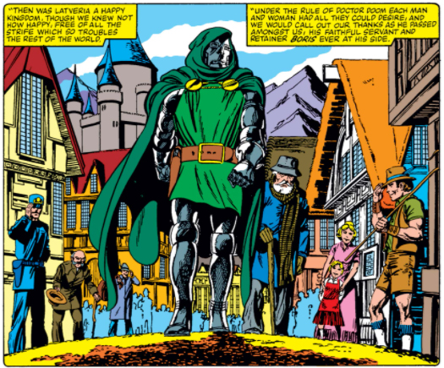
Byrne, John (w, a). "This Land Is Mine!". Fantastic Four v1 #247 (Oct. 1982), Marvel Comics.
Notes:
He does this by having the woman recall how happy people were when Doom took over. To reinforce the idea that this is genuine though, the image he uses is a direct quote of one from

Slide 16
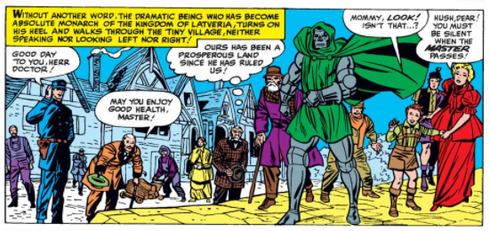
Lee, Stan (w), Jack Kirby (p), Chic Stone (i). "The Fantastic Origin of Doctor Doom!". Fantastic Four Annual v1 #2 (Sep. 1964), Marvel Comics
Notes:
Doom's original origin story in Fantastic Four Annual #2

Slide 17
Notes:
If we look at the two images together we can see that Byrne has gone to great lengths to position characters similarly to the Kirby story. It's the same image - the same event - literally from a different angle.

Slide 18
Byrne
Kirby
Notes:
This diagram also shows the relative viewpoints of the artists. Byrne has placed himself next to Kirby, possibly even slightly in front of him. Byrne is saying that he is Kirby's equal, and that this story is part of exactly the same storyworld as the earlier one. Byrne continues to quote other stories throughout this issue, such as -

Slide 19
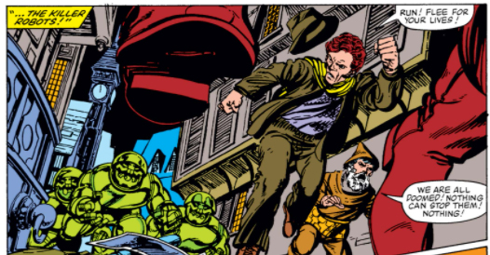
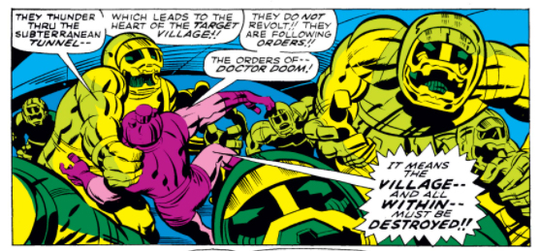
Byrne, John (w, a). "This Land Is Mine!". Fantastic Four v1 #247 (Oct. 1982), Marvel Comics.
Lee, Stan (w), Jack Kirby (p), Joe Sinnott (i). "Within This Tortured Land". Fantastic Four v1 #85 (Apr. 1969), Marvel Comics.
Notes:
The Killer Robots, last seen in Fantastic Four #85. This re-use of aspects of previous continuity not only reinforces the idea that it is part of the same, cohesive, storyworld, and so as valid as Kirby and Lee's stories, but also within the story shows us how evil Zorba has become, using Doom's own weapons. He also kills Kristoff's mother. The FF are forced to help Doom -

Slide 20
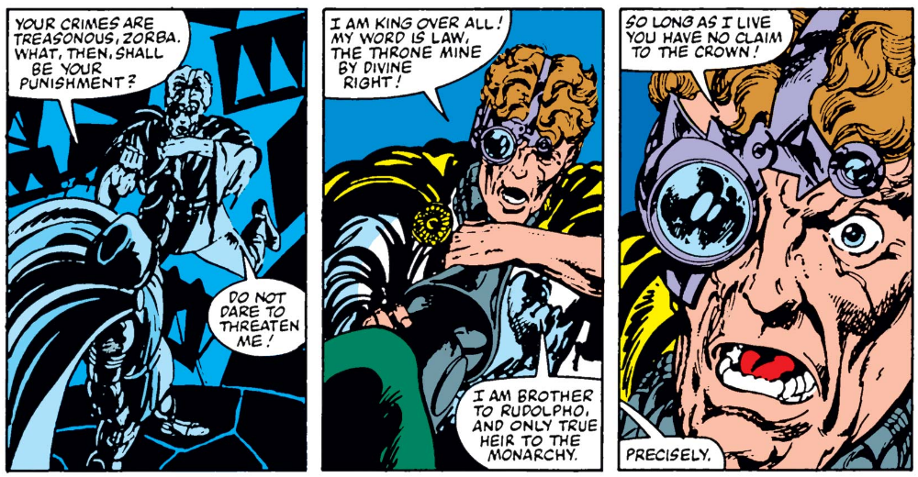
Byrne, John (w, a). "This Land Is Mine!". Fantastic Four v1 #247 (Oct. 1982), Marvel Comics.
Notes:
and in the end he retakes Latveria by simply murdering Zorba. He is still Doctor Doom!

Slide 21
Byrne, John (w, a). "Interlude". Fantastic Four v1 #258 (Sep. 1983), Marvel Comics.
Notes:
We return to Latveria a year later in Fantastic Four #258, an issue that tears away the usual cover of the comic, to reveal what goes on behind the scenes, when the Fantastic Four aren't around.

Slide 22
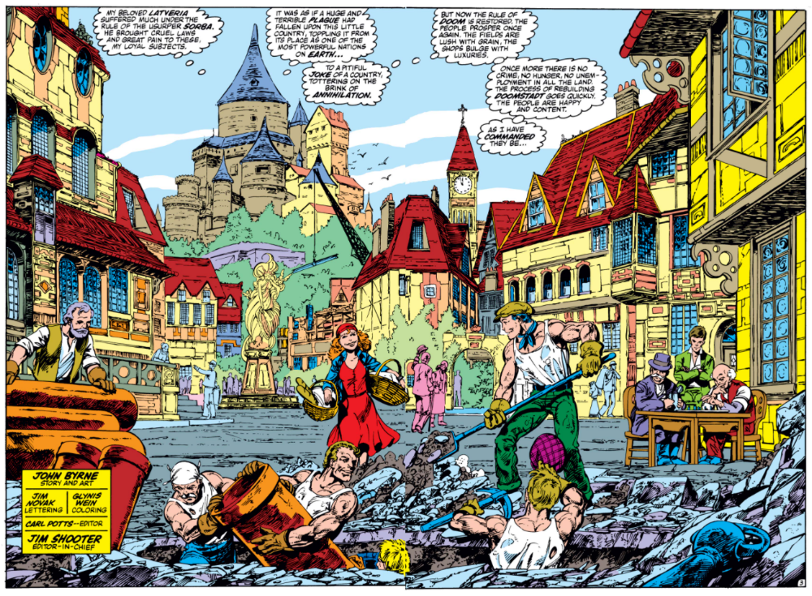
Byrne, John (w, a). "Interlude". Fantastic Four v1 #258 (Sep. 1983), Marvel Comics.
Notes:
It focuses entirely on events in Latveria, where another double page spread shows us how things have changed. This is a direct reference to the earlier image, and if we look at them side by side

Slide 23
Byrne, John (w, a). "Interlude". Fantastic Four v1 #258 (Sep. 1983), Marvel Comics.
Notes:
we can see the same items in both. The fountain, the houses behind it, the clock towers which have been re-erected and so on. Interestingly, the only major change is to the design of Castle Doom in the distance, bringing it more into line with

Slide 24
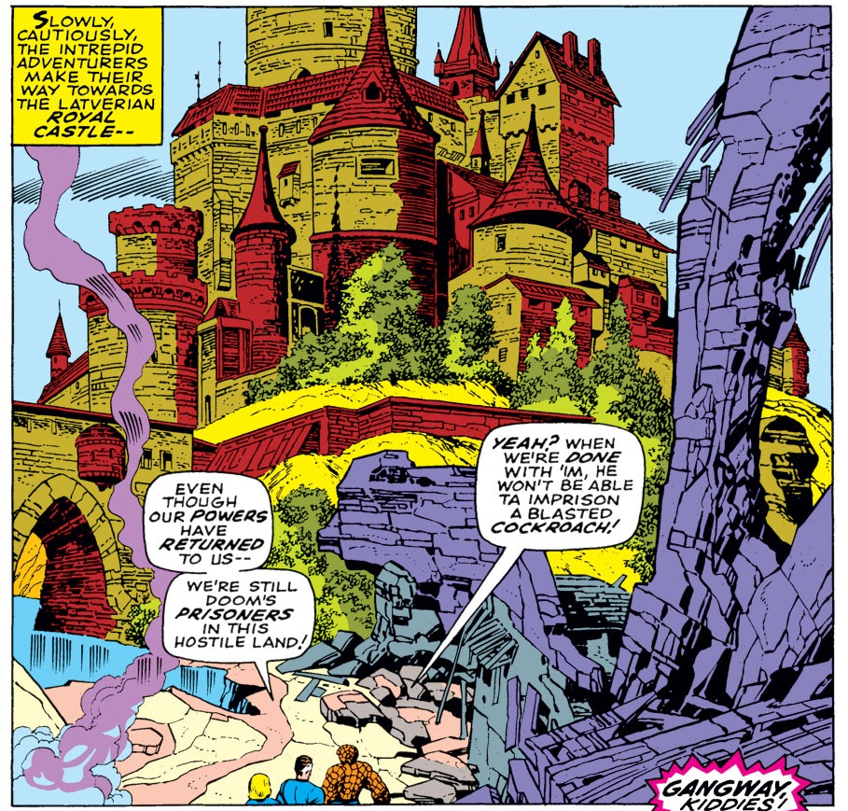
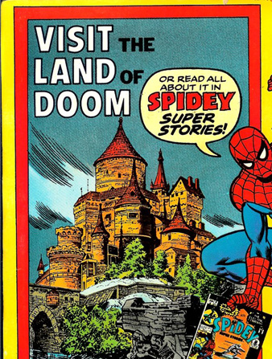
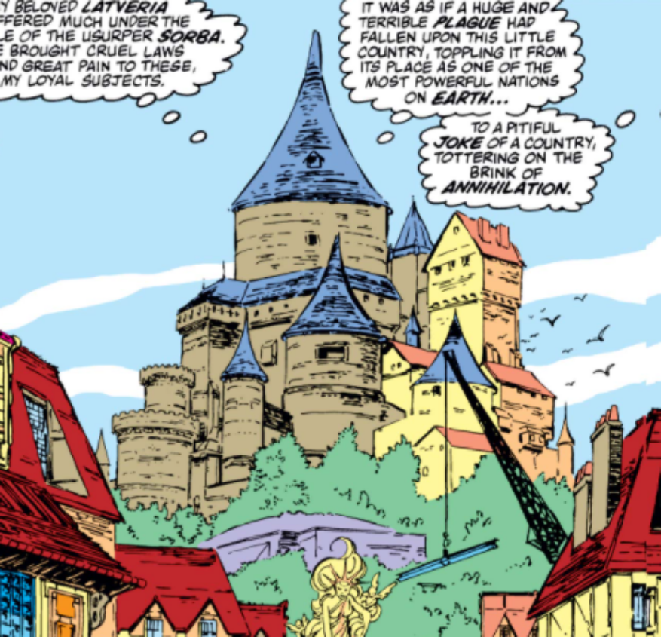
Lee, Stan (w), Jack Kirby (p), Joe Sinnott (i). "The Power and the Pride!". Fantastic Four v1 #87 (Jun. 1969), Marvel Comics.
Thomas, Jean (w), Win Mortimer (p), Mike Esposito (i), Tony Mortellaro (i). "The Day of Doom". Spidey Super Stories v1 #9 (Jun. 1975), Marvel Comics.
Byrne, John (w, a). "Interlude". Fantastic Four v1 #258 (Sep. 1983), Marvel Comics.
Notes:
Jack Kirby's design in FF#87, which was then expanded and re-used for other purposes, such as this advert for Spider Super Stories. Again, Byrne is reinforcing the idea that this is the same storyworld as Kirby's.
Byrne uses this issue to gather in lots of appearances by Doom in other series, weaving them into his version of the character as a way of asserting his authorship.

Slide 25
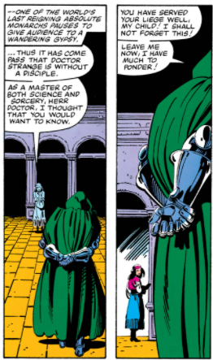
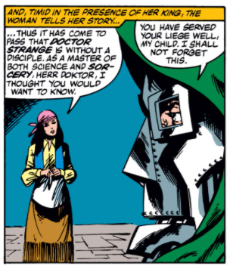
Byrne, John (w, a). "Interlude". Fantastic Four v1 #258 (Sep. 1983), Marvel Comics.
Stern, Roger (w), Kevin Nowlan (p), Terry Austin (i). "Gather My Disciples Before Me!". Doctor Strange v1 #57 (Feb. 1983), Marvel Comics.
Notes:
He does this first of all by identically repeating a conversation that was originally seen in Doctor Strange #57, again from a different angle, claiming this part of Doom's story for his own. He then goes much further when he brings in another recent appearance, in X-Men #146

Slide 26
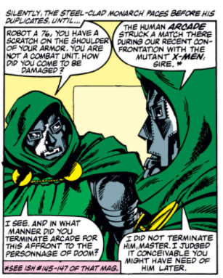
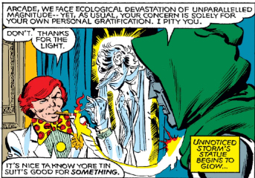
Claremont, Chris (w), Dave Cockrum (p), Joe Rubinstein (i). "Murderworld!". The Uncanny X-Men v1 #146 (Jun. 1981), Marvel Comics.
Byrne, John (w, a). "Interlude". Fantastic Four v1 #258 (Sep. 1983), Marvel Comics.
Notes:
Byrne was unhappy with Chris Claremont's use of Doctor Doom in this issue - the pair had fallen out, so he uses the idea that Doom behaved out of character in that story to imply, in-continuity, that Claremont isn't very good at writing characters. He does this by saying it must have been a Doombot because it behaved so wrongly, and Doom orders it to self-destruct.
Byrne does not redraw this incident - perhaps he feels that it's beneath him to do so. Again, this is him enforcing his authorship, taking Previous Events and re-shaping them to do so, while going to great lengths to maintain the cohesion of the overall storyworld.

Slide 27
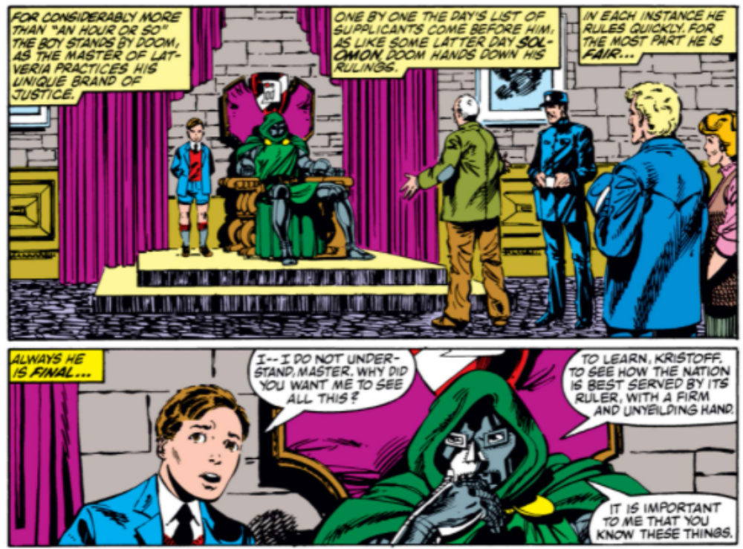
Byrne, John (w, a). "Interlude". Fantastic Four v1 #258 (Sep. 1983), Marvel Comics.
Notes:
We also find out what happened to Kristoff - Doom has adopted him, and seems to be setting him up as his heir, showing him the business of rulership. Also, note the return of the Latverian policeman here.

Slide 28
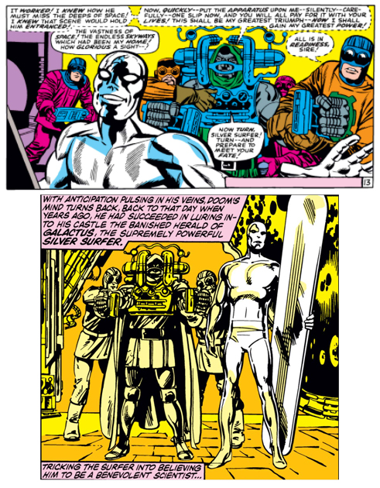
Lee, Stan (w), Jack Kirby (p), Joe Sinnott (i). "Enter... Doctor Doom!". Fantastic Four v1 #57 (Dec. 1966), Marvel Comics.
Byrne, John (w, a). "Interlude". Fantastic Four v1 #258 (Sep. 1983), Marvel Comics.
Notes:
We get more quotation, taking in the Silver Surfer's first meeting with Doom in FF #57, and Byrne uses this to finish off yet another story,

Slide 29
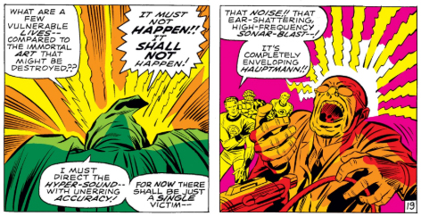
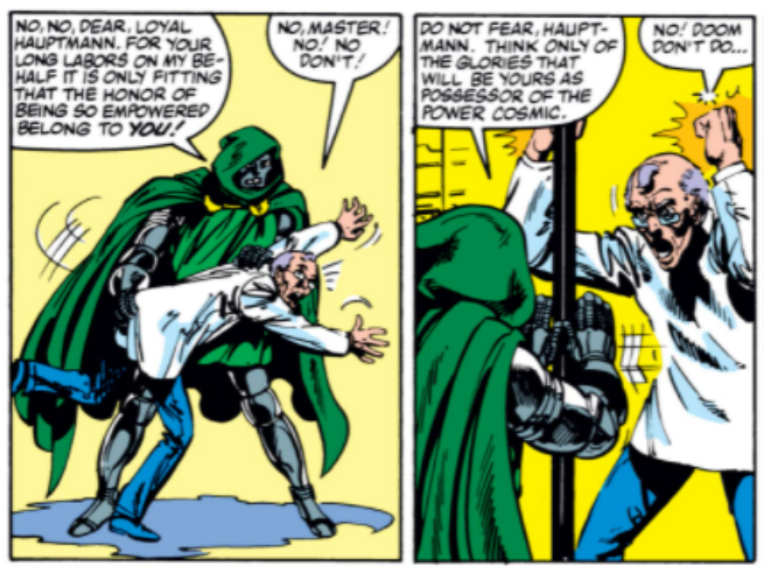
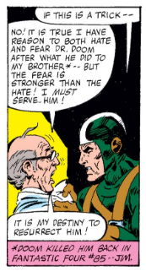
Lee, Stan (w), Jack Kirby (p), Joe Sinnott (i). "The Power and the Pride!". Fantastic Four v1 #87 (Jun. 1969), Marvel Comics.
Byrne, John (w, a). "Interlude". Fantastic Four v1 #258 (Sep. 1983), Marvel Comics.
Moench, Doug (w), Tom Sutton (a). "The Power of the People!". Fantastic Four Annual v1 #15 (Dec. 1980), Marvel Comics.
Notes:
that of the Hauptmann brothers. Doom murdered one brother back in Fantastic Four #87, then the younger brother came to work for him in Fantastic Four Annual #15. Byrne decides that this Hauptmann brother was plotting to murder Doom all along, and he meets a sticky end here. The Hauptmanns have not been major characters, this is all Byrne dragging in every aspect of Doom's past he can find.

Slide 30
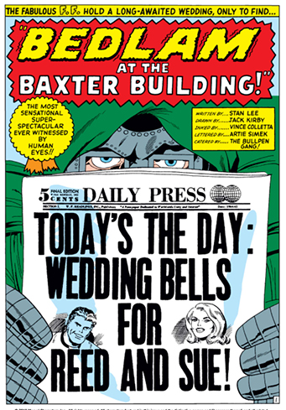
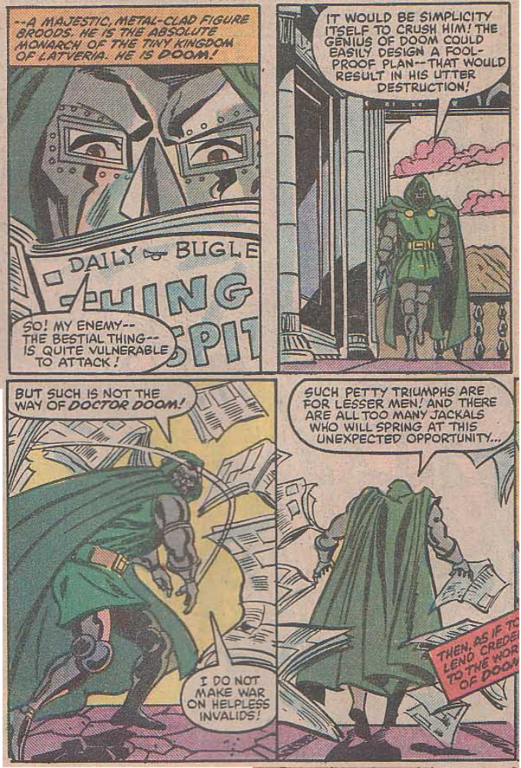
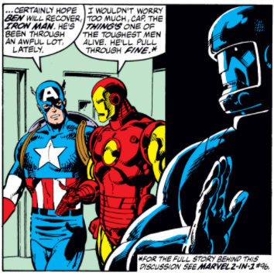
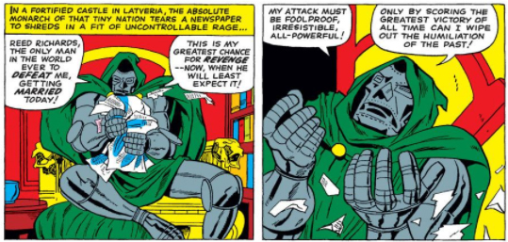
Byrne, John (w, a). "Interlude". Fantastic Four v1 #258 (Sep. 1983), Marvel Comics.
Lee, Stan (w), Jack Kirby (p), Mike Esposito (i). "The Wedding of Sue and Reed!". Fantastic Four Annual v1 #3 (Oct. 1965), Marvel Comics.
DeFalco, Tom (w), Ron Wilson (p), Mike Esposito (i). "Visiting Hours!". Marvel Two-In-One v1 #96 (Feb. 1983), Marvel Comics.
Notes:
He even finds time to bring in a very minor story from Marvel Two-In One #96, where The Thing spent the whole issue in hospital. Doom only had a brief cameo in that issue, reading about the story in the newspaper, but Byrne manages to squeeze it in by having a robot visit to kidnap another patient who's staying there at the same time. This story is itself a tribute to Fantastic Four Annual #3!

Slide 31
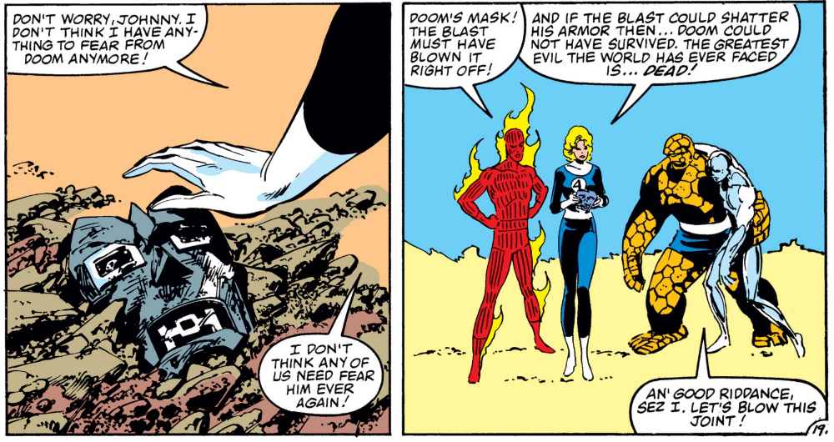
Byrne, John (w, a). "When Titans Clash!". Fantastic Four v1 #260 (Nov. 1983), Marvel Comics.
Notes:
This is all building up to the next couple of issues, where Doom ends up getting killed. What Byrne has been doing is building up his ownership of the character, specifying exactly what is and is not Doctor Doom, so that he can investigate this even further in our third text,

Slide 32
Byrne, John (w, p), Jerry Ordway (i). "True Lies". Fantastic Four v1 #278 (May. 1985), Marvel Comics.
Notes:
"True Lies" from FF 278. This was published ten months later, and shows us what happened to Kristoff.

Slide 33
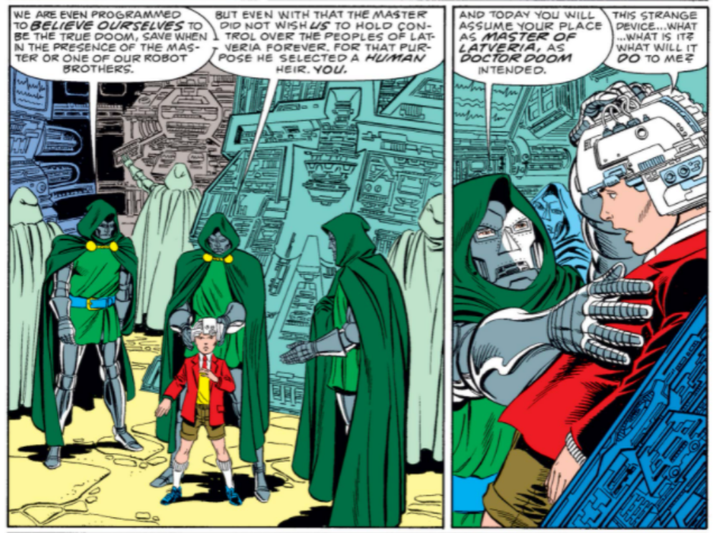
Byrne, John (w, p), Jerry Ordway (i). "True Lies". Fantastic Four v1 #278 (May. 1985), Marvel Comics.
Notes:
It turns out he wasn't being trained as an heir, he was being lined up for a mind wipe, so that Doom can replace Kristoff's memories with his own!
This process gives Byrne an opportunity to re-tell Doom's origin, as the information is fed into Kristoff's brain.

Slide 34
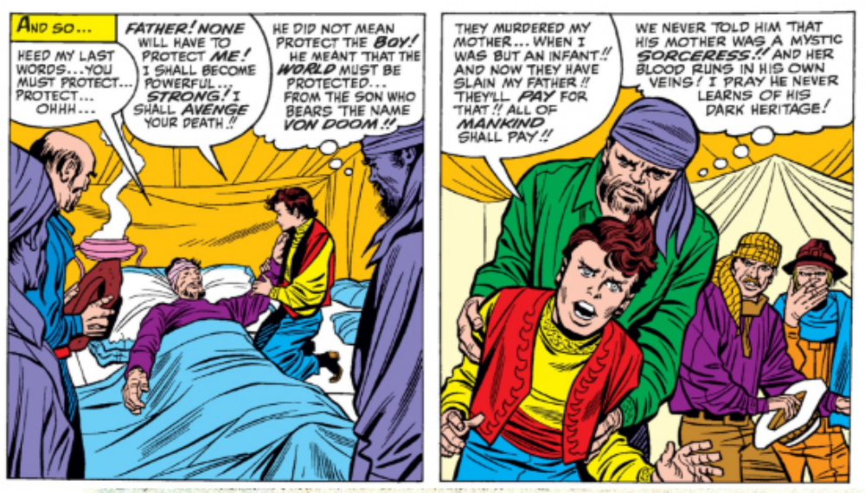
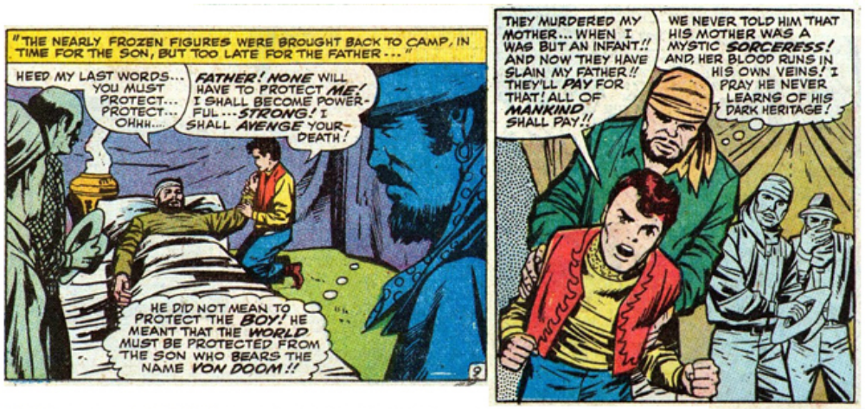
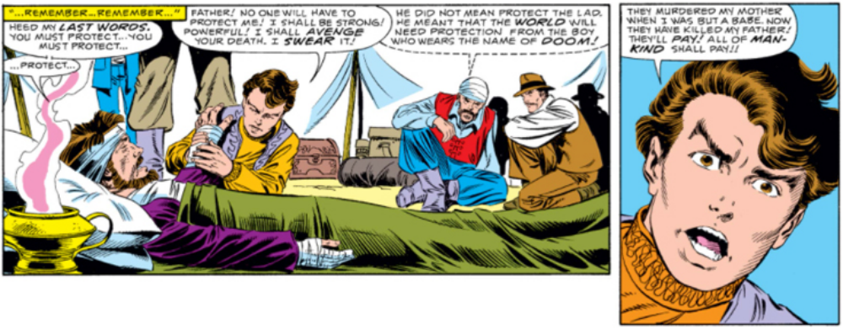
Lee, Stan (w), Jack Kirby (p), Chic Stone (i). "The Fantastic Origin of Doctor Doom!". Fantastic Four Annual v1 #2 (Sep. 1964), Marvel Comics
Lieber, Larry (w), Roy Thomas (w), Frank Giacoia (p), Vince Colletta (i). "This Man...This Demon!". Marvel Super-Heroes v1 #20 (May. 1969), Marvel Comics.
Byrne, John (w, p), Jerry Ordway (i). "True Lies". Fantastic Four v1 #278 (May. 1985), Marvel Comics.
Notes:
Byrne draws on two main sources for this - the original full version of Doom's origin in Fantastic Four Annual #2 and the first major revision on Marvel Superheroes #20 in 1969. In all three we see the death of Doom's father, directly quoted in 1969 and from a slightly different angle again in 1985.

Slide 35
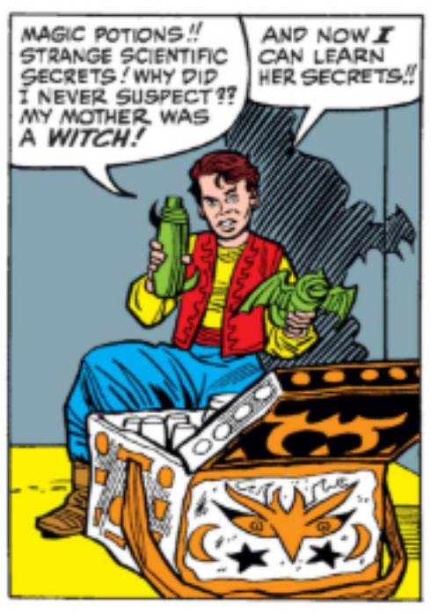
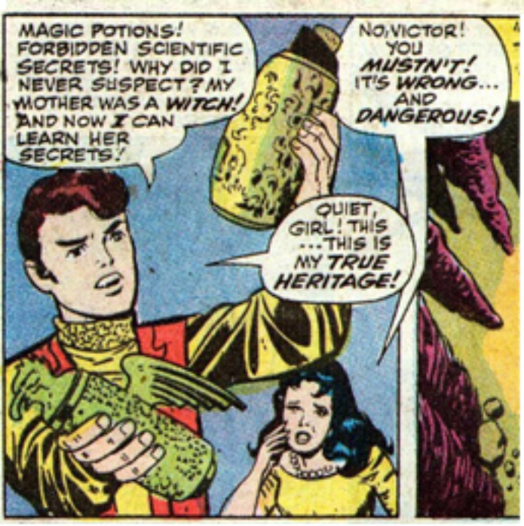
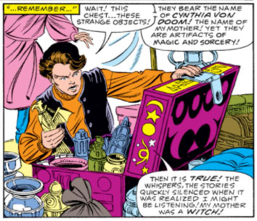
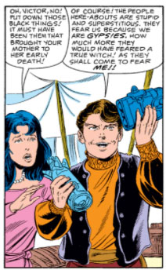
Lee, Stan (w), Jack Kirby (p), Chic Stone (i). "The Fantastic Origin of Doctor Doom!". Fantastic Four Annual v1 #2 (Sep. 1964), Marvel Comics
Lieber, Larry (w), Roy Thomas (w), Frank Giacoia (p), Vince Colletta (i). "This Man...This Demon!". Marvel Super-Heroes v1 #20 (May. 1969), Marvel Comics.
Byrne, John (w, p), Jerry Ordway (i). "True Lies". Fantastic Four v1 #278 (May. 1985), Marvel Comics.
Notes:
Then we get the discovery of his Mother's potions. Here the 1969 version is also from a different angle, as it was adding Doom's childhood sweetheart Valeria into the story. Byrne keeps this, and is careful to copy the design of the trunk, but changes the dialogue slightly.

Slide 36
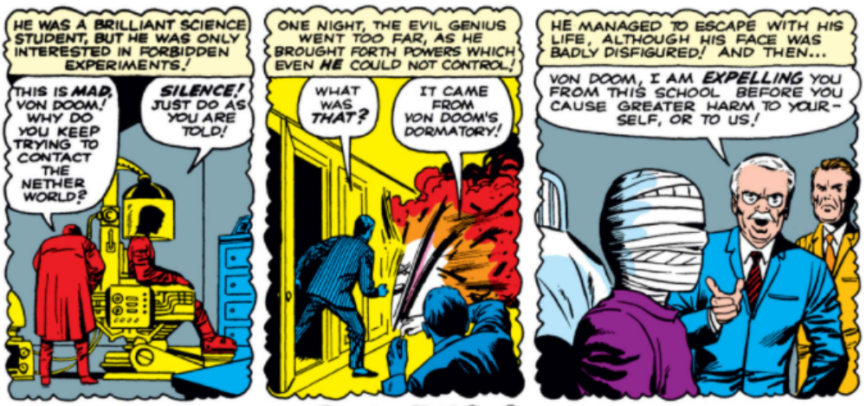
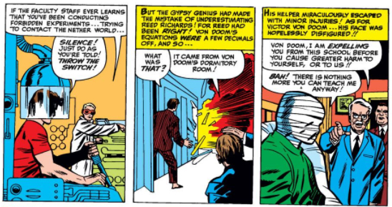
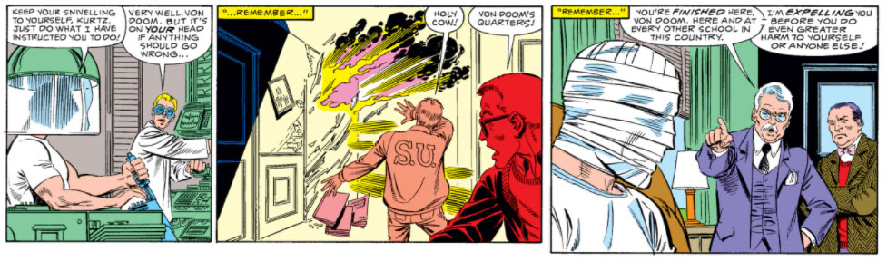
Lee, Stan (w), Jack Kirby (p), Joe Sinnott (i). "Meet Doctor Doom!". Fantastic Four v1 #5 (Jul. 1962), Marvel Comics.
Lee, Stan (w), Jack Kirby (p), Chic Stone (i). "The Fantastic Origin of Doctor Doom!". Fantastic Four Annual v1 #2 (Sep. 1964), Marvel Comics
Byrne, John (w, p), Jerry Ordway (i). "True Lies". Fantastic Four v1 #278 (May. 1985), Marvel Comics.
Notes:
This is all building up to the accident that scarred Doom's face. This was first shown in Doom's very first appearance in Fantastic Four #5, and then repeated almost exactly in Fantastic Four Annual #2. Here Byrne very deliberately illustrates this using exactly the same layouts, as if he's saying "This is exactly the same story you've seen before."

Slide 37


Lee, Stan (w), Jack Kirby (p), Chic Stone (i). "The Fantastic Origin of Doctor Doom!". Fantastic Four Annual v1 #2 (Sep. 1964), Marvel Comics
Byrne, John (w, p), Jerry Ordway (i). "True Lies". Fantastic Four v1 #278 (May. 1985), Marvel Comics.
Notes:
He continues by directly quoting the image from FF Annual #2 of Doom smashing a mirror. This has been quoted many times in many other comics, but here Byrne does something extra that's never been done before.

Slide 38

Lee, Stan (w), Jack Kirby (p), Chic Stone (i). "The Fantastic Origin of Doctor Doom!". Fantastic Four Annual v1 #2 (Sep. 1964), Marvel Comics
Byrne, John (w, p), Jerry Ordway (i). "True Lies". Fantastic Four v1 #278 (May. 1985), Marvel Comics.
Notes:
He inserts a panel and shows Doom's face! This had never been done before. By recreating the familiar origin story using the same images, and also by continually reinforcing the phrase "remember", Byrne is saying that this is exactly the same story we've seen before, just with one extra panel.
The idea that Doom was only mildly scarred beneath his mask was originally suggested by Jack Kirby, but here it's Byrne - as Kirby's equal - placing it into continuity, using Previous Events and the power of his own Authorship to do so.

Slide 39

Byrne, John (w, p), Jerry Ordway (i). "True Lies". Fantastic Four v1 #278 (May. 1985), Marvel Comics.
Notes:
We also get a recap of Doom's second appearance in Fantastic Four #6, when he stole the Baxter Building, and at this point Kristoff stops the replay. "I have no need for further memories", he says.
This is a repudiation of all that has gone before - he's got the basics, he doesn’t need any more Past Events or continuity, all he needs to do is correct the errors in his original plan and he can destroy the Fantastic Four.
Spoilers for anyone who's not read it:

Slide 40

Byrne, John (w, p), Jerry Ordway (i). "Crack of Doom!". Fantastic Four v1 #279 (Jun. 1985), Marvel Comics.
Notes:
He does not destroy the Fantastic Four. Things have changed since that early adventure, including The Invisible Woman developing Force Field powers.
Kristoff-Doom did not know this, because he had refused to engage with the Previous Events of Doctor Doom. Byrne is saying: These things are important!

Slide 41
Character components
Character-Specific
  Appearance
  Names And Titles
  Physical Actions
  Dialogue
Storyworld-Specific
  Locations
  Other Characters
  Objects
  Previous Events
Authorship
  Market Authors
  Textual Authors
Behaviour
  Perceived Behaviour
  Personality Traits
  Motivations
Notes:
As we've seen, Kristoff has many of the other character components of Doom, including the name Doctor Doom, ways of speaking and behaving, his castle in Latveria, the Doombots and so on, and Byrne has been at pains to demonstrate that he himself - John Byrne - is also a signifier of the real Doom.
However, Kristoff does not have access to Doom's Previous Events and so cannot be the true Doom.

Slide 42

Byrne, John (w, p), Jerry Ordway (i). "Crack of Doom!". Fantastic Four v1 #279 (Jun. 1985), Marvel Comics.
Notes:
This is then also signalled by Kristoff's costume - this is not revealed until the very end of the story, and we only see it in full in this panel. The different costume is a clear indicator that something is not right, but the costume is not the main thing. It was Kristoff's lack of Previous Events that meant he was not the true Doom.

Slide 43
Summary
Image quotation
Textual and Market authorship
Previous events
Notes:
In summary then, through these three comics, John Byrne uses image quotation to enforce his own position as a textual and market author. He demonstrates this via his power over Previous Events, and uses the story of Kristoff ...

Slide 44



Byrne, John (w, a). "Interlude". Fantastic Four v1 #258 (Sep. 1983), Marvel Comics.
Byrne, John (w, p), Jerry Ordway (i). "Crack of Doom!". Fantastic Four v1 #279 (Jun. 1985), Marvel Comics.
Byrne, John (w, a). "This Land Is Mine!". Fantastic Four v1 #247 (Oct. 1982), Marvel Comics.
Notes:
to show that characters who do not contain this vital component can never be the 'true' version. In an ongoing storyworld like the Marvel Universe, the past can change, but it must always remain coherent.

Slide 45

www.mjhibbett.co.uk/doom
@marvelagedoom
Notes:
And that’s it! Thanks for listening, and please visit me on the web!

