Slide 1

The importance of academic advisors in supporting a sense of belonging for Global Ethnic Majority (GEM) students.
Dr Neil Currant, University of the Arts London

Slide 2

Caveat: terminology
Black, Asian and Minority Ethnic (BAME) is not now considered useful but there is an absence of agreed language.
Some have been using Global Ethnic Majority (GEM) instead.
Foregrounds that white people are not a majority ethnic group globally.
Drops ‘minority’ which has negative connotations and relative positioning to white people.
But still need to be careful to only use in certain circumstances so as not to brush off differences between ethnic groups.

Slide 3
Background
Doctoral research at a non-London / ethnically diverse city university – qualitative, narrative enquiry.
Experiences of belonging for British Asian and Black students at a predominately white university.
The impetus was addressing awarding gaps and trying to understand what might be behind them.
Focus today – the role of academic advisor.

Slide 4
Some literature
academic advisor can play a key role in student decisions to persist (Cotton, Neale and Nash 2013), and their academic success (Stevenson 2012).
Relationship with academic advisor is a crucial precursor to students then subsequently seeking help and support at a point of need (Yale 2019).
A negative experience of academic advising has been found to be more harmful than no support (Yale 2019).

Slide 5
Some headline findings
Had intended to look at the overall experience – the role of academic advisor emerged from narratives.
The relationship with the academic advisor seemed a key differentiator between those with a strong sense of belonging and those with a weak sense of belonging.

Slide 6
Contact
“I met my academic advisor at the beginning of the year but after that I haven’t been in contact with her, but yes, she hasn’t been in contact with me either.”
- Students often feel the advisor needs to initiate and maintain a good relationship.
I have asked to see her (advisor) and she has said to send an email and whenever I have done that she has not responded to the email.
“I think you have to seek out the support. I have had no contact with my academic advisor for over a year. It would be good if he could get in touch to see how well you are doing,”

Slide 7
Emotional connection / empathy
“XXX is the best academic advisor in the world”
- When talking about their academic advisor there was a strong emotional element: positive or negative.
- Students wanted empathy, someone to listen to them.
“today I had a one to one meeting with my advisor and she was really nice to me which was a change.”

Slide 8
Relational / human
- Students want to be known by an academic member of staff (Nottingham Trent University et al. 2011).
“I would go to one of those lecturers without any hesitation whatsoever. Probably more so than anybody else in my cohort, purely because, over that period of time, I’ve developed a relationship with the lecturers that, you know, I interface with.”

Slide 9
Two contrasting stories
The link goes to a shared document of two contrasting, composite, creative non-fiction, counter-stories (borrowing from Critical Race Theory, e.g. David Gillborn).
The empathetic tutor & A bad relationship

Slide 10
The specific challenges for GEM students
GEM students are more likely to be commuter students (Donnelly and Gamsu 2018). In my research these students did not often have time to ‘hang out’ on campus. Their interactions with others were mostly in formal situations.
Onlyness (Harper 2009): GEM students might be the only person or one of a few from a particular ethnic group in the cohort.
GEM students are far more likely to be involved in cross-racial interactions.

Slide 11
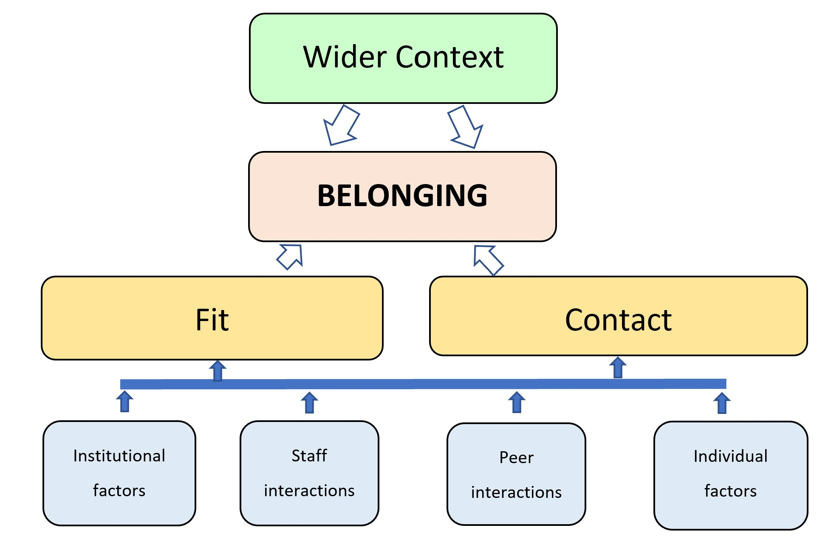
Belonging: A relational model
Sense of fit: The one to many relationships. Relationship to the environment.
Contact: one to one relationships
Thoughts on the model?

Slide 12
Discussion
How can academic advisors make GEM students feel more welcome and support a sense of belonging at university?
What practices do colleagues already engage in?
What skills / knowledge do (white) academic advisors need to better support GEM students?

Slide 13
References
Cotton, D., Kneale, P. and Nash, T. (2013) Horizon-scanning report: Widening Participation, Retention and Success, Plymouth University: Plymouth.
Currant, N. (2020) “My Stomach Churns”: Belonging and Strategies for Belonging for BME Students in a White University, Thesis, Oxford Brookes University https://radar.brookes.ac.uk/radar/items/ea510237-87ca-4f14-bc9e-5e3edcffa073/1/
Donnelly, M. and Gamsu, S. (2018) Home and Away: Social, Ethnic and Spatial inequalities in student mobility, Sutton Trust: London.
Harper, S. (2009) ‘Niggers no more: A critical race counter-narrative on Black male student achievement at predominantly White colleges and universities.’ International Journal of Qualitative Studies in Education. 22 (6), pp. 697-712.
Nottingham Trent University, Bournemouth University, University of Bradford (2011), The HERE Project, Higher Education: Retention and Engagement [final project report, online] https://www.academia.edu/20680385/The_HERE_Project_Higher_Education_and_Engagement_Final_Project_Report, Accessed 18th November 2019
Stevenson, J. (2012). Black and Minority Ethnic Student Degree Retention and Attainment, Higher Education Academy: York.
Yale, A. (2019) ‘The personal tutor–student relationship: student expectations and experiences of personal tutoring in higher education,’ Journal of Further and Higher Education, 43:4, pp.533-544.

