Slide 1
Damian Fitzpatrick
University of the Arts London
Damon Brewster
J. F. Oberlin University, Tokyo
Covert racial stereotyping in the language of football: A critical discourse analysis of online reporting

Slide 2
Abstract
This study explores to what extent racial stereotyping of footballers in the English men’s game exists in mainstream online media reports. The research is conducted against the background of an increase in the number of racist attacks/abuse on current BAME football players in the UK, and the intervention by one of the highest-profile football players in England, Raheem Sterling, who recently suggested that newspapers may help to 'fuel racism' in their reporting on the game. Over 20 years ago, McCarthy and Jones (1997) argued that 'evidence of covert racial stereotyping was found’ in TV commentators’ language and in particular when they described the following three categories: players’ performance, their physicality, and their psychology. With these categories in mind, the current study explores whether covert, and indeed overt, racial stereotyping still exists in mainstream online match reports, match reviews and opinion pieces. In order to do this, and adopting a Critical Discourse Analysis approach (Fairclough, 2010; Wodak, 2004), this presentation shares initial findings from a corpus of football on the first genre, match reports, from the 2019-20 Premier League season taken from a selection of online media outlets.

Slide 3
Outline
▪ Context
▪ Racial Stereotypes in Football Media
▪ Critical Discourse Analysis (CDA)
▪ Corpus Studies
▪ Methodology
▪ Our Corpus
▪ Preliminary Findings
▪ Conclusions
▪ Next Steps

Slide 4
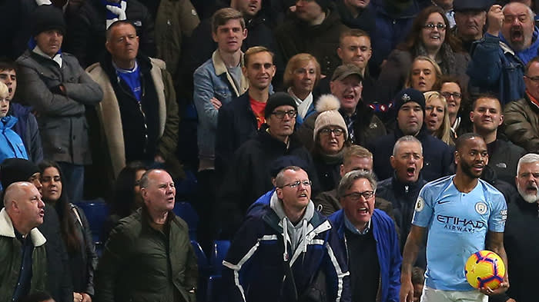
© Michael Zemanek/BPI/REX/Shutterstock

Slide 5
Newspapers
‘fuel racism’?
Good morning I just want to say , I am not normally the person to talk a lot but when I think I need my point to heard I will speak up. Regarding what was said at the Chelsea game as you can see by my reaction I just had to laugh because I don’t expect no better. For example you have two young players starting out there careers both play for the same team, both have done the right thing. Which is buy a new house for there mothers who have put in a lot of time and love into helping them get where they are, but look how the news papers get there message across for the young black player and then for the young white payer. I think this in unacceptable both innocent have not done a thing wrong but just by the way it has been worded. This young black kid is looked at in a bad light. Which helps fuel racism an aggressive behaviour, so for all the news papers that don’t understand why people are racist in this day and age all i have to say is have a second thought about fair publicity an give all players an equal chance.
(@sterling7 [Instagram] December 9th 2018)

Slide 6
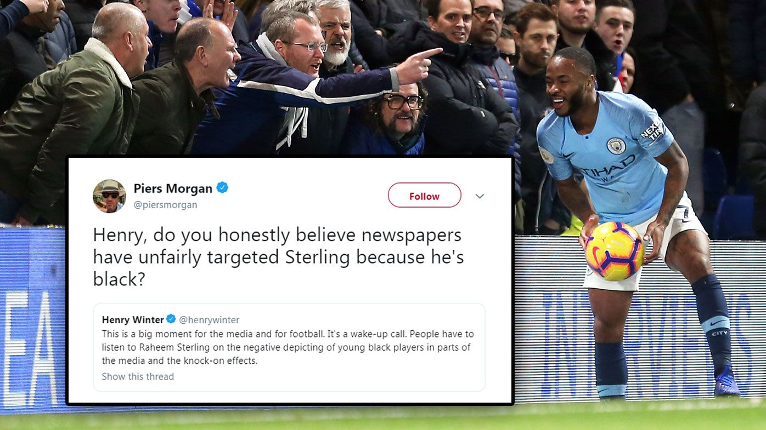

Slide 7
Sport Media
and Race
Mediated sports reporting can be seen as an ideological process in its representation of discourse (Fairclough, 2010)
This power of representation includes:
  how racial groups are described (Sabo & Jansen, 1994; van Sterkenburg, Knoppers, & de Leeuw, 2012; Wrench & Garret, 2017)
  how racial stereotypes are maintained and disseminated (van Sterkenburg, Peeters & van Amsterdam, 2019; Campbell & Bebb, 2020)

Slide 8
Racial Stereotypes in Mediated Sport (TV Commentary)
McCarthy & Jones (1997)
TV commentators use different language for players of different races:
  Players and their performances
  Physical characteristics of players
  Psychological characteristics of players
‘... excessive positive depictions related to the physicality of the Black players and the psychological characteristics of the White players’
McLoughlin (2020)
Players with lighter skin tone described as: more intelligent, higher quality, harder working
Players with darker skin tone were ‘[…] reduced to their physical characteristics or athletic abilities - namely pace and power […more] than players with lighter skin tone players were’.
Campbell & Bebb (2020)
Racial framing of players at 2018 World Cup
‘Positive praise differed for differently raced players’

Slide 9
Why BAME/Non-BAME?
McCarthy & Jones (1997)
Black/White players
McLoughlin (2020)
Lighter/darker skin tone players (from Championship Manager game)
Campbell & Bebb (2020)
Black/White/Dual heritage players

Slide 10
Aims and Research Questions
Aims
To explore to what extent racial stereotyping of footballers in the English male game exists in mainstream online media reports.
Research Questions
Is there a difference in how BAME/non-BAME players are described in match reports in the following two areas:
  their physical characteristics?
  their psychological characteristics?

Slide 11
Critical Discourse Analysis (CDA)
Language as a social practice (Fairclough, 2010; Wodak, 2004)
Uncovering opaque structures when manifested through language (Wodak, 2004; Baker, et al., 2008)
Interdisciplinary: linguistics, discourse, race, power structures
Choice of methods with CDA is not fixed but instead should be one that best fits the research question (Wodak, 2004)

Slide 12
CDA and Corpus Linguistics
Corpus Linguistics
Analyses large quantities of authentic language use via electronic text (Baker, 2006)
Useful for describing and uncovering frequencies and patterns of language
Mainly quantitative but has elements of qualitative analysis (Baker, et al., 2008)
CDA and Corpus Linguistics
‘Corpus linguistics techniques [are] becoming increasingly popular in critical approaches to discourse analysis’ (Baker, et al., 2008, p. 275)
Texts can be analysed from multiple perspectives (Baker, Gabrielatos & McEnery, 2013)

Slide 13
Our Corpus: "2019-20 Combined Match Reports​​"
Overview
Corpus type: monolingual; specialised (formulaic football match reports (Meier, 2019); and synchronic​​
Software: Lancsbox 6.0.0 (Brezina, Weill-Tessier, & McEnery, 2021)
Data from 2019-20 Premier League (English) season (516 texts in total):
  BBC – 380 reports & Daily Mail – 136 report
    Tokens: 456,531*
    Types: 14,770
    Lemmas: 13,000
*Baker, et al. (2008) write specialised corpus vary in size - 20,000–200,000 words.

Slide 14
Our Corpus: Process
Process
The match reports text included dates, writers, match details
Stripped of images, unwanted links, below the crease comments et cetera.
Saved using a standard file name format as individual text files.
Text files were batch uploaded to the software and annotated by the software on upload

Slide 15
Our Corpus: Analysis
Analysis
Key words (KW) chosen using previous studies (e.g. McCarthy & Jones, 1997); Physical: strong, athletic, running; Psychological: thinking, focus, concentrating.
​​Stage 1 Analysis - The Context: KWIC search; independently looked at context of KW; identified relevance / connection to player (other KW were added); collated and compared results (inter-rater reliability)
Threshold - At least 10 references of KW with player
Players were categorised as BAME /Non-BAME (individually, compared for inter-rater reliability)
Stage 2 Analysis - BAME Representation: Data adjusted using 25% estimate of BAME football players in the Premier League and Football League in England (Kandola, 2016)

Slide 16
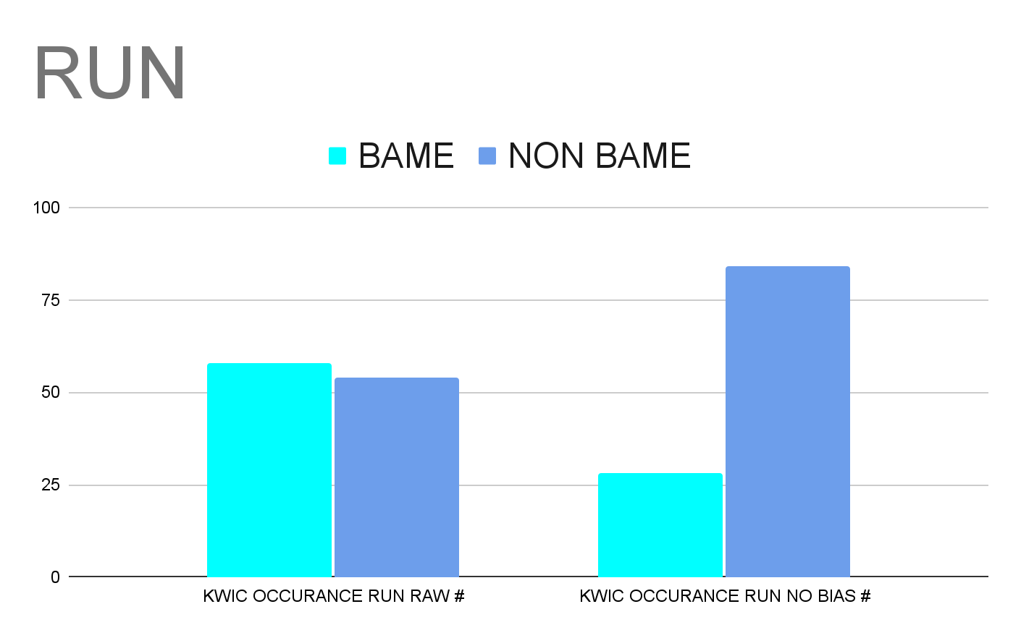
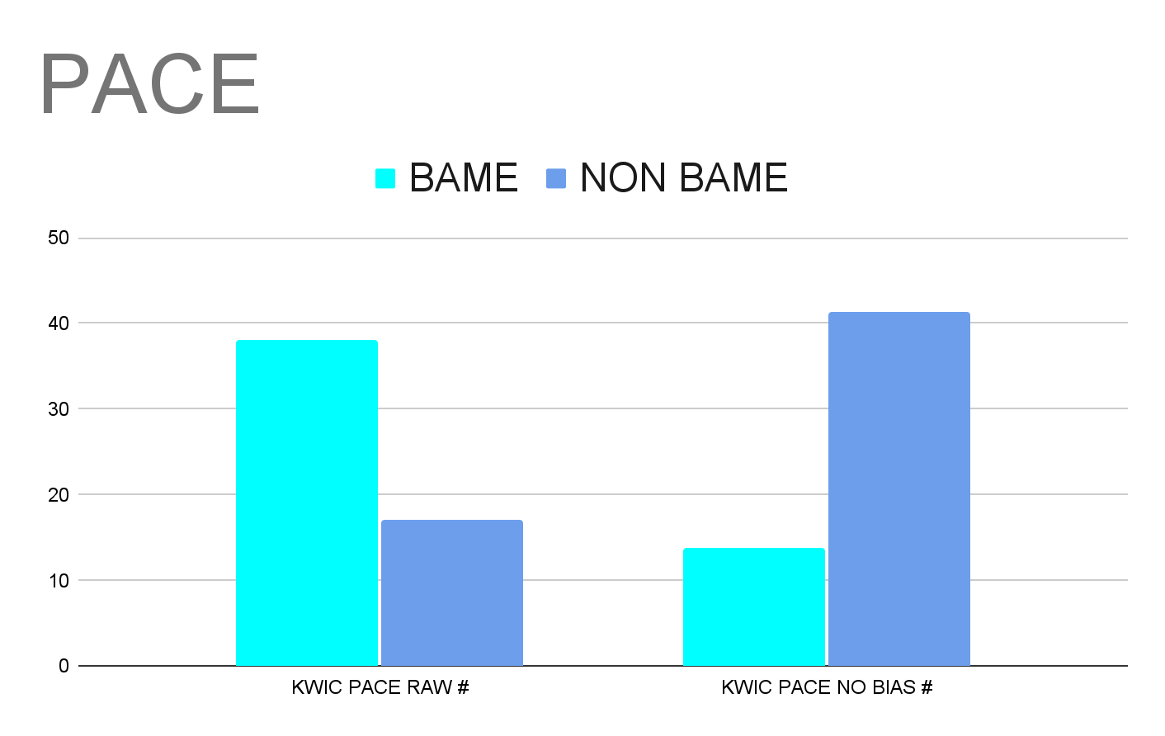
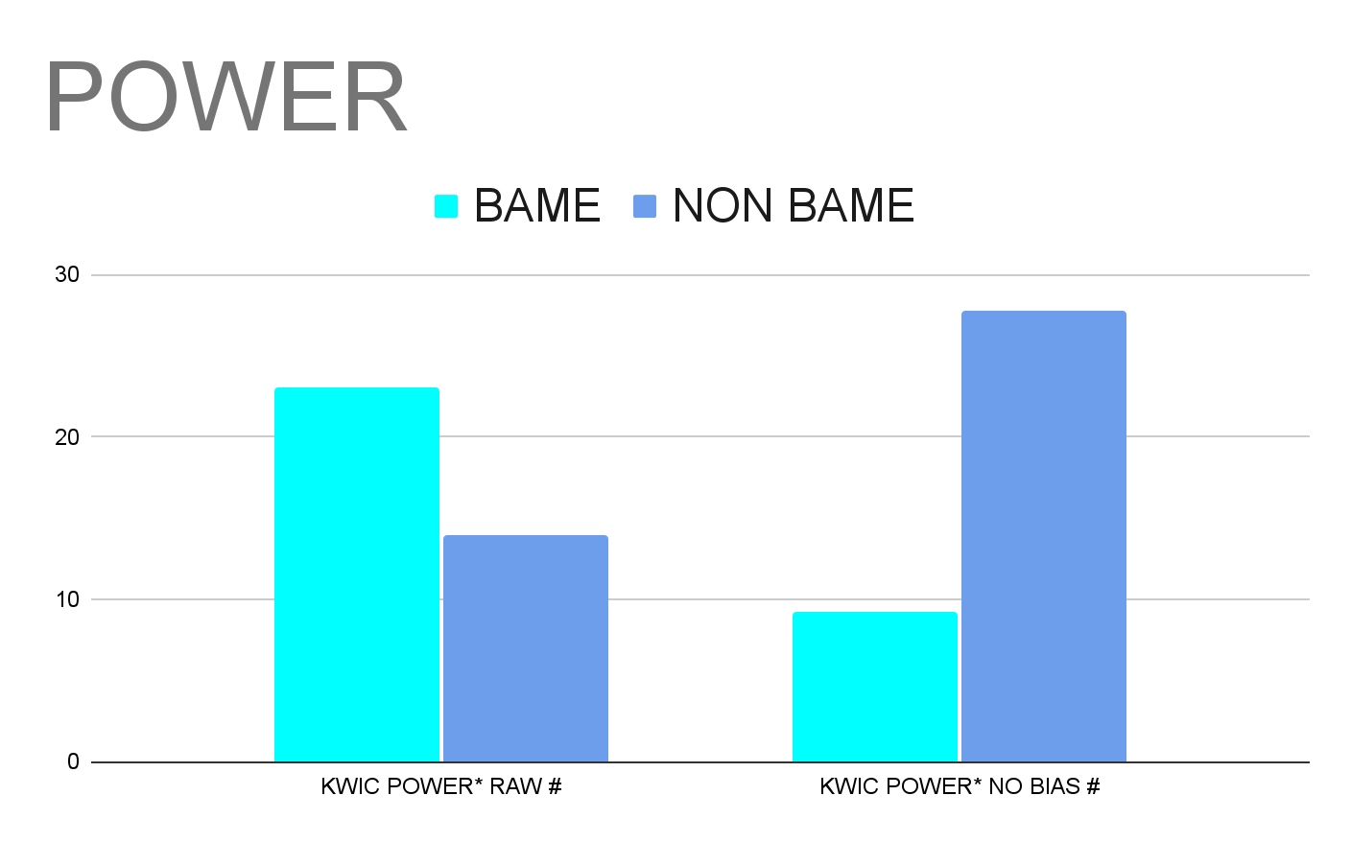
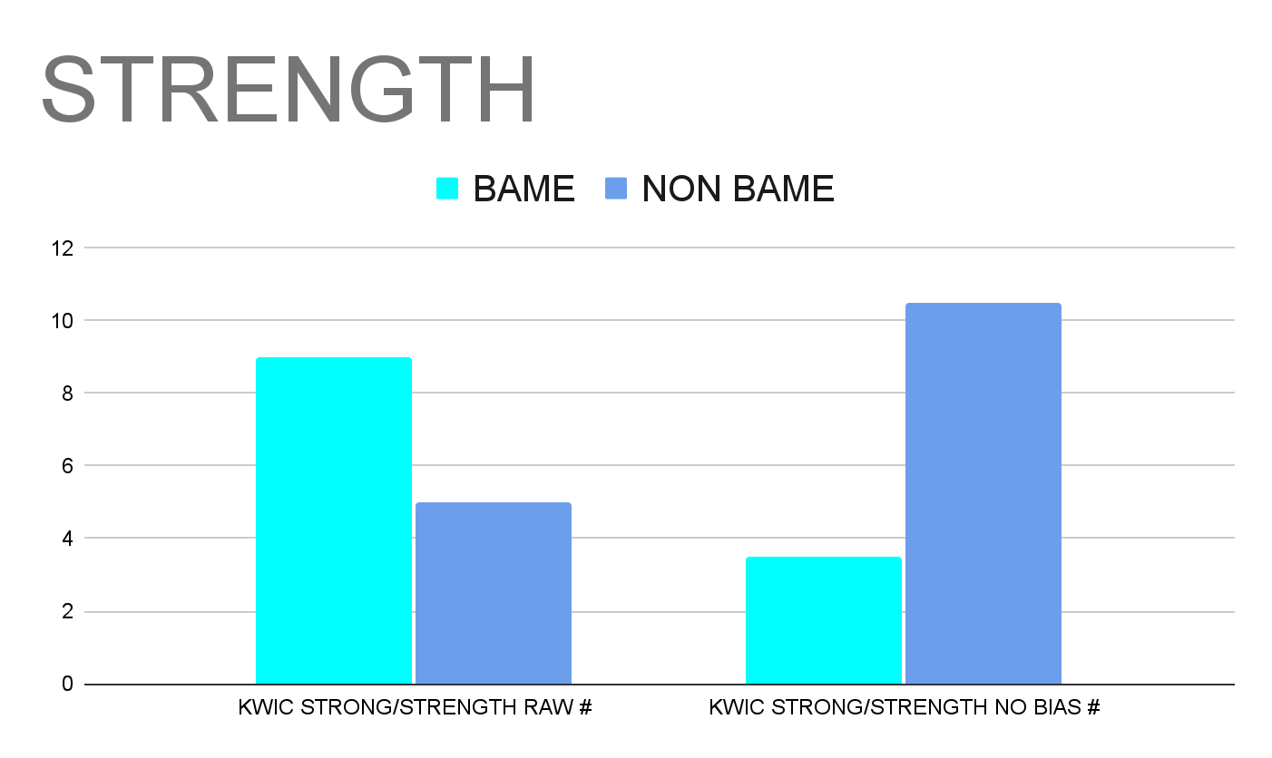
P
H
Y
S
I
C
A
L

Slide 17
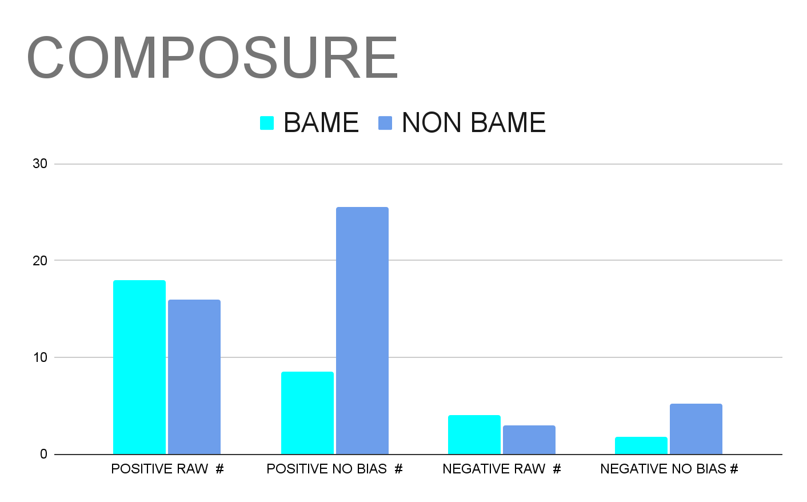
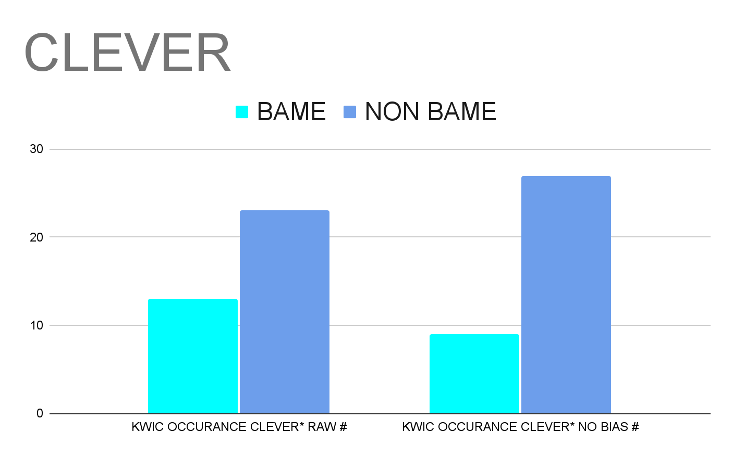
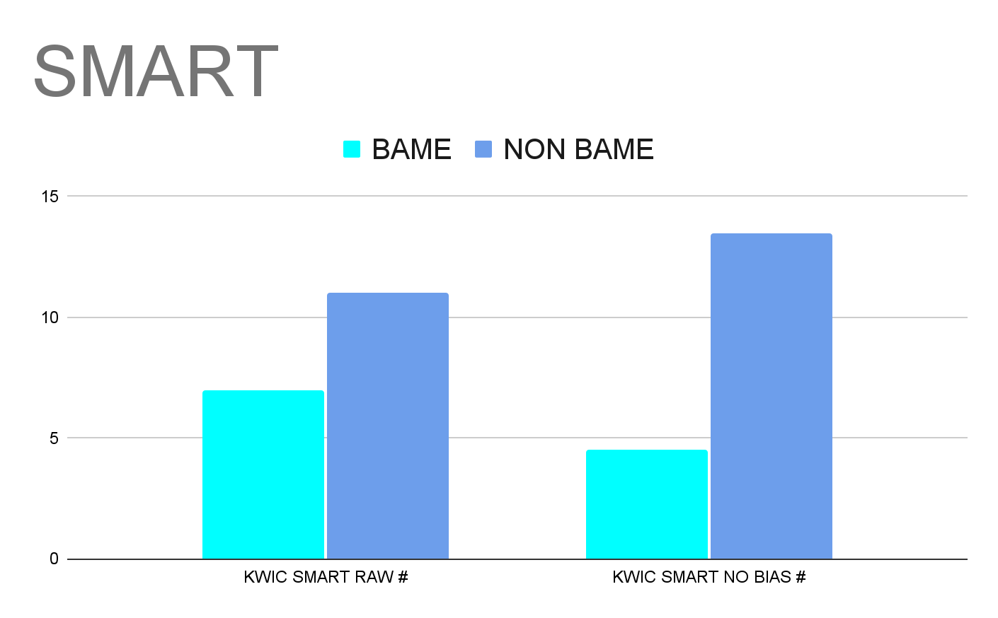
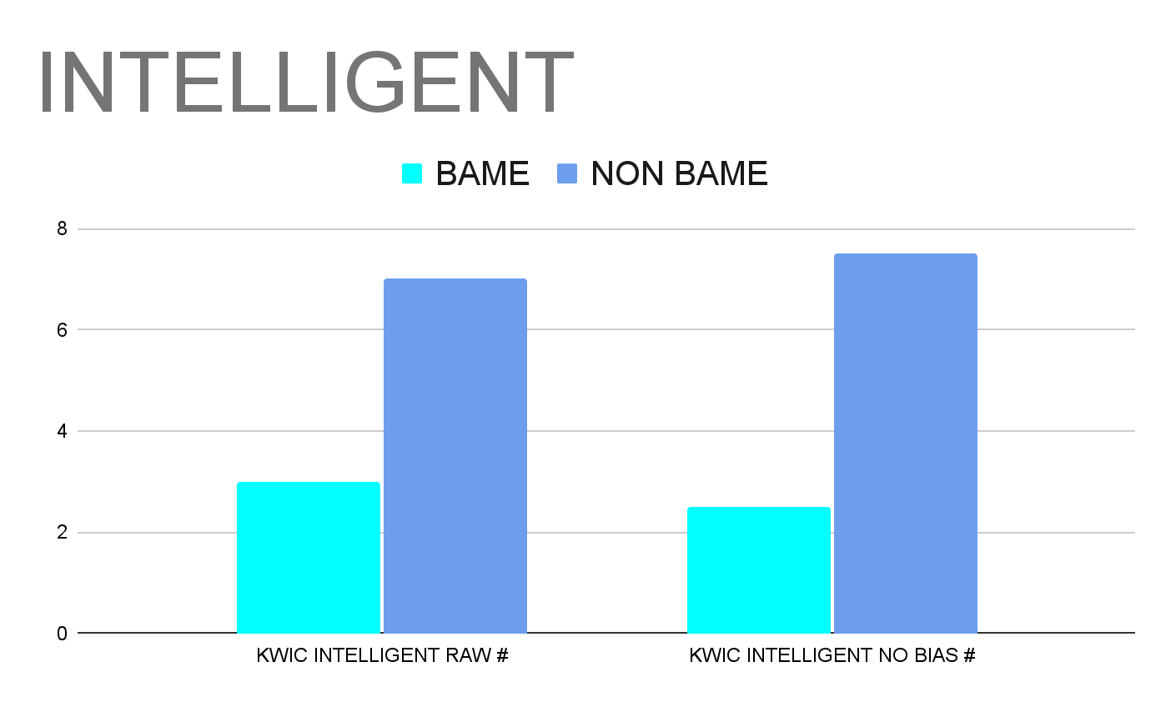
P
S
Y
C
HO
L
OG
I
C
A
L

Slide 18
Discussion
Research Questions: Is there a difference in how BAME/non-BAME players are described in match reports in the following two areas: physical and psychological characteristics?
Physical
BAME players were described more in terms of their physicality than non-BAME players, i.e. BAME players more likely to be praised on physical attributes.
  In line with recent studies (e.g. McCarthy & Jones (1997); McLoughlin (2020); Campbell & Bebb (2020))
  Reflects ideas of many previous studies (e.g. McCarthy & Jones, 1997) of ‘natural athlete’ vs ‘hard-working athlete’

Slide 19
Discussion
Research Questions: Is there a difference in how BAME/non-BAME players are described in match reports in the following two areas: physical and psychological characteristics?
Psychological
Although terms in this category were attributed more to non-BAME players, it was not as marked as physicality – slightly different from McCarthy & Jones (1997) study.
  Genre of mediated written texts rather than live TV commentary - factual, less emotional, scripted (Kassing, et al., 2004)
  Suggestions that Premier League has 25% BAME players (Pearn Kandola, 2016) may be understated (e.g. Dibble (2018) reported 33%)
  How data was categorised (using two from McCarthy & Jones (1979) rather than five from Campbell & Bebb, 2020).

Slide 20
Conclusions
Current Study: Next Stage
Further iterative analysis of corpus (i.e. deeper analysis of texts containing key words (e.g. ‘smart’)
Extend the current corpus (e.g. compare differences between players in different media)
Modify BAME/Non-BAME categories to include dual heritage players (Campbell & Bebb, 2020)
Recommendations
Mediated football reporting is an ideological process in its representation of discourse (Fairclough, 2010), so an increase in understanding/awareness/reflection on choices of language in match reports is necessary in order to avoid unconscious bias/covert racism
Increased presence of BAME journalists/editors (though Campbell & Bebb (2020) question this as being ‘superficial’

Slide 21
Next Steps
Future Studies
Historical analysis, e.g. Compare different corpora (e.g. 2012 vs 2020)
Individual player analysis, e.g. track key moments of players’ careers (e.g. Raheem Sterling)
International match reports, i.e. How is idea of nationhood (e.g. ‘Englishness’) represented?
Women’s football - Are there similar categories in mediated reporting of women’s game (e.g. ‘pace and power’?
Other languages?

Slide 22
References (1)
AP Agency (2021). Raheem Sterling takes the knee… [Photograph]. Oxford Mail.com. https://www.oxfordmail.co.uk/news/19439010.englands-footballers-take-knee/
Baker, P. (2006). Using corpora in discourse analysis. A&C Black.
Baker, P., Gabrielatos, C., Khosravinik, M., Krzyżanowski, M., McEnery, T., & Wodak, R. (2008). A useful methodological synergy? Combining critical discourse analysis and corpus linguistics to examine discourses of refugees and asylum seekers in the UK press. Discourse & Society, 19(3), 273–306. https://doi.org/10.1177/0957926508088962
Baker, P., Gabrielatos, C., & McEnery, T. (2013). Discourse analysis and media attitudes: The representation of Islam in the British press. Cambridge University Press.
Brezina, V., Weill-Tessier, P., & McEnery, A. (2021). #LancsBox v. 6.x. [software package].
Campbell, P. I., & Bebb, L. (2020). ‘He is like a gazelle (when he runs)’ (Re)constructing race and nation in match-day commentary at the men’s 2018 FIFA World Cup, Sport in Society, https://10.1080/17430437.2020.1777102
Dibble, A. (2017). Proportion of British BAME players has doubled since the Premier League began–talkSPORT special report. https://talksport.com/football/269320/proportion-british-bame-players-has-doubled-premier-league-began-talksport-special-report/
Fairclough, N. (2010). Critical discourse analysis: The critical study of language. Routledge.

Slide 23
References (2)
Kassing, J. W., Billings, A. C., Brown, R. S., Halone, K. K., Harrison, K., Krizek, B., Mean, L. J., & Turman, P. D. (2004). Chapter
10: Communication in the community of sport: The process of enacting, (re)producing, consuming, and organising sport.
Communication Yearbook, 28(1), 373–409. https://doi.org/10.1207/s15567419cy2801_10
King, C. (2004). Race and cultural identity: Playing the race game inside football. Leisure Studies, 23(1), 19-30. https://doi.org/10.1080/0261436042000182290
Meier, S. (2019). Formulaic language and text routines in football live text commentaries and match reports: A cross-and corpus-linguistic approach. In Levin, M., & Callies, M. (Eds.). Corpus approaches to the language of sports: Text, media, modalities, 13-36. Bloomsbury Publishing.
McLoughlin, D. (2020). Racial bias in football commentary: The pace and power effect. https://runrepeat.com/racial-bias-study-soccer
McCarthy and Jones (1997). Speed, aggression, strength, and tactical naivite: The portrayal of the black soccer player on television. Journal of Sport and Social Issues, https://doi.org/10.1177/019372397021004003
Morgan, P. [@piersmorgan]. (2018, December 9). ‘Henry, do you honestly believe newspapers have unfairly…’ [Tweet]. Twitter. https://twitter.com/piersmorgan/status/1071719045370662913
Pearn Kandola. (2016, January 7). Lack of diversity found in the leadership of Premier League football clubs [Press release]. https://pearnkandola.com/press/press-release-lack-of-diversity-found-in-the-leadership-of-premier-league-football-clubs/

Slide 24
References (3)
Sabo, D., & Jensen, S. (1994). Seen but not heard: Images of black men in sports media. In Sex, violence & power in sports: Rethinking masculinity. Freedom, CA: The Crossing Press, pp. 150–160.
Sterling, R. [@sterling7]. (2018, December 9). ‘Good morning I just want to say, I am not normally the person to talk...’ [Photo]. Instagram. https://www.instagram.com/p/BrKYvF3gH9e/
van Sterkenburg, J., Knoppers, A., & de Leeuw, S. (2012). Constructing racial/ethnic difference in and through Dutch televised soccer commentary. Journal of Sport and Social Issues, 36(4), 422–442. https://doi.org/10.1177/0193723512448664
van Sterkenburg, J., & Peeters, R. (2019). Everyday racism and constructions of racial/ ethnic difference in and through football talk. European Journal of Cultural Studies, 22(2), 195–212. https://doi.org/10.1177/1367549418823057
Wodak, R. (2004). Critical discourse analysis. In Seale, C., Gobo, G., Gubrium, J. F., & Silverman, D. (Eds.), Qualitative research practice (pp. 186-201). SAGE Publications Ltd, https://www.doi.org/10.4135/9781848608191
Wrench & Garret, (2017). Constructions of ‘whiteness’: Race, sport and Australian media. The Discourse of Sport, 131-149.
Zemanek, M. (2019). Raheem Sterling reacts… [Photograph]. FT.com. https://www.ft.com/content/4822b158-819c-11e9-9935-ad75bb96c84

