Slide 1
Making Visible the Invisible: Criticality in Student Academic Writing
Dr Damian Fitzpatrick

Slide 2
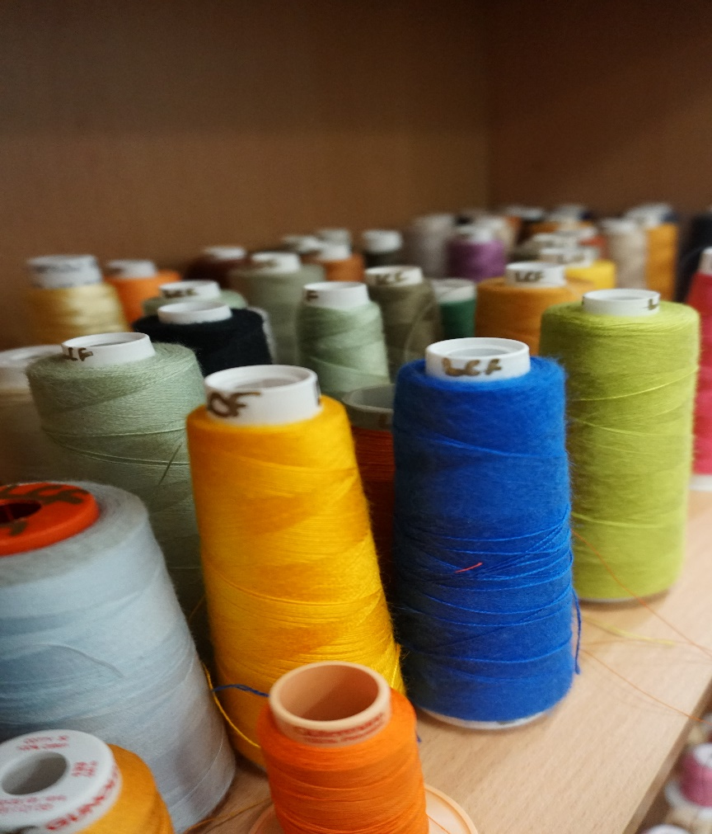
Outline
Context
  UAL < London College of Fashion
Academic Literacies
Criticality
Methodology
Findings
Materials
Implications

Slide 3
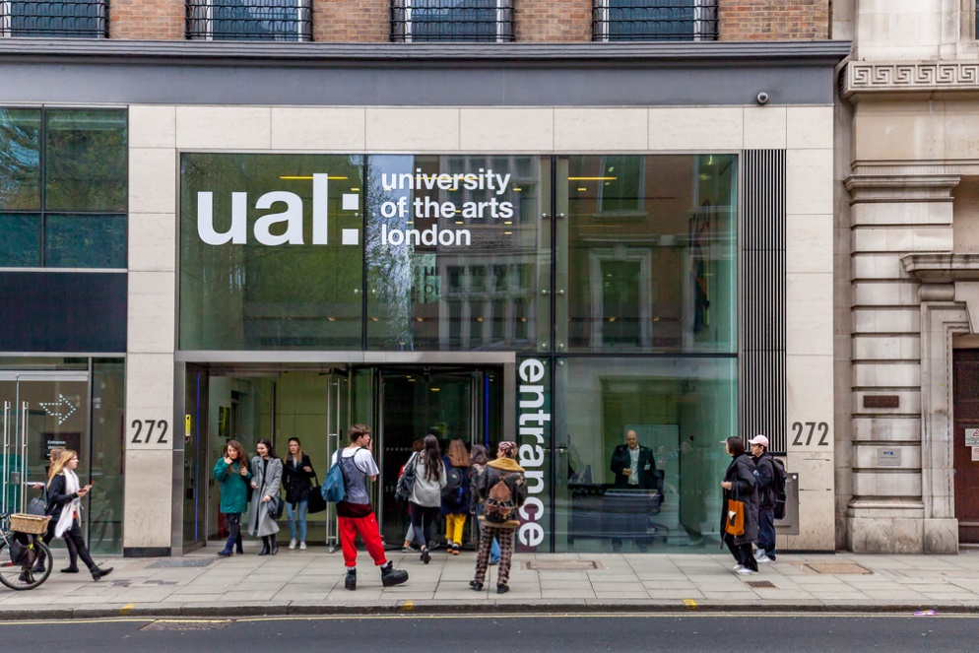
Context - UAL
Central Saint Martins
London College of Communication
Chelsea College of Art
Camberwell College of Art
Wimbledon College of Art
London College of Fashion
  Design
  Business
  Science

Slide 4
Academic literacies
‘…a critical approach to researching and teaching writing and literacy…’ and how these impact on ‘individual meaning making and academic knowledge construction in higher education’ (Mitchell, et al., 2015, p. 4)
‘How to make language and writing visible in meaningful ways in disciplinary activity’ (Lillis, et al., 2015, p. 4)
Academic writing from perspective of student writers
Students may be unaware of practices of institution/discipline/genre/assessment types
Students asked to be critical (learning outcomes) but this can be abstract/fluid

Slide 5
Learning outcomes: criticality
Critically evaluate theories and research involving…
Critically reflect on your contribution to…
Critically analyse the roles of…
Critically evaluate the outcomes of…

Slide 6
Aims/research questions
Aims
To discover more about teachers’/students’ understanding of academic writing practices;
To discover what the construct of criticality may look like for a group of students and their discipline teachers;
To investigate the linguistic/literacy skills students need to become more critical in their writing.
Research Questions
How do teachers describe the construct of criticality?
How do students describe the construct of criticality?
What implications are there for pedagogy?

Slide 7
Methodology

Slide 8
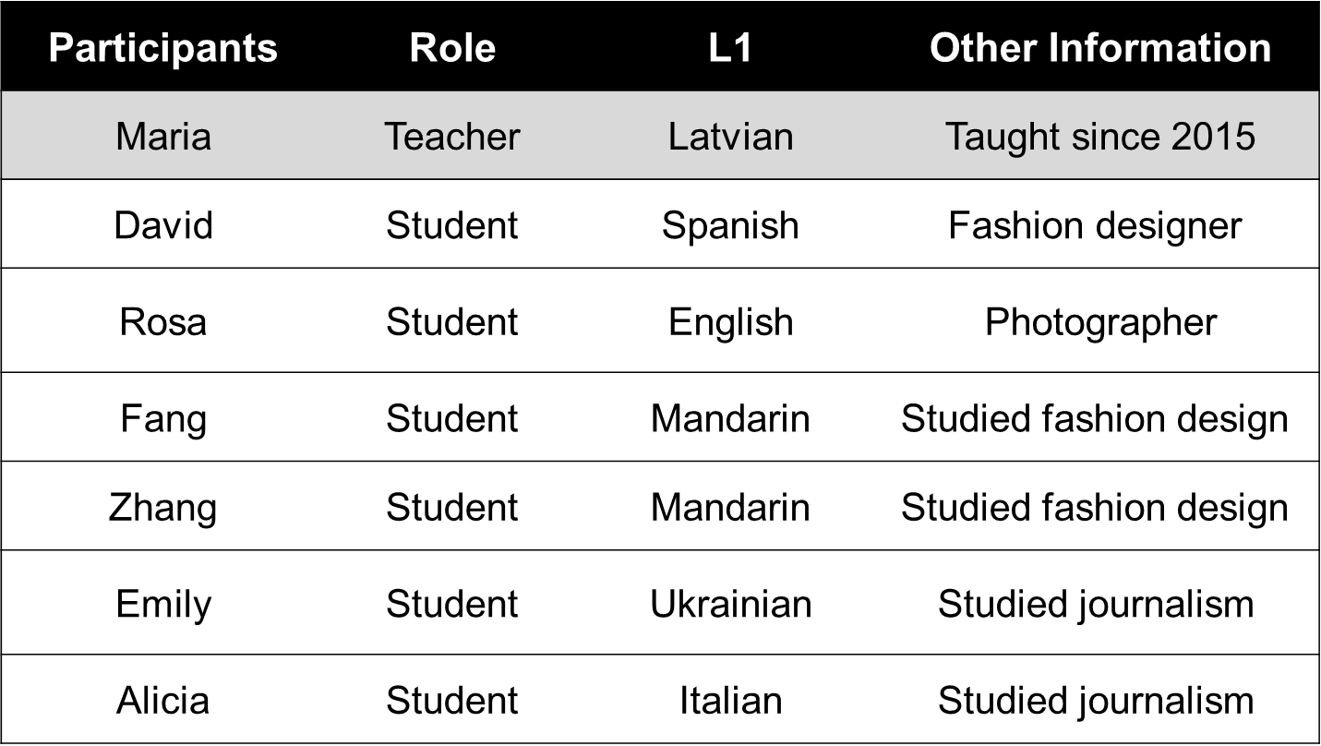
Participants

Slide 9
Methodology: process
Data Collection
Used course documents (briefs/handbooks)
Asked general questions to students/teachers about writing
  Semi-structured interviews
Asked questions about specific assignment
  Stimulated recall (Gass & Mackey, 2015)
Audio-recorded/transcribed
Data Analysis
Highlighted areas connected to criticality
Formed categories/sub-categories

Slide 10
Semi-structured interviews
What kind of issues do you/students have when writing academic work?
What things do you/they do well?
What things do you/they not do so well?
Why do you think this might be so?
What things have you previously done to mitigate some of these issues?
What issues are there with criticality?
What changes would you make if you were to do the assignment again?

Slide 11
Stimulated recall: questions
What was the most challenging aspect of this particular writing?
Explain why/how sources were used?
Can you show me an example in the writing where there was ‘criticality’?
Is there a position in this writing?
What did you want to do/say with this part?
How successful do you think you were?
How might the writing be changed?

Slide 12
Findings

Slide 13

Criticality
“But if somebody could just point…, ‘Oh here… you don’t have this critical thinking’ but I can’t really understand it on my own” (Emily)

Slide 14
Findings: general
Some good examples of criticality but students often:
  Lack understanding of criticality
  Fail to challenge knowledge
  Overly descriptive/lack of supporting evidence
  Lack of discipline knowledge

Slide 15
Lack understanding: teacher
So, it’s almost like sometimes they criticise...(work) but their criticism is irrelevant to the theory (when) applied in certain settings
They criticise, kind of hit and miss; some of them think they just need to criticise anything, it doesn’t matter what
…when they criticise they forget to acknowledge the strength of the work. So, it’s almost like they go critical, they keep going and say how bad it is.
The main thing why they do it is because they don’t read enough (it) prevents them [from] comparing if they can’t compare they can’t critically evaluate.
Sometimes it’s difficult because there are cultural things that you are working with where criticality is not something that is … a skill to be applied.

Slide 16
Lack understanding: students
I would basically include more critical thinking. That’s the thing I need to discuss more with the teacher because I don’t really understand…critical thinking is something that you can’t really understand. You can’t really just put more of it, like, in your dish or something; saying you kind of need to maybe know more about the whole topic. But if somebody could just point me, ‘Oh here you don’t have this critical thinking’ but I can’t really understand it on my own. (Emily)

Slide 17
Unchallenged knowledge: teacher
They can’t easily question ideas of other academics considering that they are students
They use loads of quotes to present… ‘praise’ for what another person said… I want them to take that work and pull it apart and tell me what are the strengths, what are the weaknesses – everyone has their weaknesses but they are a bit shy of that

Slide 18
Unchallenged knowledge: students
it’s really difficult, especially because of the different country mentality… when we are citing we could never critically evaluate professors’ work – it just, you know, for us the professor is somebody who knows everything and he [she] does everything correctly (Emily)
...so Piaget says this so this is what it must be (Alicia)

Slide 19
Overly descriptive/lack supporting evidence
They can assess very surface issues, something that kind of jumps out but they are not very good at going and looking at the whole idea, the coherent piece…is there a thought? Is there depth of knowledge? Is there breadth of knowledge? (Maria)
... by the end of my tutorial I was laughing with embarrassment because every line was an opinion and I just can hear the teacher’s words saying ‘prove it’; ‘how?’; ‘who said it’; ‘what?’ ‘why?’ (Rosa)
However, sometimes I feel that I don’t have enough judgement to know if that deduction is valid enough to be made on its own or if it requires me to look into a deeper source to support this deduction (David)

Slide 20
Discipline knowledge: teachers
But critical thinking, unless they come from [a subject] background, this is the part they struggle with the most…
My cohort will have a lot of students who come from other disciplines…so their writing is really good and they can write in a captivating way, they’ve got good background Bachelor’s degrees… however, they can’t really read [subject]…write [in a subject way]; they don’t understand how to form an argument.
So the argument is positioned in the wrong way… for [this] writing you need to evaluate evidence and then come to the conclusion based on your evaluation. But she comes to the conclusion and then starts to give you the evaluation

Slide 21
Summary
Abstract, fluid, context-dependent
Unsure about the term/construct
  Criticise, Critique, Criticise
Unaware what to do with knowledge
  How: praise/question/challenge/evaluate
  What: methodologies, methods, writers, sources, knowledge, ideas, strengths and weaknesses
  choose/compare/contrast/synthesise/(dis)agree/align/identify

Slide 22
References
Gass, S. & Mackey, A. (2000). Stimulated recall methodology in second language research. New York: Routledge.
Ivanic, R. (1998). Writing and identity: The discoursal construction of identity in academic writing. Amsterdam: Benjamins.
Lea, M. and Street, B. (1998).’ Student writing in higher education: An academic literacies approach’, Studies in Higher Education, 23(2), pp. 157-172.
Lillis, T., Harrington, K., Lea, M. R. and Mitchell, S. (2015). ‘Introduction’, in Lillis, T., Harrington, K., Lea, M. R., and Mitchell, S. In Working with academic literacies: studies towards transformative practice. Fort Collins, Colorado: The WAC Clearinghouse/Parlor Press, pp. 3-22.

Slide 23
Thank you

