Slide 1
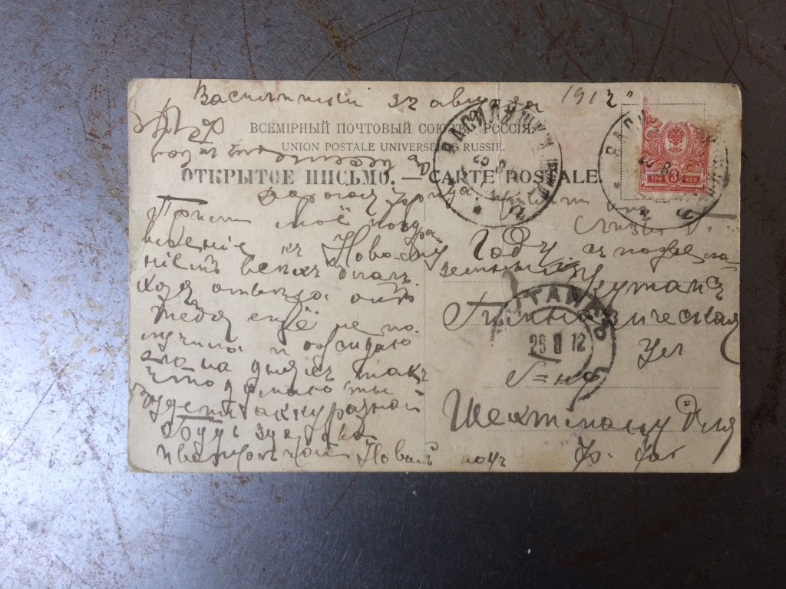
“Scored Out” a portable testimony to װאַסילישאָק
for 3 musicians

Slide 2
A project to research, realise and publicly stage a performance environment inspired by the complex
memories of the town Vasilishok, a Jewish shtetl in Belarus erased by the Nazi’s in 1942.
Drawing on a personal archive of correspondence from the town it will critically engage with the synagogue tradition of cantillation and pre-20th century German music to create hybrid scores.
These will re-configure the encounters between the two cultures and, through new listening, mediate the legacy of trauma.

Slide 3
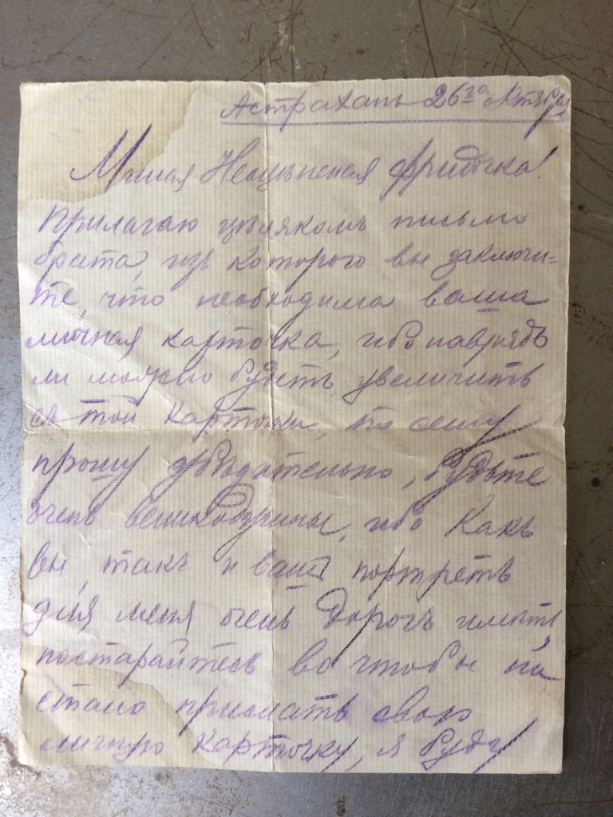

Slide 4
The work with trauma, memory and reconciliation which is the central aim of this project takes place through a carefully staged series of sonic encounters between musical practices stemming from the German tradition and the Jewish practice of Cantillation, both of which create or memorialise a sonic territory.

Slide 5
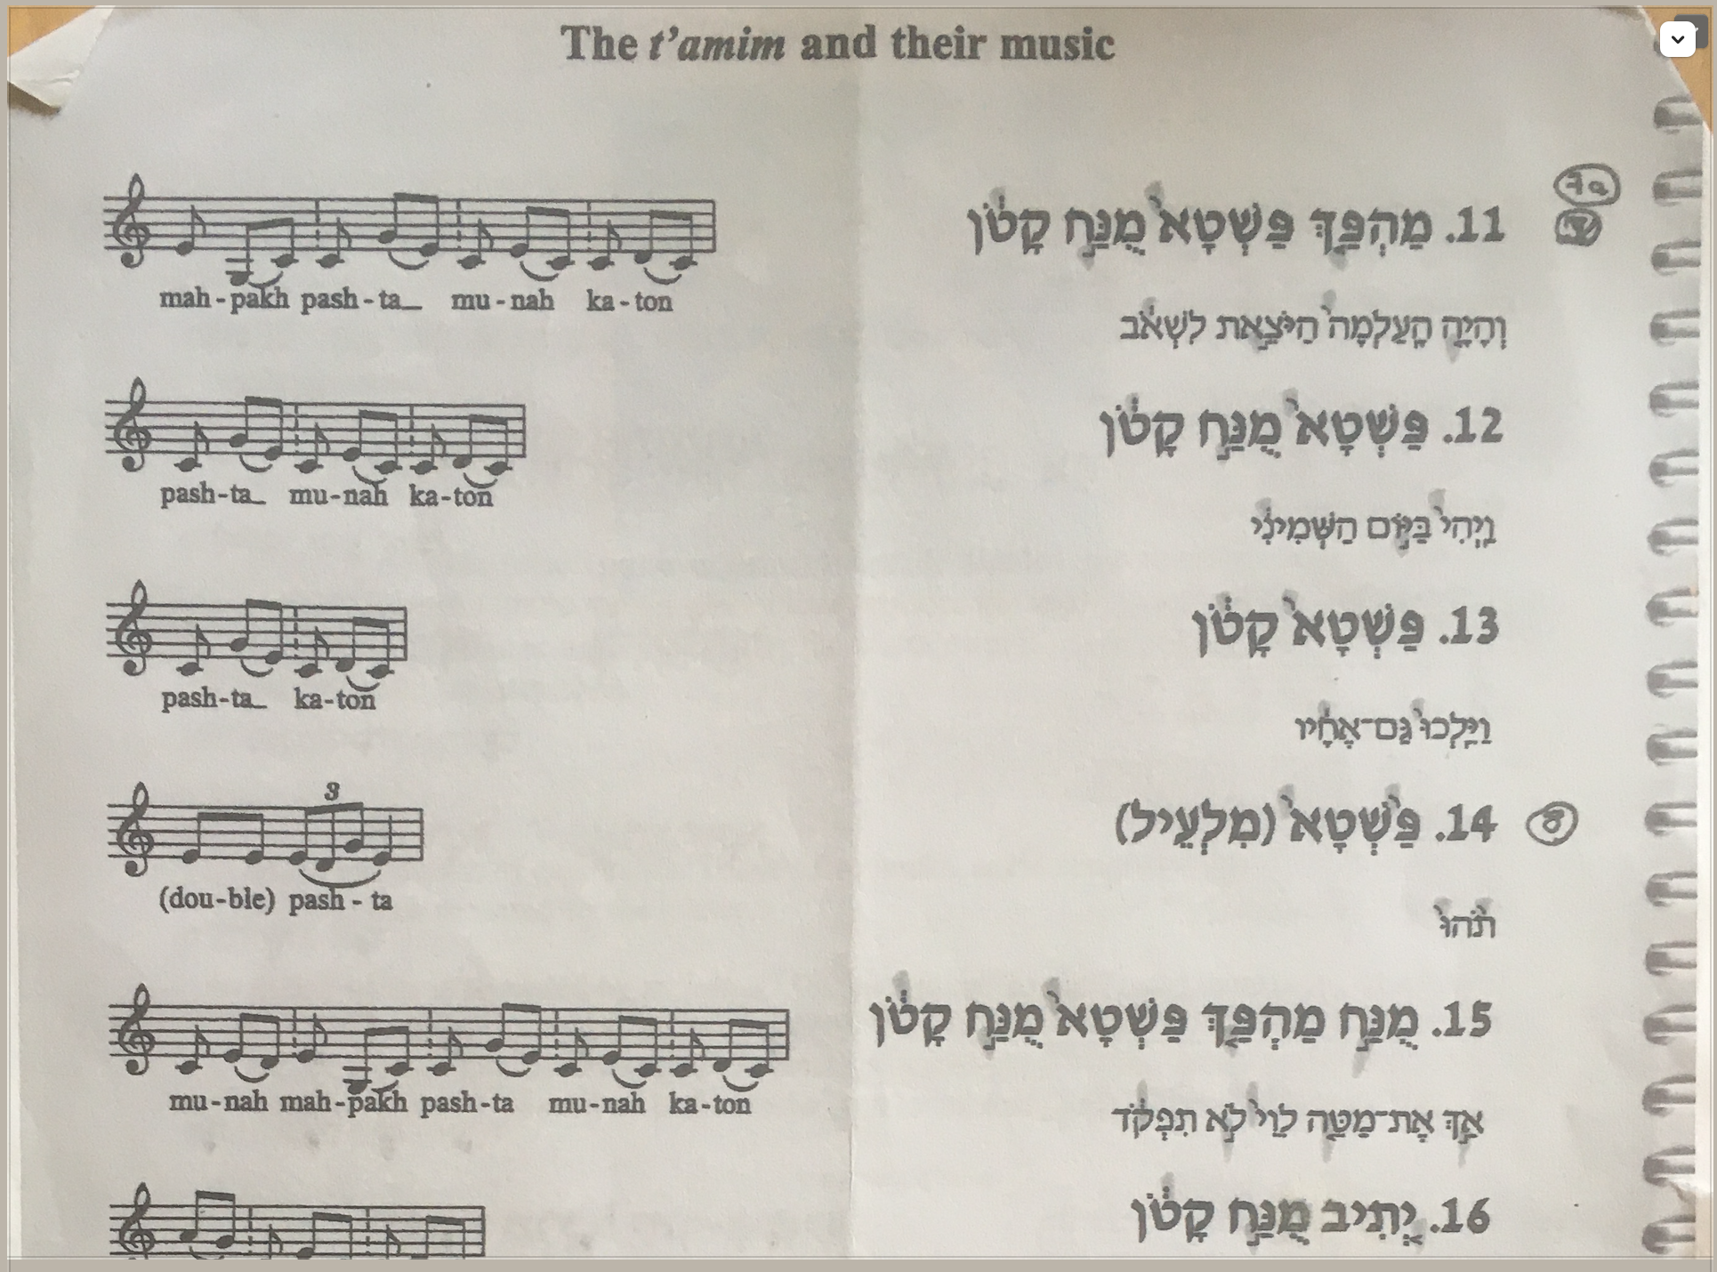
The differences between the 19th century German tradition, using cadence, sequence and modulation to suggest an organic whole, and the Jewish practice of Cantillation in which sound-shapes are used as a way of imprinting the memory of a text, is significant and is reflected in the way that notation is constructed in both these practices.

Slide 6
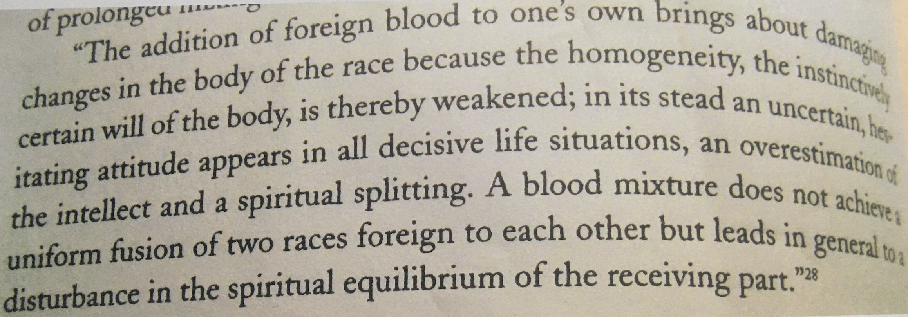
Hybridity?
Can a critical connection be made between a practice which asserts territory and one which memorialises a lost territory; between a Germanic culture that attempted total colonisation and a Jewish culture that was nearly erased by it?

Slide 7
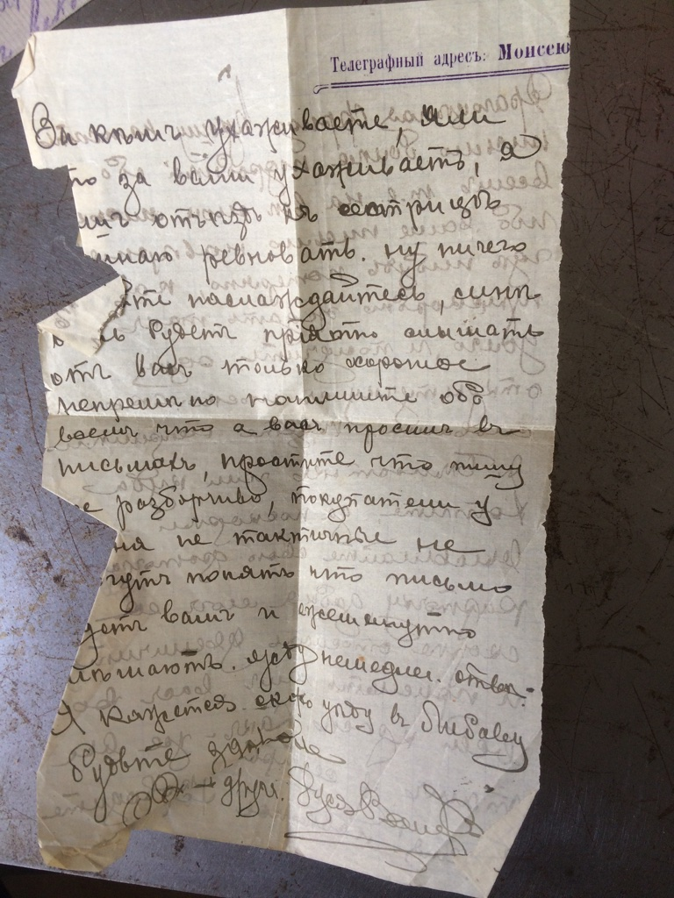

Slide 8
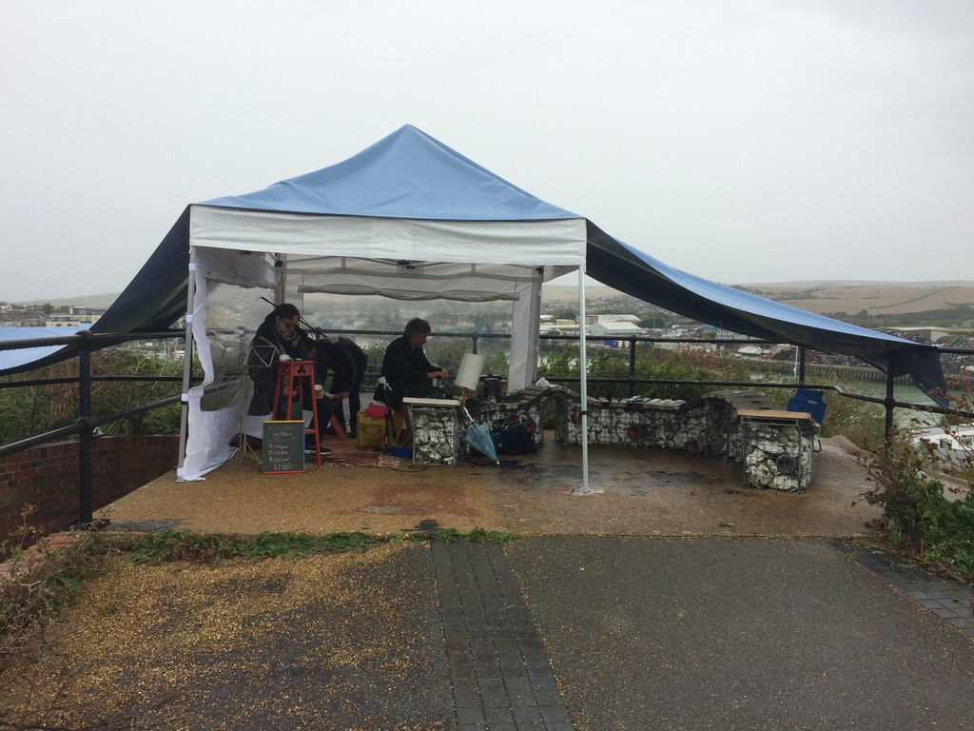
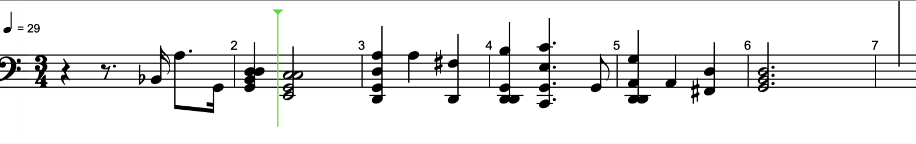
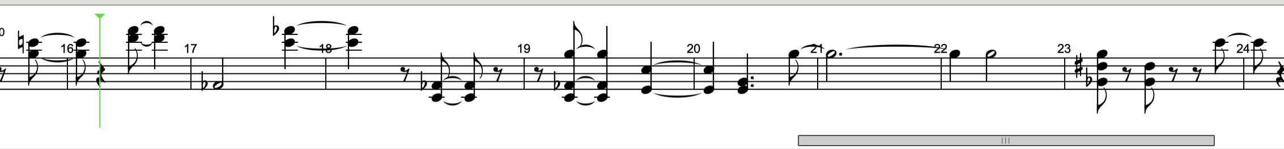
The outdoor performances use a specially constructed mobile environment influenced by the Talmudic concept of the sukkah.
How to find a place for this impossible place?

Slide 9
Reflections: post-performance
Who am I to make a hybrid?
Subject positions enabled by different modes of Audio Testimony
  Music, Speech, Field Recording
What kind of relationship is created between artist, performer, audience?
Audio Testimony and further research

