Slide 1
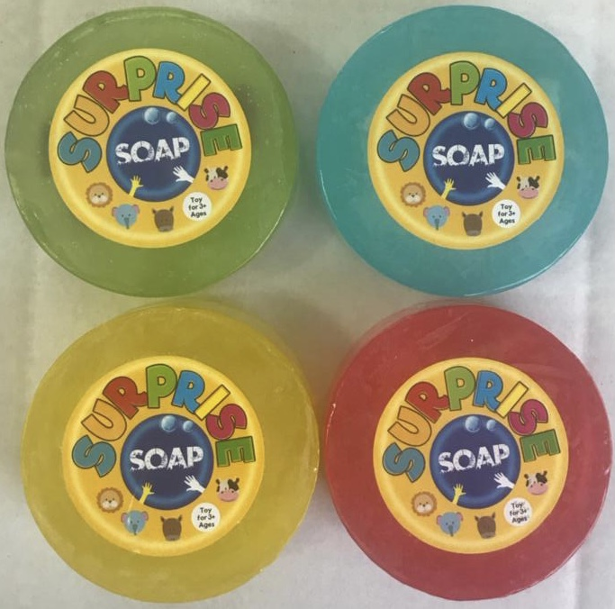
Surprise Soaps!
Good Clean Fun for kids
Global Hand-washing day 2021

Slide 2
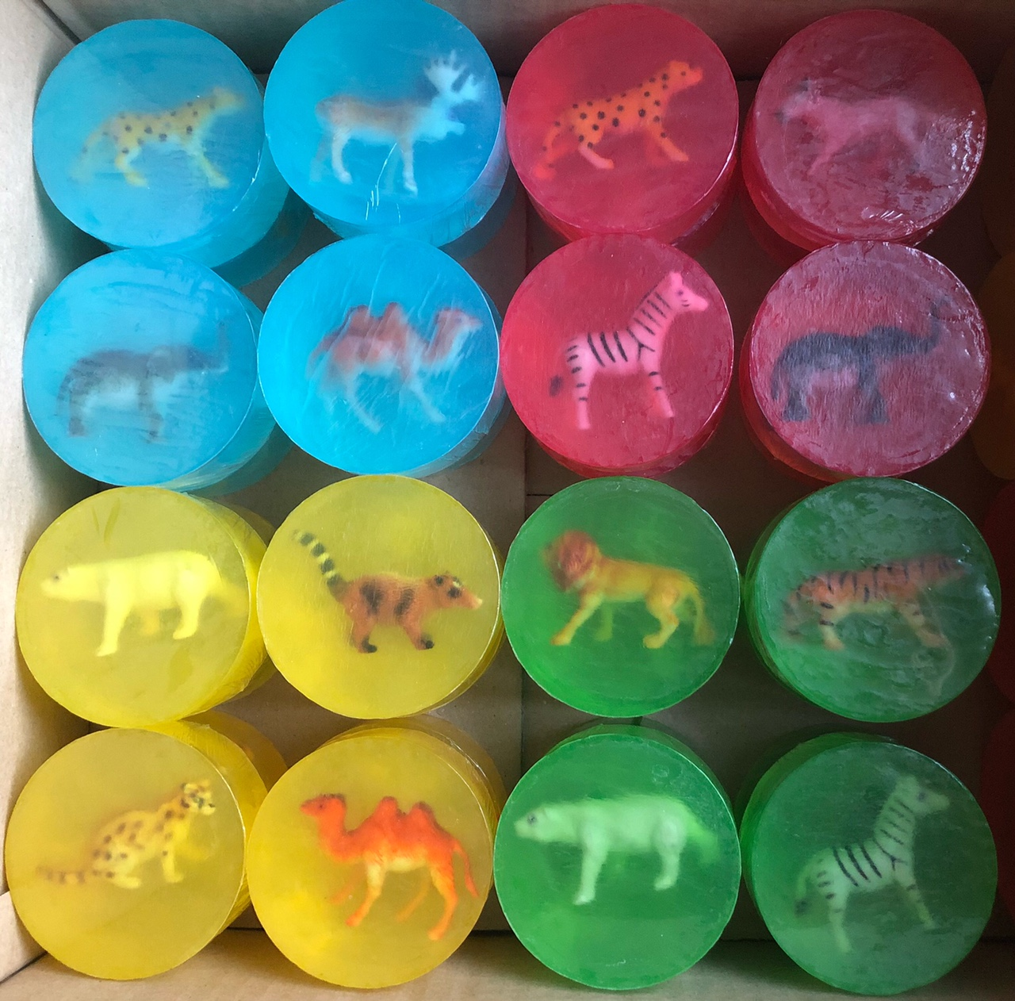
Surprise Soaps Project
Background
Givaudan is the world’s largest fragrance creation company. Since 2017, a team of Givaudan volunteers has been providing training in Fragrance and soap-making to groups of women in Zaatari and Mafraaq.
In 2020, Givaudan secured a contract with London School of Hygiene and Tropical Medecine (LSHTM) to partner on the Surprise Soaps research project. The project objective is to increase frequency of hand-washing and children’s engagement with hand hygiene, through the inclusion of toy animals in transparent glycerine soap.
Givaudan’s ambition was to facilitate the manufacture of the soaps in a partnership between KIMA, a Jordanian client company and the soap-making community in Zaatari camp. It was hoped that this project would contribute to ongoing work to create a sustainable small business for the ladies. Unfortunately, due to a requirement for cosmetic safety certification, the Zaatari team were not able to be involved in the soap production for the main study, but LSHTM have given their approval for the Surprise soaps project to be adapted for delivery in Zaatari as an educational activity for children.
There is therefore a great opportunity to organise a Surprise Soaps hand-washing animation in Za’atari to coincide with Global Handwashing day, October 15 2021

Slide 3

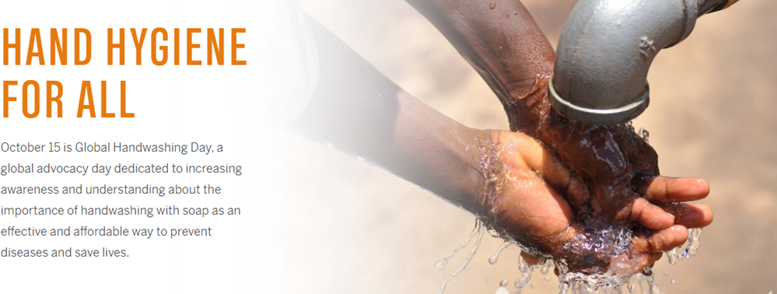



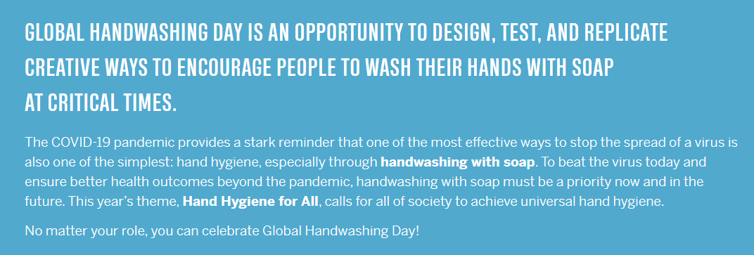



What is Global Handwashing day ?
Supported by
https://globalhandwashing.org/global-handwashing-day/

Slide 4
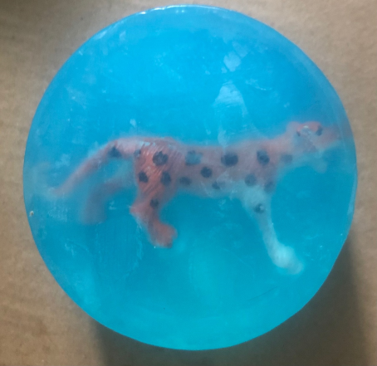
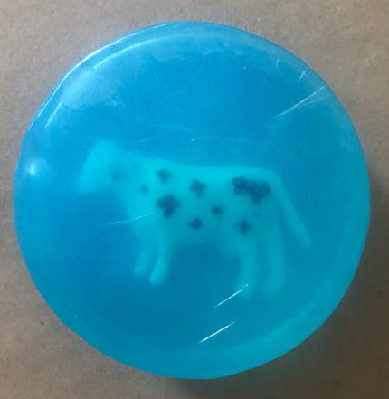
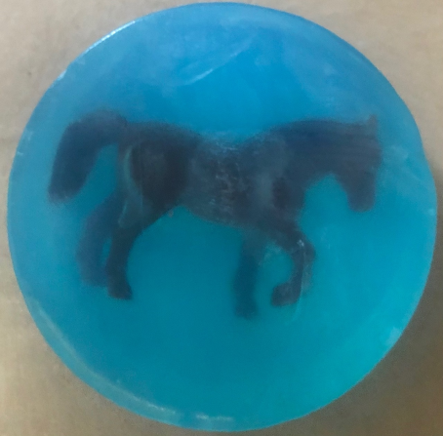
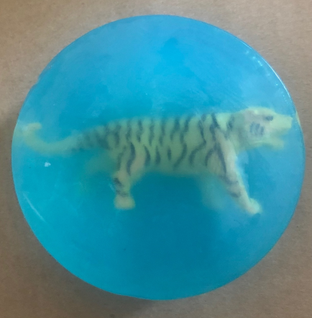
Surprise Soaps Project
Good Clean Fun – and enhanced family hygiene
Givaudan, with technical support from KIMA and logistical support from Blumont and UNHCR, proposes to organise and fund the Surprise soaps activity
Timing: Global Handwashing day Oct 15th 2021
Target group: Primary school children (age-range 5+)
Fun Hand-washing awareness sessions in school (protocol and content to be defined) Possibility to plan the event with support from globalhandwashing.org
Each child takes home one or more soaps with toy inclusions
TIGER community can be involved in preparation and communication of the project (poster creation, content creation, potential for market-research activities to monitor behaviour-change)
Soap making community from the Made in Zaatari centre will be commissioned by Givaudan to create the Surprise soaps, thus creating a remunerated activity for up to 30 women.

Slide 5
Creating for happier, healthier lives with love for nature
Let’s imagine together
Givaudan contact
Anne Louvet, Global Business Director anne.louvet@givaudan.com

