Slide 1
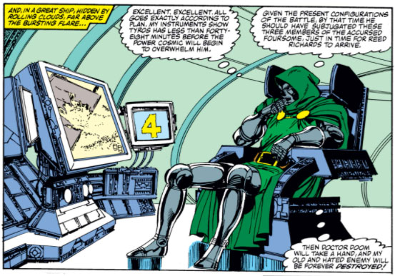
When the world catches up with science-fiction:
Doctor Doom and the missing view screens
Mark Hibbett, University of the Arts London
Notes:
This paper discusses what happened to our memories of Doctor Doom and his viewing screens during The Marvel Age - and what that means for research

Slide 2
When the world catches up with science-fiction:
Doctor Doom and the missing view screens
Unified Catalogue of Transmedia Character Components
Using a survey to uncover initial ideas of character
Objects in the storyworld
Survey vs Catalogue
Why are viewing screens missing?
Fuzzy Trace Theory
Why Umberto Eco was wrong
What Doctor Doom can teach us

Slide 3
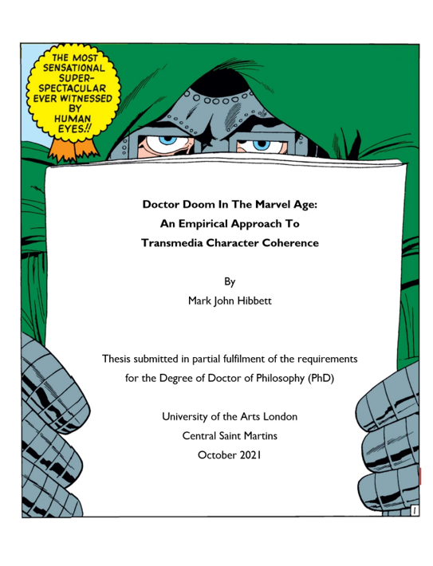
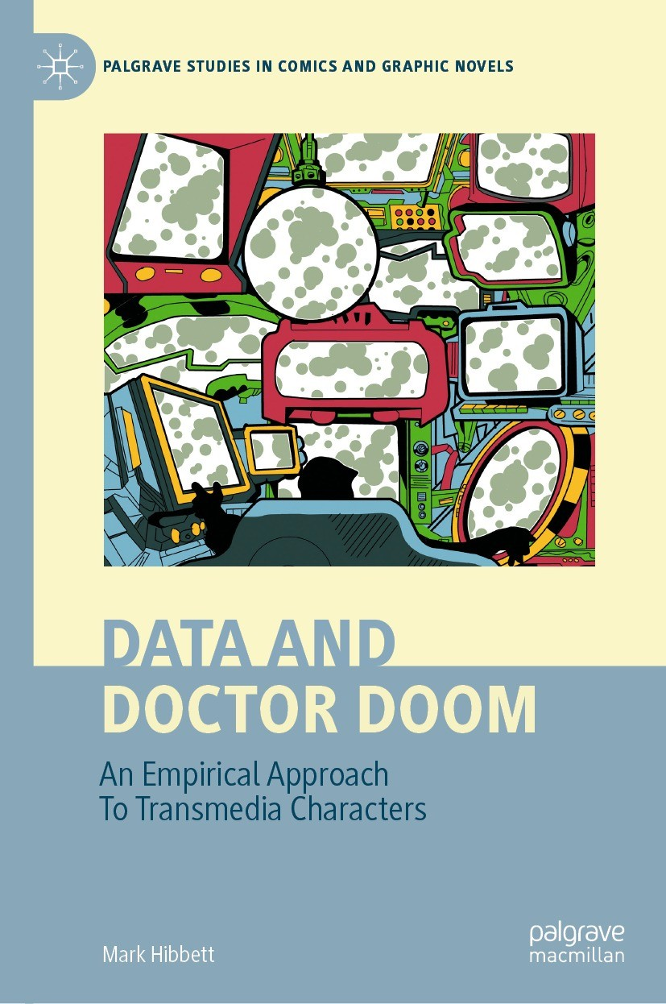
Notes:
This talk is based on the data gathered for my PhD, recently published as a book by Palgrave Macmillan.

Slide 4
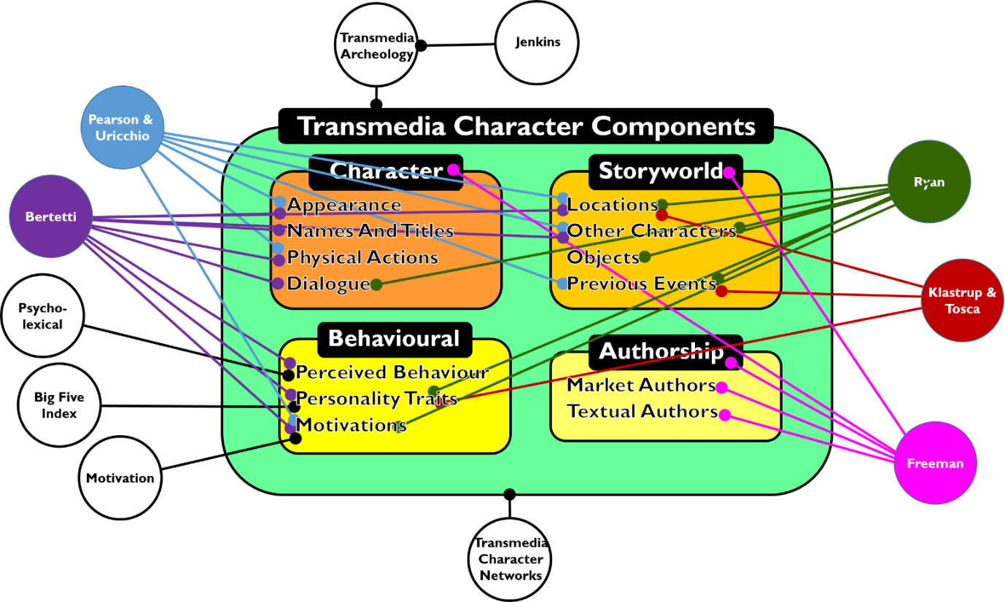
Notes:
This was a project where I tried to develop an empirical methodology for looking at character components. It brings together lots of other people's ideas into 13 components in four groupings. But why do you need to do an empirical analysis?

Slide 5
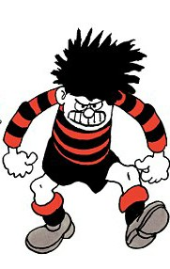
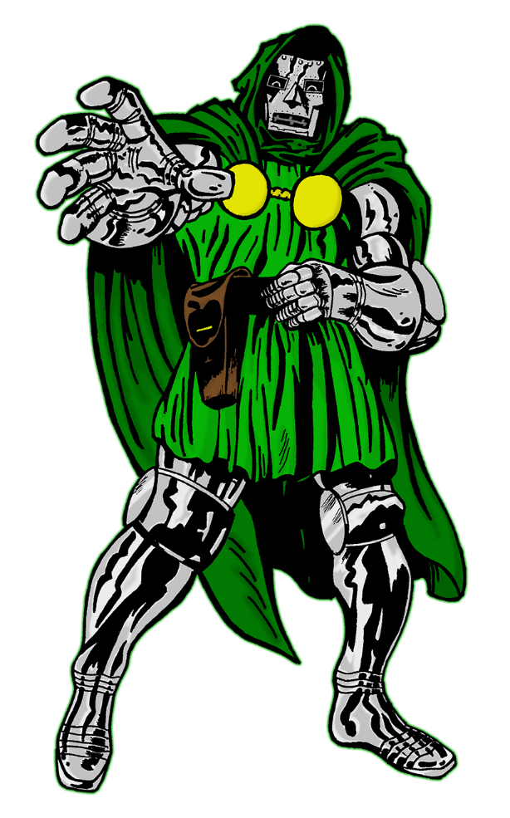

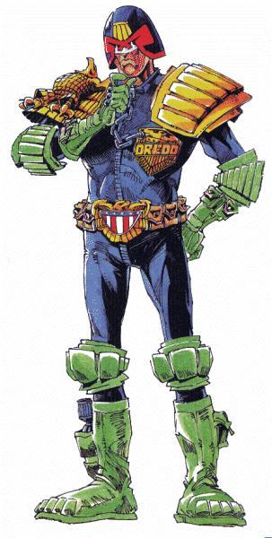

Notes:
Firstly so you can share data - build datasets using same methodology. But also so you're getting the same sort of results within the dataset.

Slide 6

sailor's hat
beak
blue jacket
no trousers
duck's feet
Notes:
Secondly, to avoid personal bias. Here's what one person might think Donald Duck's "Appearance" signifiers are.

Slide 7
beak
feathers
bow tie
tail
yellow buttons
no trousers
duck's feet
Notes:
And here's someone else's.

Slide 8
blue sailor's hat
orange beak
white feathers
red bow tie
blue jacket
with yellow trim
fluffy white tail
two yellow buttons
no trousers
orange duck's feet
Notes:
A third person's ideas, showing the addition of further detail.

Slide 9
IS A DUCK
blue sailor's hat
orange beak
white feathers
red bow tie
blue jacket
with yellow trim
fluffy white tail
two yellow buttons
no trousers
orange duck's feet
Notes:
All of these miss the fact that he's a duck!

Slide 10
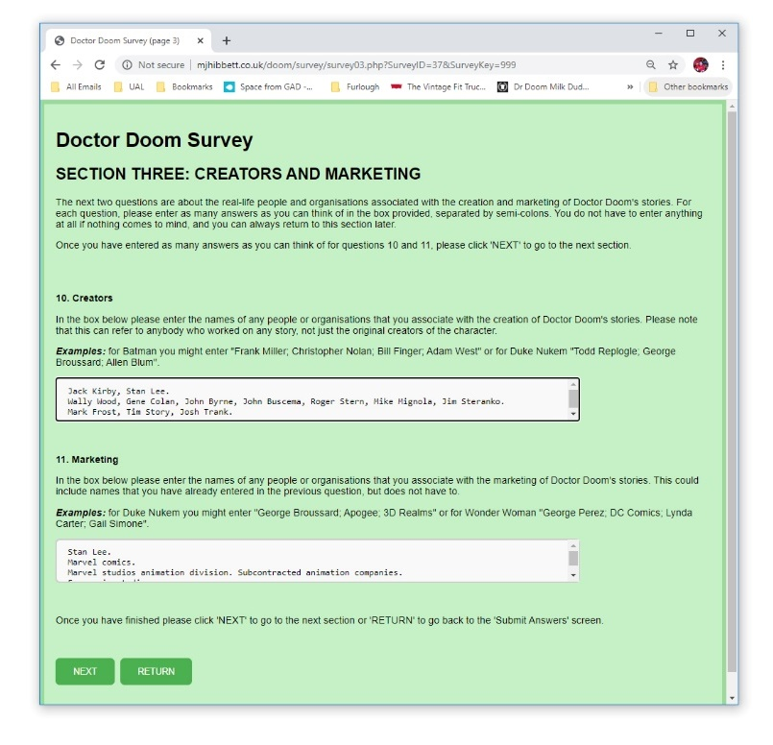

https://bit.ly/DoomData
Notes:
My methodology was to do a survey. Here's one of the forms from my Doctor Doom survey, plus a QR code to access the data. 225 people took part.
To be clear, this wasn't the main data entry - just to get a starting point .

Slide 11
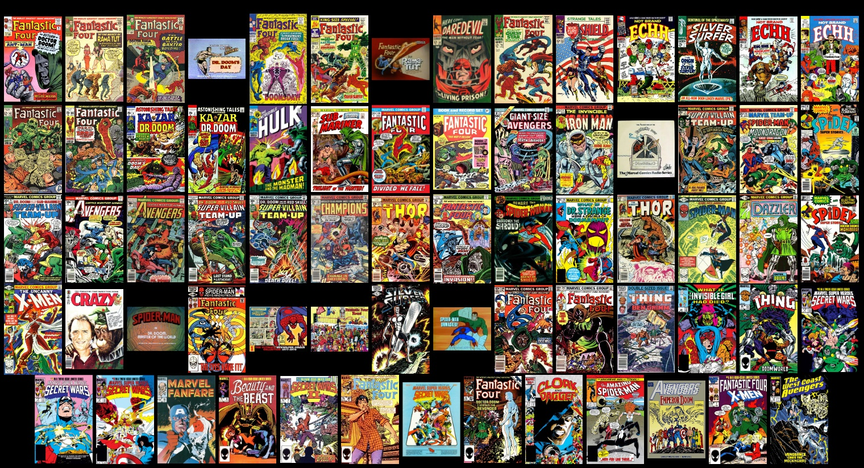
Notes:
Main data entry was done by going through 69 texts and, for every single one, noting down everything I found there.

Slide 12
Notes:
Did this in terms of my catalogue - used the survey as a starting point but then others could be added.
However, it also meant I could compare what people thought components were with what they were in the actual texts, and lots of very interesting things came up.

Slide 13
Survey
Object | Rank | Responses
Doombots/Robots | 1 | 107
Armour | 2 | 62
Time machine | 3 | 57
Machinery/Kirbytech | 4 | 41
Castle | 5 | 37
Mask | 6 | 35
Throne | 7 | 29
Cloak and/or hood | 8 | 25
Goblets | 9 | 17
Weaponry (high tech) | 10 | 16
Mad Science Device | 11 | 13
Magical artefacts | 12 | 11
Cosmic cube | 13= | 9
Gun | 13= | 9
Notes:
For example, tjis is what my survey respondents thought the objects of Doom were. There were 22 items identified more than once, these are the most popular. Several went into appearance or location category - mask, cloak, armour, gun, castle etc. If we remove those -

Slide 14
Survey
Object | Rank | Responses
Doombots/Robots | 1 | 107
Time machine | 3 | 57
Machinery/Kirbytech | 4 | 41
Throne | 7 | 29
Goblets | 9 | 17
Weaponry (high tech) | 10 | 16
Mad Science Device | 11 | 13
Magical artefacts | 12 | 11
Cosmic cube | 13= | 9
Notes:
- these are the top 9.

Slide 15
Sample
Object | Rank | Texts
Machinery/Kirbytech | 1 | 45
Viewing screen | 2 | 35
High tech weaponry | 3 | 34
Control console | 4 | 28
Doombots/Robots | 5 | 18
Throne | 6 | 14
Rocket pack | 7 | 12
Force field projector | 8 | 8
Silver Surfer's Board | 9 | 7
Notes:
Here's what I found by examining the sample. 28 objects found more than once - here's the top 9. But what happens when we put both top ones together?

Slide 16
Sample and survey
Object | Sample | Survey
Machinery/Kirbytech | 1 | 4
Viewing screen | 2 | 22=
Weaponry (high tech) | 3 | 10
Control console | 4 | -
Doombots/Robots | 5= | 1
Throne | 6 | 7
Rocket pack | 8 | -
Force field projector | 9 | -
Magical artefacts | 13 | 12
Time machine | 15 | 3
Mad Science Device | 15 | 11
Goblets | 19 | 9
Cosmic cube | - | 13=
Notes:
Here we can see that the survey missed several objects. For Viewing Screens only 4 out of 252 respondents mentioned it.

Slide 17
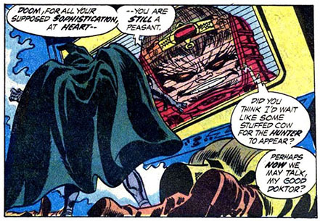
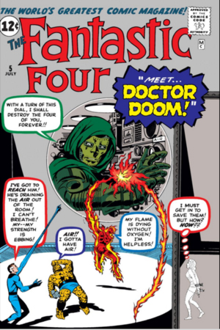
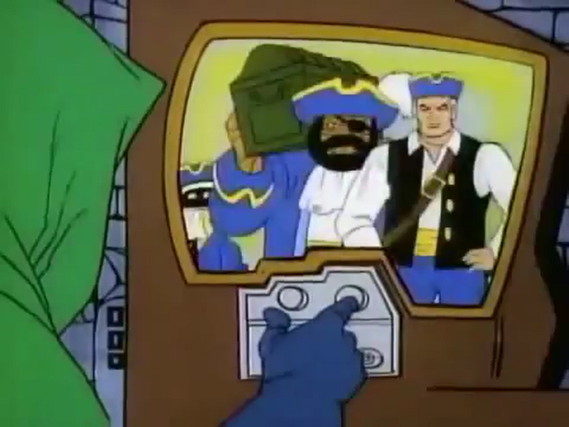
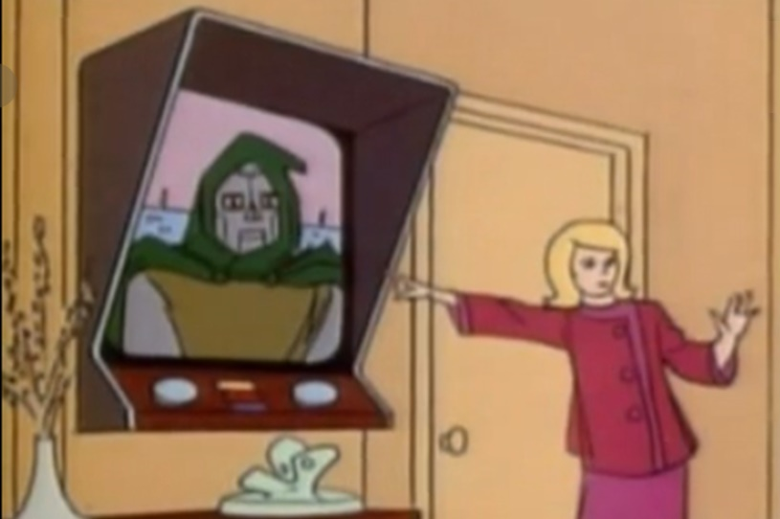
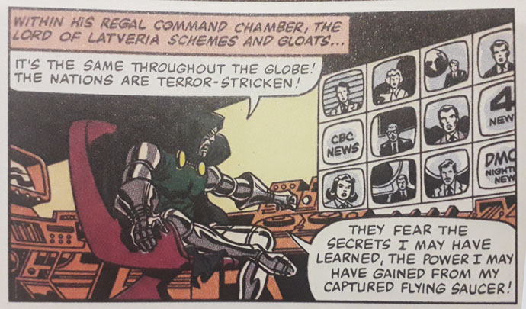
Notes:
Viewing screens were everywhere in the sample, right from his first appearance, all the way through to the end of my sample in 1987, in all forms of media.
So what was going on here? Key thing is - the sample ended in 1987, when viewing screens were science fiction.

Slide 18

Notes:
However, now viewing screens are everywhere - part of daily life.

Slide 19
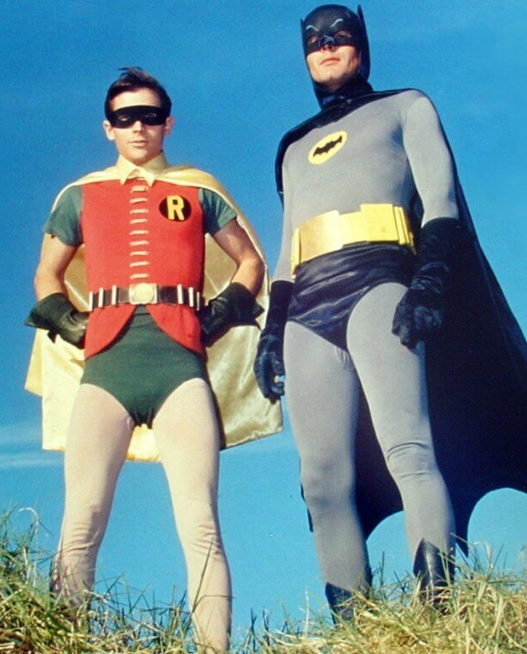
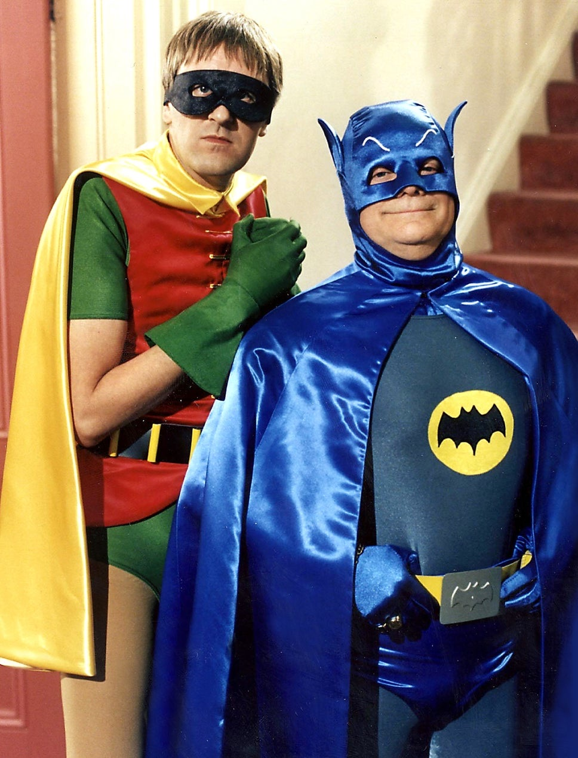
Fuzzy-trace theory
Notes:
One explanation could be Fuzzy-Trace Theory- the idea that our memories store information as verbatim or gist. Verbatim is precise, but gist is more robust, so over time we tend remember the general idea of things rather than the precise detail.
Also, these memories can be manipulated, so for instance the gist of a supervillain now is different to then.
(example is Rodney and Del Boy getting the gist of the Batman TV show costumes just about right)

Slide 20
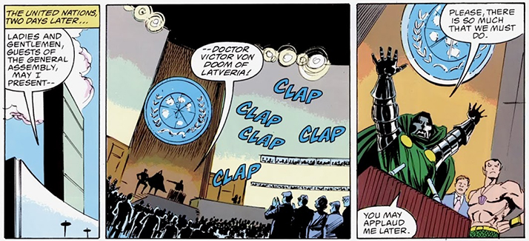
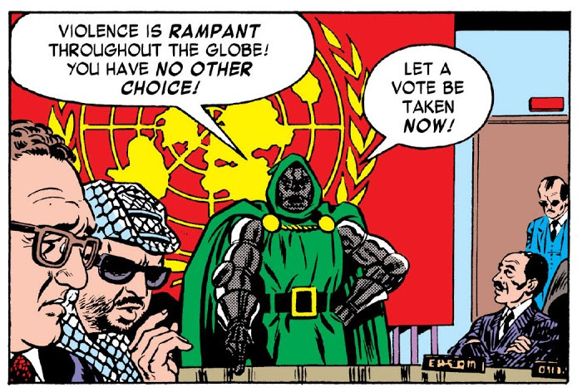
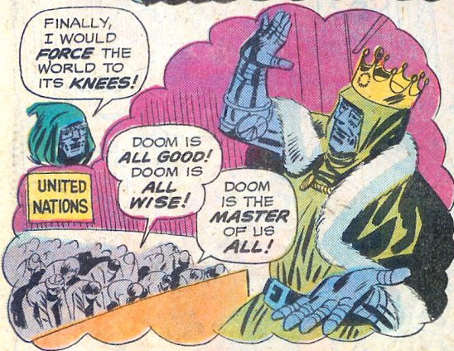
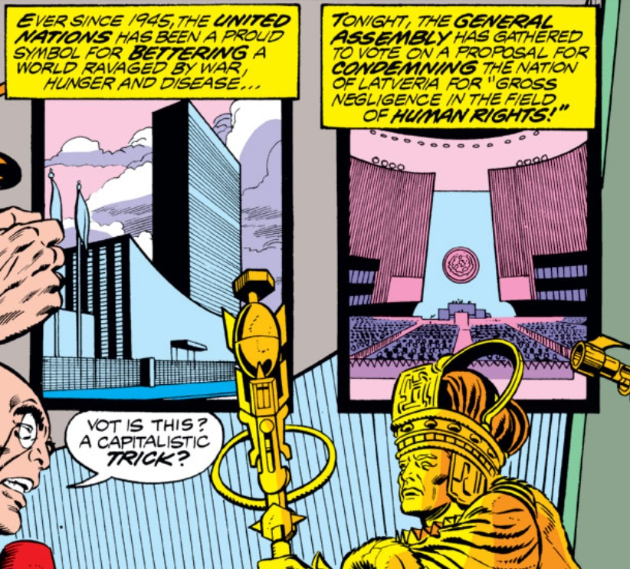
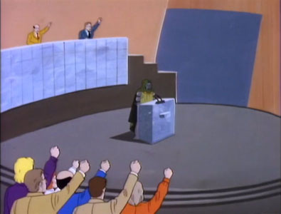
Notes:
Another example is the United Nations as a location - appears throughout the sample, as it was in the news all the time during the cold war, but only mentioned by 4 out of 225 people in the sample (a different 4 from the ones who mentioned viewing screens).
So why does any of this matter?

Slide 21
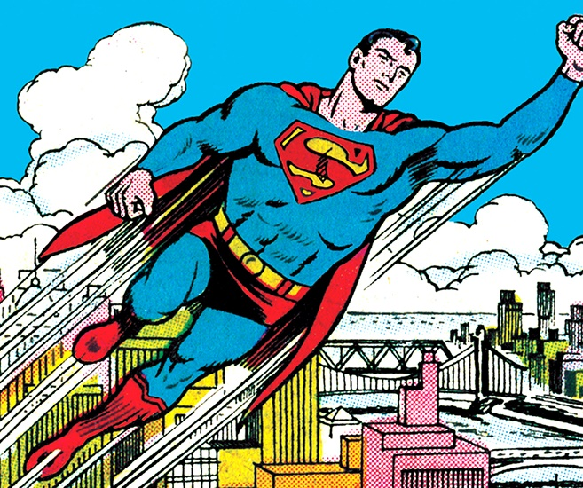
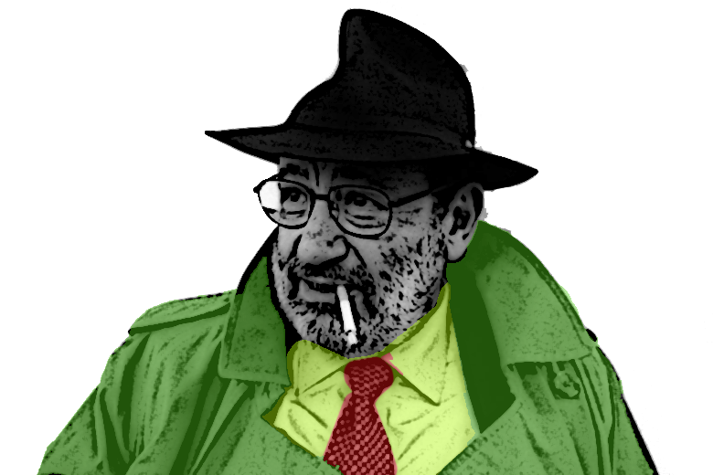
Notes:
It matters because relying on gist memory means we get things wrong - we only get a memory of what we feel is worth remembering, rather than an accurate representation of what actually happened, so missing out huge amounts of data.
A really good example of this is Umberto Eco who, in The Myth of Superman, which said that superheroes live in an Oneric climate - a fuzzy world where there was no past. This was based on Eco reading a small number of comics and relying on his impressions of them, whereas

Slide 22
Previous events
Previous events | Texts | %
Recap of previous issue | 37 | 53.62
Other | 32 | 46.38
Original takeover of Latveria | 8 | 11.59
Hitler/Nazi Germany/WW2 | 6 | 8.7
Various confrontations with FF | 5 | 7.25
Accident that destroyed his face | 4 | 5.8
Origin of FF | 4 | 5.8
Secret Wars | 4 | 5.8
College days with Reed Richards | 3 | 4.35
First meeting between FF and Doom | 3 | 4.35
Overthrow of Doom in FF #200 | 3 | 4.35
Previous attempts to cure The Thing | 3 | 4.35
Notes:
If we look at data from my study it shows that Superhero comics during this time period were full of Past events - over half of all Doctor Doom stories featured an in-diegesis discussion of what had happened in the previous issue of the comic, for example.
But as this presentation has hopefully shown, using empirical data doesn’t replace traditional methods, it enhances it and shows us other avenues of discussion that we wouldn’t otherwise think of, underpinning theories rather than just relying on vague ideas.

Slide 23
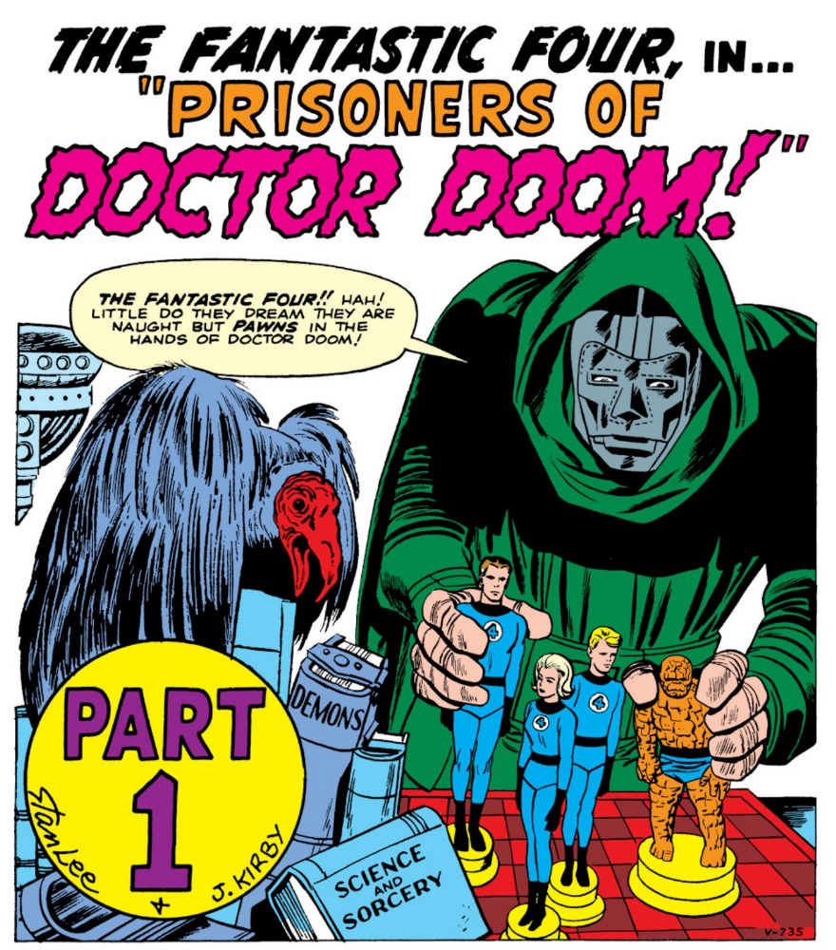
Notes:
Or to put it another way, as we learn from Doctor Doom on the very first page of his very first panel, we do not have to choose between quantitative and qualitative research we can use both -

Slide 24

Notes:
We can use science and sorcery!

