Slide 1
ACTIVATING DIGITAL LEARNING
A case study of an interactive pre-sessional online module
FRANIA HALL, UAL

Slide 2
Outline of session
The pedagogy context
Benefits of blended learning
Challenges
A walk through the module
Pilot study and results
MA Publishing on-going results
Challenges for the module
Discussion
Next steps

Slide 3
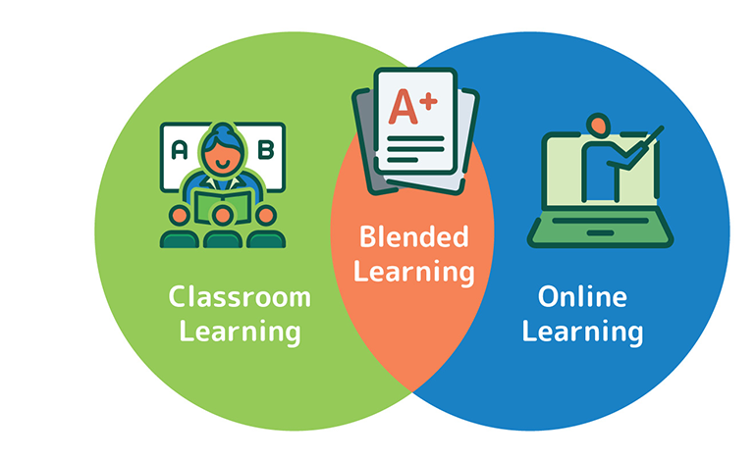
Overview
Digital learning is an important way for students to learn alongside in-person sessions
but students can be reluctant to participate in digital learning environments when they are undertaking broadly residential/in-person courses

Slide 4
The pedagogy context
Covid moved things online at speed
Departments pivoted to teaching online
Involved reinforcing with students that online could be productive learning space
Developed experience using more interactive digital tools - breakouts, forums, journals, padlets, miro boards, quizzes – alongside multimedia
As well as exploring concepts such as community of inquiry more deeply in the context of digital learning

Slide 5
Benefits of blended learning
Can promotes a range of learning styles
Inclusivity and accessibility
Individualization, customisation and differentiation – own journey
Supports peer to peer interactions, continuity between in-person classes
Learning reinforcement, asynchronous learning, flipped learning
Resources at point of need
Learn about digital technologies – including creative technologies and future work
(Boelans et al. 2017; Fleischman 2021; Graham 2006; Kintu et al 2017, Namysova 2019 et al, Platanova et al, 2022,)

Slide 6
Challenges
Art and design students want to be in person, in the studio
Digital learning seen as less valuable
Seen as an emergency response due to covid
Students do not see they need to engage with it if they are on an in-person course
Student do not see the benefits of digital learning – either/or, not blended

Slide 7
It is important because
Behavioural research explores the relationship between different learning styles and creativity in HE settings
and the way interactive online learning can incorporate different learning styles in ways class situations can’t always manage
(Kassim, H. 2013, Tanjea et al, 2023)

Slide 8
Module plan
Show students how this connects to their wider learning –less focus on digital as learning in general - raise awareness of the many different ways in which we learn
Make it relevant to them – through understanding individual benefits to them, to see the opportunities,
Show why we do this – transparency about pedagogy – eg introduced community of inquiry model
Model digital engagement using digital tools
Build confidence in using digital environments for learning

Slide 9
The module aims to
illustrate choices and individualised learning approaches
allow students to connect to their cohort and staff before they join
reflect creativity within a digital environment
establish a seamlessness between digital and physical environments.

Slide 10




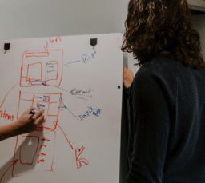
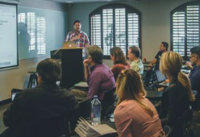

Learning reflection
Audio, visual, experiential
Groups, independent, in person, online, in a library, out and about

Slide 11
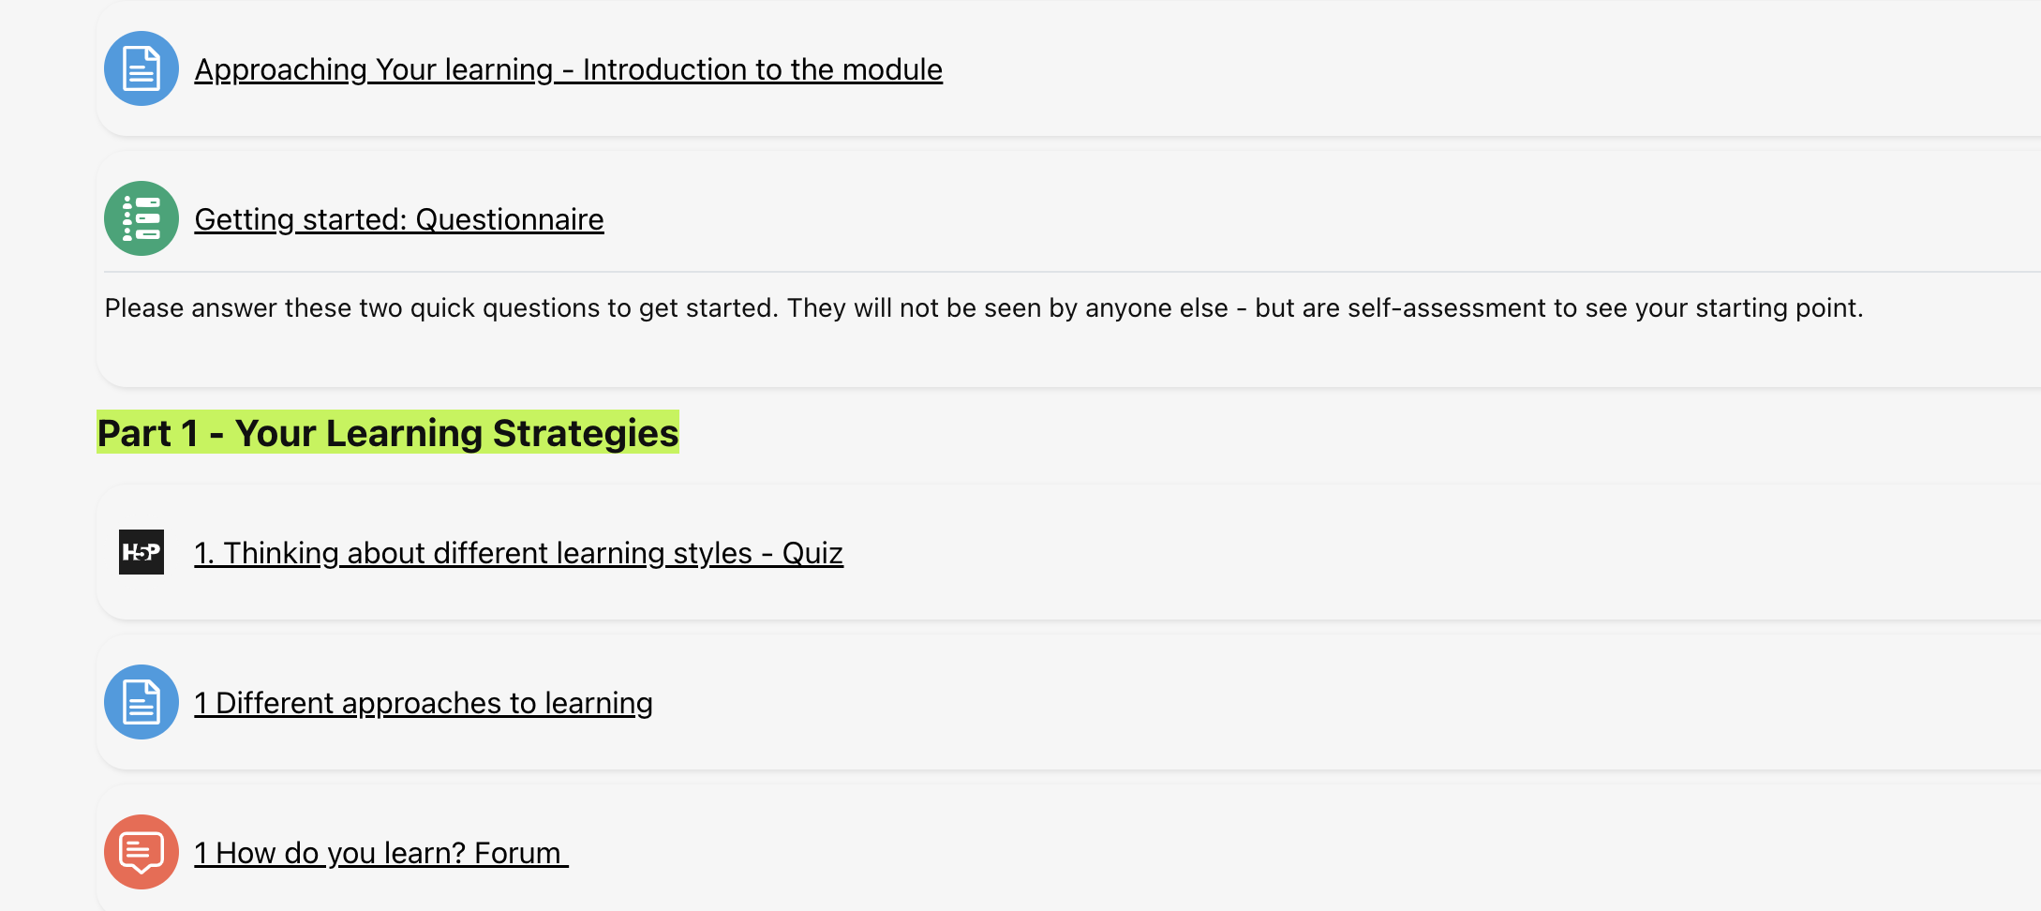
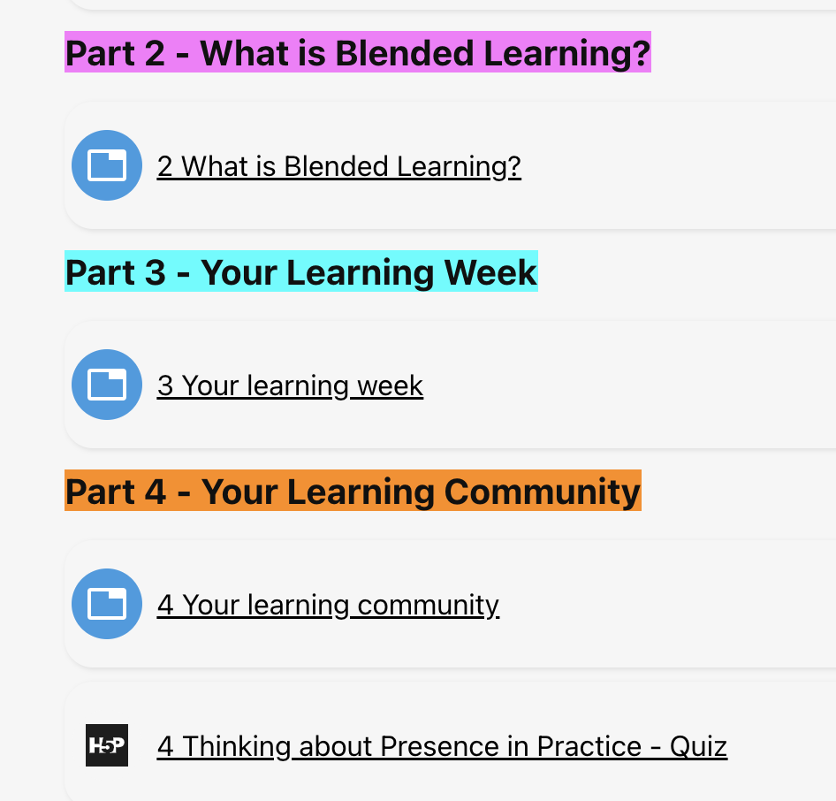
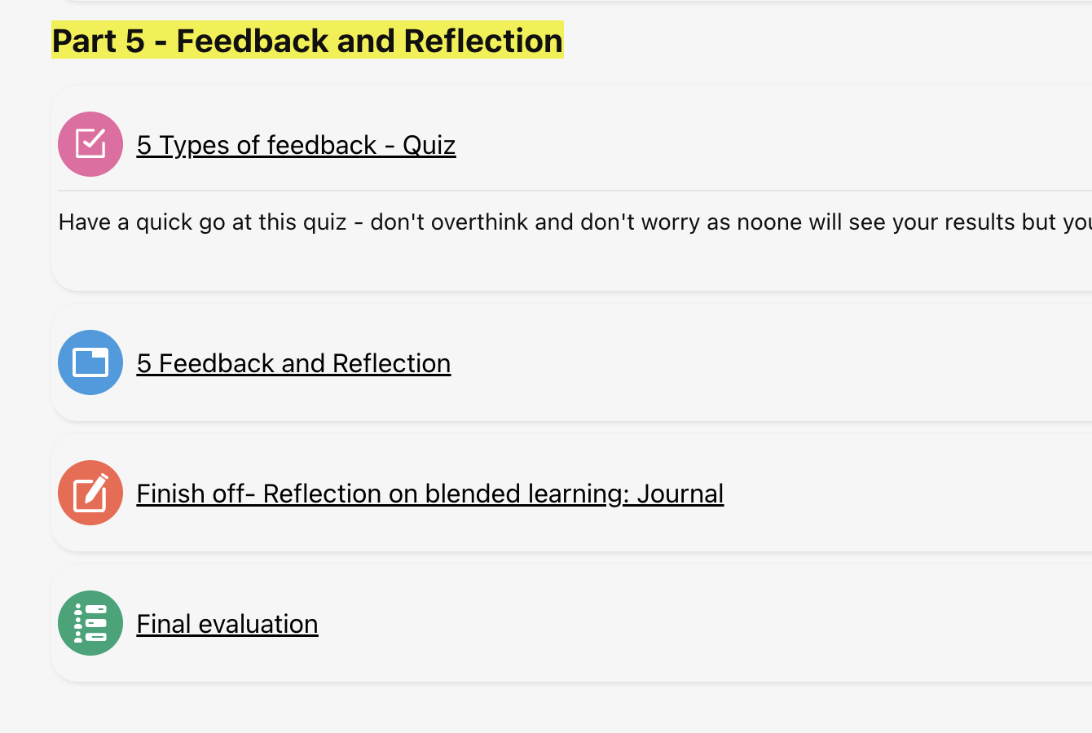
CONTENT OF MODULE – takes about 25 mins

Slide 12
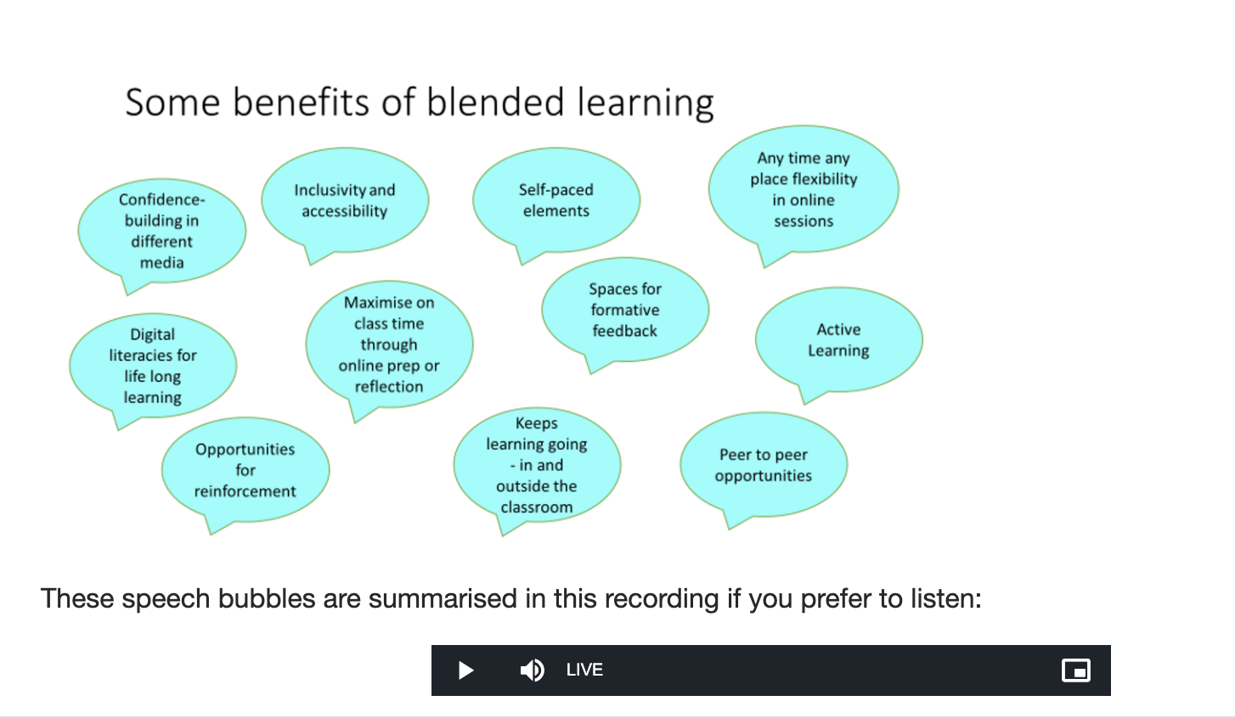
Modelling different formats

Slide 13
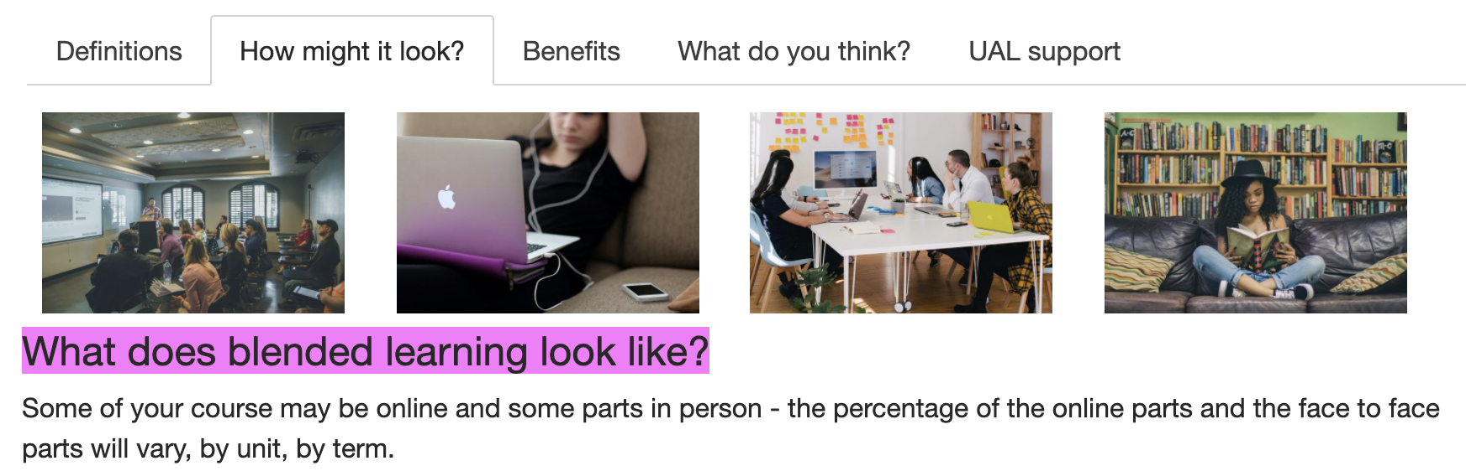
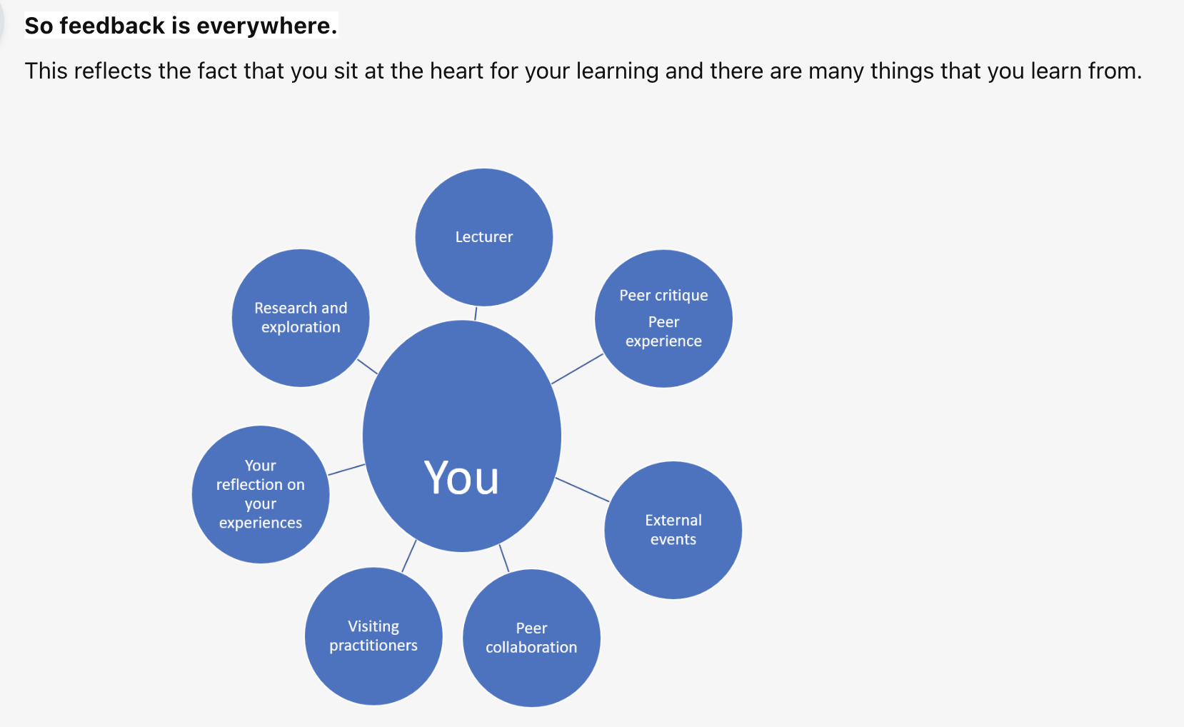
Visual

Slide 14
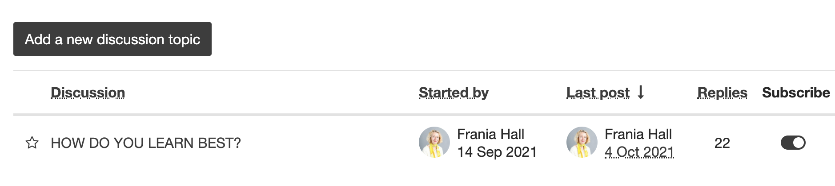
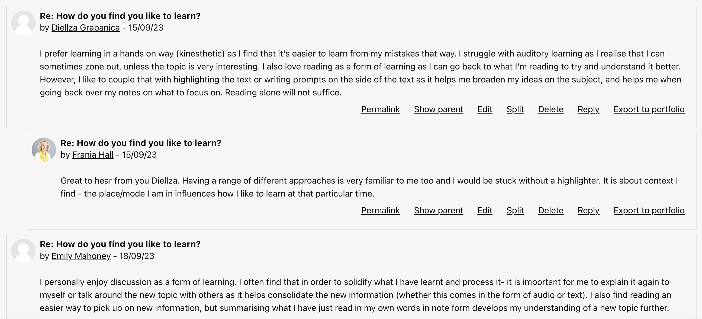
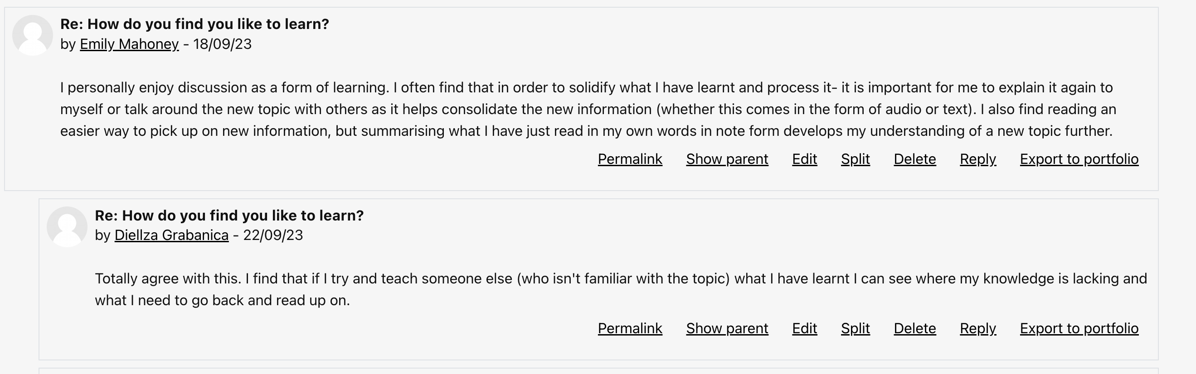
Discussions – social presence

Slide 15
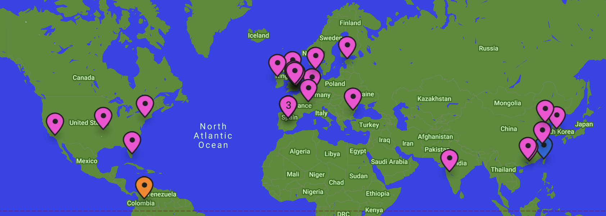
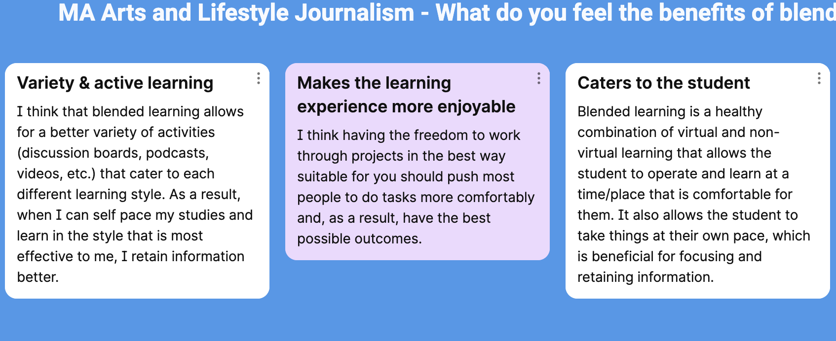
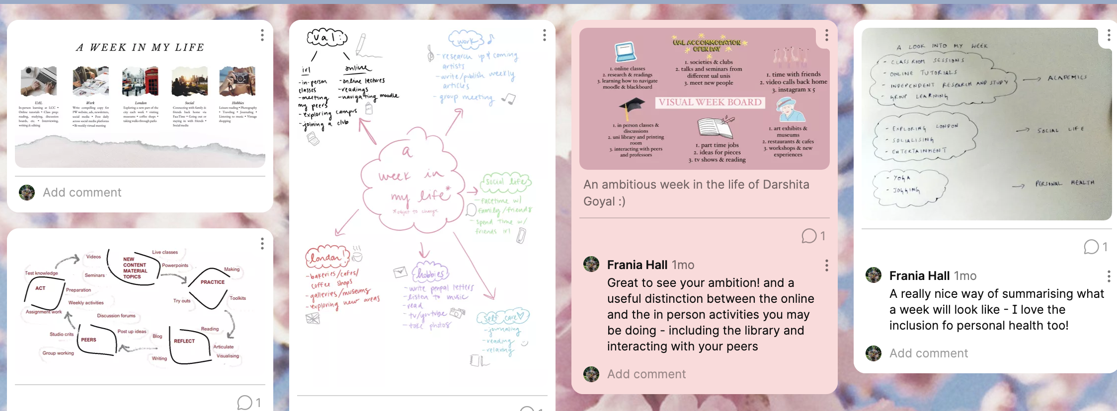
padlets

Slide 16
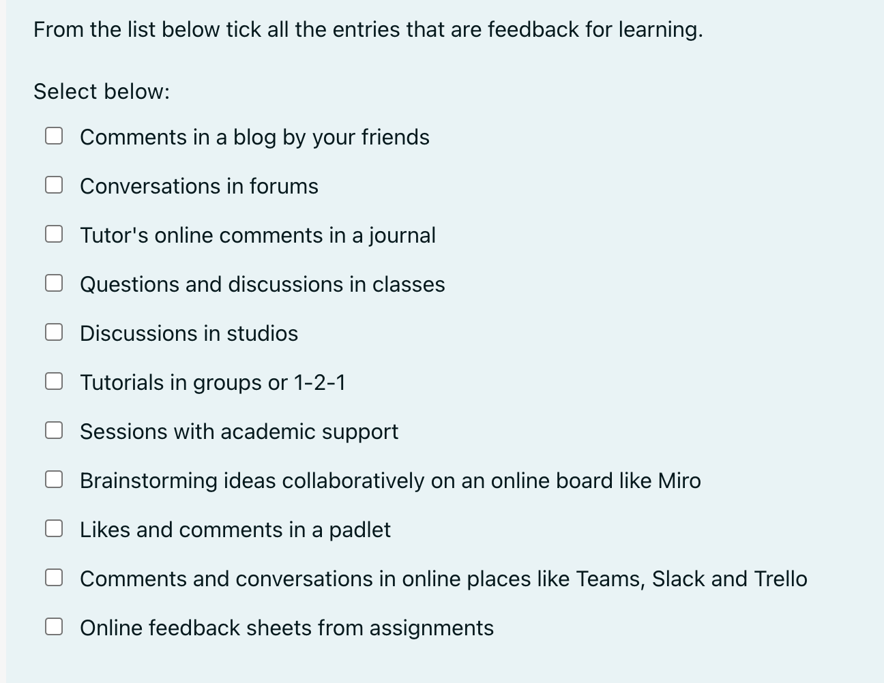
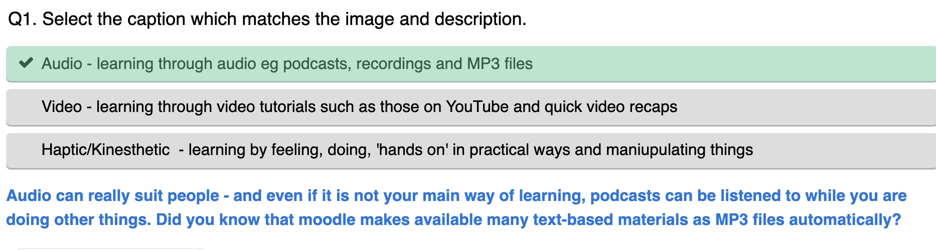
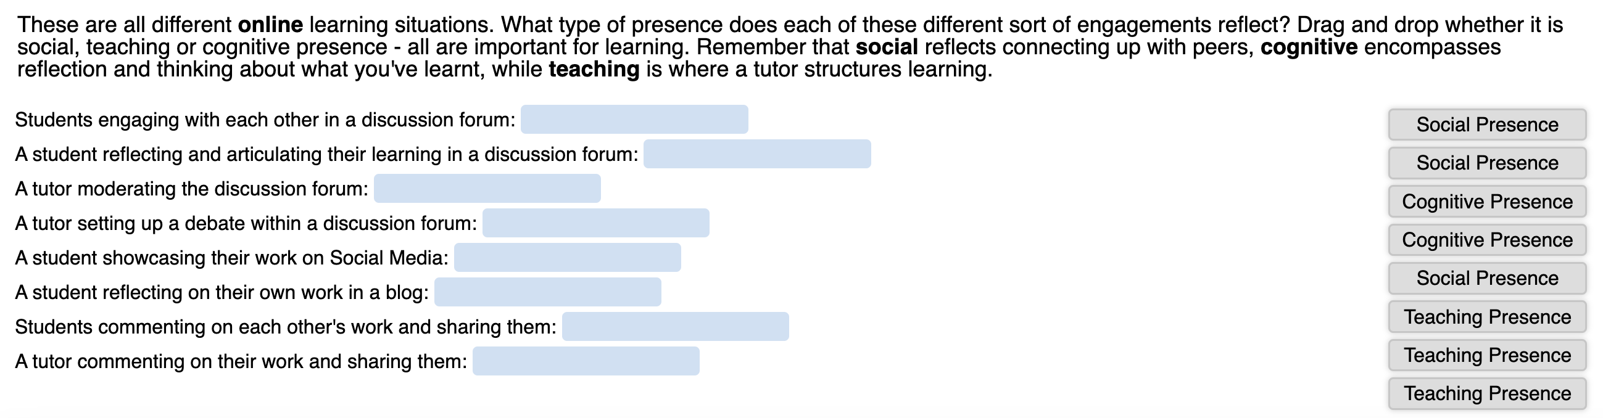
Quizzes

Slide 17
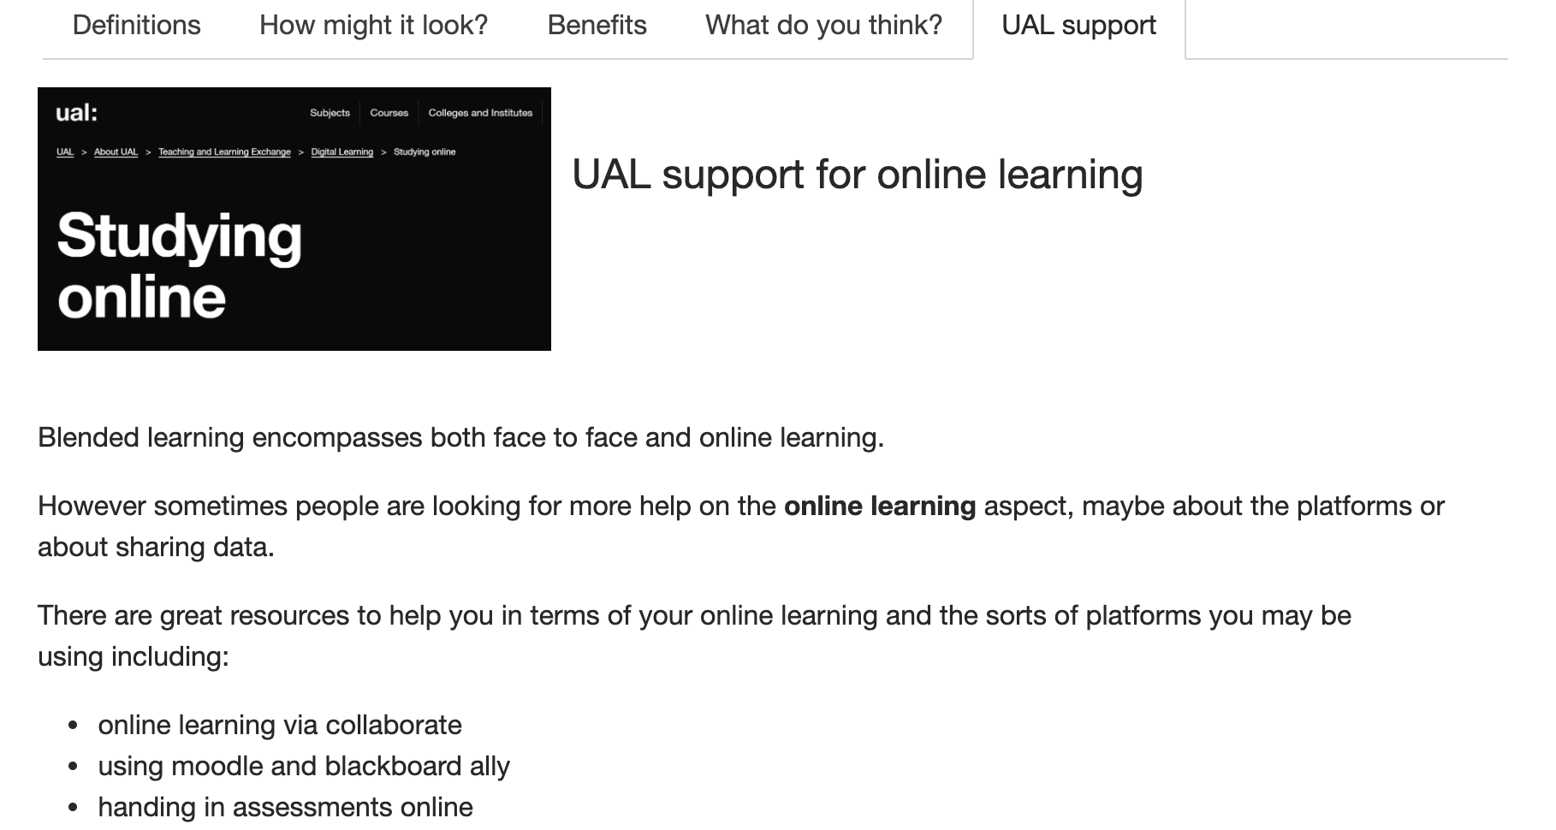
Linked to Academic support
Points to features like blackboard ally –
Avoiding overload - course specific

Slide 18
VISUALISATION EXAMPLES

Slide 19
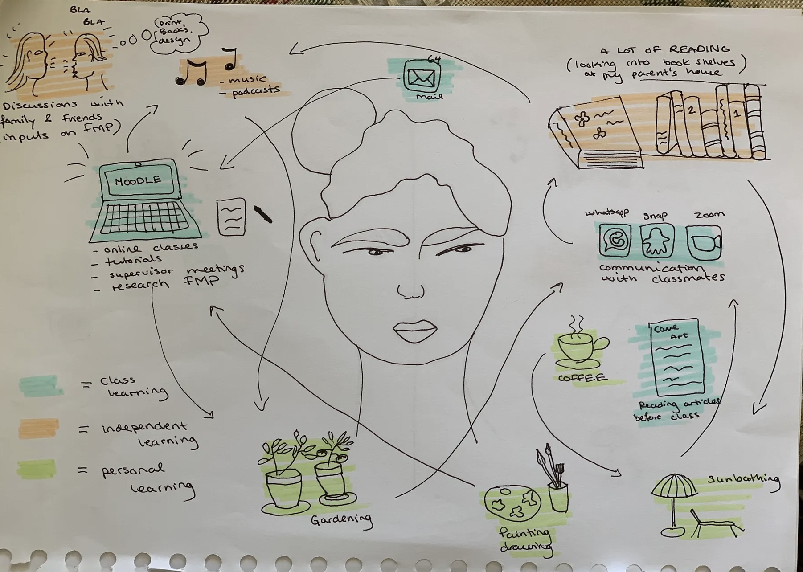
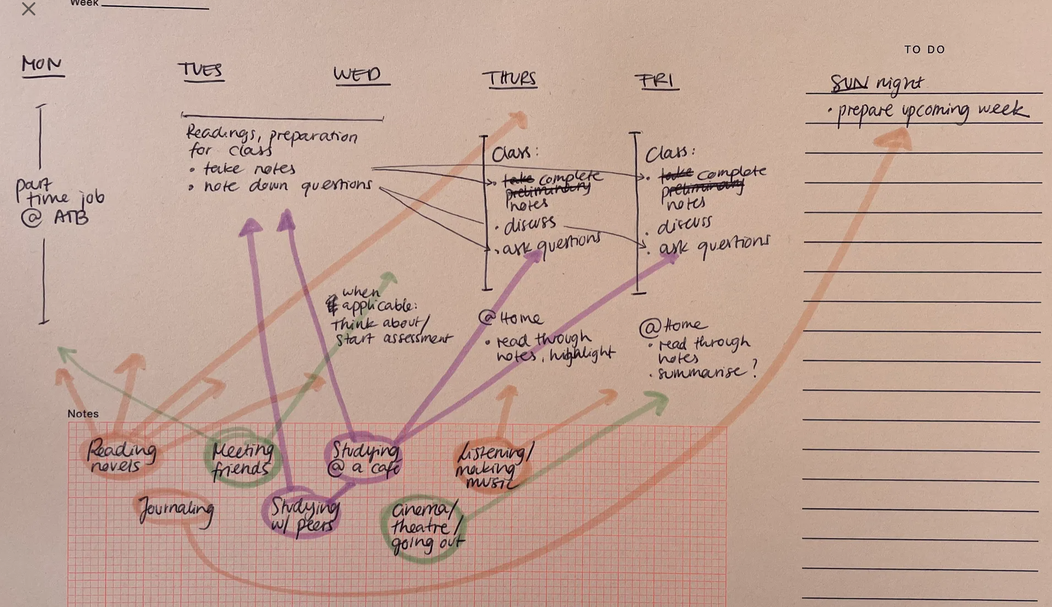
Creative confidence

Slide 20
Pilot
4 courses in LCC Media School
Ran for 3 weeks over start of term
Self-assessment at the start and evaluation questionnaire embedded into module at the end
43 Students undertook the module
More engagement p/g than u/g
Some issues difficult to solve – eg moodle enrolment and limitations in the evaluation
Technical aspects (quizzes, padlets, forums etc.) all worked
Good engagement between staff and students and good completion rates
Engagement within journal and forum activities providing more insights into student experience

Slide 21
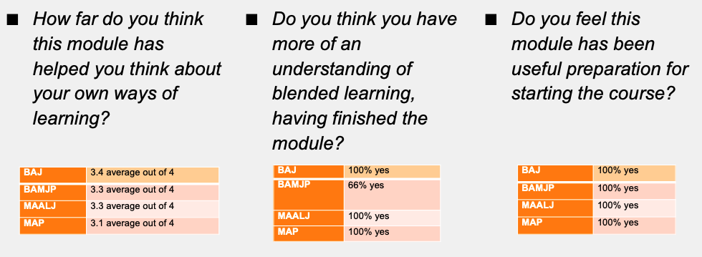
Evaluation Questionnaire

Slide 22
100% agreed it was good preparation for starting the course
Agreed it helped them understand own learning style
Good understanding of blended learning evident from the written journal & forum
Course-based community building was appreciated by participants
Summary of Evaluation Questionnaire
Notes:
To avoid overloading the slides with text, use speaker notes to add more detail and prompts.

Slide 23
BA KEY POINTS
Had started to consider their learnings styles before they came
Alert to study skills – eg around note taking
Were interested in the teaching presences
More nervous about sharing ideas (eg in forum)
In summarising blended learning they showed how they had engaged with the pedagogy of the concept

Slide 24
MA KEY POINTS
Linked learning styles to digital environment
Setting challenges for themselves
Emphasis on learning in a variety of ways - using this approach to reach a higher quality of work.
High level of recognition that P2P working online and in class was a valuable way to learn.

Slide 25
Other points
Recognised need for taking responsibility for learning
All acknowledge had a variety of learning styles
Learning disabilities benefits
Quizzes more popular than expected; Padlets used effectively and creatively

Slide 26
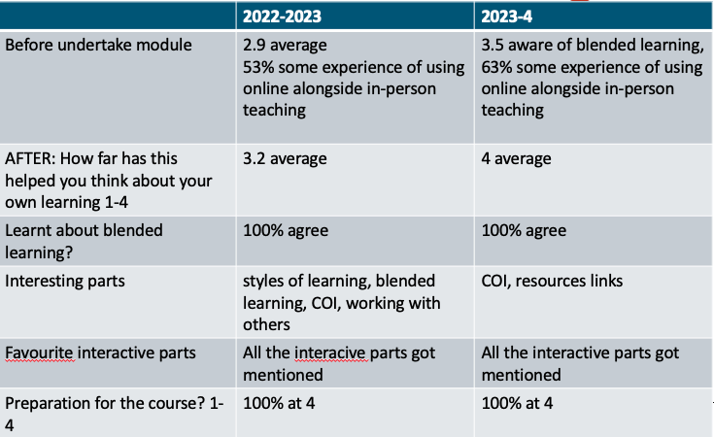
MA Publishing year on year

Slide 27
BA
Going forward, I will study to my best type of learning so I can do what works best for me. I will also write out a weekly planner so I know what my week looks like and what tasks I need to get done. (student from BAMJP)

Slide 28
MA
Reading through this module, I have realised that blended learning makes use of visual, auditory and interactive content - a method that could really boost my efficiency as a learner. Most importantly, it provides instant access to my learning, wherever I am and whenever I need it. Blended learning thus allows for a more self-paced learning, which makes a difference. Personally, I am more effective when the teaching is flexible, adaptable and engaging. (Student from MAPub)

Slide 29
Challenges going forward
Getting engagement is still a challenge
Creative students participate more in visual activities (eg padlet learning rhythms} compared to those less creatively confident
Time-poor students – timetabling it in
Those who engage continue to use the digital tools
Digital resources used at point of need effectively

Slide 30

DISCUSSIONS
Explore three key themes:
  Asynchronous learning – value and relevance
  Engaging students in the digital elements of their courses
  Embedding creativity in digital learning modules
The discussion will feed directly into the next iteration of the unit
https://artslondon.padlet.org/fhall23/discussion-points-l2nfuek1y9xnkhgk

Slide 31
QUESTIONS TO CONSIDER
Asynchronous learning - what are your experiences?
How valuable do you feel asynchronous activities are? Is this different for art and design courses?
How have you engaging students in the digital elements of their courses
What challenges have you faced?
How can you embed creativity within digital learning?

Slide 32
References
Boelens, R., De Wever, B., Voet, M., (2017). Four key challenges to the design of blended learning: A systematic literature review. Educational Research Review 22, 1–18. https://doi.org/10.1016/j.edurev.2017.06.001
Fleischmann, K. (2021). Hands-on versus virtual: Reshaping the design classroom with blended learning. Arts and Humanities in Higher Education, 20(1), 87-112. https://doi.org/10.1177/1474022220906393
Graham, C. R. (2006). Blended learning systems: Definition, current trends, and future directions. In C. J. Bonk & C. R. Graham (Eds.), The Handbook of Blended Learning: Global Perspectives, Local Designs (pp. 3–21). San Francisco: Pfeiffer. http://doi.org/10.2307/4022859
Kassim Procedia - Social and Behavioral Sciences 97 ( 2013 ) 229 – 237
Kintu, M.J et al (2017) Blended learning effectiveness: the relationship between student characteristics, design features and outcomes. Int J Educ Technol High Educ 14, 7 (2017). https://doi.org/10.1186/s41239-017-0043-4
Namyssova, G., Tussupbekova, G., Helmer, J., Malone, K., Afzal, M., & Jonbekova. D. (2019). Challenges and benefits of blended learning in higher education. International Journal of Technology in Education (IJTE), 2(1), 22-31.
Platanova et al. 2022 Frontiers in Education Volume 7 - 2022 https://doi.org/10.3389/feduc.2022.957199
Taneja, R., Taneja, P, Goel. M (2023) https://doi.org/10.61275/ISVSej-2023-10-10-10

