Slide 1
COLLABORATING ACROSS CREATIVE CULTURES
Frania Hall
By the Book 5

Slide 2
Publishing and Porous Boundaries
Creative organisations – publishing/education/arts
Convergence across form/transmedia
Innovation & experimentation – with other creative enterprises
Commercial arrangements run through these

Slide 3
Complexities
Apparently traditional situations - publisher in market they expect etc. content producer= author; but different balance of power/relationship
Commercial/educational dichotomies
Creative values/creative visions
Joint venture in feel, managed under standard contract basis
Different ways of working/internal hierarchies
Charitable status

Slide 4
Research
4 case studies in development
Building on work around evolving theories of collaboration
Case study (Yin, Flick, Krippendorf)
  Publisher & arts organisation – building curriculum-based books (print and digital) for educational market – UK schools GCSE (14-16yrs)
1 presented here – based on 4x 1hr interviews
  Publisher
  Freelancer
  Broker
  Arts organisation

Slide 5
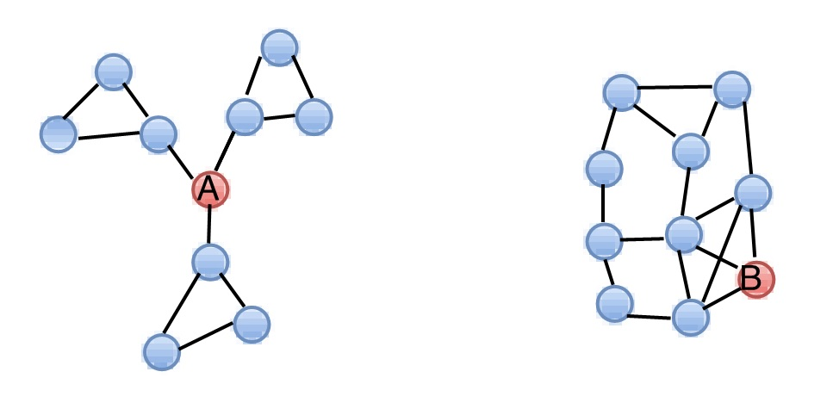
Network theory – Granovetter/Burt
Entrepreneurial and creative networks
Weak ties/Structural holes
Role of broker

Slide 6
Project ecologies/typologies for creative partnerships
Grabher
Requirement for uniqueness rather than iteration – weak ties
Divergent thinking leads to creativity
Disruption/improvisation
Kaats & Opheij
Exploratory/entrepreneurial
Move into a market could not enter alone
Exchange
Starkey et al
Latent organisations – nuanced to strong ties

Slide 7
Arts organisation
Curriculum development/ schools focus
Less control over product
Need publisher can work with – in tune with concept
A collaboration – not a logo
Cultural capital
Content & resources

Slide 8
PUBLISHER
Strategically enter a market that is crowded and competitive
Have no content themselves – need to generate unique content
Have platform they can make use of
Product design experience
Wider network
Wanting to understand digital opportunities with content

Slide 9
Why new?
New sorts of partners
Both equal
Trying to test out a market together and compete in a new space
Creative solutions (eg over contract)
Different unpredictable outcomes emerge
Couldn’t do it alone

Slide 10
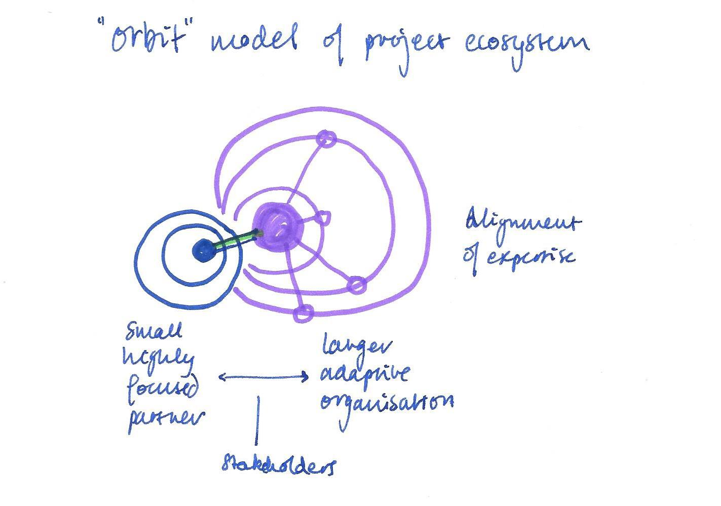

Slide 11
The publisher’s role
Interpreter (of author – now of organisation)
Speak the language of different stakeholders
Translate different visions
Flexibility to step in and out of cultures
Alignment of other functions/expertise – publisher knows they are key but arts org leaves that up to publisher
Arts org is really focused on content – their asset – their knowledge base - their resources -
Take learning further – take more risks? Go with the other further
Diplomat - What controls do they have? Who makes decisions? Where to put their foot down? This is embedded in structure of the project
Understand value of content

Slide 12
Dilemmas
Language – arts org resistant to marketing speak of educational publishers
Arts Vision – arts org wary that ethos of books must still represents ethos of organisation - but for publisher that too is uniqueness
Unease around focus – both sides wonder if they should have pushed further for something - Was the project vision diluted through accommodation of each other?
Who has control over what?
Timing – this was dictated by project and not by market
Learning & Entrepreneurial aspects – arts org more entrepreneurial than publisher because outside the box– could publisher have been more flexible?
Was learning more about working together than about creative thinking?

Slide 13
Requirements for success
Importance of broker
Autonomy of participants
Expertise – very focused and all stakeholders
Size of collaboration
Vision formation (long term) and vision engagement (vision broker/vision – vision flow….stakeholders and dissemination
Modus operandi – meetings and decision making – highly structured – for buy in = equality embedded in design

Slide 14
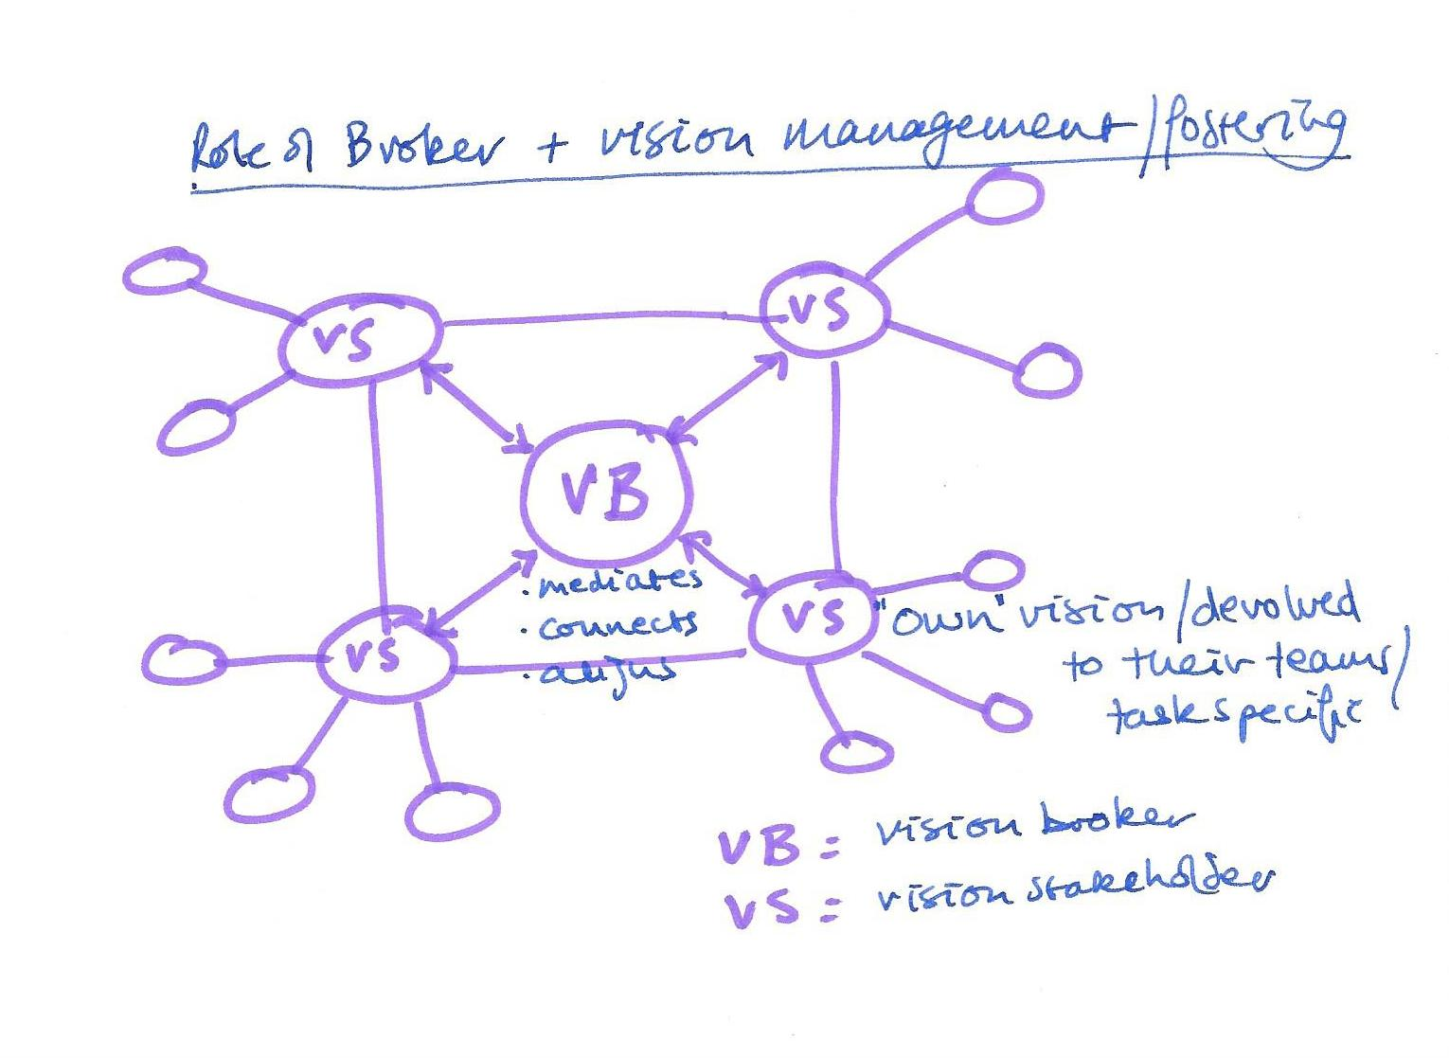

Slide 15
Collaborative structure/structure alignment
Broker develops the project vision and structure for stakeholders
Publisher develops the wider project hierarchy
Dissemination to wider project
Vision management spreads to the publisher

Slide 16
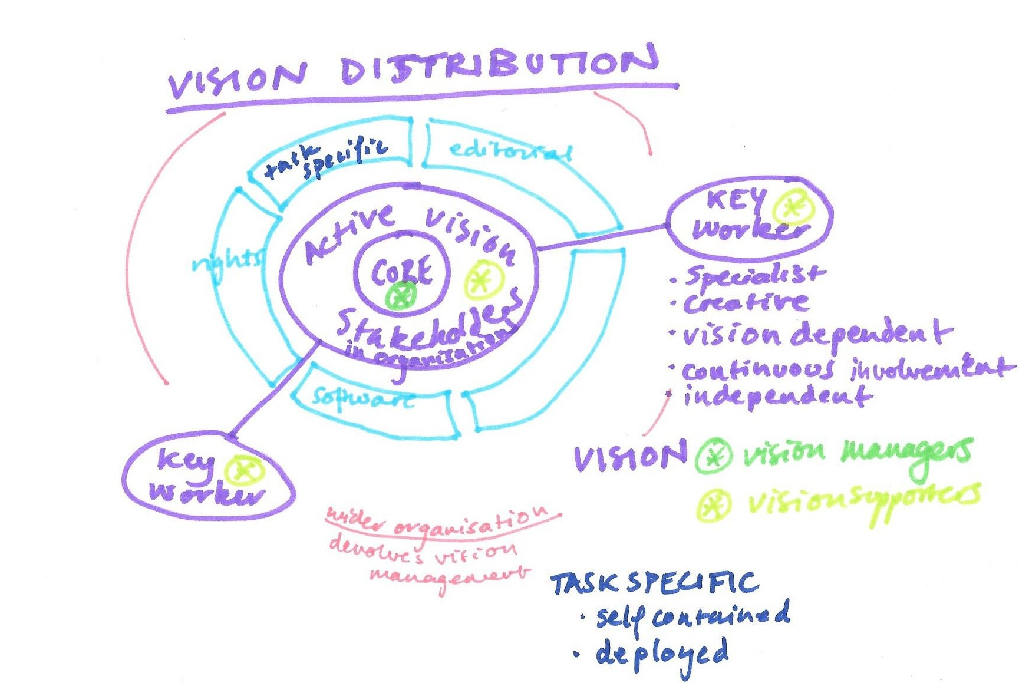

Slide 17
MEASUREMENT OF SUCCESS
Actual projects very good – all parties satisfied – projects done very well
Successful series – continuing to evolve
Less outstanding commercially – some disappointment
Recognition of amount of effort put in integrity of content from all parties was perhaps over-delivered – passion projects
Learning – from each other – about each other’s environments (publisher s more relaxed about this) and also about how far to push another time
Enjoyment and intellectual stimulation as to how to make this work
Unique approach to curriculum development through collaboration – in a challenging environment – no budget no time.

Slide 18
broker
‘This is where we were amazingly, incredibly lucky and it wouldn’t have happened so without him so he was able to understand both languages’

Slide 19
Networks
‘and there’s one of those pieces of serendipity: there is someone who is responsible for the list whose heart is probably with the fantastic new things you can do with digital’

Slide 20
VISION
it was absolutely consultative all the way
We all had the building blocks in place and we had a group of people who were genuinely thinking the same way

Slide 21
Working together
big leap of faith
you can’t run this the way you guys normally behave
we don’t need to go through x number of committees to get there
they have to be the people who can make the decisions

Slide 22
Compromises
we had an interesting month on typography

Slide 23
Outcomes
it was actually a very integrated project with a number of strands coming together in a glorious way
it was stimulating it was exciting to think of new way of doing things
you can really look at the possibilities and yes different worlds coming together

Slide 24
For publishers and innovation going forward
What publishers need to do – to be ready to align – to pull resources
have a central crack team
Be aware of vision brokers/
Be aware of brokers
Speaking both languages is central
Broker – could have done analysis of his ability to speak both languages

Slide 25
Organisations
Uniqueness of each project – how can that be managed?
Vision development and articulation and embedding of the vision
Sit outside the workflow but use it
Fast alignment of task specific aspects
Network behaviour
Paraorganisation

