Slide 1
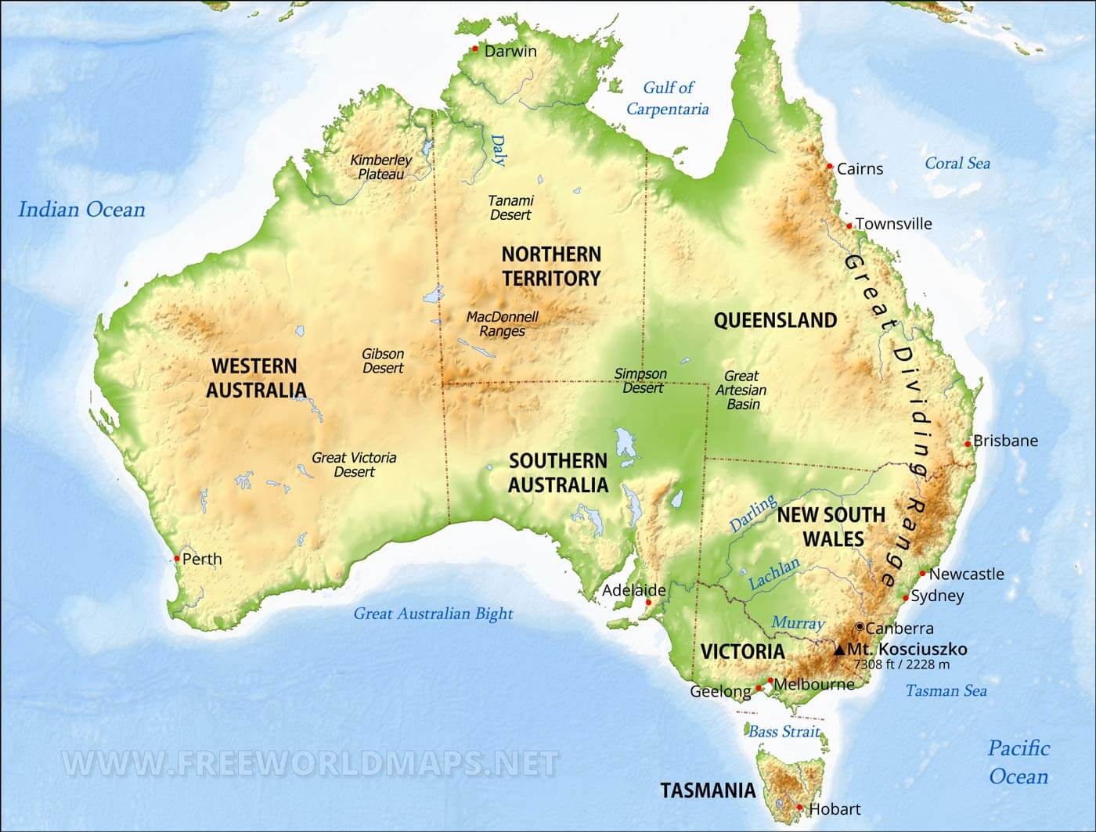
Another Intercultural Context:
Australian Universities and
Indigenising the Curriculum
Karen Harris
Intercultural Communications Trainer/
Language Development Tutor
Language Centre
University of the Arts London
k.harris@arts.ac.uk
Notes:
This session offers a fresh perspective on intercultural/ decolonising practices in Higher Education. It presents new possibilities, getting us thinking about what may or may not work in our UAL context – and why.
An enhanced awareness of how ‘decolonisation’ can mean different things and be approached in different ways, depending on geographical, historical or other contextual factors

Slide 2
Primary research: sources…
Interactions with ‘Indigenising University Mathematics’ community in Australia
Conversations with Dr Gabrielle Murray (Principal Advisor Academic in the Office of Indigenous Education, Research and Engagement at RMIT in Naarm (Melbourne).
Illustrative image removed.
Click here for image link.
Aboriginal Astronomy, Western Sydney University
Notes:
The Australian Indigenisation programme also has collaborative links (e.g. joint conferences) worldwide, especially countries such as USA and Canada, that have First Nations/ Indigenous communities.
IUM interactions: included my attending online conferences/ symposia in the small hours (UK time)!
Conversations with Dr Murray were face-to-face, on my visit to Australia earlier this year (2024).

Slide 3
Some background context
History of persecution and discrimination
Universities Australia implemented its first Indigenous Strategy in 2017.
Data from the 2021 UA report shows: “Positive trends include initiatives to encourage Indigenous students’ participation in higher education and increased enrolment rates; yet completion rates for Aboriginal and Torres Strait Islander students at 47% ‘are still lagging well behind’ the 74% for non-Indigenous students.”
Murray and Campton (2023)
Notes:
Long history of persecution and discrimination (e.g. “Stolen Generations” 1910s to 1970s - forced child removal and assimilation). The effects continue (widespread poverty).
Indigenous Strategy – e.g. specialist centres within universities, scholarships, access programmes, etc.
2021 data shows a huge completion gap, despite an Indigenous strategy! So clearly, it’s not just about remedying the enrolment gap by encouraging more Indigenous students to apply to HE. There must be other reasons why so many do not finish their courses. Something more is needed…. something to do with the curriculum itself? This leads us on to:

Slide 4
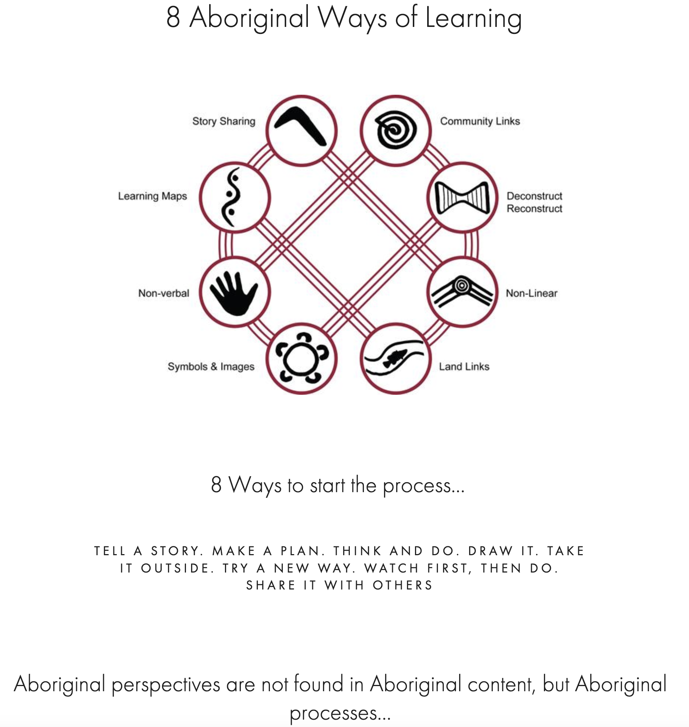
What is Indigenisation?
Bringing the perspectives, traditional knowledges and processes of Aboriginal cultures into mainstream education: not just as an adjunct, but embedded.
8ways.online
Notes:
Links to land (country) and community are of huge importance. As is the oral storytelling tradition…

Slide 5
Aboriginal learning
This includes:
story sharing; non-verbal elements (symbols and images); land and community links.
Illustrative image removed.
Click here for image link.
Aboriginal Art
Oral traditions include: narratives and spiritual beliefs; histories; kinship and community obligations; relationship with -and scientific knowledge of- the environment.
Relevance to the ‘pedagogy of love’ (Loreman, 2011)
Notes:
‘Learning’ in this context can refer to both the knowledge and the approach/ process.
Links to land (country) and community are of huge importance. As is the oral storytelling tradition…
Scientific knowledge of the environment include ecological aspects such as land and water management (such as handling bushfires); plants, medicines and agriculture; navigation, etc.
Referenced in IUM symposium (see previous slide): Tim Loreman (Concordia University, Edmonton, Canada) has worked to create more supportive, inclusive institutions for Indigenous learners. His Pedagogy of Love (2011) includes “passion, kindness, empathy, intimacy, bonding, sacrifice, forgiveness, acceptance, and community.” Intimacy and bonding = a teacher/student collaboration in learning, trust, a shared quest for knowledge.

Slide 6
Quotes to consider
From ‘Indigenising University Mathematics’ online symposium hosted by CARMA, University of Newcastle, NSW, Australia (Sept 2021):
On oral traditions: “Elements of the story are passed down in fragments and it takes years to begin to see the pattern of the carpet.” (Bruce Pascoe)
“We have our own unique ways of knowing, teaching and learning which are firmly grounded in the context of our ways of being. And yet we are thrust into the clothes of another system designed for different bodies, and we are fed ideologies which serve the interests of other peoples.” (Dodson, 1998)
Notes:
Anything that resonates?

Slide 7
Another quote to consider
“Traditional Knowledge is knowledge, know-how, skills and practices that are developed, sustained and passed on from generation to generation within a community, often forming part of its cultural or spiritual identity. (...) What makes knowledge ‘traditional’ is not its antiquity: much Traditional Knowledge is not ancient or inert, but is a vital, dynamic part of the contemporary lives of many communities today. (…) (It) is being created every day and evolves as individuals and communities respond to the challenges posed by their social environment.”
World Intellectual Property Organization
Notes:
Focus especially on the highlighted part.

Slide 8
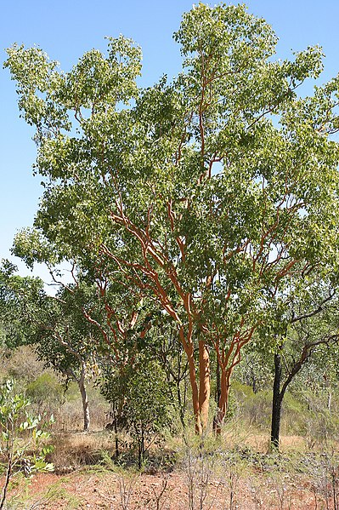
Ethics and cultural awareness
Data sovereignty
Protocols re. the dead
Place names and boundaries
Not homogeneous! 280 language groups remaining, and different communities have different knowledges.
How to reference Indigenous knowledge respectfully, avoiding misappropriation or tokenism
Eucalyptus
Notes:
Data sovereignty (control over personal or community info and how it’s used) – of huge importance in Aboriginal communities. This relates to the next point:
Protocols re. the dead. In Australian media (e.g. news, some official websites), there is often an announcement to warn that the next part will contain the voices and images of people who (may) have since died. And at any point in time, the family can withdraw the rights to use that person’s image or voice.
Not a homogeneous clump – so v. complex. (280 language groups – according to Dr Gabrielle Murray in our conversation)

Slide 9
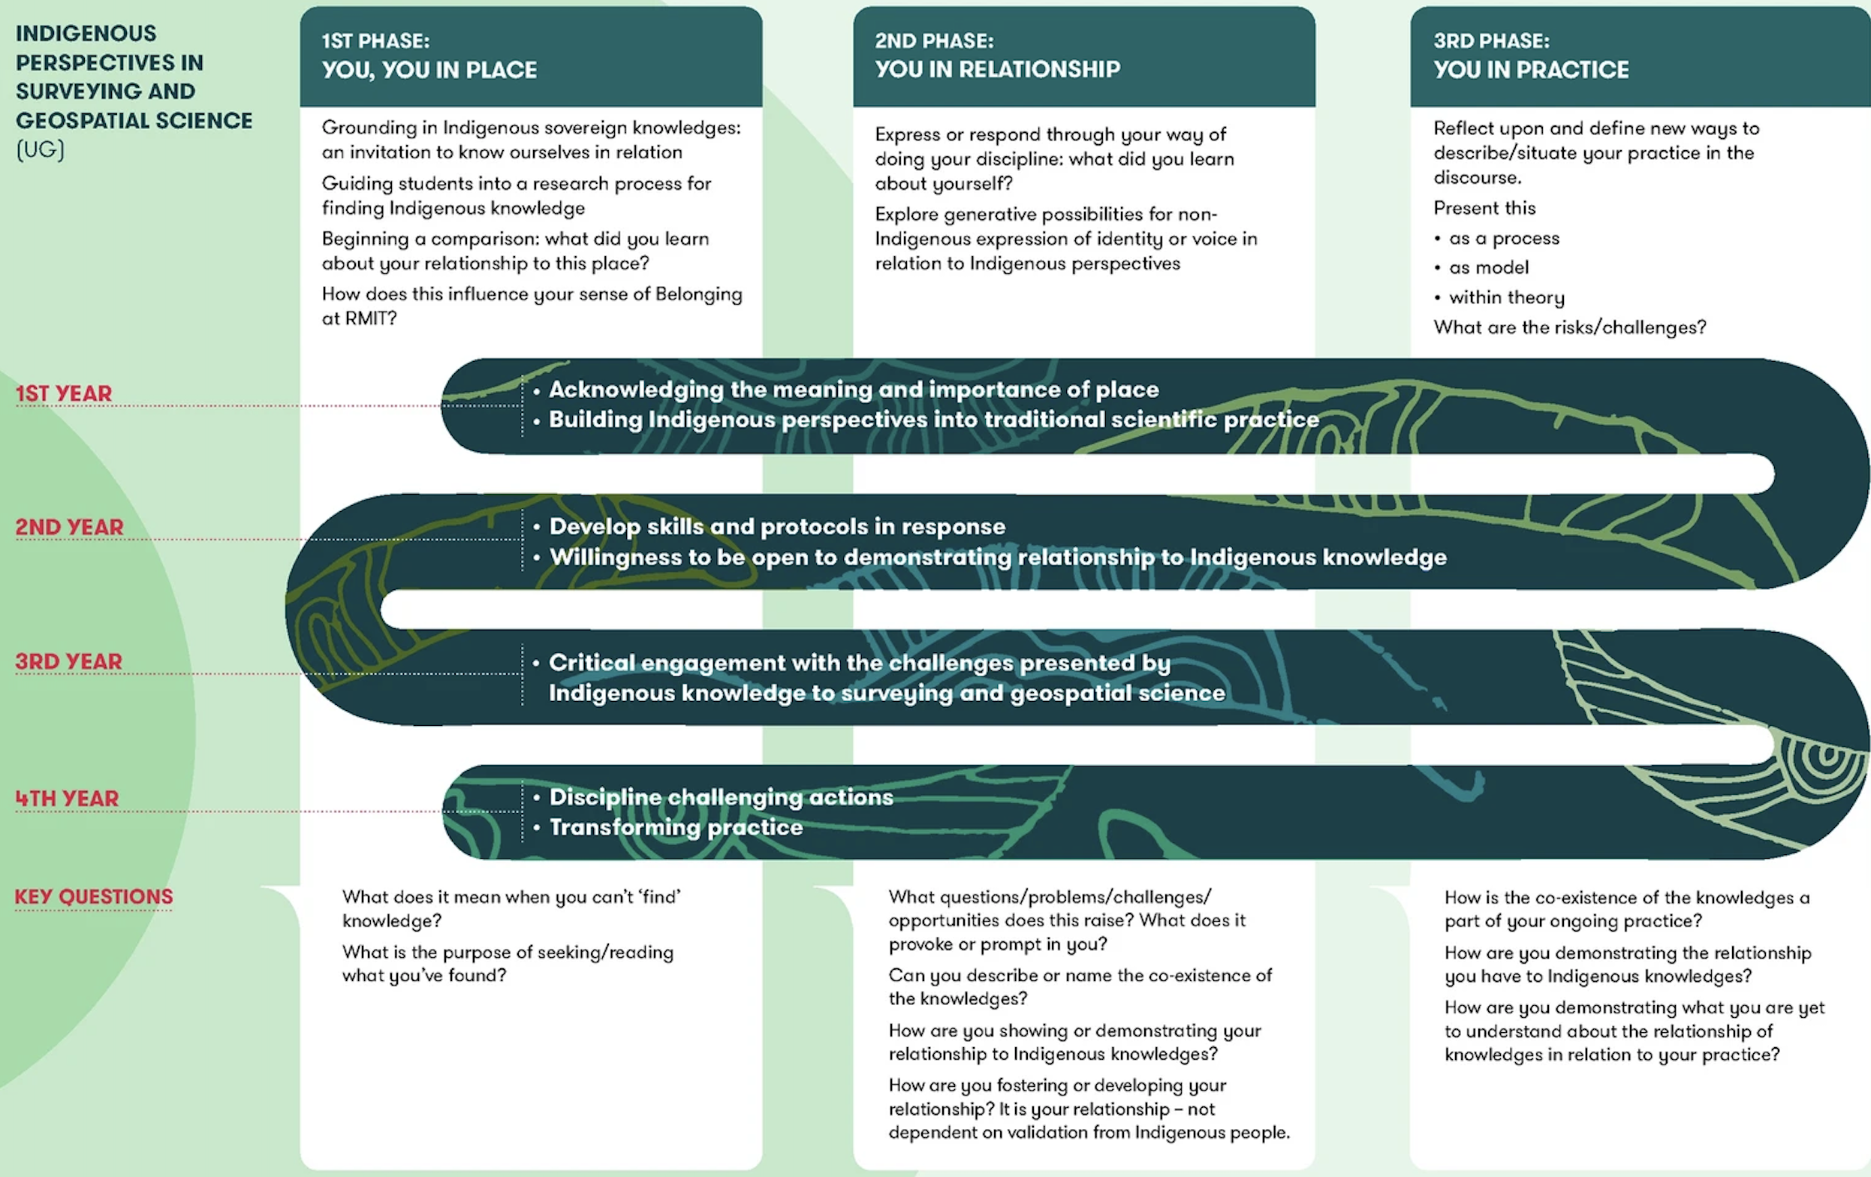
Piloting via mapping at RMIT
Murray and Campton (2023)
Notes:
This image shows one example of mapping: from the Surveying and Geospatial Science (UG) discipline.
From Murray and Campton’s report (link at end of slideshow, as we don’t have time to look at it in huge detail now):
WHY: “The purpose of the maps was … to understand how best to develop the capability of educators to embed Indigenous perspectives in discipline knowledge, practices, protocols, and skills.”
HOW: "We invited a small group of non-Indigenous educators including discipline leads and program managers to collaborate with us in this work.
Rather than using self-development mapping software, we worked at a grass roots level with pens, whiteboards, and post-it notes.”
WHAT: “At some point in the mapping process, we asked participants to articulate the Indigenous specific discipline capability they wished students to have learned by the completion of their degree. The discipline capabilities were captured in the curved pattern on the front side of the maps. As seen in Fig. 1a, for Surveying and Geospatial Science, it was reflexivity – ensuring students as professionals would never rename an area or place a boundary mark thoughtlessly again. They would know whose land it was, its Aboriginal name, and the names of the Traditional Owners. They would endeavour to practice codesign and collaboration. For Environmental Engineering, it was the ability to engage in respectful relationships and collaboration in the management of water culture…”
BENEFITS OF MAPPING: “The maps captured information, created transparency, made strengths and gaps visible and were fluid enough to invite reconsideration.”

Slide 10
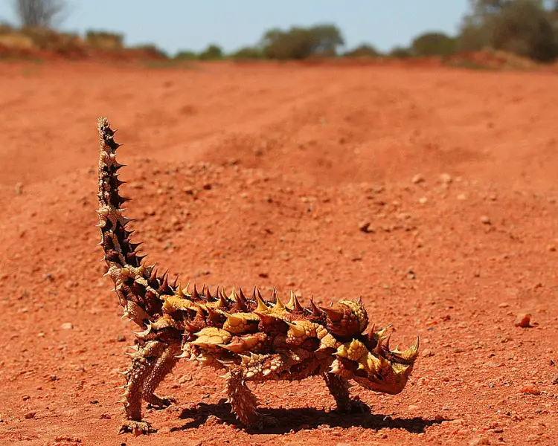
The challenges
Murray and Campton (2023) note that among educators, there may be perceptions of:
irrelevance/ unimportance
lack of time
one’s own lack of expertise
fear of doing the wrong thing
Logistics: collaboration with Indigenous partners is ideal … but can lead to overly depending on them.
Thorny devil (Australian lizard)
Notes:
How might some of these challenges be addressed…? Perhaps discuss this in Q&A.
From Murray and Campton’s paper: “Non-Indigenous educators are not being required to teach Indigenous knowledges in this sense. They are not being asked to teach culture, but to teach about culture, in a contextualised manner.” How does one make the distinction in practice?

Slide 11

Some provocations
Concepts to consider:
agnotology
de-centring
*Indigenous thinking often perceives things -including time itself- as a circle rather than linear. Is this a challenge to the idea of ‘progress’?
*Is our emphasis on individual achievement (rather than a shared quest for knowledge) a restrictive, ethnocentric construct? Or...?
RMIT in Naarm
(Melbourne)
Notes:
Agnotology = the study of how knowledge has been intentionally lost/ suppressed over time.
“De-centring” = questioning western ontologies and systems as the only conduit of “truth”; a process of unlearning.
Ethnocentric = bound up in our own cultural norms, and assuming that these are the ”standard”, universally applicable ways of being and doing.

Slide 12
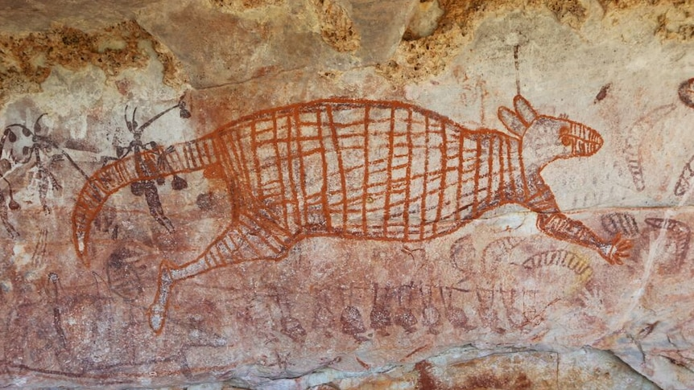
And finally…
Which aspects could we apply/ adapt to our context here at UAL?
And what do we leave in Australia…?
Ancient Aboriginal rock art in the Kimberley
Notes:
In other words, what is most relevant to us…?

Slide 13
Image and source links:
Slide 1: https://www.freeworldmaps.net/australia/
Slide 2: https://www.westernsydney.edu.au/campbelltown_observatory/home/areas_of_research_and_teaching/aboriginal_astronomy
Slide 3, 9 and 10: https://doi.org/10.1007/s13384-023-00663-3
Slide 4: https://www.8ways.online/
Slide 5: https://www.welcometocountry.com/collections/art?page=3 and https://link.springer.com/book/10.1007/978-94-6091-484-3
Slide 7: https://www.wipo.int/tk/en/
Slide 8: https://commons.wikimedia.org/wiki/File:00_4937_Eucalyptus_salubris_-_tree_%28Australia%29.jpg (W. Bulach)
Slide 10: https://animalia.bio/thorny-devil
Slide 11: https://commons.m.wikimedia.org/wiki/File:Design_Hub_RMIT_%2848400086107%29.jpg (Rob Deutscher)
Slide 12: https://www.abc.net.au/news/2015-11-02/indigenous-rock-art-could-be-among-oldest-in-world/6906476?utm_campaign=abc_news_web&utm_content=link&utm_medium=content_shared&utm_source=abc_news_web

Slide 14
Further information
https://aiatsis.gov.au/sites/default/files/2020-10/aiatsis-code-ethics.pdf
https://carmamaths.org/iumproject/details.shtml
https://indigenousmathematicians.org/
https://rmit.edu.au/students/support-services/indigenous
https://universitiesaustralia.edu.au/policy-submissions/diversity-equity/indigenous-higher-education/

