Slide 1
Demonstrating programming concepts with non-programming objects
Thom Kaczmarek – Senior Lecturer in Games Design at
London College of Communication, University of the Arts London

Slide 2
The issue
Notes:
The issue is that

Slide 3
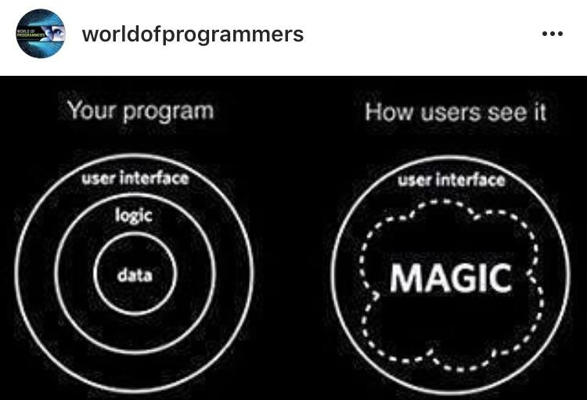
Based on my MA in Academic Practice…
There is a new digital divide, potentially with more socio-economic and political significance than initially thought - the division between creators (programmers of the experience) and consumers (those who consume the content of the programme).
  The black magic
  @worldofprogrammers
Notes:
Thus, for many, code is black magic.

Slide 4
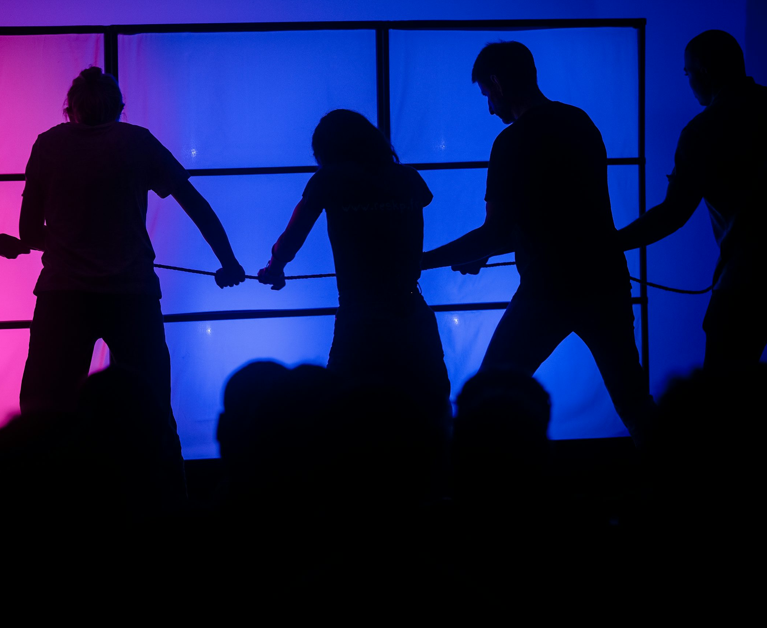
So let us pull on the curtain
In less than 5 minutes, I will teach you how to use
Variables to track scores
Print to display them
Math for numeric changes
Conditionals for game state changes
And in the end, make a Tug of War game using all of those!
  ResKPTour
  Unsplash | Photo: Nathan Pellerin
Notes:
https://unsplash.com/photos/people-are-pulling-on-a-rope-under-colorful-lights-TtqE496f8FE

Slide 5

AC/DC – Are you Ready (Official HD Video)
Notes:
So, are you ready?
https://www.youtube.com/watch?v=CIhylLW4Fcs

Slide 6
Containers

Slide 7
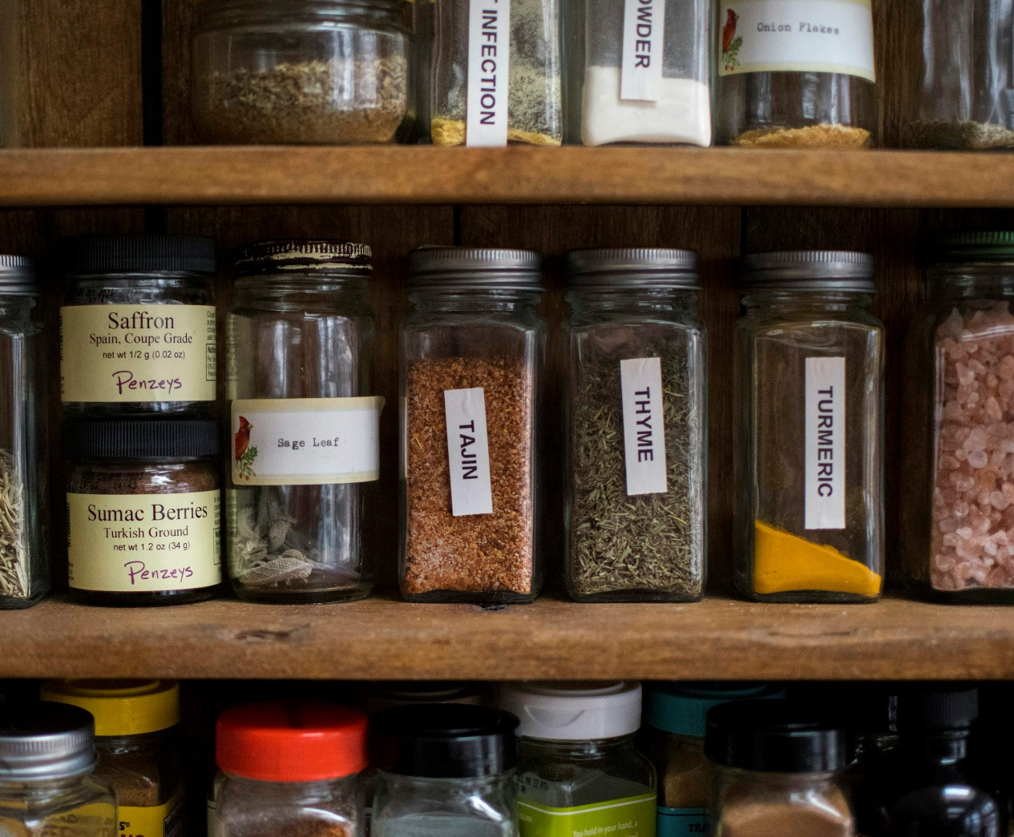
Variables as containers
I bet you have a fridge and/or a spice cabinet at home, with various containers for different things!
In programming, we also use containers, which we call variables. Each is labelled with a unique name for easier identification.
There are specific types of variables for different data, such as numbers or text.
  Racked up spices
  Unsplash | Photo: Paul Esch-Laurent
Notes:
You wouldn’t want to get a drink in plastic bag, would you?
https://unsplash.com/photos/a-shelf-with-jars-of-food-on-it-wCbDabmsDtQ

Slide 8
Printers

Slide 9
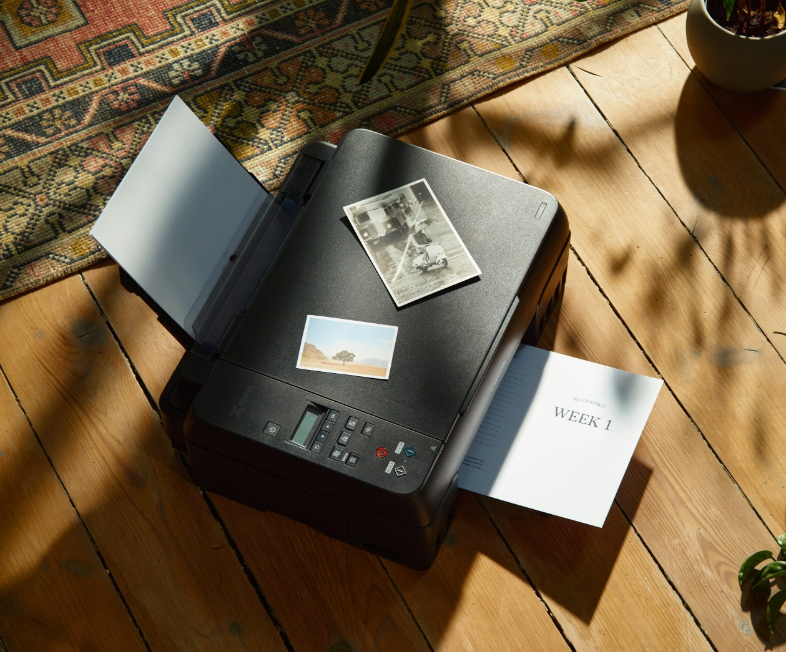
Communicate changes
We are all familiar with printers, and how they put any data we tell them to on paper – text, images, etc.
In coding, we do have a print() function that does exactly that; it displays whatever data we put in it, usually in the console (print) window.
  Printer
  Unsplash| Photo: Joonas Sild

Slide 10
Conditional Clause / If statement

Slide 11


Hypothetical scenario, what if?
If you’re attending IGDA London tonight, do follow them on Eventbrite for more events like this!
This could be expressed in code as:
if(in_IGDA_Attendance == true) if(condition is met)
{ {
follow_On_EventBrite(); then do something;
} }
  IGDA London chapter logo
  IGDA

Slide 12
The scary math

Slide 13
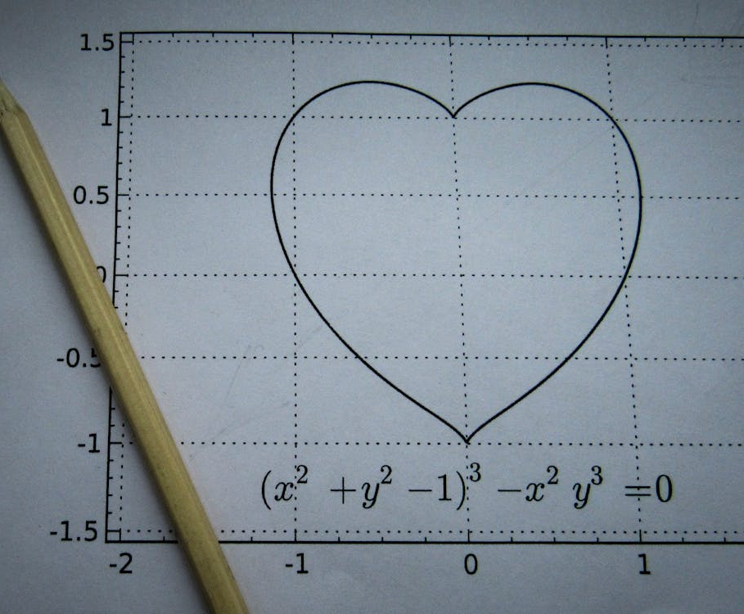
A simple addition…
1. Arithmetic (basic operations on numbers)
1 + 2 = ?
Yes 3!
  Yellow Pencil on White Paper
  Pexels | Photo: Sergey Meshkov
Notes:
Key Stage 2, specifically around Year 4 (ages 8-9) introduced Cartesian Coordinate System (X/Y graphs)
https://www.pexels.com/photo/yellow-pencil-on-white-paper-8482029/

Slide 14
…and multiplication…
2. Algebra: uses letters to represent unknown values.
If y = 1, how much is x? If x = y * 6
Yes 6!
  Yellow Pencil on White Paper
  Pexels | Photo: Sergey Meshkov
Notes:
Key Stage 2, specifically around Year 4 (ages 8-9) introduced Cartesian Coordinate System (X/Y graphs)
https://www.pexels.com/photo/yellow-pencil-on-white-paper-8482029/

Slide 15
…and graphs, sorry!
3. Cartesian Coordinates (XY Graph):
A point in a graph is often represented as a pair of values (X, Y) or, in Unity terms, a Vector2(X, Y).
So, if the object starts at (0, 0) and we want to move it ten times by (0.5, 0.1), where does it end?
Yes, at (5,1)! as it travels from (0,0), its position changes: (0,0)>>(0.5,0.1)>>(1,0.2)>>(1.5,0.3) >>(2,0.4) >>(2.5,0..5) >>(3,0.6) >>(3.5,0.7) >>(4,0.8) >>(4.5,0.9) >>(5,1)
  Yellow Pencil on White Paper
  Pexels | Photo: Sergey Meshkov
Notes:
Key Stage 2, specifically around Year 4 (ages 8-9) introduced Cartesian Coordinate System (X/Y graphs)
https://www.pexels.com/photo/yellow-pencil-on-white-paper-8482029/

Slide 16
That’s all folks!

Slide 17

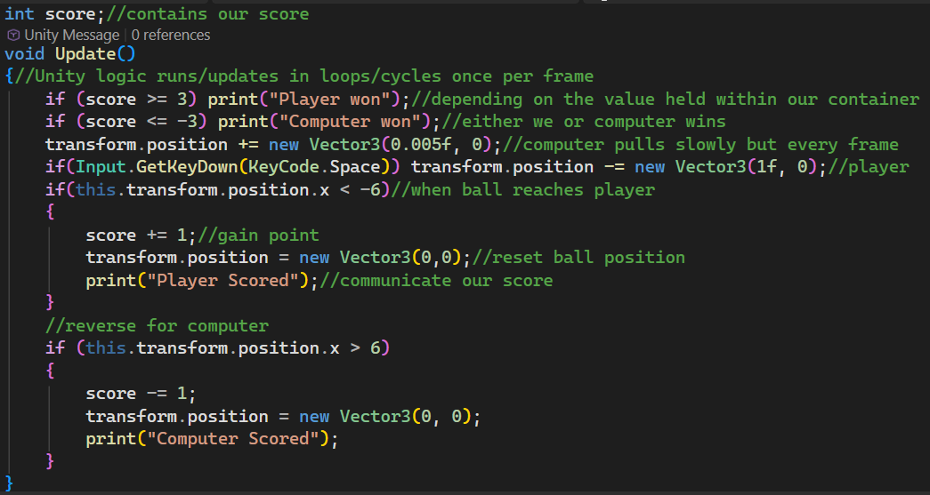
Notes:
Let us use a float container to track the score (you can hate me for it later!), and that’s all we need in terms of variables!
Unity apps run by default at 60 FPS – frames per second. Every frame, the Update function goes through all code, up and down, left, and right, and repeats the cycle.
If we lead with 3 points, we win; if the computer does, we lose.
Every frame (so 60 times a second!) , the computer will slowly pull (move) the object on the X-axis towards itself.
If we press the space key as our input, we move the object towards the player at a much faster pace (as there is only so much you can do in 60 frames per second).
Then, if the object position reached the player (presented here is -6:
We scored, the ball resets to the initial position of 0,0, and we print the message of the score.
We also repeat the same logic for the computer with values that reflect it

Slide 18
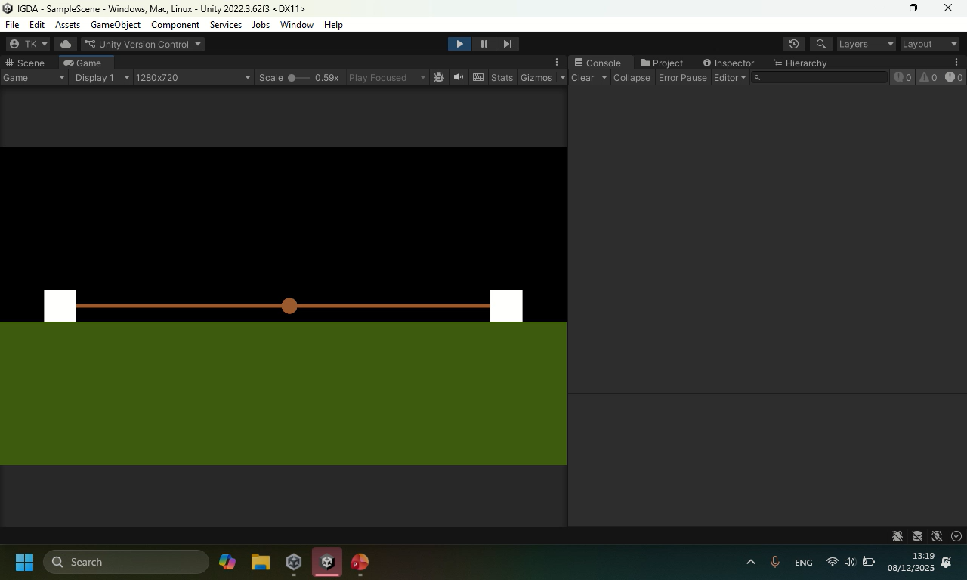
UNITY GIF
Notes:
And that’s it, we have a game.

Slide 19
Games to learn code

Slide 20
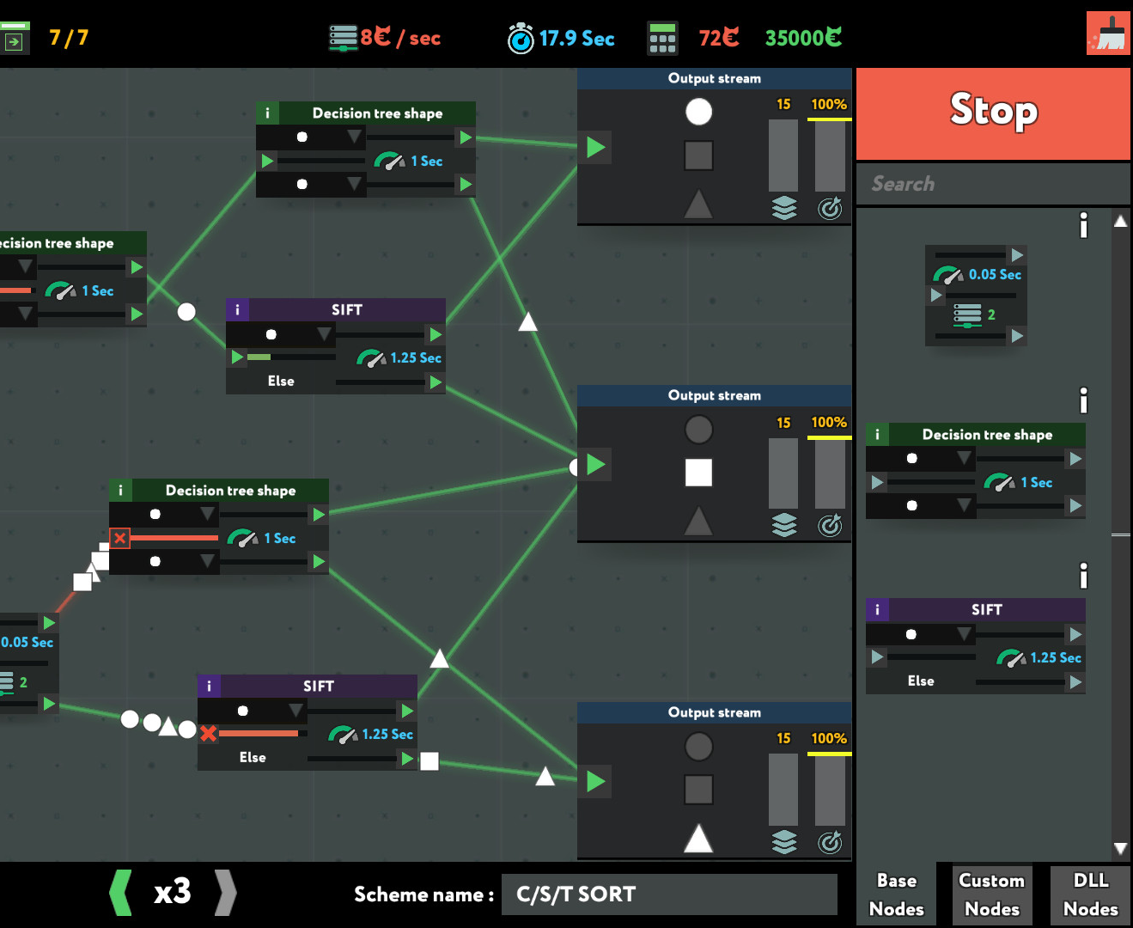
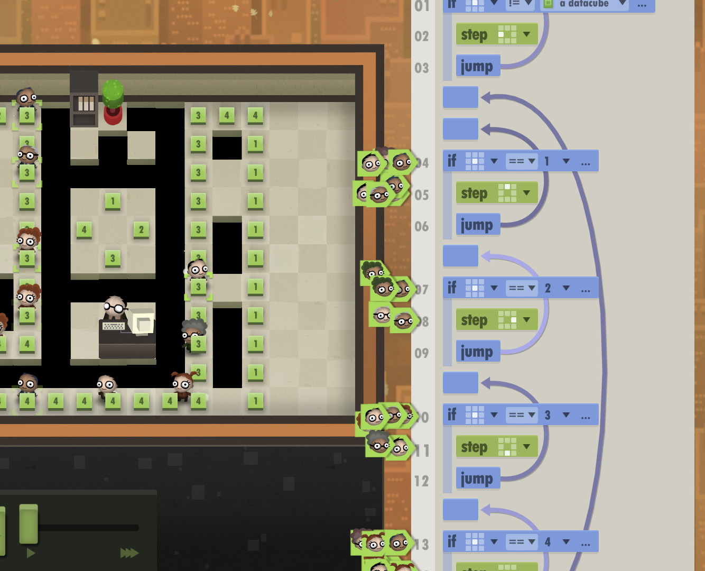
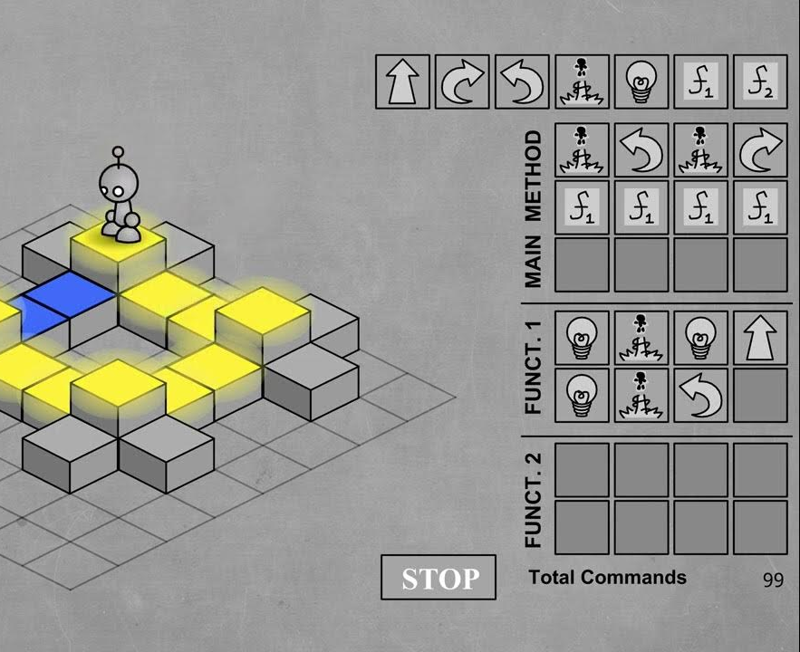
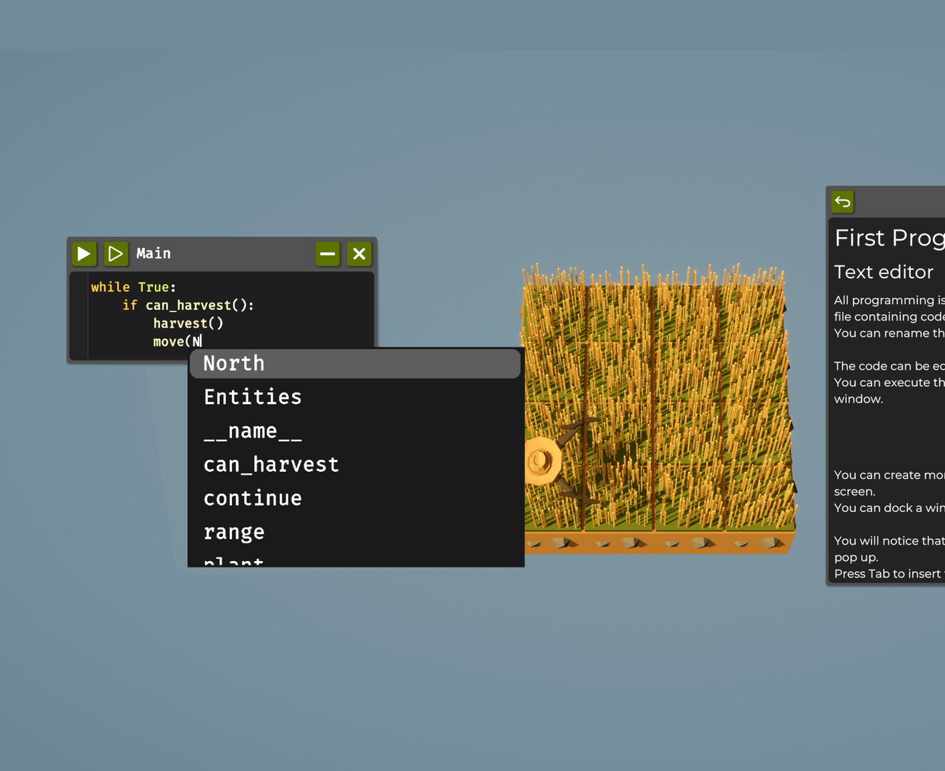
Play to learn
Start with “LightBot” – sequential Logic, basic loops and conditionals – my MA was based on it!
In time expand to “Human Resource Machine” / “7 Billion Humans” for more Scratch-like visual programming
Finally upgrade to either an Unreal-like blueprint of “while True: Learn” or Python-oriented “The Farmer Was Replaced”
  Screenshots from games
  light-Bot (2008) / 7 Billion People (2018) / while True: Learn (2019) / The Farmer Was Replaced (2025)

Slide 21
That’s all, folks!
Thom Kaczmarek – Senior Lecturer in Games Design at
London College of Communication, University of the Arts London t.kaczmarek@lcc.arts.ac.uk
@Fanotherpg
Notes:
Thank you for listening.

