Slide 1
Cataloguing art ephemera and artefacts in libraries
Cataloguing art materials: an ARLIS/UK & Ireland Cataloguing and Classification Committee workshop
Christie’s Education
15 December 2011
Gustavo Grandal Montero
Academic Support Librarian, Chelsea College of Art & Design / Camberwell College of Arts
Notes:
Copyright on all artworks reproduced belong to the artists (slide 7, ‘Red Boxers’ – Gilbert & George; slide 16, ‘House Rules’ – Rose Finn-Kelcey)

Slide 2
Cataloguing ephemera and artefacts
Overview:
Library cataloguing context
What is art ephemera
How to catalogue ephemera (or not)
Some artefacts in our collections
Cataloguing artists’ multiples and other 3D artworks
References & Questions
Notes:
Overview of the presentation, focusing on practical issues for cataloguers in the current context

Slide 3
Cataloguing the ‘unusual’ in art libraries
Library cataloguing standards:
Cataloguing rules AACR2 is a universal code, covers the description and the provision of access points for all library materials ‘commonly collected‘.
Large variety of formats but primarily print publications (books, serials, etc.), AV material, digital material…
Other rules could be applied in different contexts: ISAD(G) in archives, Spectrum in UK galleries and museums, etc.:
Emphasis on ‘horizontal’ level relations (other works by same author, on same subject) –as opposed to ‘vertical’ in archives
and description (to identify the item –not process based as for instance in museums: provenance, conservation, exhibition, location, etc.)
In addition to AACR2 various other library cataloguing and classification standards used: bibliographic data format MARC21, controlled vocabularies (Library of Congress Subject Headings, Art & Architecture Thesaurus), and
classification schemes (Dewey Decimal Classification).
Notes:
Basic level of familiarity with AACR2 (Ch. 1 General rules of description, and Ch. 2 Books, pamphlets and printed sheets) and MARC21 assumed

Slide 4
Cataloguing the ‘unusual’ in art libraries
These materials demonstrate the flexibility and adaptability of library cataloguing practices and tools, and particularly AACR2, but also expose limitations and long term problems.
Level of detail in cataloguing records is always a consideration but more so for these formats. Some problems:
No ISBN or other standard ID.
No available records to derive.
Need for specialists skills and/or subject knowledge.
Can be very time consuming (i.e. expensive).
But there are some solutions:
Cataloguing at collection level or intermediate (not item).
Development of local guidelines.
Use of templates (making possible use of non qualified staff or even
volunteers).
Digitisation and use of images in online catalogues.
Notes:
Presentation based on 2 projects completed at Chelsea College of Art & Design Library –
1. CLIP CETL Small Rewards (2006/7 and 2007/8) project which allowed the production of digital photography and a printed visual catalogue of the Artists’ Multiples Collection, and the creation of high quality records for all the items on the online UAL library catalogue.
2. 2010/11 project completed with the help of a volunteer to re-file, create listings and catalogue records for individual artist files to allow discovery via the online UAL library catalogue.

Slide 5
What is art ephemera?
Small scale printed material related to artists and their work such as press releases, artists' statements, CVs, invitations, cards, correspondence, listings, programmes, guides, maps and plans, reviews, newspaper and magazine clippings, flyers, stickers, leaflets and posters relating to art. It may also include small catalogues, artists’ books, multiples, and other 3D objects. Digital ephemera encompasses emails, websites, pdf files, etc.
Made for specific, limited uses, usually intended to be discarded, freely or inexpensively distributed.
Sometimes referred to as artists files, vertical files, etc. (particularly in museum/gallery libraries).
Valuable as a source of documentation on many artists, artworks, events, etc. (sometimes unique: 40-50% according to study at CCAD).
Sometimes made and designed by artist, in some cases can be considered original artwork (e.g. Mail art) but in all cases valuable as artefacts (typography, images, etc.) not just for its content.
Notes:
Phillpot, C. (1995) Flies in the Files: Ephemera in the Art Library. Art Documentation, v. 14: no. 1, pp. 13-14.
Leiber, S. (2001) Extra art: a survey of artists' ephemera, 1960-1999. Santa Monica, Calif.: Smart Art Press.
Lawes, E. and Webb, V. (2003) Ephemera in the art library. Art Libraries Journal, v. 28: no. 2, pp. 35-39.
Cooke, Jacqueline (2006) Heterotopia: Art Ephemera, Libraries, and Alternative Space. Art Documentation. v. 25: no. 2, pp. 34-39.
Art Libraries Journal (2006) Ephemera as a research resource: special issue. v. 31: no 4.
Cooke, J. (2007) Ephemeral traces of 'alternative space': the documentation of art events in London 1995-2005, in an art library. Doctoral thesis, Goldsmiths.
Harvey, A. (2007) Ephemera in the art library. MA Thesis, City University.
ARLIS/NA. Artist Files Working Group (2010) Artists’ files revealed: Documentation and access. http://www.arlisna.org/pubs/onlinepubs/artist_files_revealed.pdf

Slide 6
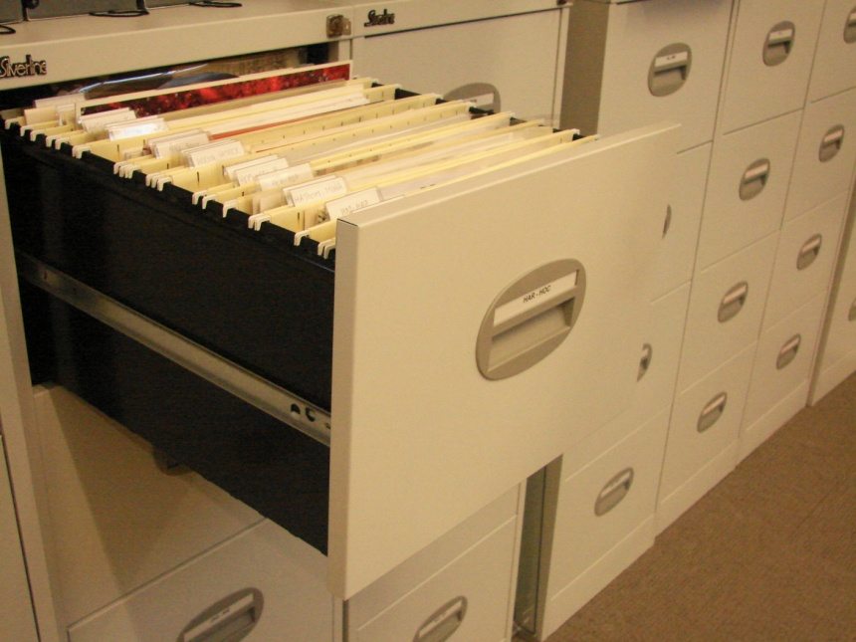
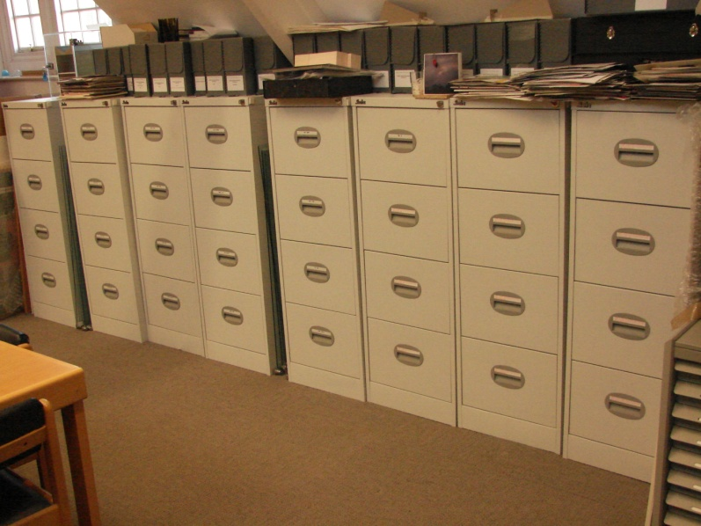
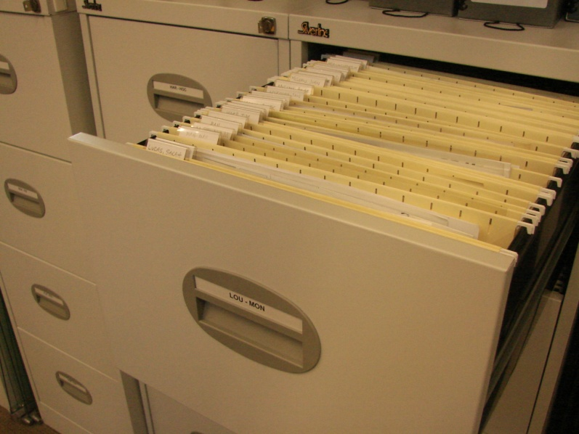
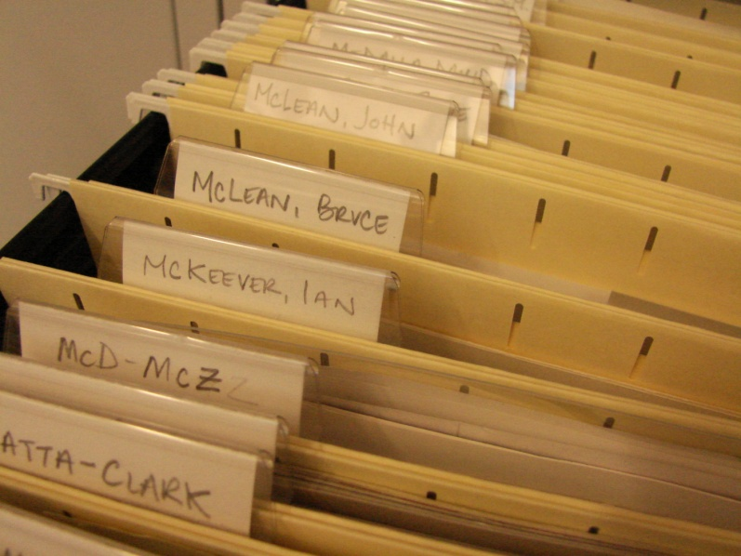
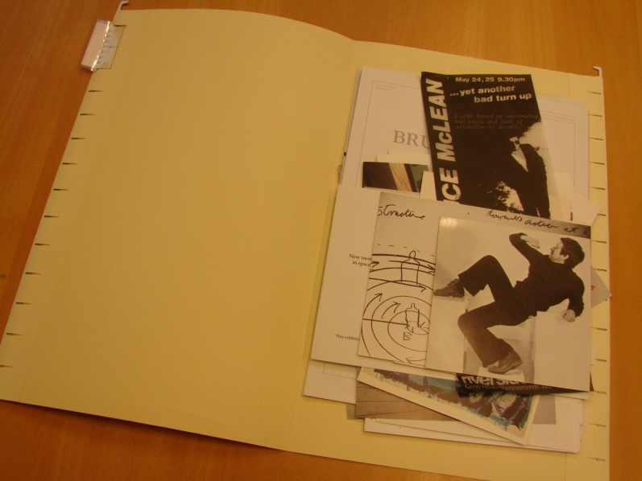
What is art ephemera?
Notes:
Ephemera Collection CCAD:
http://www.arts.ac.uk/library/archives-collections/chelsea
Information also available on ARLIS/NA Artist Files Revealed website: http://www.artistfilesrevealed.com/tiki/tiki-view_tracker_item.php?itemId=51&trackerId=2&show=view
Documents Modern and contemporary art (1950-)
Est. ca.1980 (Stephen Bury) to complement the exhibition catalogue collection and other research sources
2003-2005 separated, moved into filing cabinets in hanging files
2010/11 new project completed with the help of a volunteer to re-file and edit content, and to create listings and catalogue records for individual artist files

Slide 7
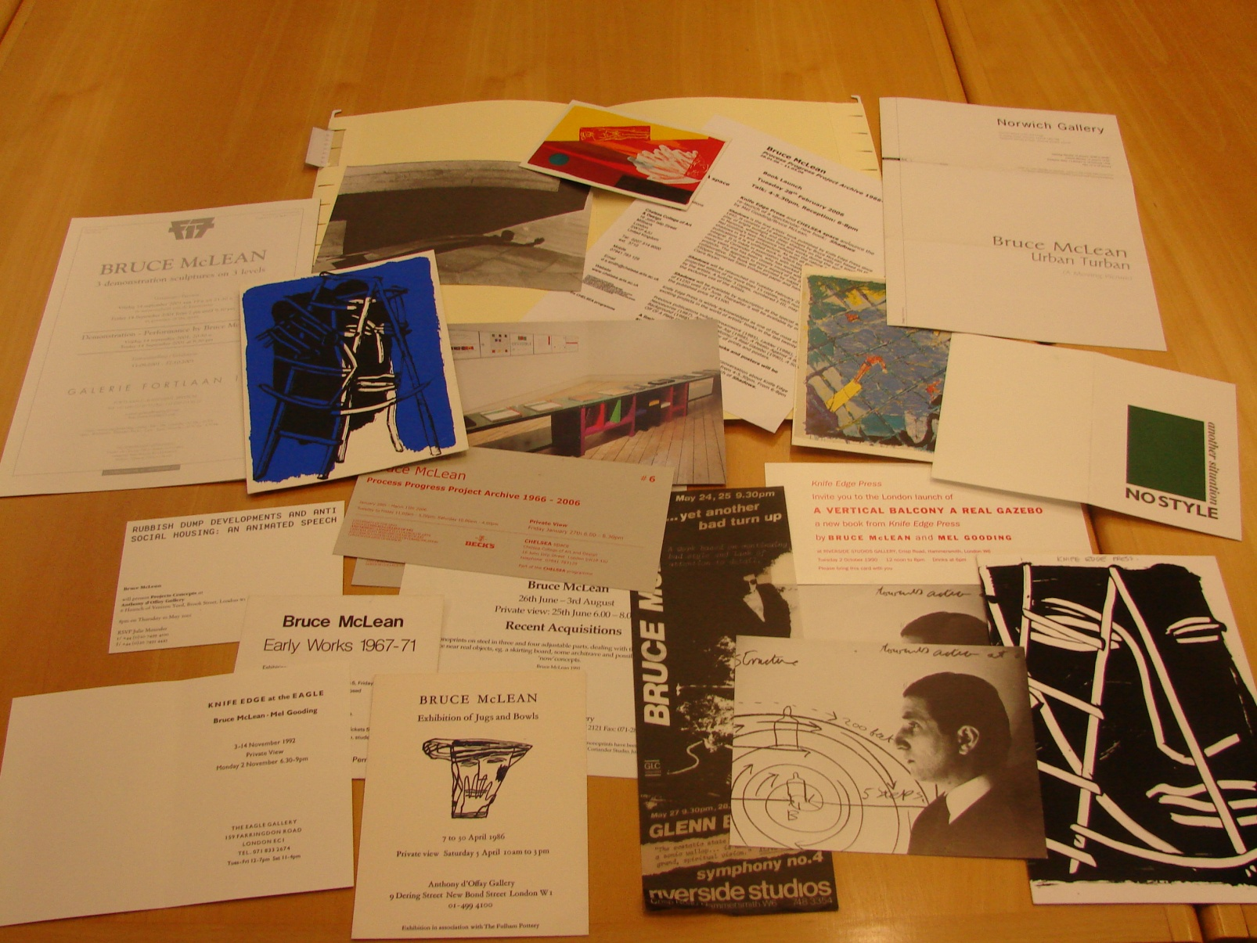
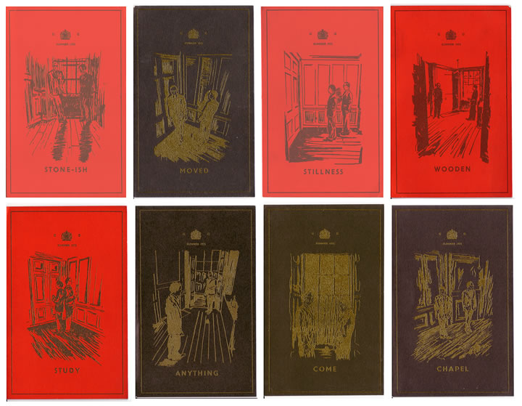
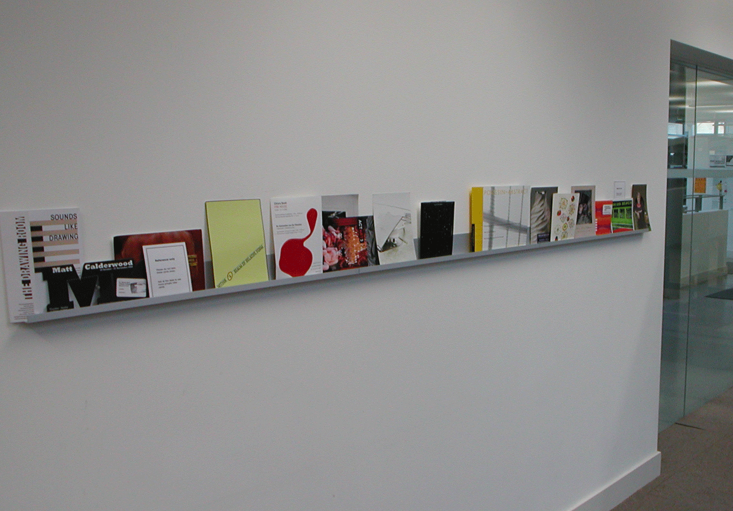
What is art ephemera?
Notes:
24 linear metres; listings with 690 entries for individual artists; 281 single artist files with individual catalogue records
Living collection: new material is added constantly (most received by mail, also collected in situ by staff, and donated) –displayed on a ‘look shelf’ by the library entrance, for current exhibition awareness
Artworks (ephemera art, mail art, artists’ books, artists’ multiples) and exhibition catalogues are not part of the Ephemera Collection, but other Special Collections

Slide 8
Cataloguing art ephemera (or not)
How to publicise and make accessible this valuable resource? AACR2 Ch. 2 (Books, pamphlets and printed sheets) provides a sound basis to catalogue this material, but this is a practical, not technical problem.
Standard item level cataloguing depends on:
  Material itself: size and nature (e.g. significant individual items)
  User requirements
  Staffing resources
  Funding resources
Large ephemera collection: not feasible to catalogue all individual items as policy
  Current practice in similar collections/institutions (MoMA, Whitney, Tate …)
  Existing standards and recommendations: Artists files Working Group ARLIS NA (2010) Artist files revealed: documentation and access http://www.arlisna.org/pubs/onlinepubs/artist_files_revealed.pdf

Slide 9
Cataloguing art ephemera (or not)
Artist files revealed: documentation and access offers cataloguing advice and recommendations, including two templates (minimal and expanded level).
Incorporates AACR2, MARC21, etc.
Specific individual items can still be catalogued individually when required but items are integrated into artists’ files, and these are catalogued instead, with a relatively low level of detail (variable).
Minimal and expanded level offer flexibility, including dates, use of additional LCSHs, etc.
Uses AAT ‘Artist files’ as genre/form indexing (655) to facilitate retrieval.

Slide 10
Cataloguing art ephemera: Template
LEADER
Type of Record a : Language material
Bibliographic Level c : Collection
Type of Control _ : No specific type of control
Encoding Level _ : Full level
Cataloging Form a : AACR2
Linked Record Requirement _ : Related record not required
008
Publication Status n : Dates unknown
Date 1 (uuuu)
Date 2 (uuuu)
Place of Publication xx : No place, unknown or undetermined
Notes:
Based on Artist files revealed: documentation and access

Slide 11
Cataloguing art ephemera: Template
040__ |a UK-LoUA
1001_ |a
24510 |a [name of the artist : |b ephemera file] .
300__ |a 1 folder.
500__ |a File of miscellaneous uncatalogued printed ephemera. It may include private view cards, artists' statements, CVs, press releases, listings, reviews, newspaper and magazine clippings, invitations, correspondence, flyers, leaflets and posters.
60010 |a
655_7 |a Artist files. |2 aat
Notes:
Based on Artist files revealed: documentation and access minimal record template
100 LC/NAF AUTHORISED
245 SUPPLIED BY CATALOGUER: name of artists in direct order
24510 |a [name of the artist :|b ephemera file] . NOT |a[Title :|b artist file] HISTORICAL REASONS
NO DATES (practical reasons)
600 LC/NAF AUTHORISED

Slide 12
Cataloguing art ephemera: Example
000 00639cac a2200169 a 4500
001 446912
005 20110623132817.0
008 110512nuuuuuuuuenka eng d
035__ |a 446912
040__ |a UK-LoUA
1001_ |a McLean, Bruce.
24510 |a [Bruce McLean : |b ephemera file].
300__ |a 1 folder.
500__ |a File of miscellaneous uncatalogued printed ephemera. It may include private view cards, artists' statements, CVs, press releases, listings, reviews, newspaper and magazine clippings, invitations, correspondence, flyers, leaflets and posters.
60010 |a McLean, Bruce.
655_7 |a Artist files. |2 aat
Notes:
http://voyager.arts.ac.uk/vwebv/holdingsInfo?bibId=446912
245 SUPPLIED BY CATALOGUER

Slide 13
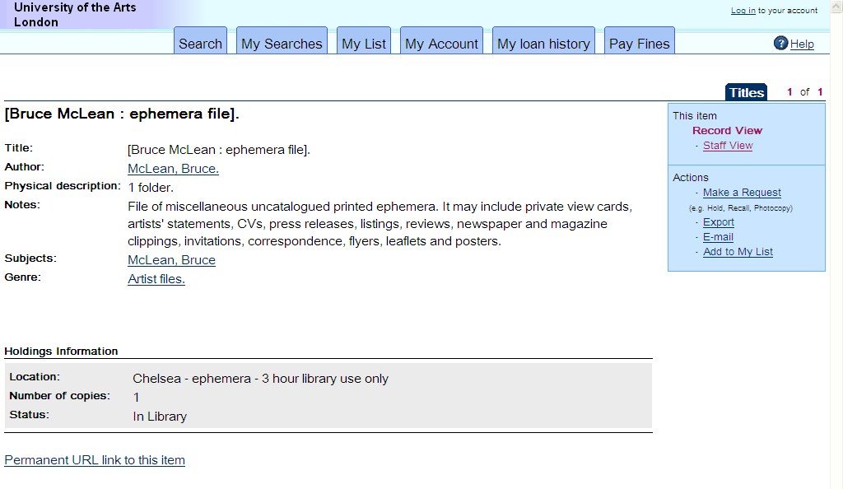
Cataloguing art ephemera: Example
Notes:
http://voyager.arts.ac.uk/vwebv/holdingsInfo?bibId=446912
281 single artist files (and 281 catalogue records) SELECTION FROM 690 ARTISTS WITH MORE THAN 5 ITEMS based on significance of artist. material, local history

Slide 14
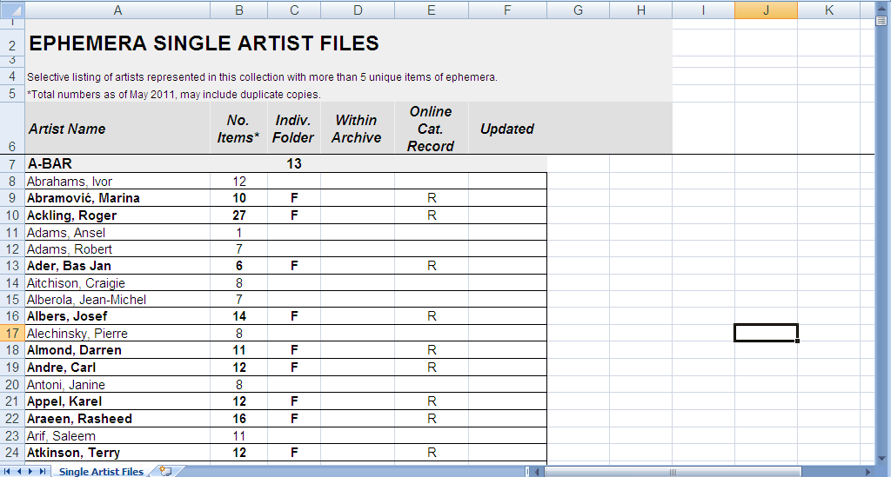
Cataloguing art ephemera: Other options
Notes:
Additional tool to facilitate discovery and access: spreadsheet 690 entries for individual artists with more than 5 items of ephemera (easier and faster to maintain)
[only 281 single artist files and catalogue records]
Digitisation is a huge opportunity but there are two main obstacles: resources and copyright
It would improve search and retrieval enormously by using OCR FT search!

Slide 15
Some artefacts in our collections
Three-Dimensional Artefacts and Realia (AACR2 Ch. 10):
“Three-dimensional objects of all kinds (...), including models, dioramas, games (...), sculptures and other three-dimensional art works, exhibits, machines and clothing (...), naturally occurring objects (...) “
Sometimes equipment is catalogued for convenience, to allow circulation (often not displayed in OPAC: not part of the collection).
Other more significant 3D material, often related to areas of specialism or special collections and archives: artworks, realia, etc. are found in numerous libraries.
Less often certain categories of 3D objects are acquired on a regular basis (artists’ multiples at Chelsea, designer toys at Camberwell, etc.), as part of the collecting policy of the institution.
Notes:
Textiles collections, scientific sample collections, etc.
CCAD Artists’ Multiples Collection http://www.arts.ac.uk/library/archives-collections/chelsea
CCA Designer Toys Collection: http://www.arts.ac.uk/library/archives-collections/camberwell

Slide 16
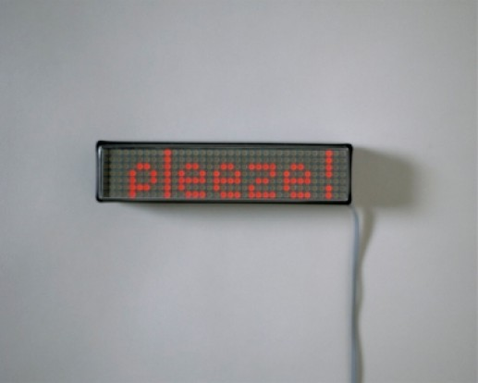
Artists’ multiples and other 3D artworks
Notes:
CCAD Artists’ Multiples Collection
http://www.arts.ac.uk/library/archives-collections/chelsea
This is a collection of more than 500 original artworks by contemporary artists, produced in editions.
Established in the 1980s by Librarian Stephen Bury, some of the items had been acquired during the previous two decades.
Bury, S. (1988) Multiple choice: artists’ multiples in the collection of Chelsea College of Art & Design Library. London: Flaxman Press.
Bury, S (2001) Artists’ multiples, 1935-2000. Aldershot: Ashgate.
Lalita Kaplish, L., Elizabeth Lawes, E. In edition: artists’ multiples in an academic collection, Art Libraries Journal, 2004, 29:3, pp 37-42.

Slide 17
Cataloguing artists’ multiples and other 3D artworks
Specialist, time consuming original cataloguing.
Requires staff with subject and technical specialist knowledge.
High level of detail in the description required, including copy specific information (and specific 5xx Notes fields):
541 Immediate Source of Acquisition Note (acquisition)
561 Ownership and Custodial History (provenance)
562 Copy and Version Identification (identification)
585 Exhibitions Note (display)
Some copy-related information / processes not covered, e.g. conservation (could be included as general note).
Notes:
General considerations

Slide 18
Cataloguing artists’ multiples and other 3D artworks
Relevant and consistent subject and genre indexing important to facilitate retrieval (e.g. LCSH ‘Multiple art’)
Images! Could be integrated within the catalogue record, but:
Copyright (artwork, photograph) clearance required
Resource intensive (local photography required)
Local guidelines and use of templates can help in training and day to day situations, but are not replacement for expertise.
Notes:
More general considerations

Slide 19
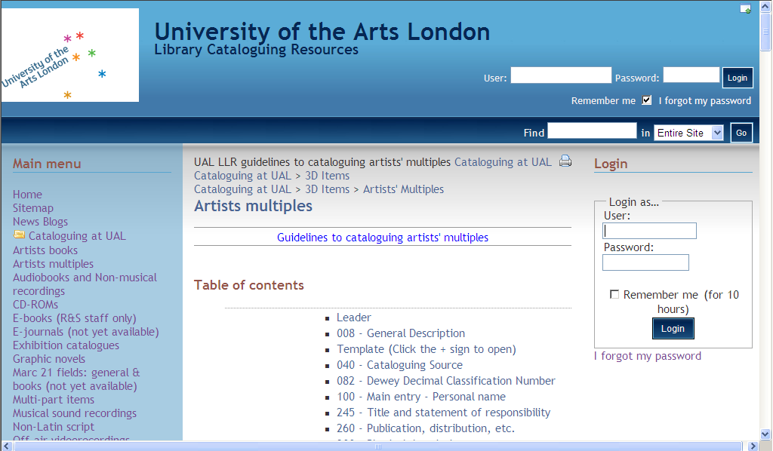
Cataloguing artists’ multiples: Guidelines
Notes:
CLIP CETL Small Rewards (2006/7 and 2007/8) project which allowed the production of digital photography and a printed visual catalogue of the Artists’ Multiples Collection, and the creation of high quality records for all the items on the online UAL library catalogue.
UAL guidelines for cataloguing artists’ multiples
http://www.arts.ac.uk/is-llr-cataloguing/tiki-index.php?page=Artists+multiples

Slide 20
Cataloguing artists’ multiples: Template
LEADER
Type of Record r : Three-dimensional artifact or naturally occurring object
Bibliographic Level m : Monograph/item
Type of Control _ : No specific type of control
Encoding Level _ : Full level
Cataloging Form a : AACR2
Linked Record Requirement _ : Related record not required
008
Publication Status s : Single known date/probable date If there is no date for the artist book: q - Questionable date If a reprint: r - Reprint/reissue date and original date
Notes:
Type of Record r : Three-dimensional artifact or naturally occurring object

Slide 21
Cataloguing artists’ multiples: Template
Date 1 (yyyy)
Date 2 (yyyy) Add original date when a reprint/reissue
Place of Publication
Running time
Audience _ : Unknown or not specified (unless appropriate)
Accompanying matter 1 – 5
Govt. Publication _ : Not a government publication (unless appropriate)
Form of Item _ : None of the following (unless appropriate)
Type of material a : Art original
Technique
Language
Modified Record _ : Not modified Cataloging Source
Notes:
Type of material a : Art original

Slide 22
Cataloguing artists’ multiples: Template
040 # # ‡a UK-LoUA
100 1 # ‡a
245 ? ? ‡a ‡h [object] : ‡b / ‡c.
246 ? ? ‡a
250 # # ‡a
260 # # ‡a : ‡b, ‡c.
300 # # ‡a ? art original : ‡b ; ‡c ? x ? x ? cm.
500 # # ‡a
505 ? # ‡a
520 # # ‡a
Notes:
Chief source of information (10.0B1): “the object together with any accompanying textual material and container issued by the publisher or manufacturer of the item. Prefer information found in the object itself …” See also 10.0H1 for multipart items.
Prescribed sources of information (10.0B2): chief source of information in all areas, except Physical description (ANY SOURCE) and Note (ANY SOURCE)
10.1C1 Give … the appropriate General Material Designation ‡h [object]
10.5B Extent of item including specific material designation 300 # # ‡a 1 art original
10.5C When appropriate, give material and colour ‡b

Slide 23
Cataloguing artists’ multiples: Template
541 ? # ‡3 Chelsea College of Art & Design Library copy barcode ? : ‡a
546 # # ‡a
561 # # ‡3 Chelsea College of Art & Design Library copy barcode ? : ‡a
562 # # ‡3 Chelsea College of Art & Design Library copy barcode ? : ‡a
585 # # ‡3 Chelsea College of Art & Design Library copy barcode ? : ‡a
600 1 0 ‡a
610 2 0 ‡a
650 # 0 ‡a Multiple art.
710 2 # ‡a
Notes:
Copy specific information ‡3
541 Immediate Source of Acquisition Note
561 Ownership and Custodial History
562 Copy and Version Identification
585 Exhibitions Note
650 #0 ‡a Multiple art [Pre 2007 guidelines]

Slide 24
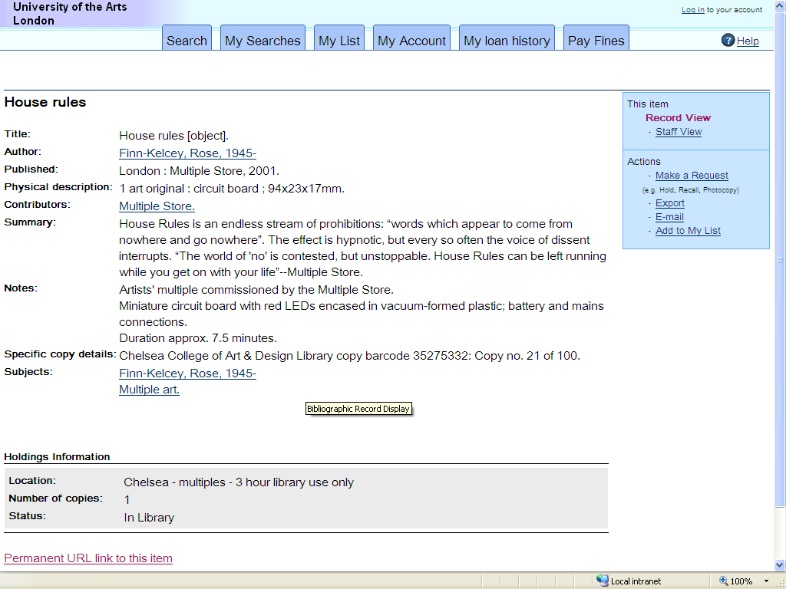
Cataloguing artists’ multiples: Example
Notes:
http://voyager.arts.ac.uk/vwebv/holdingsInfo?bibId=154306

Slide 25
Cataloguing artists’ multiples: Example
000 01123crm a2200217 a 4500
005 20111214091429.0
008 010227s2001 enk008 azeng d
040__ |a UK-LoUA
1001_ |a Finn-Kelcey, Rose, |d 1945-
24510 |a House rules |h [object].
260__ |a London : |b Multiple Store, |c 2001.
300__ |a 1 art original : |b circuit board ; |c 94 x 23 x 17mm.
500__ |a Artists' multiple commissioned by the Multiple Store.
500__ |a Miniature circuit board with red LEDs encased in vacuum-formed plastic; battery and mains connections.
500__ |a Duration approx. 7.5 minutes.
520__ |a House Rules is an endless stream of prohibitions: “words which appear to come from nowhere and go nowhere”. The effect is hypnotic, but every so often the voice of dissent interrupts. “The world of 'no' is contested, but unstoppable. House Rules can be left running while you get on with your life”--Multiple Store.
562__ |3 Chelsea College of Art & Design Library copy barcode 35275332: |a Copy no. 21 of 100.
60010 |a Finn-Kelcey, Rose, |d 1945-
650_0 |a Multiple art.
7102_ |a Multiple Store.
Notes:
http://voyager.arts.ac.uk/vwebv/holdingsInfo?bibId=154306

Slide 26
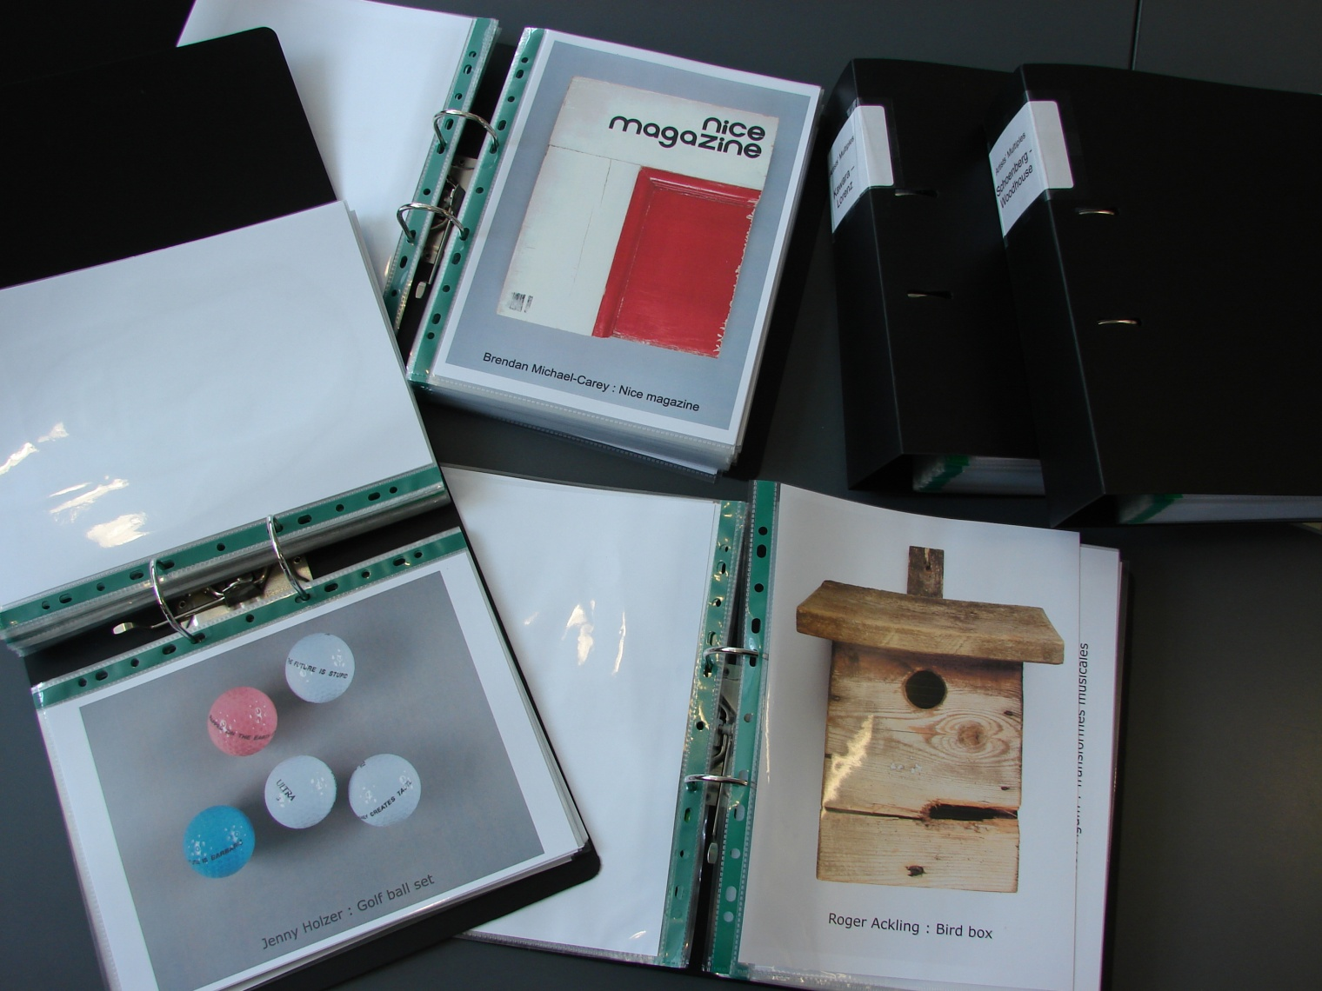
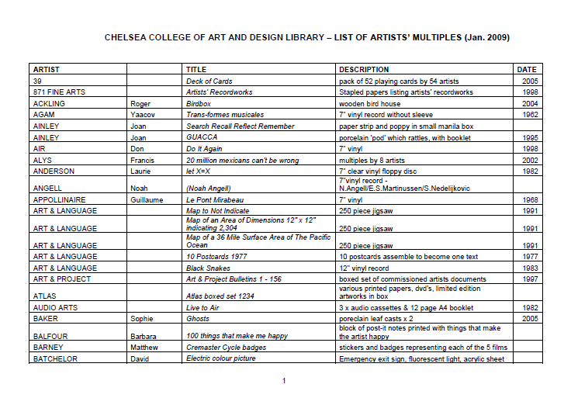
Cataloguing artists’ multiples: Other options
Notes:
Additional tools to facilitate discovery and access:
1. Visual aid in print, with high quality images of all multiples arrange by artist name
2. Online listing (inc. artists name, artwork title, description, year) http://www.arts.ac.uk/media/oldreddotassets/docs/CHELSEA_COLLEGE_OF_ART_AND_DESIGN_LIBRARY_ARTISTS_MULTIPLES_Nov_09.pdf
Use of images on OPACS is already common for mainstream material (books, periodicals, DVDs). These are available with other cat. enhancements purchased from specialist suppliers (e.g. Syndetics or Google Books), but not for this type of material.
Digitisation and/or using images in online catalogues could reduce level of detail in the description, make cataloguing less resource intensive, or even substitute it completely.

Slide 27
Very brief bibliography
Anglo-American cataloguing rules. London: Chartered Institute of Library and Information Professionals, 2005-
MARC 21 Format for Bibliographic Data http://www.loc.gov/marc/bibliographic
Artist files revealed: documentation and access http://www.artistfilesrevealed.com/tiki/tiki-index.php
Thurmann-Jajes, A. Manual for artists' publications (MAP): cataloging rules, definitions and descriptions. Bremen: Weserburg, 2010.
Notes:
End. Thanks.

