Slide 1
documentation as scenography
Michael Spencer BRISTOL 2013

Slide 2
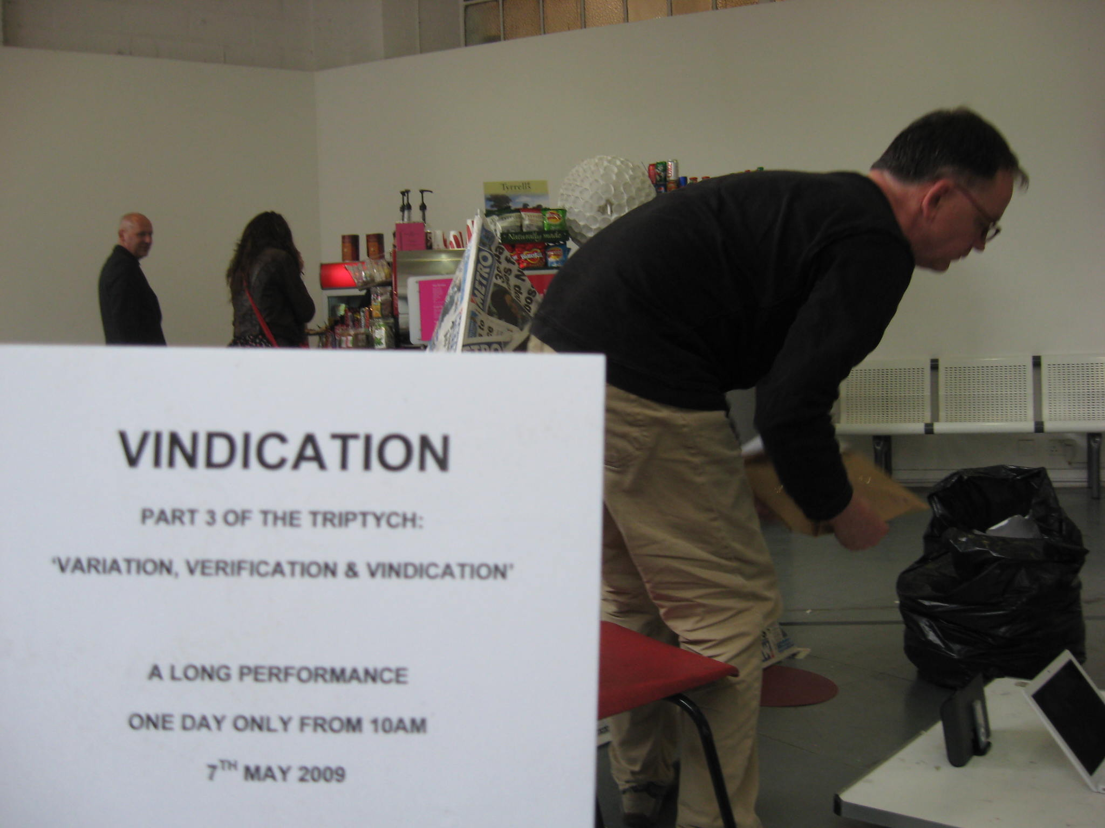
you had to be there…..

Slide 3
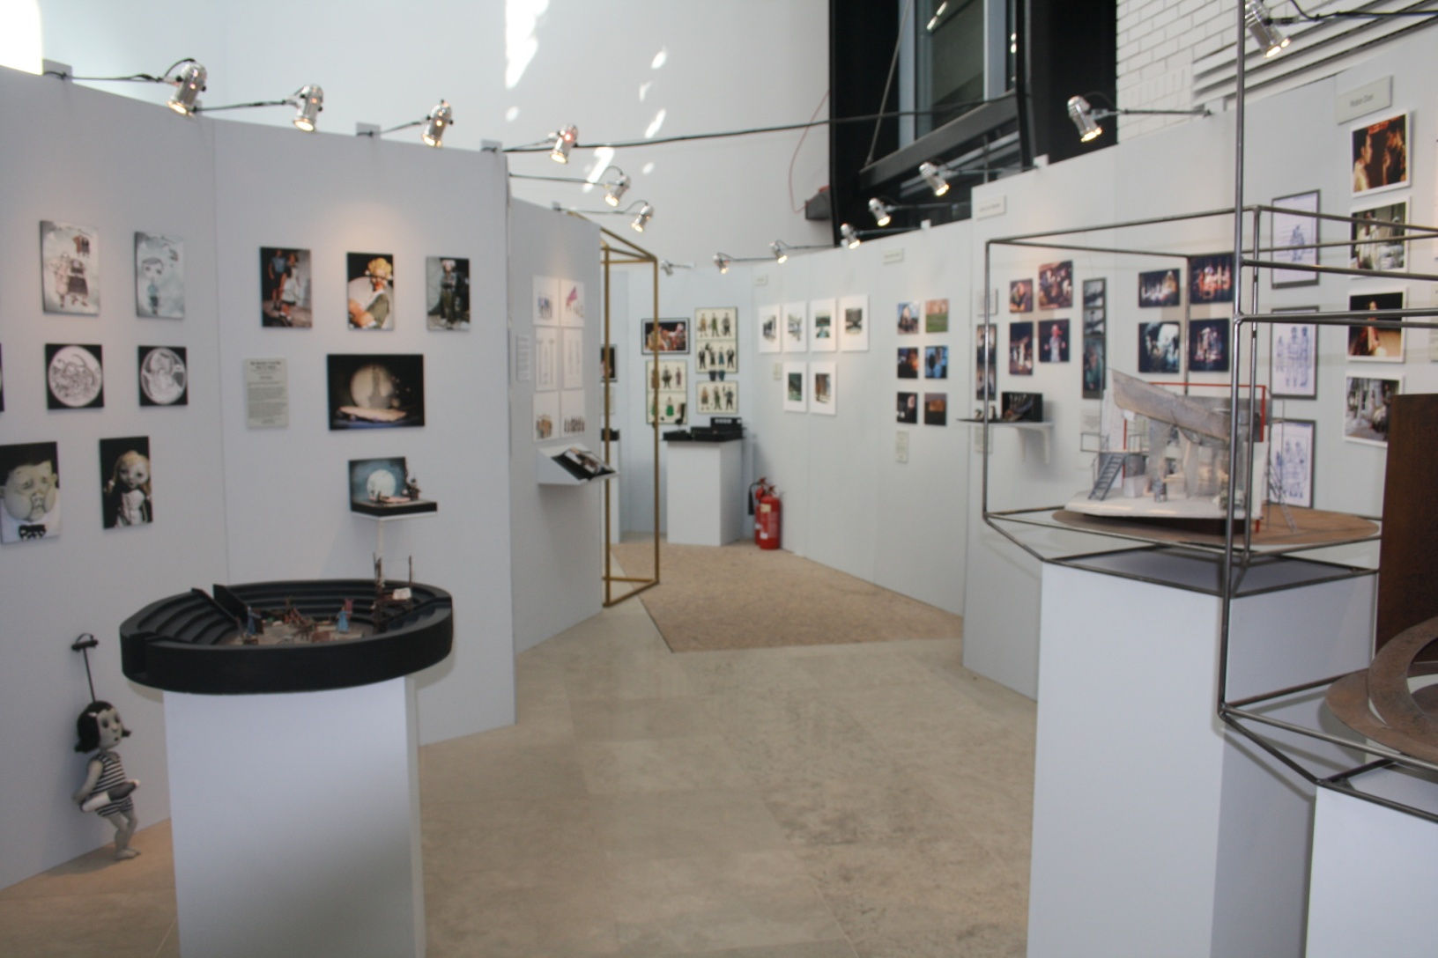
stuff

Slide 4
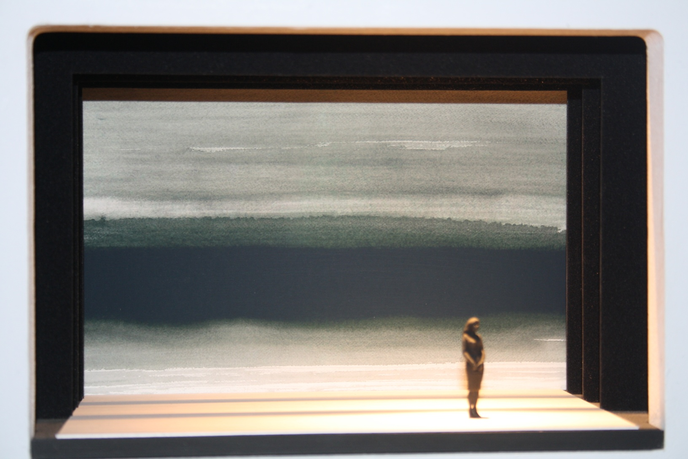
a celebration of absence

Slide 5
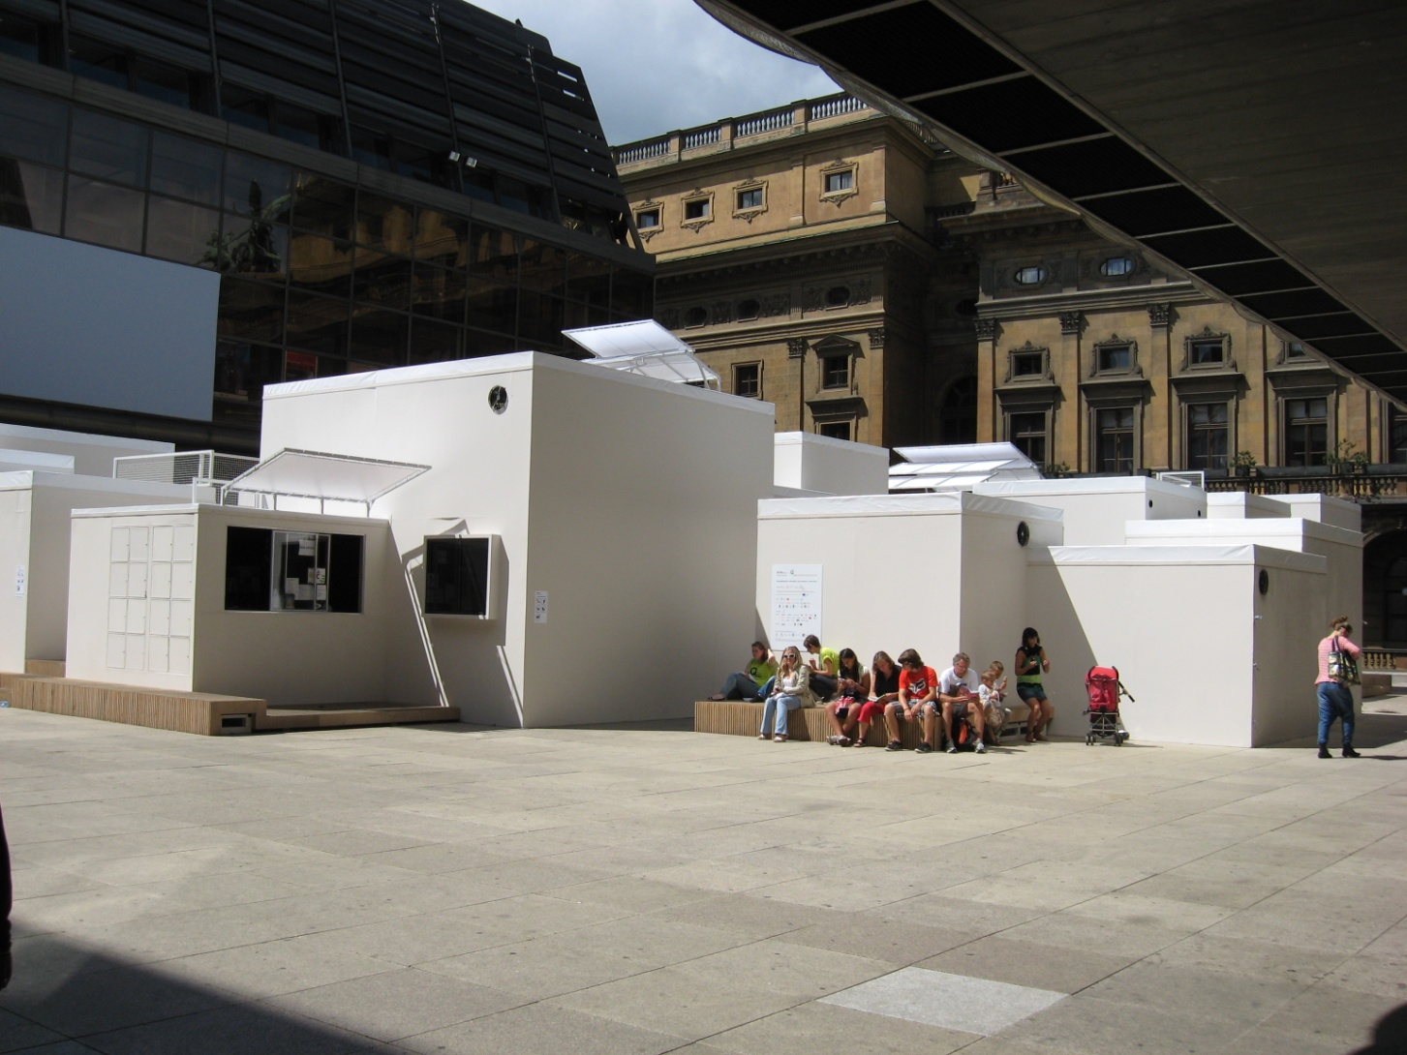
intersections – PQ’11

Slide 6
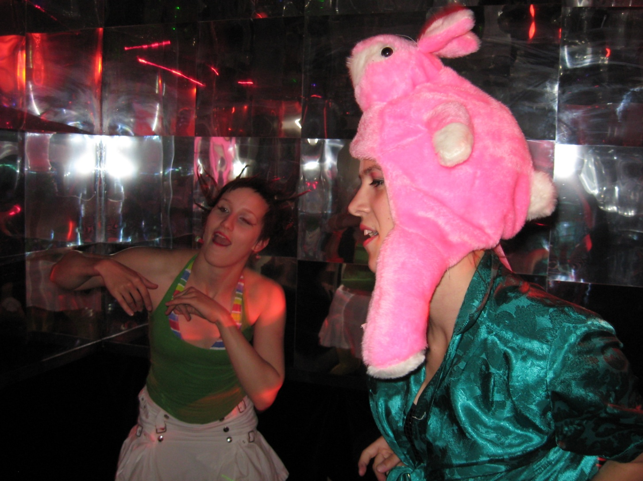
dance

Slide 7
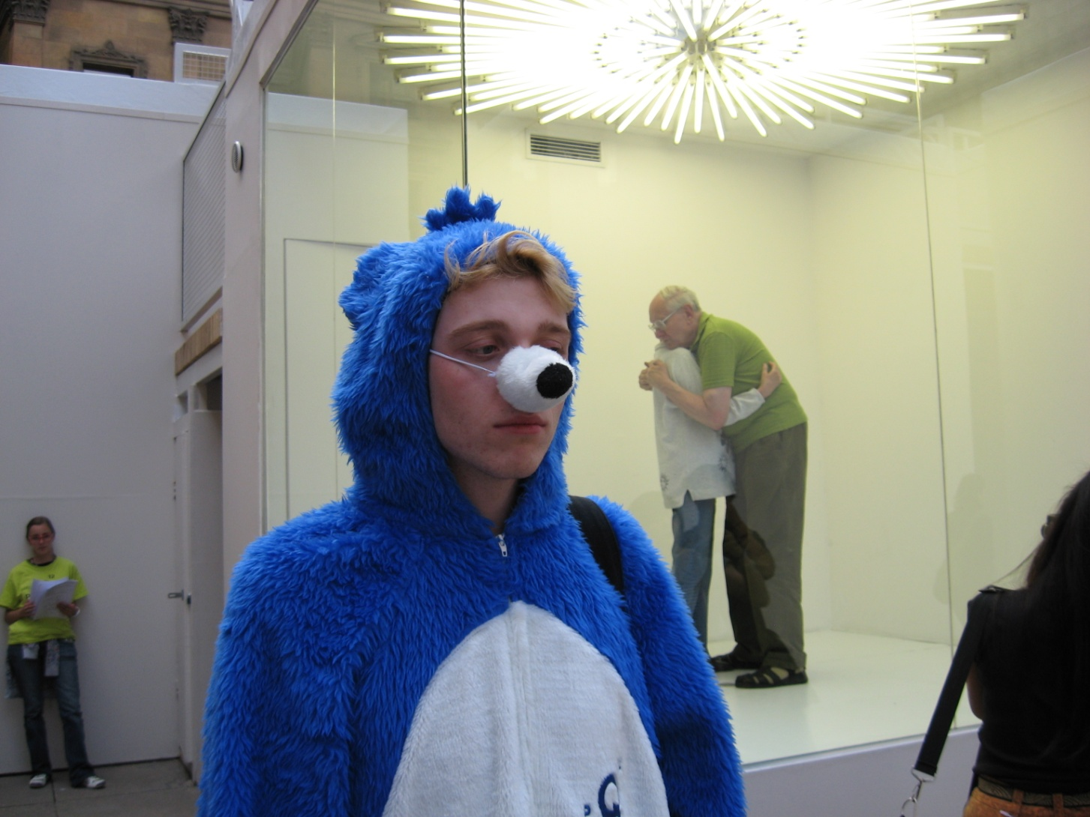
dress up hug

Slide 8
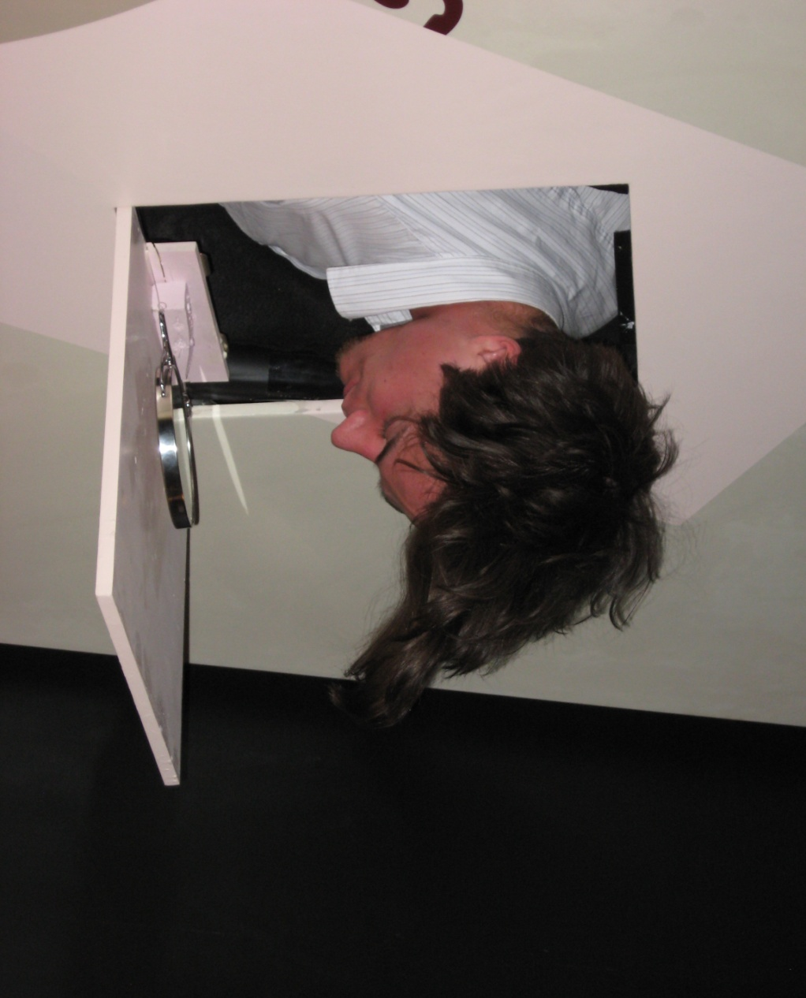
look up

Slide 9
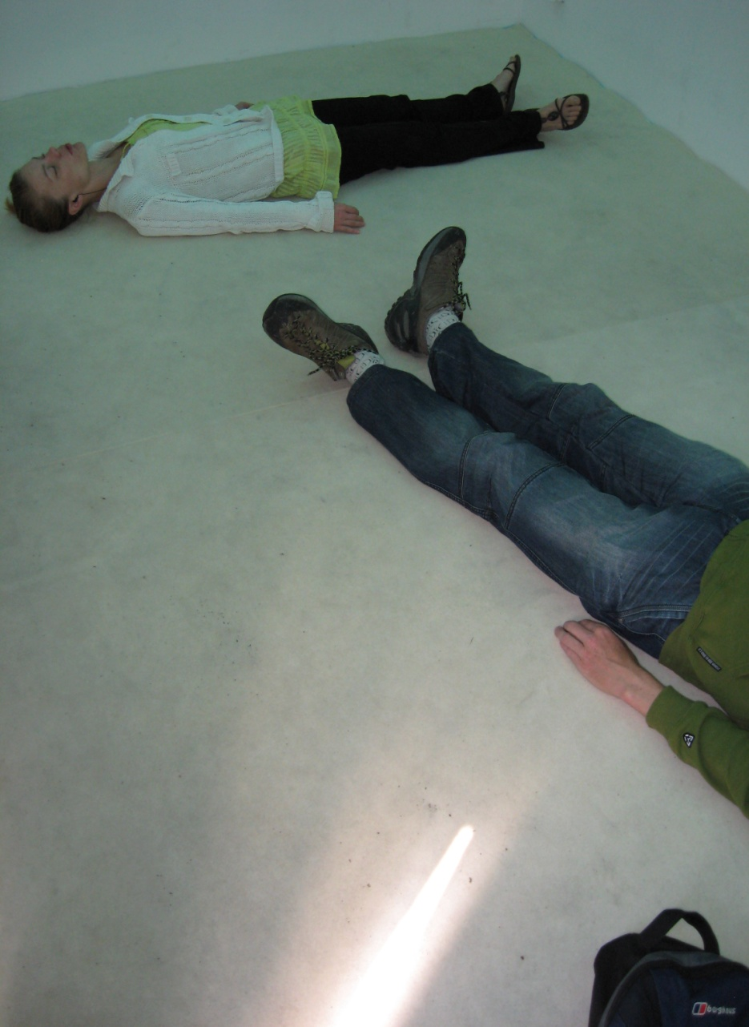
look down

Slide 10
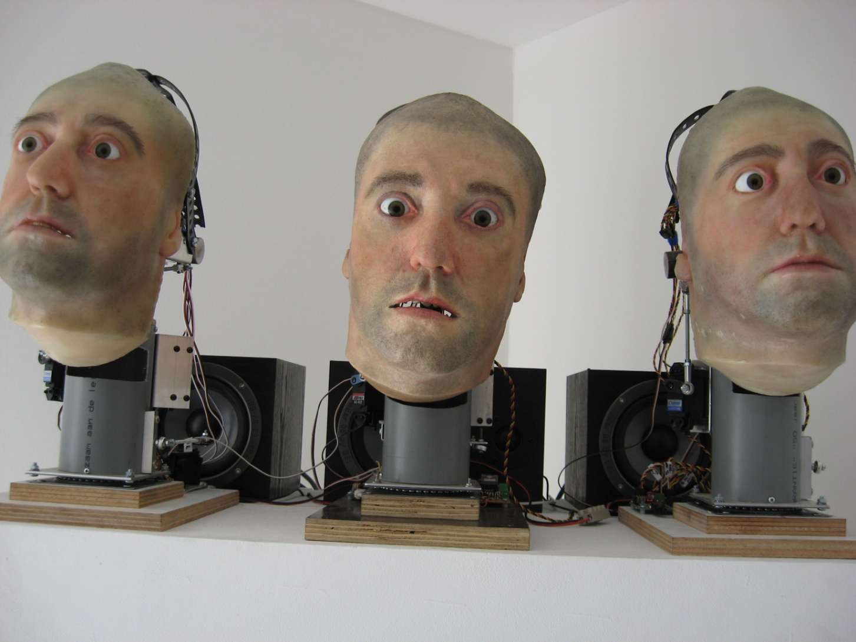
objects perform

Slide 11
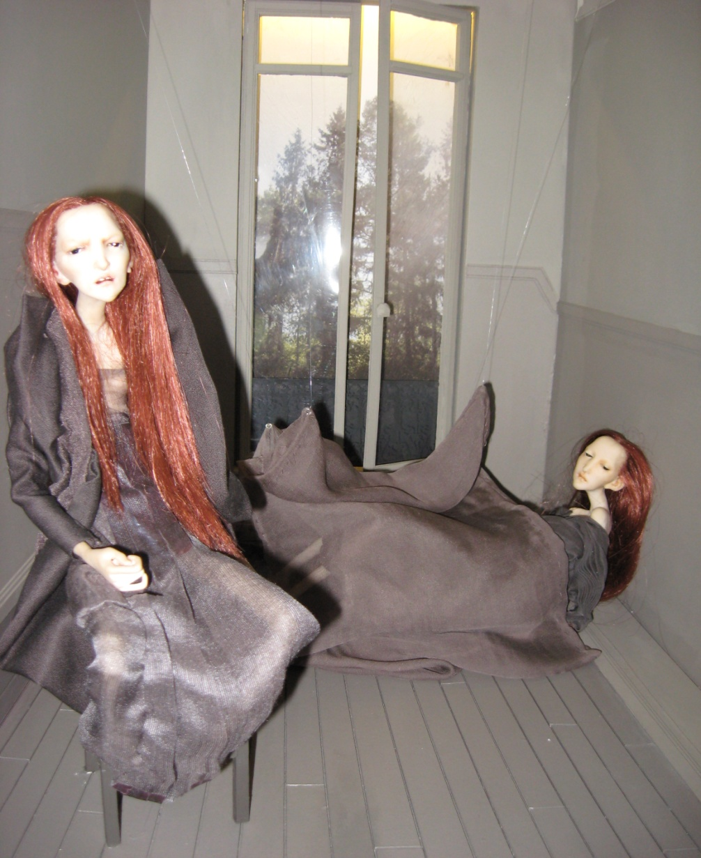
scale models perform

Slide 12
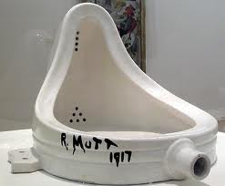
duschamp

Slide 13
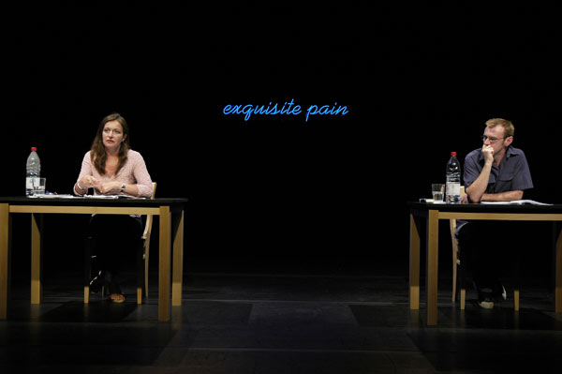
forced entertainment

Slide 14
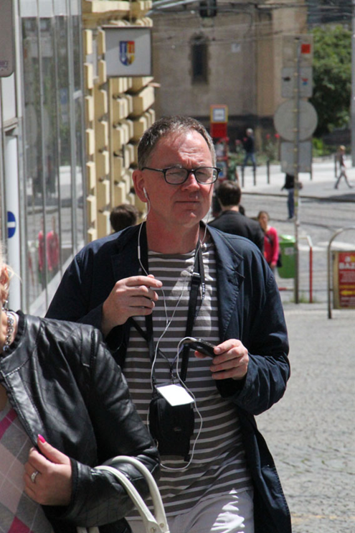
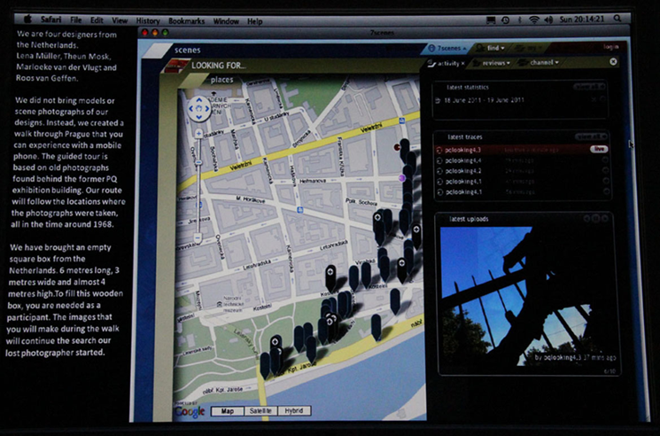
dutch national exhibit – pq’11
.
.

Slide 15
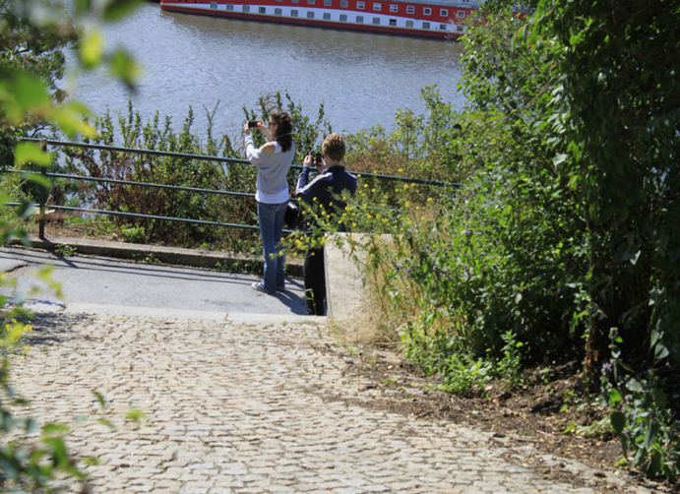
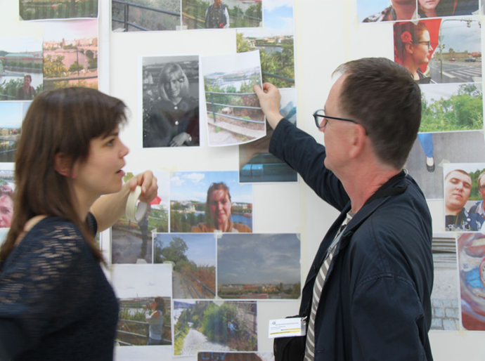
dutch national exhibit – PQ’11
documenting the documenters
the show

Slide 16
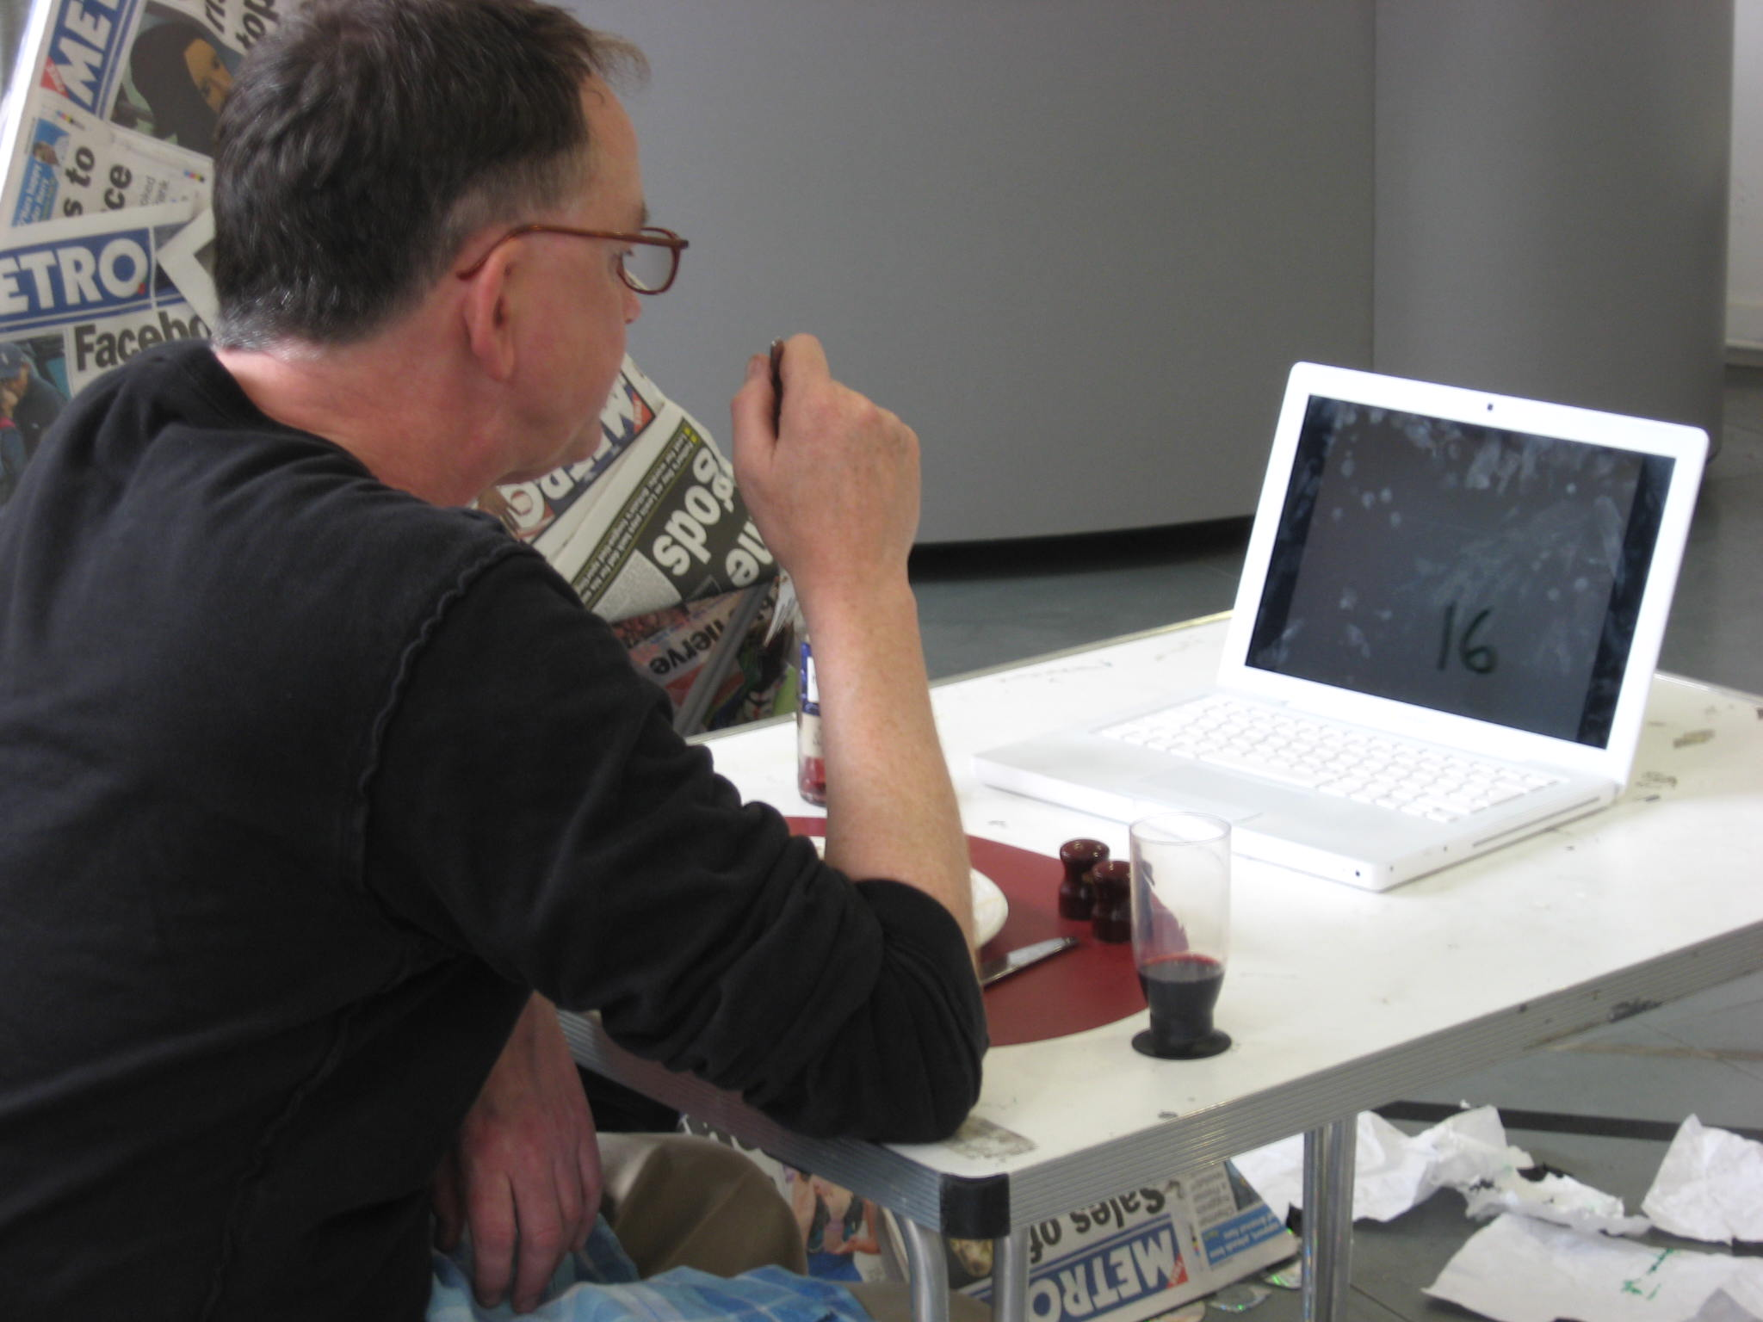
vindication

Slide 17
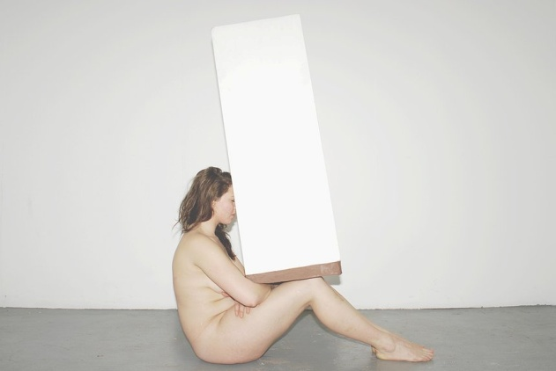
sisters from another mister

Slide 18
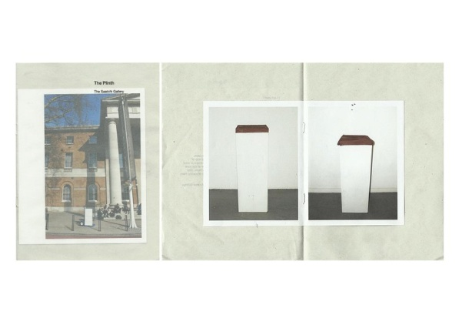
the plinth

Slide 19
documentation as scenography
...is a manifestation of….
the dissatisfaction with artefacts as a means of conveying the practice
the role of the visual in performance expanding to embrace notions of authorship
the change in emphasis from product to process
the change in emphasis from representation to presentation

