Slide 1
“Art and design for all”: communist civil servants and museum service.
Dr Linda Sandino, Victoria & Albert Museum, London.

Slide 2
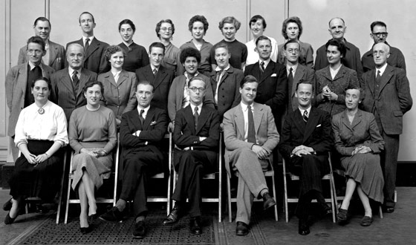
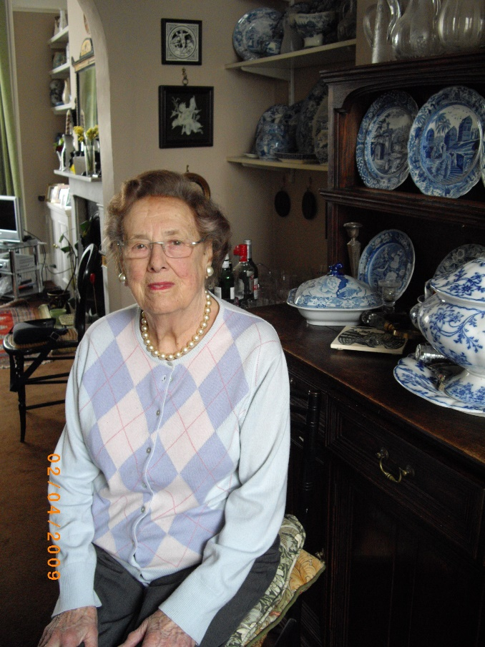
The Circulation department, V&A
Circulation Department c.1953
Image© courtesy of the V&A
yy9y08y8y98y98y98y
Barbara Morris (1918-2009)

Slide 3
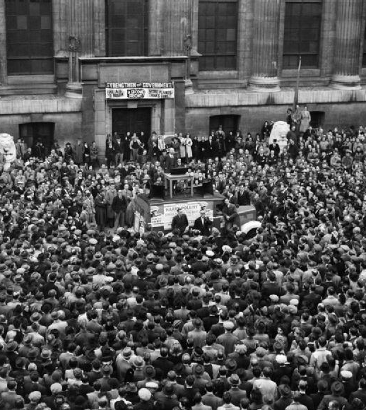

Communism in post-war Britain
LS: Was it easy to go to places like this, to Hungary, to the Eastern bloc?
BM: Well, if you were a member of the Communist Party, yes!

Slide 4
‘Totally different…’
Circ was totally different from anywhere elsewhere. We all talked together which was rare. I found out in other departments if you were a Museum Assistant you didn’t talk to – well you could talk to Research Assistant just about but you didn’t talk to a Keeper; and if there was any point made, then the Research Assistant would approach the [Assistant] Keeper and the Keeper might approach the full Keeper, but you didn’t do that, and in Circ we did. It was always like that all the time.

Slide 5
The Circulation department c.1954
Image © courtesy of the V&A

Slide 6

Egalitarian values
‘The first thing I do remember doing when I first got to Circ was I went with Hugh [Deputy Keeper] on a tour round the libraries in East London and beyond, out as far as Thanet, I think, on a day which it absolutely bucketed down all day, and because it was Hugh we were never going to do it in comfort. We always had to get on and off buses. Well, it’s not that buses are uncomfortable, but in the pouring rain it took forever […] because we were about to tell them, the libraries, that we could no longer lend to them. Actually we charged almost nothing for those exhibitions and I think it simply wasn’t viable. I guess that Hugh felt he should go round and at least look concerned and show his face, and I was the new girl and it was good for me’. (J Opie, 04, 2012)

Slide 7
Doors closing
‘I know the arguments that [the Director] was faced with, and I don’t pretend to think it was easy. I mean it’s always a case of either chop off a whole limb or take a slice off everything.’ (J. Opie, 04, 2012)
‘At the time it felt really bad, and as I say, at the time we thought what’s the rest of the country going to say? It’s the Museum slamming doors.’

Slide 8
Paradox or resolution?
Well, I suppose it began with the disillusionment at the time of the invasion of Hungary, you know, the Soviet invasion in 1956. And now, I mean I can’t see much difference between any of the political parties. I wasn’t ever really what I call a political animal. It wasn’t – I suspect it was partly through being a rebel and the fact that both my husbands were [Communists] you know and that just sort of – although I was my own personality. And I suppose also being very interested in [William] Morris, you know, who was an early Communist and socialist, and I say what I always have been is what I call, well no proper category, I’m really a sort of Morrisean, you know, idealist rather than a practical – it was more a sort of romantic view of socialism rather than a sort of hard political feeling (Morris, 2009, Track 13)

Slide 9
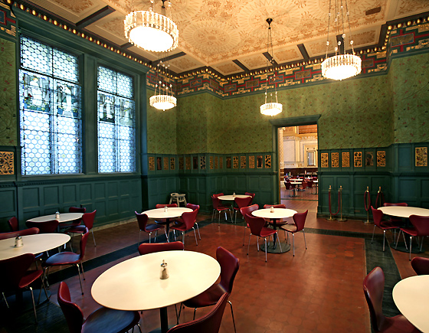
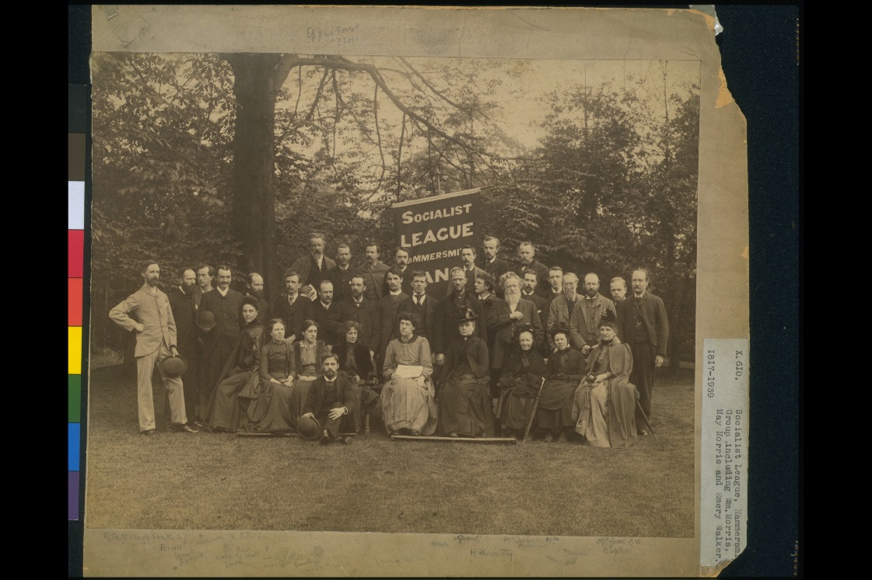
‘We are working for equality…’
Green Dining Room, 1864
designed by William Morris
The Socialist League, 1884
Images © courtesy of the V&A

Slide 10
Art for all
‘…instilled [in us] that our job was to serve the public…that’s what museums were for: to inform, educate, and generally improve public taste’ (BM 07, 2009)
‘We were there to help and educate the public’ rather than ‘pursuing our own interests for the sake of it.’ (BM 03, 2009).
‘I do not want art for a few, anymore than I want education for a few, or freedom for a few.’ William Morris, ‘Hopes and Fears for Art: the Lesser Arts’ (1877).

Slide 11
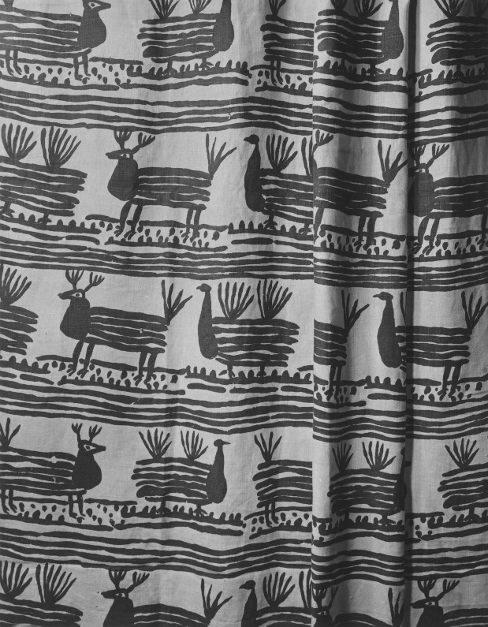
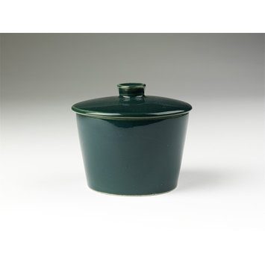
‘People can relate to objects…’
Jan Hladik for Centrotex Ltd, 1949
Sugar bowl, Kaj Franck, c.1948
Images © courtesy of the V&A

Slide 12
Those first years in Circulation were brilliant. I couldn’t believe my luck. I felt I had landed – I was going to say I felt I’d landed in heaven but that sounds silly – but in terms of my interests and what I believed in doing where the arts were concerned, we did it and we did it right and as best as we could. We all did really believe in spreading the good news about design, architecture, historical information… (Coachworth Track 03, 2012).

Slide 13
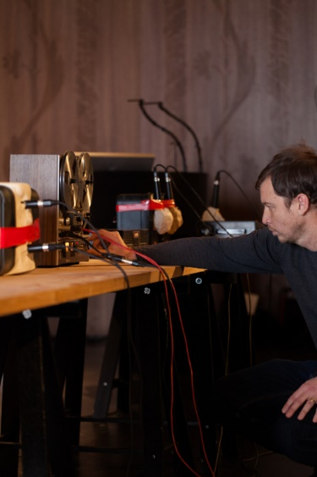
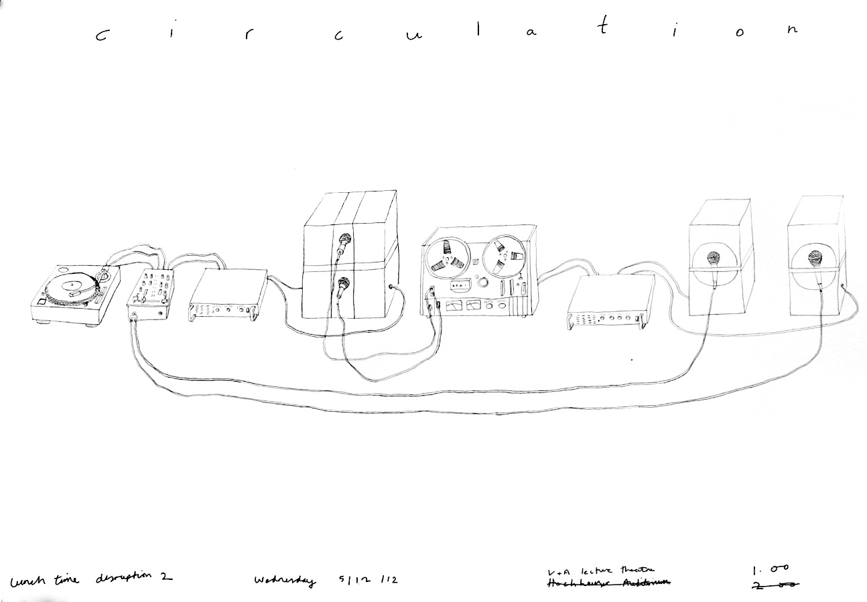
Keith Harrison, Circulation, (2012)
Images © courtesy of K.Harrison and the V&A

Slide 14
