Slide 1
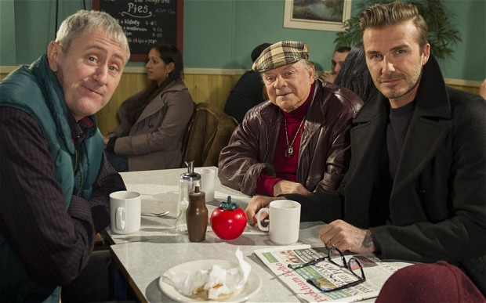
Del Boy, Beckham and a Sartorial Utopia.
‘…Something more, something less, something else; lived experience….. (Lefebvre, [1981]2005 P5)

Slide 2
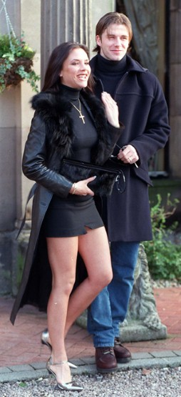
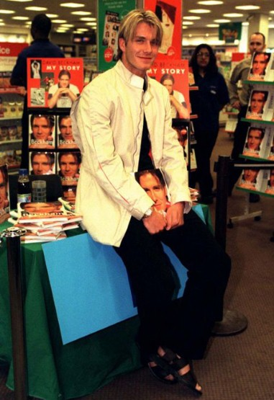
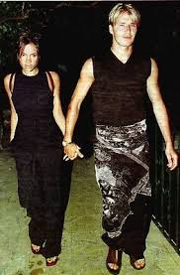
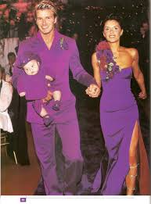
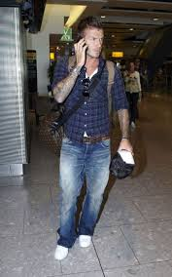
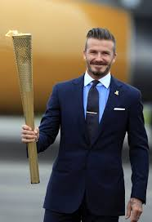
Class Passing?
UK is characterised by class differences…..accent, vocabulary, dress, recreation etc (Andersron, P 1964 p8)
We expose ourselves to classification by offering indices of personal taste such as clothing (Bourdieu, P [1979] 1996 p57)

Slide 3
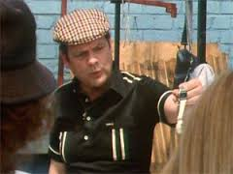
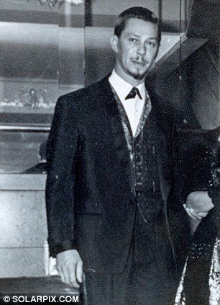
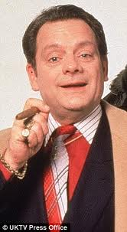
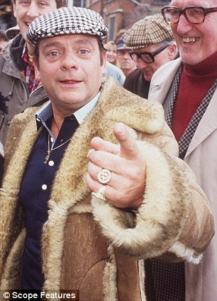
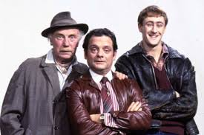
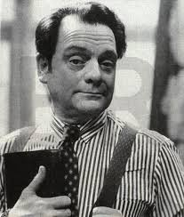
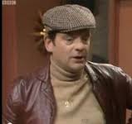
‘so you ask Joyce and Vicki who's their favourite brickie
I'm not a common thicky
I'm Billericay Dickie and I'm doing very well’
(From ‘Billericay Dickie’ by Ian Dury, 1977)
Derek, Chickey….
Del and Dickey.

Slide 4
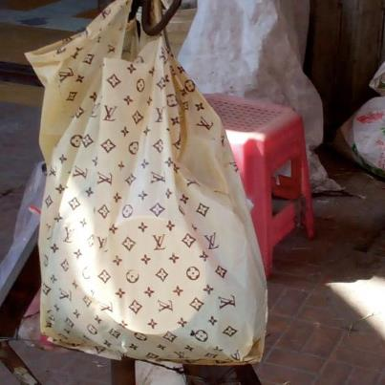
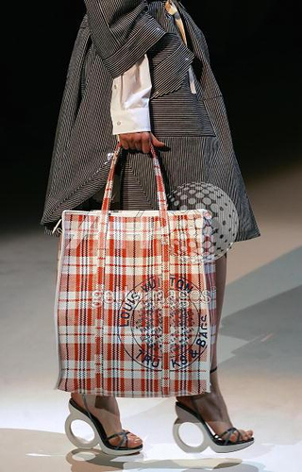
A victim of materialism or knowledgeable consumer?
(Partington, 2014)
Consumption is key to social distinction rather than a reflection of it (Partington 2014 p8)
Gradations of social status are aesthetic and inform everything (Munt 2000 p5)

Slide 5
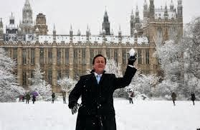
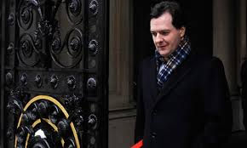
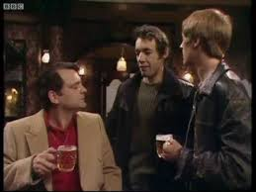
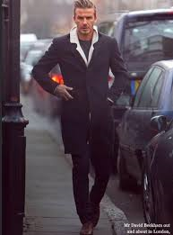
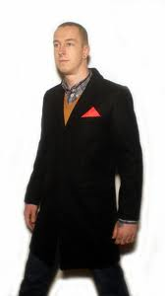
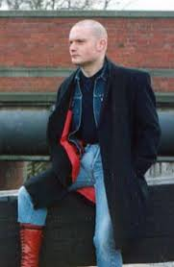
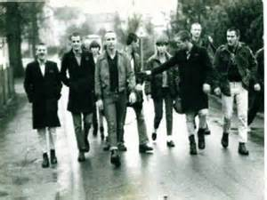
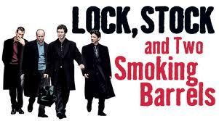
Meaning is a negotiation & struggle (Gillespie 2003)

Slide 6
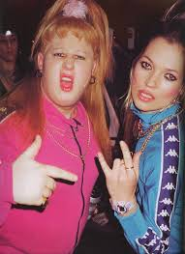
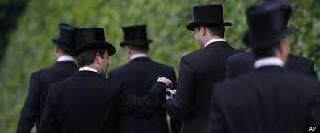
Perceive, identify, classify.
(Lennon & Davis, 1989)
Responses are individual but not individualistic, signs operate via agreed meaning (Fiske & Hartley [1978] 2003)
Irony is realisms answer to the abstract realities of commodity fetishism (Kaplan, 2004)

Slide 7
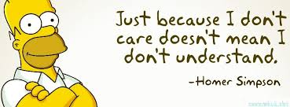
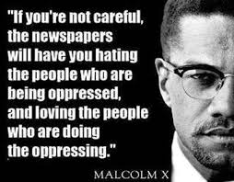
Stereotypes can upset the status quo.
(Casey et all 2002)
Homer
Malcolm

Slide 8
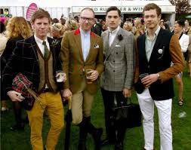
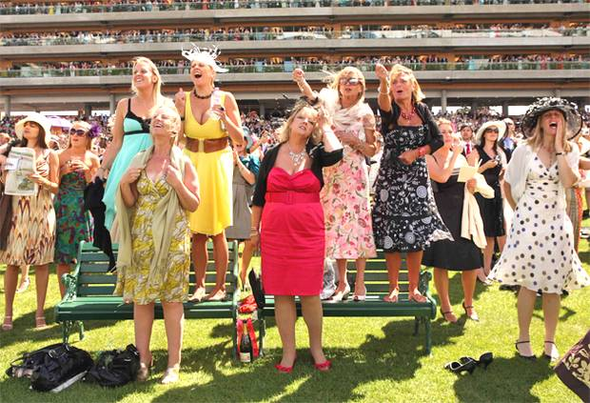
Guerrilla Tactics? (De Certeau 1984)
Pure aesthetic not for working class (Bourdieu [1979] 1996)
How does social distinction become politicised? (Cannadine 1998)

Slide 9
Style is a way of representing in- between spaces (Guy, Green, Banham 2001)
spaces in between

