Slide 1
Digital Change and Industry Responses:
Exploring organisational and structural challenges for the publishing industry in light of digital development
Frania Hall
By the Book Conference 2015

Slide 2
The content Industries:
‘first and heavily hit by digital shift’
Simon, Bogdanowictz 2012)

Slide 3
Changes
Changing value chain
Disintermediation
Downstream distribution
Changing consumer behaviour
Prosumer
Convergence culture
New entrants/competitive environment

Slide 4
Revaluating issues
Copyright
Pricing
Business models
Platforms
Territoriality
Realignment around markets
Skills
structures

Slide 5
Research questions
Where is the industry now?
How does it view digital change?
Where is that change having most effect in their day to day business
What organisational changes are they making? (if any)
How far does collaboration form part of this change

Slide 6
Research process into digital collaboration
Level of change in general
Exploration around collaboration
New structures to accommodate collaboration

Slide 7
Frameworks
Creative industries and digital change
Industries that are:
Collaborative
Innovative
Converging
Network based
Risk taking & entrepreneurial
Digital enabling connecting and making behaviours

Slide 8
Organisational change, creativity and risk
Digital change in publishing:
New skills needed
New attitudes to creativity
Structures to promote exploration
Structures to enable new risk taking
Structures to promote network behaviour internally and externally
Structures to facilitate effective organisational learning

Slide 9
Collaboration
Collaboration styles – transactional to enterprenurial
Project based
Change in emphasis to compete with new entrants and realign where markets changing
Share knowledge
Promote invention

Slide 10
To analyse change
ASK!
No research in retrospect
What is the perception within the industry of change
Refelective responses/narratives (Latour, Axelsson etc,)
Non-randomised Sample

Slide 11
Expo light bulbs image

Slide 12
Research methods
Survey asking 21 questions
22 CEOs, MDs, Digital Directors, Operations/business directors
Including: Hodder Education, Sage, Bloomsbury, T&F, Macmillan, Thames and Hudson, CUP, Octopus
(org 2 boxes?)

Slide 13
Testing
Pace of change
Challenges of particular concern
How far structural change would be required
What activities are currently undertaken
Collaboration
  Frequency
  Type of partners
  Change in emphasis of collaboration (experimental)
  Change in feel of business relationship

Slide 14
Findings
1) Digital Change is transforming the publishing industry
Only at start of change
And will continue

Slide 15
Summarise on other slide
2) Functions most impacted:
  Sales, distribution, marketing
  Less impacted: production, editorial/NPD
  3) Issues of most concern
  Technical competence, legacy business models, growth/dominance of global IT companies
  - Of some but definitely less concern – copyright, piracy, content development, speed of NPD

Slide 16
Yes structural change essential
Much done already but more needed – continuous process was the implciaiton
Lots more entreprenuers
Skills – more emphaiss on analytical skills- consumer insight etc.

Slide 17
Quote on still about good content
Product oriented to service oriented working with many partners (JG)
(SC personal view) at the heart of what the industry does – commissionign and producing good content is not idferent than it has ever been – we simply have ot work in different ways and with different partners to ensure th ti tis packaged appropriately

Slide 18
Car engine image

Slide 19
Organisational Activities undertaken
Majority:
Reviewing company structure
Looking at skills sets – In-house
More collaborations
New strategies for content devpt
Almost all reviewing business models (but not legacy infrastructure)
Bring the content and skills together

Slide 20
Collaboration
Majority involved in more collaboration
Majority view collaboration as new in emphasis – exploratory
Majority view – collaborations involve different wider range of partners
Majority view – collaborations are different in structure- much more risk sharing

Slide 21
Creativity woven image arty

Slide 22


Slide 23
We are moving from a product oreiented business to a service based business workign with many partners (Bloomsbury)
The institutioanl conservatism of publihsig which is a result of its narrow social demographic in terms of employees does seem to me to mean that change in publishing may be harder to effect than other industries.

Slide 24
Partners chosen significantly because of cultural fit and alignment – ie do we work quickly and effectively together so we trust each other
What is interesting to me is different types of collaboraating eg between formally competting suppliers to create global networks to service publisher need
We are getting much more input on the end prodcut from thrid party suppliers AJ

Slide 25
Summary
Confident of content
Measured responses
Aware of all the issues and accomodating them
Exploring new skills – not just technical
Seeing opportunities in new collaborative strateiges

Slide 26
next
Step image?
Network image
Unpick collaborations – why exploratory
creativity and learning – alchemy
network behaviour to initiate and develop collaborations
How structurally can this be achieved

Slide 27
Final image

Slide 28
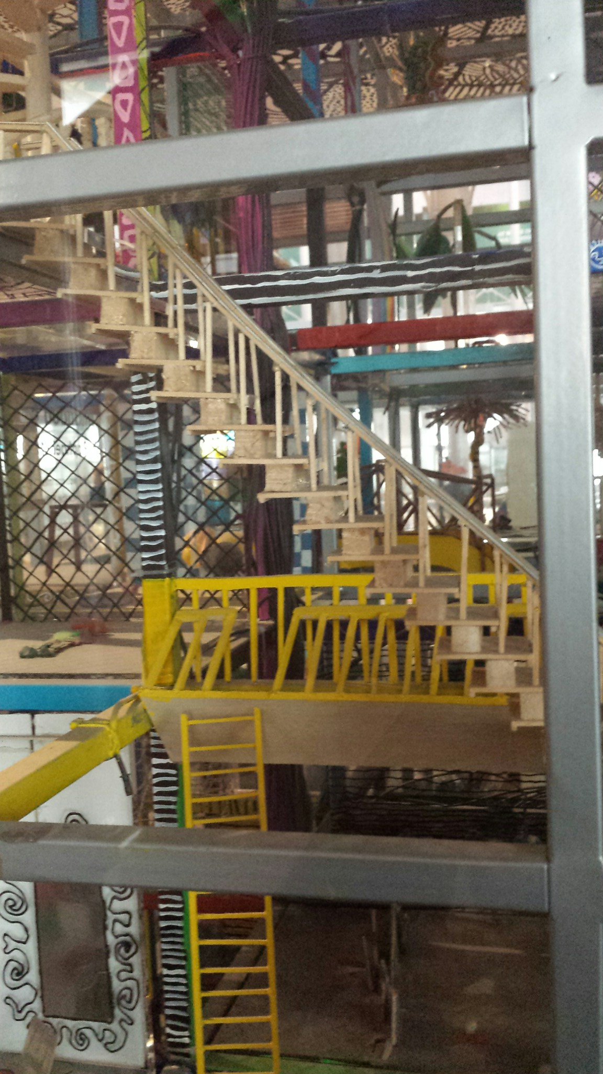

Slide 29
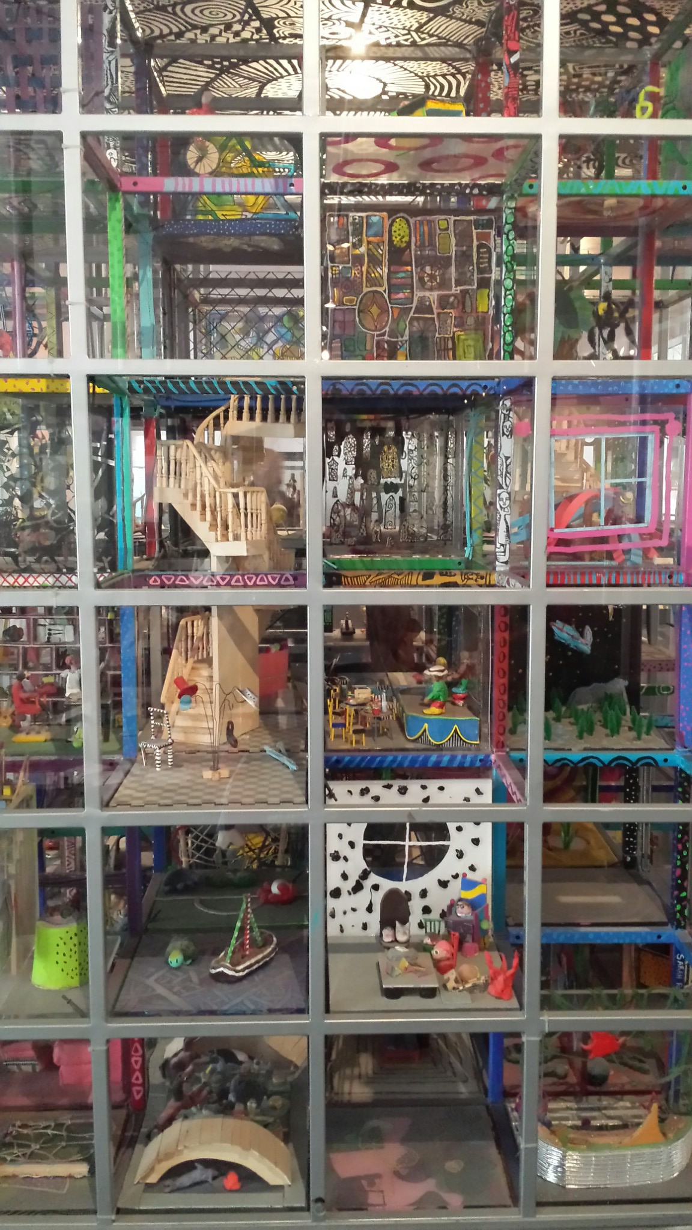

Slide 30
References
Kaats and Opheji
Fineman, Gabriel; Gauntlett,
Bilton, Flew, Hesmondhalgh, Grabher, Jenkins, Wheedon et. al), Granovetter,)

